Slide 1
COMP2501 Lesson 10
Programming Fundamentals Part 2

Slide 2
Exploring Polymorphism
More About Inheritance

Slide 3
Review - Inheritance
When one class becomes the subtype of another using keyword “extends”
subtype will inherit all the non-private members of the supertype, and its supertype and its supertype...up to and including the Object class
forms the “IS A” relationship

Slide 4
Review - Substitution
When a subtype object is stored in a supertype reference
requires “is a” parent-child relationship
used to avoid duplication by reducing all references to a lowest common type
eg.
Vehicle v = new Car(...);
store.addVehicle(Vehicle v) //will take any type that inherits from Vehicle

Slide 5
Storage.java – add displaySpecifications()
public void displaySpecifications() {
System.out.format("Make: %s%n Model: %s%n Yar: %d%n Passengers: %d%n Color: %s%n%n", make, model, year, numberOfPassengers, color);
}
In Storage.display() call displaySpecifications() instead of toString();
Make: Chevrolet
Model: Corvette
Year: 1979
Passengers: 2
Color: burgundy
Make: North American Aviation
Model: P-51D
Year: 1944
Passengers: 1
Color: natural finish
Make: Spartan
Model: Maxima
Year: 2019
Passengers: 8
Color: silver and red

Slide 6
Problem
When in Store.displayVehicles()we call displaySpecifications() we will see only the common
details available in Vehicle
Vehicle
make
model
year
numPassengers
color
displaySpecifications()
Display method that displays all the Vehicle fields
Car
milesPerLitre
Airplane
wingspan
maxCargoWeightKg
Boat
hullDesign
skiPackage

Slide 7

A Bright Idea!
Remember that subtypes have access to super type non-private methods
we could build a displaySpecifications method in each subclass instead of the superclass, where we could call the super.getters to include in the display.
Let’s test it out in Car first:
public void displaySpecifications() {
System.out.format("Make: %s%nModel: %s%nYear: %d%nPassengers: %d%nColour: %s%mi/Litre: %d%n%n",
getMake(), getModel(), getYear(), getNumberOfPassengers(), getColour(), milesPerLitre);
}

Slide 8
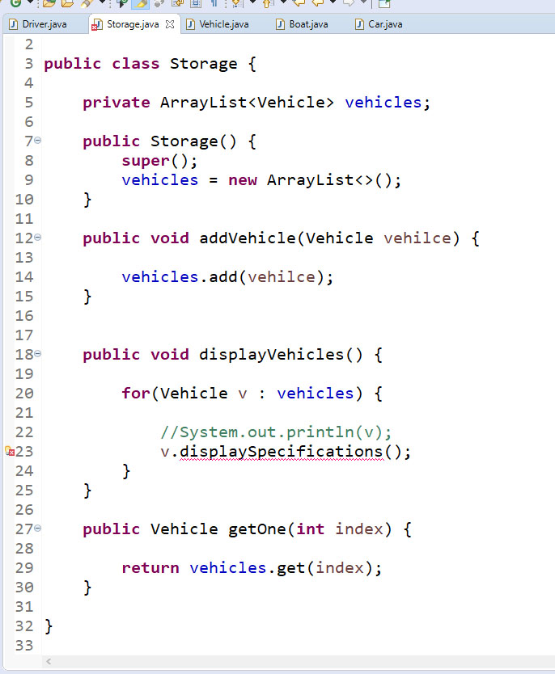
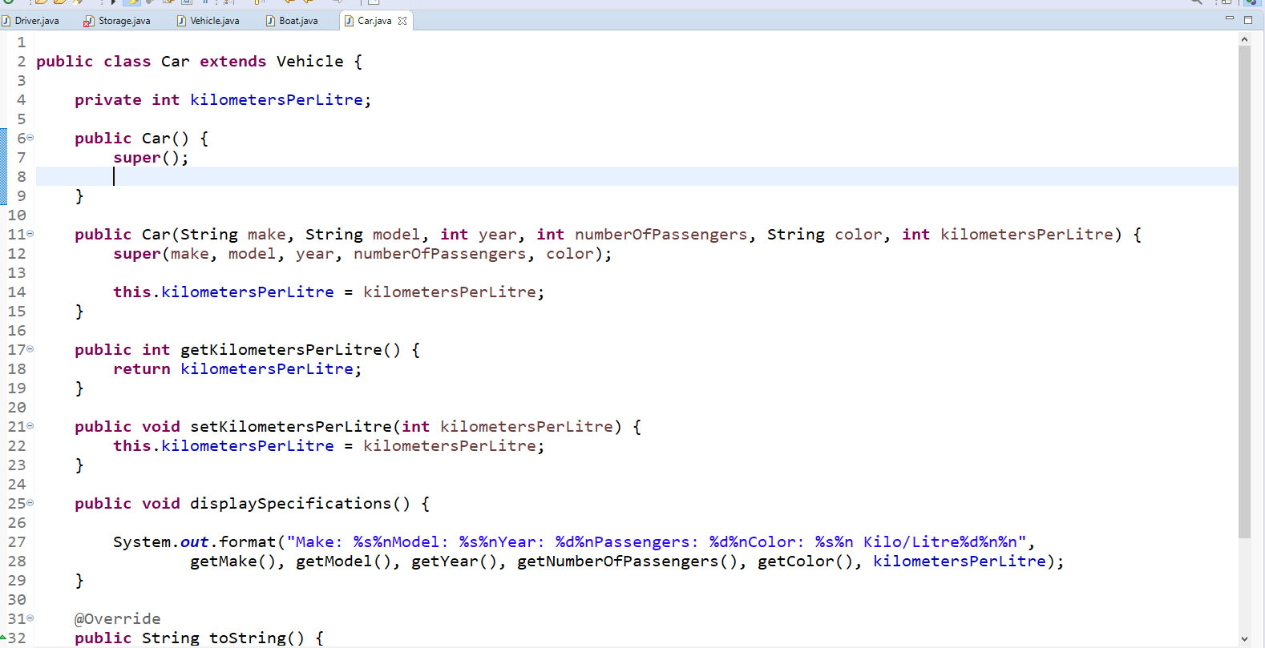

KABOOM!!!
The method displaySpecifications() is undefined in type Vehicle

Slide 9
Static Type Checking
the Java compiler checks syntax, not logic
part of the process is to examine reference type declarations, checking the apparent or declared type
this is called the STATIC TYPE CHECK.
When the reference is different than the actual Object type the type check works as long as the object type has a parent-child (“is-a”) relationship with the declared reference type
eg.
Vehicle v = new Car(...) SUBSTITUTION
works since Car IS A Vehicle
even though we are storing a Car address, the compiler sees it as a Vehicle
therein lies the problem
Next Slide

Slide 10
Static Type Checking ... continued
Even though we have a Car address, the compiler sees a Vehicle, so if we try to call a Car method we get a compile error
eg.
Vehicle v = new Car(...);
v.displaySpecifications() COMPILE ERROR
there is no displaySpecifications() method in the Vehicle class
the compiler has forgotten that “v” actually holds a Car object address, and instead it looks at the Vehicle class to resolve the method name, fails to find IT, and throws a compile error

Slide 11
The solution: OVERRIDING
not to be confused with overloading
What is it?
when a subclass inherits a superclass method and changes the implementation (method body) it OVERRIDES the superclass method
NOTE: the method signature must not change in any way from that in the superclass

Slide 12
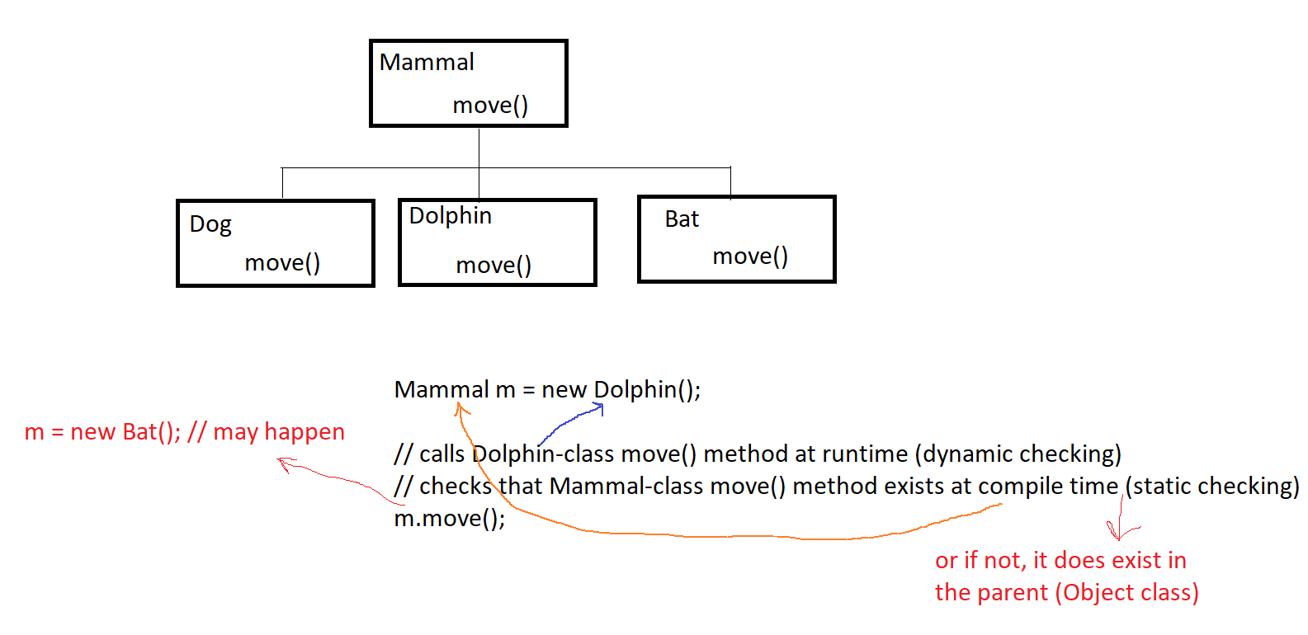
runtime vs. compile time

Slide 13
Visibility
When a child class overrides a parent method, the method’s visibility must remain the same or be even wider.
The visibility cannot be narrowed by a child.

Slide 14
“final” methods
prevents subclasses from overriding that method
notice the Vehicle setters are declared final
done to ensure that only the superclass can mutate its own fields
subclasses should never be able to change a superclass field except via super() calls in the constructor
subclass setters should likewise be made final

Slide 15

Fixing the Vehicle Hierarchy
re-introduce the displaySpecifications() method in the Vehicle class
notice it compiles now
run the program again

Slide 16
Dynamic Type Checking Polymorphism
done by the Java Runtime Environment (JRE)
Not satisfied with the “declared type, the JRE digs deeper and checks the actual type by looking inside the reference to discover what the actual object type is.
v.displaySpecifications();
JRE discovers that “v” holds a Car address and resolves to call the Car’s overloaded method polymorphically
this is POLYMORPHISM

Slide 17
“super” Revisited
Rather than have Car.displaySpecifications() call all the superclass getters, replace with super.displaySpecifications().
public void displaySpecifications() {
super.displaySpecifications();
System.out.format("Kilo/Litre: %d%n%n", kilometersPerLitre);
}
do the same for Airplane and Boat

Slide 18
Polymorphism vs instanceof
with Polymorphism we no longer have to do this:
if(v instanceof Car) {
Car c = (Car) v;
c.displaySpecifications();
}
the Polymorphic process resolves the actual type for us:
v.displaySpecifications(); // calls the appropriate version (Car, Airplane, etc…) automatically

Slide 19
Review
Polymorphism is the dynamic (runtime) lookup of methods
The three pillars of Polymorphism:
Inheritance class Dog extends Mammal
Substitution Mammal m = new Dog()
Overriding m.speak() // “woof”
Static type checks are performed by the compiler
Dynamic type checks are performed by the JRE

Slide 20
Protected access modifier
We have (1) private, (2) public, and (3) package (default; aka package-private)
Now we can add (4) protected: gives access to the child classes and classes in the package.
Eg: protected List<String> words;
private access in the superclass may be too restrictive for a subclass.
The closer inheritance relationship is supported by protected access.
Protected access is more restricted than public access.
Fields must still be private but methods can be protected.
Never make a field more visible than is necessary for the program logic – DON’T OVER-EXPOSE

Slide 21
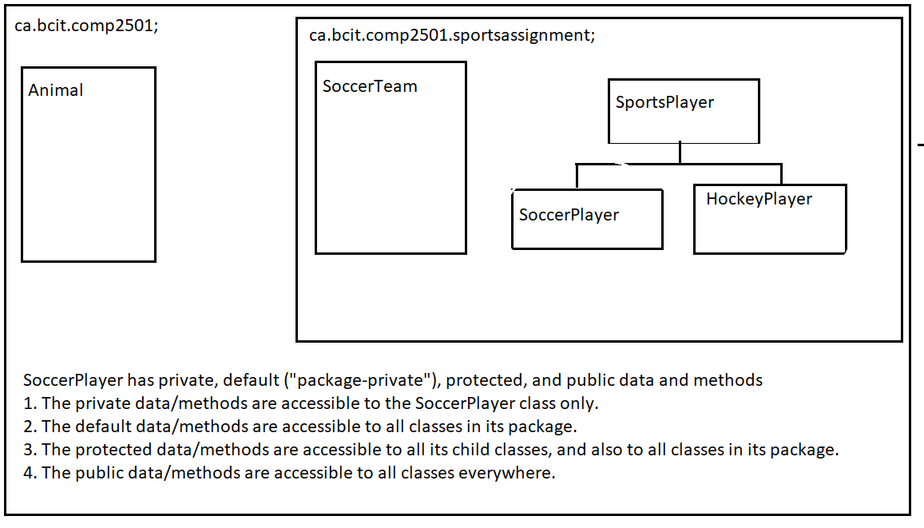
Access levels

Slide 22
Summary
Parent class: Mammal. Its parent is Object.
Make Mammal fields private and probably final.
Make Mammal mutators final.
Child class: Dolphin. Its parent is Mammal.
Override generic Mammal methods.
E.g. Mammal’s move() method could be overridden as:
@Override public void move() { System.out.println(“swim”); // Dolphin-specific move }

Slide 23
Summary
A collection of Mammal references can call individual, overridden methods automatically, polymorphically:
for(Mammal m: mammals) { m.move(); // Dolphins swim, Bats fly, Dogs run, etc… }
By having move() in the Mammal parent class, the above code will compile and run for sure. And the appropriate child-version of the method will be selected and run by Java.

