Slide 1
COMP2501 Lesson 3
Programming Fundamentals Part 2

Slide 2
Lesson 3 topics
Introduction to Java String class
Working with Strings and selected methods

Slide 3
Comparing Strings
Reference types (such as Strings) store the address of their object
Therefore comparing two String objects using == compares their address, not their contents, and you rarely if ever want to compare two String addresses.
Use String .equals() and .equalsIgnoreCase() methods to compare String contents
if(s1 == s2) // don’t; compares the address of two Strings
if(s1.equals(s2)) // compares the contents of two Strings exactly; // make sure s1 is not null
if(s1.equalsIgnoreCase(s2)) // compares the contents of two Strings but // ignores case, so “AbcdEf” would be the same as // “abcDEF”

Slide 4
null
A String is a reference type
Any reference type can be null, which means “there is no object”
Strings have a variety of useful methods
Be careful when using String methods…null does not have any methods
null is not the same as “”:
null means no String
“” is a String with no characters:
but still is located at an address
and still has String methods available

Slide 5
null
String s1 = null; String s2 = ""; System.out.println(s1.length()); // NullPointerException System.out.println(s2.length()); // 0

Slide 6
null vs. Empty String
A NullPointerException will occur by attempting to call methods on a null String reference
String s = null;
System.out.println(s.toUpperCase()); // NullPointerException
String s = "";
System.out.println(s.toUpperCase()); // Prints ""; no problem

Slide 7
null vs. Empty String vs. Blank String
if s == null true if s is null
if s.isEmpty() true if s is not null, but is ""
if s.isBlank() true if s is not null, but is empty or contains only whitespace
if(s != null && !s.isEmpty()) // good check; won’t crash if s is null
// !s.isEmpty() won’t be executed on a null String
versus
if(!s.isEmpty() && s != null) // bad; crashes if s is null
// check for null before using any String method
// the next line checks that a String is not null, and contains visible characters
if(s != null && !s.isBlank())

Slide 8
null vs. Empty String vs. Blank String
if(s == null || s.isBlank())
{ // no actual String… }

Slide 9
Commandline Arguments: String Array
public static void main(final String[] args) accepts an array of String references
The program can start with String inputs from the command line
Intellij IDEA:
Run
Edit Configurations…
+
Application
Name: (name it something meaningful e.g. “practice cmdline args”
Set the class that contains public static void main (e.g. Main)
Commandline arguments (e.g. hello 123 goodbye)
OK
See next slide
System.out.println("the person running this code is " + args[0]);

Slide 10
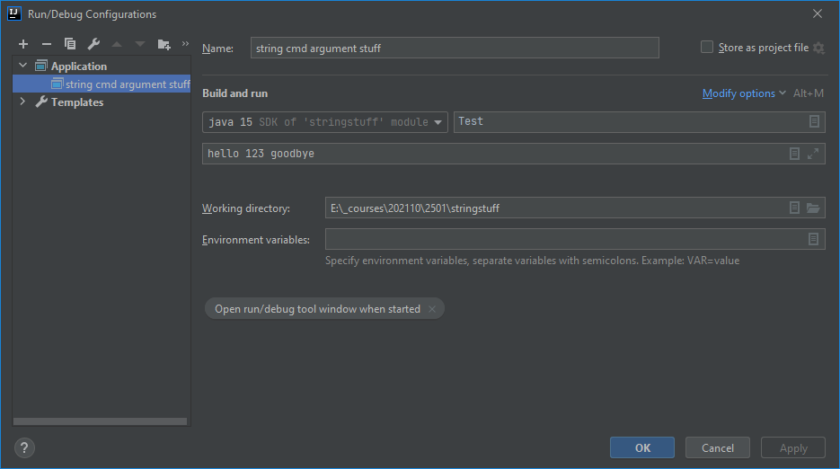
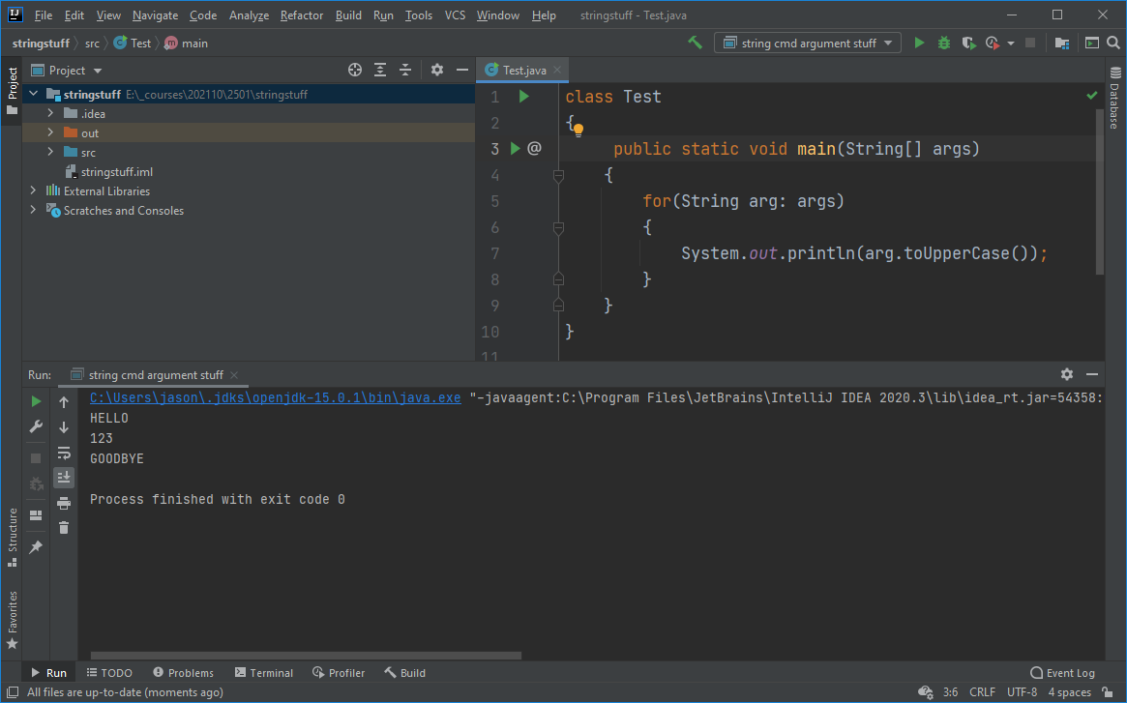
Commandline Arguments

Slide 11
Strings are Immutable
Once a String has been created, it cannot be modified
The following code simply points s to a new String (the original String, again, cannot be changed):
String s = "hello";
s = "world"; // there are now TWO Strings in memory
// s has the address of "world" in it now
The following two sections of code run differently in Java too:
String s1 = "hello"; String s2 = "hello"; // only one String exists; both point to it | String s3 = new String("goodbye"); String s4 = new String("goodbye"); // creates two new Strings in memory

Slide 12
Strings are Immutable
String s1 = "hello";
System.out.println(Integer.toHexString(s1.hashCode()));
s1 = "world";
System.out.println(Integer.toHexString(s1.hashCode())); // new address!

Slide 13
Numeric Strings etc
Sometimes Strings contain String versions of other data types
E.g.: get input from the user’s keyboard: that input is always a String, but can possibly be “converted” to other types
We can get the numbers out of numeric Strings in several ways:
int a = Integer.parseInt("123"); // 123
int b = Integer.valueOf("123"); // 123
int c = Integer.valueOf("hello"); // NumberFormatException
double c = Double.parseDouble("123.456"); // 123.456
double d = Double.valueOf("123.456"); // 123.456

Slide 14
More String Methods
Once we are certain we have a non-null String reference, there are many useful String methods we can use:
https://docs.oracle.com/en/java/javase/15/docs/api/java.base/java/lang/String.html
charAt() e.g. charAt(0) is the first character of the String
concat() or + e.g. String s = “Tiger” + “Woods” which is the same as “Tiger”.concat(“Woods”);
contains() e.g. if(s.contains(“the”)) or if(s.toUpperCase().contains(“THE”))
endsWith() e.g. if(s.endsWith(“xYz”)) or if(s.toLowerCase().endsWith(“xyz”))
equals() e.g. “hello”.equals(“Hello”) is false; “hello”.equals(“hello”) is true
equalsIgnoreCase() e.g. “hello”.equalsIgnoreCase(“Hello”) is true
indexOf() e.g. “hello”.indexOf(“l”) returns 2 (the index of the first l)
length() e.g. “hello”.length() is 5; “”.length() is 0
replace() e.g. “hello”.replace(‘l’, ‘T’) creates heTTo
startsWith()
strip() e.g. “\nhello world \t ” becomes “hello world”
toLowerCase()
toUpperCase()
Examples next slide...

Slide 15
More String Methods
String s1 = "TiGEr wooDs ";
String s2 = "My name is ".concat(s1);
String s3 = "My name is " + s1;
System.out.println(s2); // My name is TiGEr wooDs
System.out.println(s3); // My name is TiGEr wooDs
System.out.println(s1.charAt(0)); // T
System.out.println(s1.contains("ig")); // false
System.out.println(s1.contains("iG")); // true
System.out.println(s1.endsWith("oDs")); // false; note the space at the end of s1
System.out.println(s1.strip().endsWith("oDs")); // true; spaces stripped off ends of s1
System.out.println(s1.equals("Tiger Woods")); // false
System.out.println(s1.equalsIgnoreCase("Tiger Woods ")); // true
System.out.println(s1.indexOf('o')); // 7; the first o occurs at the 8th char
System.out.println(s1.length()); // 12
System.out.println(s1.strip().length()); // 11
System.out.println(s1.replace('o', 'x')); // TiGEr wxxDs
System.out.println(s1.startsWith("Ti")); // true
System.out.println(s1.toLowerCase()); // tiger woods
System.out.println(s1.toUpperCase()); // TIGER WOODS

Slide 16
Format Strings
In addition to System.out.print(), we can use System.out.printf() and String.format() methods to print.
printf():
int yearBorn = 2000;
double weightKg = 120.129;
String firstName = "Tiger";
System.out.printf("The golfer %s weighs %.2f kg and was born in %d!!!", firstName, weightKg, yearBorn);
format():
String s;
s = String.format("The golfer %s weighs %.2f kg and was born in %d!!!", firstName, weightKg, yearBorn);
System.out.println(s);
Both of these print “The golfer Tiger weighs 120.13 kg and was born in 2000!!!”

Slide 17
Lab 3
Lab 3
Do with a different partner than previous labs
Each partner submits their own copy
Due before the start of next lesson
Just one lab this lesson
There is a quiz next lesson also

