Slide 1
COMP2501 Lesson 8
Programming Fundamentals Part 2

Slide 2
Lesson 8 topics
java.util.Scanner
Reading text files
Read the keyboard
override toString()

Slide 3
Purpose
Often we need a means to read runtime input, information after the program has started
Usually that input comes in the form of text, which would store as Strings inside out program code
Java provides multiple means to do this through various classes which use input streams do read runtime input from either the user or from data files
Scanner gives us the simplest way to do this
provided are several methods that will read in put at the command prompt and store that input under many different data types, including String

Slide 4
Scanner – user input
Scanner scanner = new Scanner(System.in);
int value = scanner.nextInt();
reads and returns the whole number entered
double value = scanner.nextDouble();
reads and returns the decimal number entered
boolean value = scanner.nextBoolean();
reads and returns “true/false” entered
String value = scanner.next();
reads and returns the first single String entered
“System.in” static reference to java.io.InputStream

Slide 5

“Cool” Part
There's one more kid that'll never go to school Never get to fall in love, NEVER GET TO BE COOL!
Neil Young, Rockin’ in the Free World, 1989
When each “nextXXX()” is called the program flow pauses, waiting for the user to enter something and hit the enter key. Once “enter” is tapped the nextXXX() method automatically returns whatever was entered converts to the right data type and returns the converted value.
IF the wrong type of data is entered Scanner will throw a java.util.InputMismatchException
int input = scanner.nextInt() // but user enters “abc”
KABOOM!

Slide 6
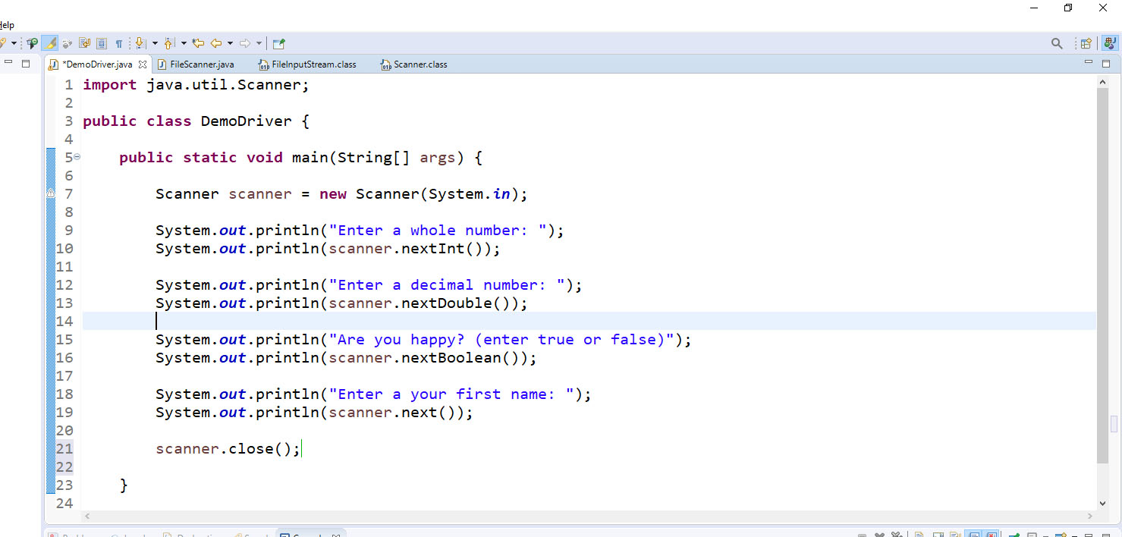
Demo
using nextInt(), nextDouble(), nextBoolean(), next()

Slide 7
Scanner – Reading Text Files
Scanner can be used to read any text file
Here would we use Scanner.nextLine() to read each line in a file
Scanner.hasNext();
use when read a file in a loop, stop when the end of the file is reached
scanner.close();
always close your Scanner connection before exiting.

Slide 8
Usage
java.io.File
used to identify a file on the hard disc
File file = new File(“filename”);
Using Scanner
Scanner fileScanner = new Scanner(file);
throws checked Exception:
java.io.FileNotFoundException

Slide 9
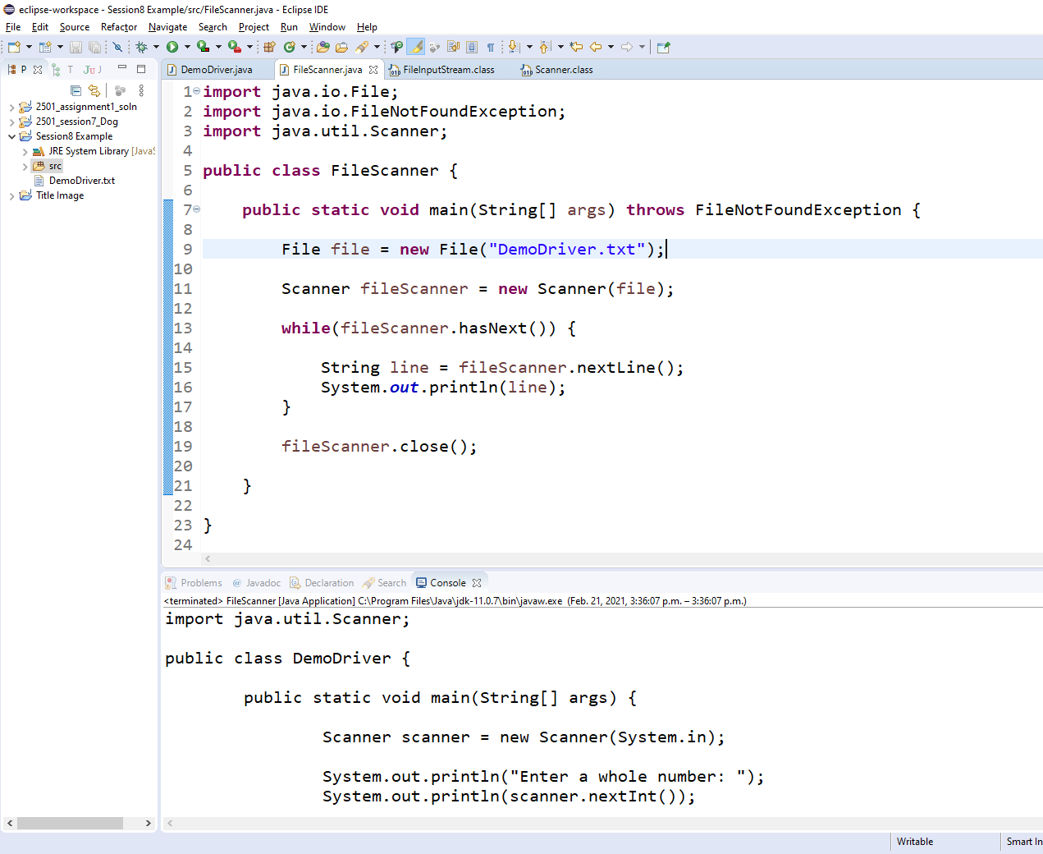
Usage
deploy source
file here
throws FileNotFoundExeption
reads and writes
one line at a time
file path is relative
to the project folder
DON’T FORGET TO CLOSE!!!

Slide 10
Object Stringification
for debugging purposes its useful to be able to display the field values or “STATE” of the object
toString() inherited from Object and overridden
eg.
@Override
public String toString() {
return "Address [unitNumber=" + unitNumber + ", streetNumber=" + streetNumber + ", streetName=" + streetName
+ ", postalCode=" + postalCode + ", city=" + city + "]";
}
output - Address [unitNumber=null, streetNumber=333, streetName=elm street, postalCode=90111, city=los angeles]
can be auto-generated to save time

Slide 11
toString() should-nots
should not be considered a display method – purpose is for when debugging your code
should not perform any logic – display only the existing field data
should not format data – need to see the data in its raw/true form when debugging (let’s see those 15 digits of decimal precision)

Slide 12
on to Lab 8
“Once more into the breach!”

