Slide 1
COMP2501 Lesson 2
Programming Fundamentals Part 2

Slide 2
Lesson 2 topics
Assignment 1 introduction: try to pass some AddressTest tests
Comparing Java to Python: containers and iteration
Introduction to, and comparison with, Java collections and iterating techniques

Slide 3
Python vs. Java
Python
Java
Tuple
List
Set
Dictionary
List or Array
List or Array
Set
Map

Slide 4
Java Array: Simple Array of Strings
book_store.py
BookStore.java
book_titles = ("getting things done",
"python for everybody",
"the four-hour workweek")
public class BookStore
{
private String[] bookTitles;
public BookStore()
{
bookTitles = new String[2];
bookTitles[0] = "getting real";
bookTitles[1] = "the $100 startup";
bookTitles[0] = "the 5AM club";
}
}
* bookTitles will now always be length 2; it is not possible to add more Strings to it

Slide 5
Java Array: More Arrays of Strings
book_store.py
BookStore.java
/* Array of book titles */
import java.util.Arrays;
public class BookStore
{
private String[] bookTitles = {"getting things done", "the four-hour workweek"};
private String[] moreBookTitles;
private String[] allBookTitles;
public BookStore()
{
moreBookTitles = new String[2];
allBookTitles = new String[4];
moreBookTitles[0] = "getting real";
moreBookTitles[1] = "the $100 startup";
/* IGNORE THE NEXT TWO LINES; WE DON’T NEED TO MEMORIZE THIS */
allBookTitles = Arrays.copyOf(bookTitles, bookTitles.length + moreBookTitles.length);
System.arraycopy(moreBookTitles, 0, allBookTitles, bookTitles.length, moreBookTitles.length);
}
public static void main(String[] args)
{
BookStore b = new BookStore();
}
}
# tuple and list of book titles
book_titles = ("getting things done",
"python for everybody",
"the four-hour workweek")
more_book_titles = []
more_book_titles.append("getting real")
more_book_titles.append("the $100 startup")
all_book_titles = list(book_titles) + more_book_titles

Slide 6
Java Array: while loop
book_store.py
BookStore.java
i = 0 while i < len(all_book_titles):
print(all_book_titles[i]) i += 1
# prints:
getting things done
python for everybody
the four-hour workweek
getting real
the $100 startup
int i = 0;
while(i < allBookTitles.length)
{
System.out.println(allBookTitles[i]);
i++;
}

Slide 7
Java Array: while loop
book_store.py
BookStore.java
i = 0 while i < len(all_book_titles):
print(all_book_titles[i]) i += 1
# prints:
getting things done
python for everybody
the four-hour workweek
getting real
the $100 startup
int i = 0;
if(allBookTitles != null)
{
while(i < allBookTitles.length)
{
if(allBookTitles[i] != null)
{
System.out.println(allBookTitles[i]);
}
i++;
}
}

Slide 8
Java Array: for loop
book_store.py
BookStore.java
for title in all_book_titles:
print(title)
# prints:
getting things done
python for everybody
the four-hour workweek
getting real
the $100 startup
if(allBookTitles != null)
{
for(int i = 0; i < allBookTitles.length; i++)
{
if(allBookTitles[i] != null)
{
System.out.println(allBookTitles[i]);
}
}
}

Slide 9
Java Array: for-each loop (“enhanced for”)
book_store.py
BookStore.java
for title in all_book_titles:
print(title.lower())
# prints:
getting things done
python for everybody
the four-hour workweek
getting real
the $100 startup
if(allBookTitles != null)
{
for(String title: allBookTitles)
{
if(title != null)
{
System.out.println(title.toLowerCase());
}
}
}
* This is probably usually the best iteration form, better than for loops, better than while loops.

Slide 10
New Example: Array and Foreach Loop
class Mathematics
{
private final double[] mathematicalConstants;
Mathematics()
{
mathematicalConstants = new double[4];
mathematicalConstants[0] = 3.14159;
mathematicalConstants[1] = 1.41421;
mathematicalConstants[2] = 1.61803;
mathematicalConstants[3] = 2.71828;
for(double constant: mathematicalConstants)
{
System.out.println(constant);
}
}
public static void main(final String[] args)
{
Mathematics math = new Mathematics();
}
}

Slide 11
Java Collections
Java Collections include three types:
List
Set
Map
(Array is NOT a collection type)
There are different subclasses (subtypes) of each of these, too:
ArrayList
HashMap
Java collections can contain only references (not primitives)

Slide 12
ArrayList
ArrayList is a subtype of List
Import it from the java.util package
Declare it as an instance variable (or local variable)
Parameterize its type (e.g. the ArrayList below stores only String references)
Instantiate it in the constructor (for example)
Use its remove(), add(), get(), size() methods (RAGS).
import java.util.ArrayList;
class CarLot
{
private final List<String> cars;
CarLot()
{
cars = new ArrayList<>();
…

Slide 13
Java ArrayList: ArrayList + Foreach
BookStore.java
import java.util.List;
import java.util.ArrayList;
public class BookStore{
private final List<String> titles;
public BookStore() {
titles = new ArrayList<>();
titles.add("getting things done");
titles.add("the four-hour workweek");
titles.add("getting real");
titles.add("the $100 startup");
if(titles != null) {
for(final String title: titles) {
if(title != null) {
System.out.println(title.toLowerCase());
}
}
}
}
public static void main(final String[] args) {
BookStore b = new BookStore();
}
}
*An ArrayList can “always” add more elements into it.
book_store.py
# tuple and list of book titles
book_titles = ("getting things done", "python for everybody", "the four-hour workweek")
more_book_titles = []
more_book_titles.append("getting real")
more_book_titles.append("the $100 startup")
all_book_titles = list(book_titles) + more_book_titles
for title in all_book_titles:
print(title)

Slide 14
Java Collections: Iterator
Iterator rules:
Import from java.util: import java.util.Iterator; at top of the class
Declare as local variable inside a method
Parameterize the iterator (whatever type is in the collection)
Combine with while loop: while it.hasNext() next()

Slide 15
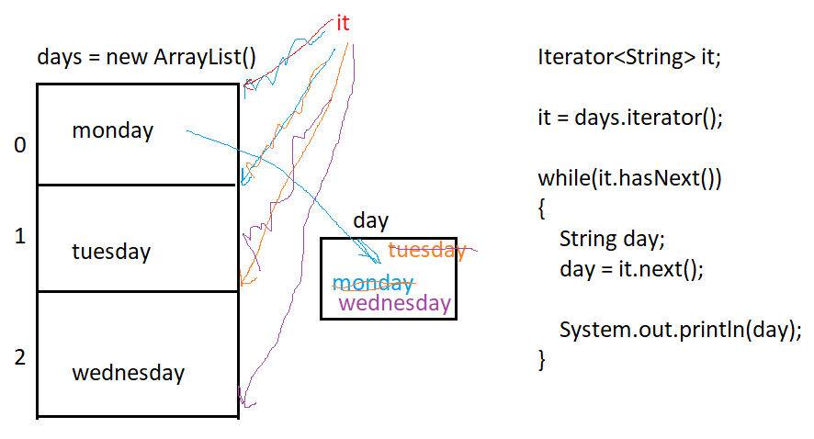
Iterator

Slide 16
Java ArrayList: ArrayList + Iterator
book_store.py
BookStore.java
# tuple and list of book titles
book_titles = ("getting things done", "python for everybody", "the four-hour workweek")
more_book_titles = []
more_book_titles.append("getting real")
more_book_titles.append("the $100 startup")
all_book_titles = list(book_titles) + more_book_titles
for title in all_book_titles:
print(title)
import java.util.ArrayList;
import java.util.Iterator;
public class BookStore2
{
private final ArrayList<String> titles;
public BookStore2()
{
titles = new ArrayList<>();
titles.add("getting things done");
titles.add("the four-hour workweek");
titles.add("getting real");
titles.add("the $100 startup");
if(titles != null)
{
Iterator<String> it = titles.iterator();
while(it.hasNext())
{
String title = it.next(); // also advances the iterator
if(title != null)
{
System.out.println(title);
}
}
}
}
public static void main(String[] args)
{
BookStore2 b = new BookStore2();
}
}

Slide 17
New Example: ArrayList + Iterator
Television.java | ElectronicsStore.java | Main.java | Output
class Television { private String manufacturer; private int inches; public Television(final String manufacturer, final int inches) { this.manufacturer = manufacturer; this.inches = inches; } public String getManufacturer() { return manufacturer; } public int getScreenSizeInches() { return inches; } } | import java.util.ArrayList; import java.util.Iterator; class ElectronicsStore { private List<Television> televisions; ElectronicsStore() { televisions = new ArrayList<>(); televisions.add(new Television("Panasonic", 82)); televisions.add(new Television("Sony", 55)); televisions.add(new Television("BENQ", 32)); } public void listAllTelevisions() { Iterator<Television> it; it = televisions.iterator(); while(it.hasNext()) { Television tv; tv = it.next(); System.out.println((tv.getManufacturer() + " " + tv.getScreenSizeInches() + " in")); } } } | public class Main { public static void main(final String[] args) { ElectronicsStore store; store = new ElectronicsStore(); store.listAllTelevisions(); } } | Panasonic 82 in Sony 55 in BENQ 32 in

Slide 18
ArrayList RAGS: remove, add, get, size
car_lot.py
CarLot.java
cars = ['viper', 'accord', 'beetle']
cars.append("charger")
cars.remove("accord")
print(len(cars))
print(cars[2]) # equivalent to java’s “get”
print(cars)
prints:
3
charger
['viper', 'beetle', 'charger']
import java.util.ArrayList;
class CarLot
{
private List<String> cars;
CarLot()
{
cars = new ArrayList<>();
cars.add("viper");
cars.add("accord");
cars.add("beetle");
cars.add("charger");
cars.remove("accord");
System.out.println(cars.size());
System.out.println(cars.get(2));
System.out.println(cars);
}
public static void main(final String[] args)
{
CarLot carLot;
carLot = new CarLot();
}
}
prints:
3
charger
[viper, beetle, charger]

Slide 19
Java Collections and Iterating
The collections can be iterated similarly to one another, regardless of the underlying collection type:
Sets, lists, and maps can all use foreach loops and iterators
List has RAGS (remove, add, get, size) methods
Map has RPGS (remove, put, get, size) methods (and keySet)
Maps, like python dictionaries, have no duplicate keys and no order

Slide 20
Dictionary vs. Map
number_list.py
NumberList.java
numbers = {1: "one", 2: "two", 500: "five hundred", 730: "seven hundred thirty"}
print(numbers[500])
del(numbers[500])
for num in numbers: # gets each KEY print(num)
for key, value in numbers.items(): print("key is ", key, " and value is ", value)
prints:
five hundred
1
2
730
key is 1 and value is one
key is 2 and value is two
key is 730 and value is seven hundred thirty
import java.util.HashMap;
import java.util.Set;
class NumberList
{
private final Map<Integer, String> numbers;
NumberList()
{
numbers = new HashMap<>();
numbers.put(1, "one");
numbers.put(2, "two");
numbers.put(500, "five hundred");
numbers.put(730, "seven hundred thirty");
System.out.println(numbers.get(500));
numbers.remove(500);
Set<Integer> allOfTheKeys;
allOfTheKeys = numbers.keySet();
for(Integer key: allOfTheKeys)
{
System.out.println(key);
}
for(Integer key: allOfTheKeys)
{
System.out.println("key is " + key + " and value is " + numbers.get(key));
}
}
public static void main(String[] args)
{
NumberList numList;
numList = new NumberList();
}
}

Slide 21
New example: Dictionary vs. Map
student.py
Student.java
School.java
class Student:
def __init__(self, last_name, student_number, year_born, grade_point_average):
self.last_name = last_name
self.student_id = student_number
self.year_of_birth = year_born
self.gpa = grade_point_average
import java.util.HashMap;
import java.util.Set;
class School
{
private Map<String, Student> students;
School()
{
students = new HashMap<>();
Student student1 = new Student("woods", "A00111222", 1975, 3.9);
Student student2 = new Student("gates", "A00333444", 1955, 3.8);
students.put("A00111222", student1);
students.put("A00333444", student2);
students.get("A00333444").setGpa(4.0);
Set<String> keys = students.keySet();
for(String key: keys)
{
Student student = students.get(key);
System.out.println("st #" + key + " is " + student.getLastName() + " with gpa " + student.getGpa());
}
}
public static void main(final String[] args)
{
School school = new School();
}
}
public class Student
{
private final String lastName;
private final String studentNumber;
private final int yearOfBirth;
private double gpa;
public Student(String lastName, String studentNumber, int yearBorn, double gradePointAverage)
{
this.lastName = lastName;
this.studentNumber = studentNumber;
this.yearOfBirth = yearBorn;
this.gpa = gradePointAverage;
}
public String getLastName()
{
return lastName;
}
public String getStudentNumber()
{
return studentNumber;
}
public int getYearOfBirth()
{
return yearOfBirth;
}
public double getGpa()
{
return gpa;
}
public void setGpa(double gpa)
{
this.gpa = gpa;
}
}
school.py
from student import Student
def main():
student1 = Student("woods", "A00111222", 1975, 3.9)
student2 = Student("gates", "A00333444", 1955, 3.8)
students = {"A00111222": student1, “A00333444": student2}
students["A00333444"].gpa = 4.0
for key, value in students.items():
print("st #", key, " is ", value.last_name, " with gpa ", value.gpa)
if __name__ == "__main__":
main()

Slide 22
Lab 2
Lab 2a
Lab 2b
Do with a different partner than lab 1
Each partner submits their own copy
Due before the start of next lesson
Do alone (at home)
Due before the start of next lesson
There is a quiz next lesson also

