Slide 1
COMP2501 Lesson 5
Programming Fundamentals Part 2

Slide 2
Lesson 5 topics
Constructor overloading
Java classes: methods
Method overloading
Accessor methods
Mutator methods

Slide 3
Overloading
Constructors and methods can both be overloaded
Overloading allows a class to have two or more methods having the exact same name, if their signatures are different
Three ways in which signatures can be different:
Different number of parameters
Different type of parameters
and/or
Different order of parameters.
Note: the return type is irrelevant to overloading

Slide 4
Overloading constructors
public Book()
public Book(final String title)
public Book(final String authorLastName)
public Book(final int numPages)
public Book(final String title, int numPages)
public Book(final int numPages, final String title)
In all these cases the compiler can tell them apart:
Book b1 = new Book(“harry potter”); // calls second constructor
Book b2 = new Book(700, “harry potter”); // calls fifth constructor

Slide 5
Overloading methods
public int withdraw(final double amountUSD){}
public void withdraw(final double amountUSD, final int yourPIN){}
public void withdraw(final int yourPIN, final double amountUSD){}
public void withdraw(final String acctNumber, final double amountUSD){}
public void withdraw(final String acctNumber, final double amountUSD, final int thePin){}
public void withdraw(final int amountCAD){}
public void withdraw(double x){}
account1.withdraw(100.0);

Slide 6
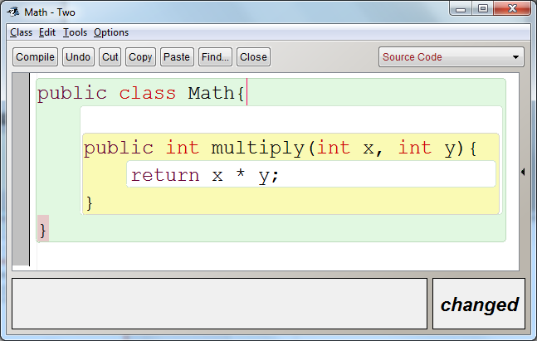
Methods: return types and parameters
A method is an instruction, a function, a verb
A method can be private, public, or default (“package”)
Use the principle of least privilege: only give the visibility access that is needed
The return type must be specified and it is a contract that must be met
Java methods can take input (parameters, arguments) and give zero or one outputs (return)
An example could be:

Slide 7
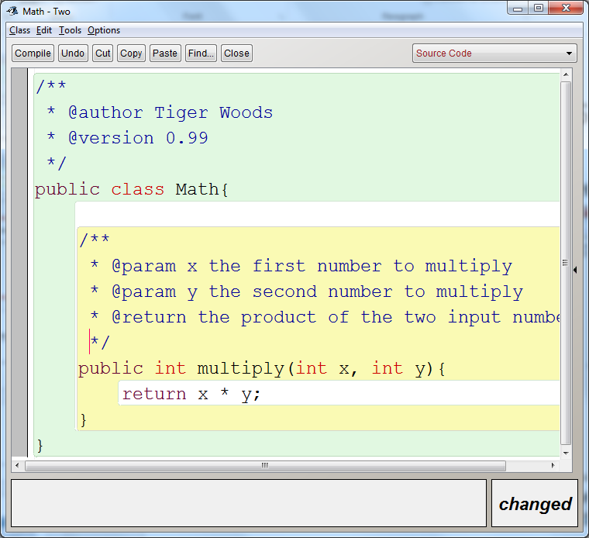
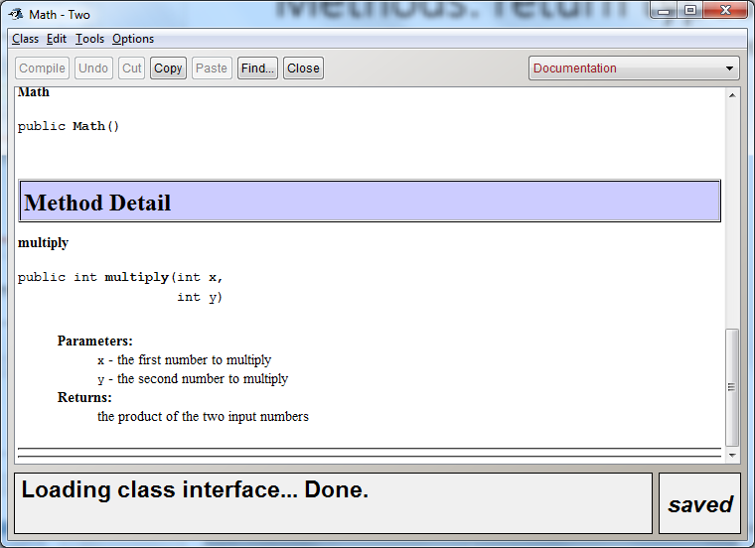
Methods: return types and parameters
Since this method is not private it needs JavaDoc comments on top.

Slide 8
Methods: return types and parameters
Methods should be named as verbs
If a particular method doesn’t need to return anything, its return type is “void”
Example: public void returnNothing() {
// do some stuff but don’t return anything }
Notice that this method also didn’t need any inputs.
Inputs are called parameters or arguments.

Slide 9
Methods: return types and parameters
A method signature includes:
name(parameters) // not the return type
Examples:
isStudentEnrolled(final String studentID)
doSomething(final double a, final int b, final char c)
getAverage(final double num1, final double num2, final double num3)
doSomethingElse()
getAuthorFirstName()
getPin(final String accountNumber)

Slide 10
Methods: return types and parameters
boolean isStudentEnrolled(final String studentID) // package access (default)
private void doSomething(final double a, final int b, final char c)
public double getAverage(final double num1, final double num2, final double num3)
private char doSomethingElse()
Call those methods later:
System.out.prinln(isStudentEnrolled(“a00123456”)); // callable from within this package
doSomething(5.5, 4, ‘c’) // callable from its own class, only
double average = getAverage(1.0, 2.2, 3.4) // callable from anywhere
doSomethingElse() // callable from its own class, only

Slide 11
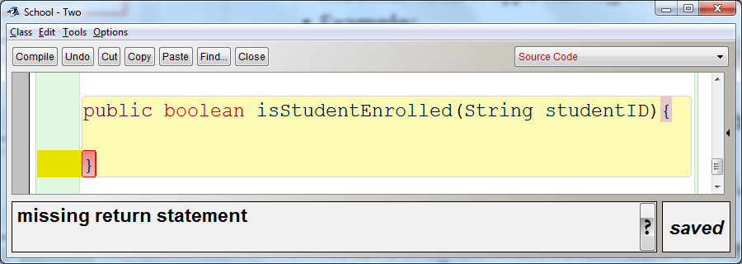
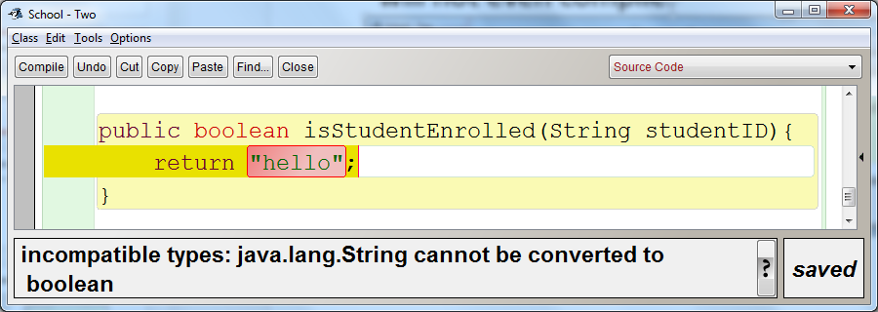
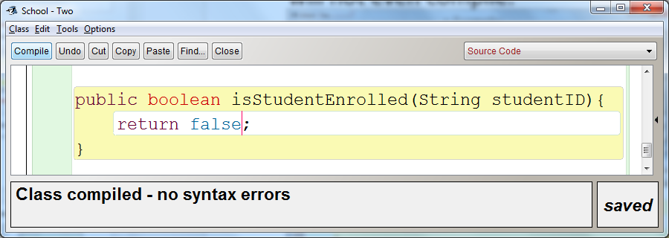
Methods: return types and parameters
Note: a method must return data of the specified return type, or it will not even compile.

Slide 12
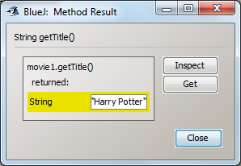
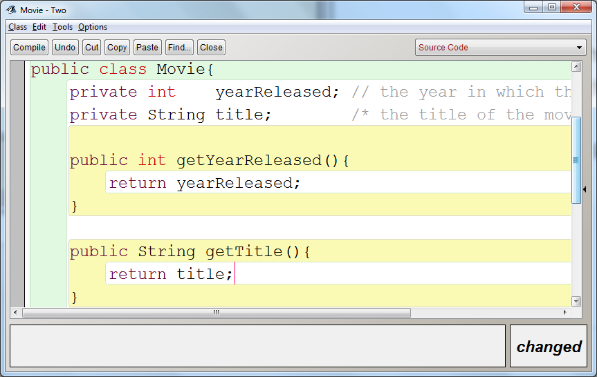
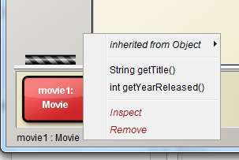
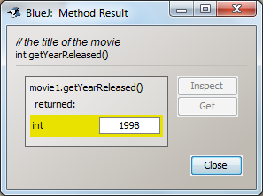
Accessors
Accessor methods are also known as “get methods” or “getters”.
They are only one of many “categories” of methods that we can make.
Accessor methods give other classes access to private data (instance variables, for example).

Slide 13
Accessors (“getters” or “get methods”)
The common method signature for accessor methods:
<return type> getInstanceVariableName()
Accessor methods should not be private
Usually, no parameters are necessary
The return type matches the type of the instance variable being returned
Often, the accessor method does nothing except simply return data
Otherwise the data is inaccessible outside this class, since we always make our instance variables private.

Slide 14
Mutators (“setters” or “set methods”)
Another category (out of many) of method is the mutator method
Also known as “set method” or “setter”
Allows other classes to change instance variables
Mutators generally have rules that must be followed first; if the rules are not followed, then the data is not changed
These rules are what make mutators useful. We protect the data this way
Without any guard rules, we may as well have made the instance variables public (a bad idea since any code anywhere could change the data to any value)
A class often has more accessors than mutators.

Slide 15
Mutators
In general, the method signature for a mutator method:
void setInstanceVariableName(<data type> newVariableValue)
Our constructors act similarly to mutator methods, too.
public class Book{
private final String title;
private final int yearReleased;
private double priceCad;
public Book(final String title, final int yearReleased, final double priceCad) {
this.title = title;
this.yearReleased = yearReleased;
if(priceCad > 0.00) {
this.priceCad = priceCad;
}
}
public String getTitle() {
return title;
}
public int getYearReleased() {
return yearReleased;
}
public double getPriceCad() {
return priceCad;
}
public void setPriceCad(final double priceCad) {
if(priceCad > 0.00) {
this.priceCad = priceCad;
}
}
}

Slide 16
Lab 5
Lab 5
Do with a different partner than previous labs
Each partner submits their own copy
Due before the start of next lesson
Just one lab this lesson
There is a quiz next lesson also

