Slide 1
COMP2501 Lesson 6
Programming Fundamentals Part 2

Slide 2
Lesson 6 topics
More About Strings
Associated Classes and methods
static
Symbolic Constants
this

Slide 3
Review
Strings are a Reference type (Object): i.e. not a primitive type
they give us all kinds of built-in functionality through their methods
E.g. "hello".toUpperCase()
Strings are immutable: System.out.println(Integer.toHexString(stringRef.hashCode()));
String s = "Beatles";
s = "Stones"; // creates a brand new String object (Strings are immutable)
String concatenation ("joining")
string1 + string2 + string3 + …
can be very expensive and bit awkward to code // more on this later

Slide 4
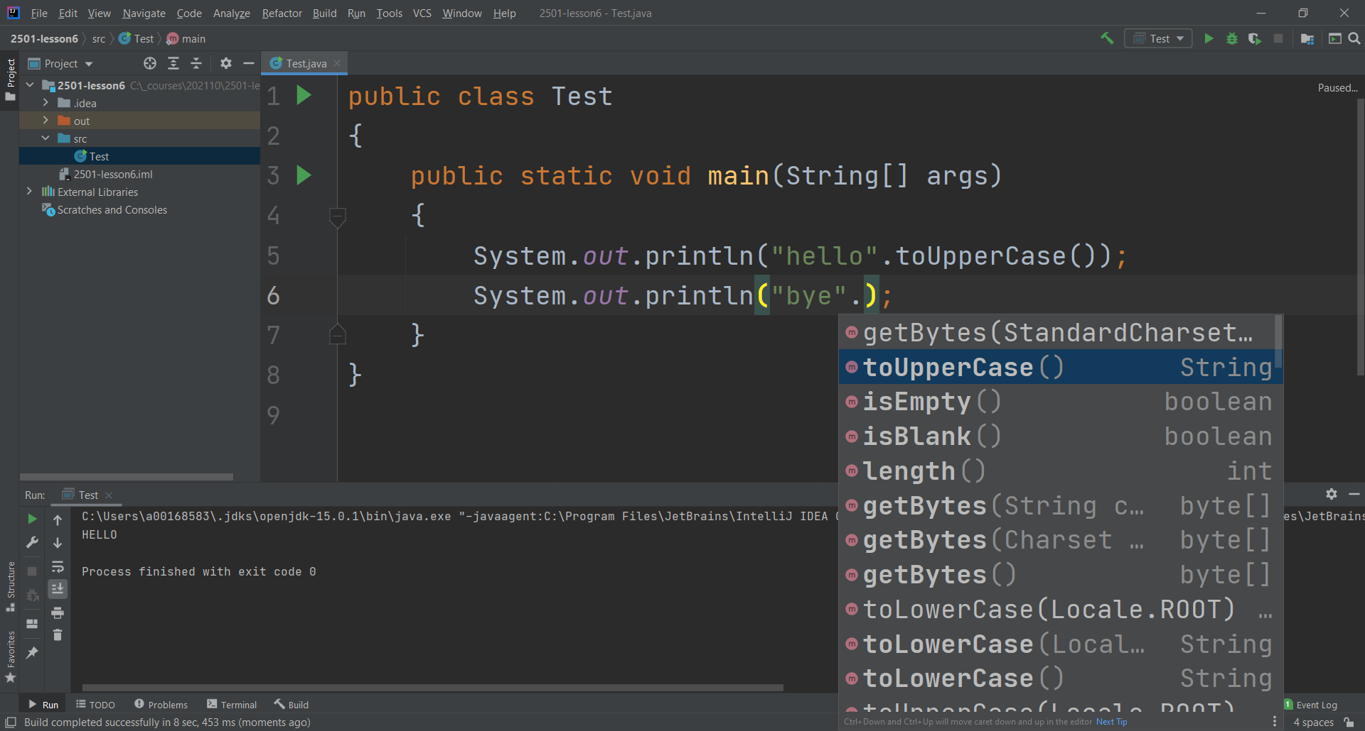
Strings have methods

Slide 5
Strings as an array
At their core, a String is a char[]
this allows us to manipulate Strings in ways that we could not do otherwise
eg.
s.charAt(0)
s.length()
s.substring(0, 5)
Converting String to char[]
String data = “Programming is fun”;
char[] words = data.toCharArray();
once we have this, each character of the original String can be accessed by its index starting with [0]
System.out.println(words[0]); // will display ‘P’

Slide 6
StringBuilder: a Better Concatenation
String concatenation can be very expensive when joining a number of String together because Strings are immutable
StringBuilder offers a more efficient means to join Strings because it works with a single mutable object
StringBuilder builder;
builder = new StringBuilder(); // java.lang.StringBuilder
builder.append("Programming");
builder.append(" ");
builder.append("is");
builder.append(" ");
builder.append("fun"); // still not a String
String generated = builder.toString(); // gives us “Programming is fun”

Slide 7
Splitting Strings
Often we will want to take String input and split it into separate component Strings.
String names = "John Paul George Ringo"; // space delimited-String
String[] theBeatles = names.split(" "); // parameter is the original delimiter
Other popular delimiters (i.e. separators):
split(",") //common for CSV files
spit("\\|") //note the double \ "\\|"

Slide 8
Comparing Objects (such as Strings)
Before:
if(s1 == s2) // compares addresses, returns boolean (you would RARELY do this)
if(s1.equals(s2)) // compares the String values, returns boolean
if(s1.equalsIgnoreCase(s2)) // “doG” is the same as “DOG” etc
New:
s1.compareTo(s2); // returns an int
A positive int if s1 > s2; a negative int if s1 < s2; zero if s1 equals s2
Each character in a String has a numeric Unicode value that can be used to see if Strings are sorted alphabetically
if(s1.compareTo(s2) < 0) // negative means s1 is smaller than s2
{
System.out.println(“s1 has the lower Unicode value”);
}

Slide 9
.equals
String s1 = new String("hello"); String s2 = new String("hello");
System.out.println(s1 == s2); // false; they do NOT share the same address System.out.println(s1.equals(s2)); // true; they have the same letters

Slide 10
Local Variables
We have two types of variables in Java, class fields and LOCAL variables
Local Variable:
is declared in a method or occasionally in a constructor
can been seen only in the scope they are declared, which means a local variable of one method cannot be seen outside of that method
is used as temporary data storage used expressly in the scope in which they are declared
Parameters are also considered local variables since that exist only upon the method call and do not persist beyond the scope, lifetime, or execution of the method.

Slide 11
Local Variable Examples
Local Variable
Local Variable
double getCircleArea(final double radius)
{
final double pi = 3.14159;
double area;
area = pi * (radius * radius);
return area;
}
Local Variable

Slide 12
“static”
Fields can be static, which means there is just a single variable, and it belongs to the class rather than to any instance
private static int number;
NOTE: static fields are belong to the class. Individual instances (if any) of that class can reference that data also. They are NOT unique to each instance. Also, note that NO instances of the class need even exist, for the field to be usable.
If you use one instance to change a static field the change is seen by all instances

Slide 13
“static”
Person class:
// instance variables: values are particular to individual objects
hair color
birth date
first name
country born in
weight lb
eye color
profession
salary
// static variables: values belong to the Person class, not objects
population
weight lb of the heaviest person
year of first person (e.g. 200000 years ago)
richest person: elon musk
breathe air
Royal Bank Account class:
// instance variables: values are particular to individual objects
account number
pin
name
balance CAD
account type
branch
interest rate
// static variables: values belong to the Person class, not objects
number of clients
highest balance CAD
prime interest rate
fees
types of accounts
headquarters branch

Slide 14
“static” continued …
Static Methods
Java has two types of methods, ones that belong to the instance called “instance methods” and ones that belong to the class, “class methods”.
Until now we have been using instance methods, which means you have to first create an Object and then use its reference to call the method
MyClass mc = new MyClass();
mc.someMethod();
To declare a class method we use the keyword “static”, which means we do not have to create an object to call it.
public static void someMethod(){…}
MyClass.someMethod(); // no instance/object required

Slide 15
static methods
public class Circle { public static double getArea(final int radius) { return 3.14 * radius * radius; } }

Slide 16
The Dreaded Static Error
Mixing static and non-static
static methods cannot directly access non-static (instance) fields
throws compile error
private int number;
public static void someMethod(){
System.out.println(number);
the only way to fix this is to make number static, BUT this may not be desired as it would then become a shared field.
Use “static” JUDICIOUSLY
Compile Error:
Cannot make static reference to the non-static field number

Slide 17
Symbolic Constants
By definition a variable’s value can change: “vary”.
A constant is a fixed value that cannot change once it is set. It should never be referred to as a variable.
Constants represent real-life values where the value is fixed over the lifetime of the object
eg:
final int double PI = 3.141592;
keyword “final”
NOTE the all caps for the constant name. This makes it obvious and a reminder that you should not attempt to alter the value.

Slide 18
Symbolic Constant notes
Avoid “magic numbers”
Because you cannot change constants, only read them, they do have not setters, and are often declared public because there is no longer the same need to protect them. If public then we don’t need getters.
If we have a constant that must have ONE unchanging identical value for all objects and all classes, make it static and final.
eg;
In a Circle class: public static final double PI = 3.14159265;
static because there is only ONE value of pi!!!
final because its value must not change
public because it is in no danger of being changed, but must remain usable outside the class
public static final int DAYS_PER_WEEK = 7;

Slide 19
…and finally “this”
“this” is a reference to “the current object”
The keyword “this” is a reference to the current (this) object. It can be thought of as an Object pointing to itself.
Commonly used in reference to fields, as in:
private int number;
public MyClass(final int number)
{ //note the field and the parameter carry the same name
this.number = number;
}
Without “this” the compiler will attempt to assign the parameter value back to the itself (same parameter), leaving the field unset.
“this” is used so the compiler can tell the difference between the field and the parameter. The statement above can be read as “this object’s field “name” equals the parameter “name”.

Slide 20
No magic numbers ever again
There are 8000000001 people in the world. These 8000000001 people eat a lot of food and cause lots of problems. In 2022, there is still enough food for 8000000001 people. 2022 is improving for lots of people. The hourly minimum wage in bc is $15.20. $15.20 is not easy to buy a house with, especially in 2022. Sometimes it feels like all 8000000001 people are in traffic on my way to work.

Slide 21
No magic numbers ever again
public static final int HUMAN_POPULATION = 8000000001;
public static final double MIN_WAGE_BC_CAD = 15.20;
public static final int CURRENT_YEAR = 2022;
There are HUMAN_POPULATION people in the world. These HUMAN_POPULATION people eat a lot of food and cause of problems. In CURRENT_YEAR, there is still enough food for HUMAN_POPULATION people. CURRENT_YEAR is improving for lots of people. The hourly minimum wage in bc is $MIN_WAGE_BC_CAD. $MIN_WAGE_BC_CAD is not easy to buy a house with, especially in CURRENT_YEAR. Sometimes it feels like all HUMAN_POPULATION people are in traffic on my way to work.

Slide 22
Spot the error
if s > 10.0
sb = true
if incomingShipSpeedKnots > MAX_SUB_SPD_KNOTS
incomingShipIsSubmarine = true

Slide 23
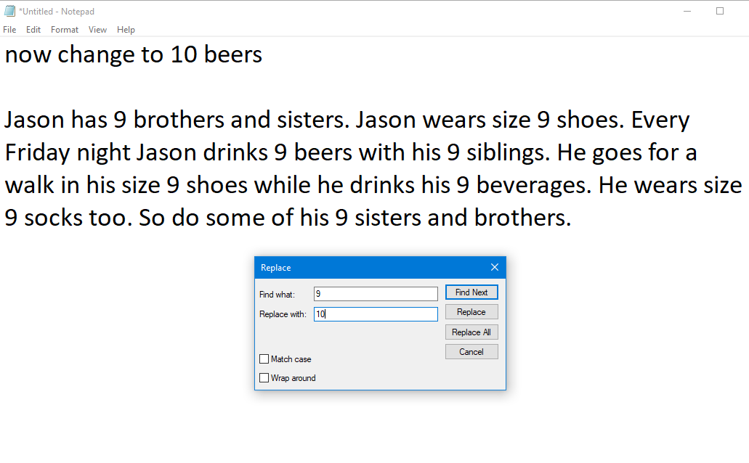
No magic numbers

