Slide 1
COMP2501 Lesson 4
Programming Fundamentals Part 2

Slide 2
Lesson 4 topics
Comparing Java to Python: exception handling
Data validation with Java constructors and exception handling

Slide 3
Constructor
In Java, the constructor must have the same name as its class
The constructor should have the same visibility as its class too:
public (accessible anywhere) or
default (accessible only in its package)
The constructor is called automatically when an object is created; e.g. Movie = new Movie(“Groundhog Day”);
The constructor’s job is to validate data before setting it
If the parameters have invalid data, an Exception can be thrown
When a constructor is invoked, either an object of that class is created, or an Exception is thrown instead
We don’t want an object created, with bad data values in it

Slide 4
Python vs. Java: Constructor Exceptions
employee.py | main.py
class Employee: MIN_WEIGHT_LB = 40 MAX_WEIGHT_LB = 1000 def __init__(self, last_name, weight_lb): """ :param last_name: The last name of the Employee. :param weight_lb: The weight of the Employee, in pounds. :raise ValueError: If last_name is None or is empty. :raise ValueError: If weight_lb is not between MIN_WEIGHT_LB and MAX_WEIGHT_LB. """ if last_name is None or len(last_name) == 0: raise ValueError("invalid last name") if weight_lb < self.MIN_WEIGHT_LB or weight_lb > self.MAX_WEIGHT_LB: raise ValueError("invalid weight") self.last_name = str(last_name) self.weight_lb = int(weight_lb) | from employee import Employee def main(): try: employee1 = Employee("woods", 200) print(employee1.last_name + " weighs " + str(employee1.weight_lb)) except ValueError as e: print("cannot create employee 1: " + str(e)) finally: print("employee 1 section is done") try: employee2 = Employee("gates", 175) print(employee2.last_name + " weighs " + str(employee2.weight_lb)) except ValueError as e: print("cannot create employee 2: " + str(e)) finally: print("employee 2 section is done") try: employee3 = Employee("", 200) print(employee3.last_name + " weighs " + str(employee3.weight_lb)) except ValueError as e: print("cannot create employee 3: " + str(e)) finally: print("employee 3 section is done") try: employee4 = Employee("harrison", -5) print(employee4.last_name + " weighs " + str(employee4.weight_lb)) except ValueError as e: print("cannot create employee 4: " + str(e)) finally: print("employee 4 section is done") if __name__ == '__main__': main()

Slide 5
Python vs. Java: Constructor Exceptions
Employee.java | Employee.java | Main.java
public class Employee { private String lastName; private int weightLb; public static final int MIN_WEIGHT_LB = 50; public static final int MAX_WEIGHT_LB = 1000; /** * @param lastName the last name of the Employee * @param weightLb the weight of the Employee, in pounds */ public Employee(final String lastName, final int weightLb) { if(lastName == null || lastName.isBlank()) { throw new IllegalArgumentException("invalid last name"); } setWeightLb(weightLb); this.lastName = lastName; } | /** * @return the last name of the Employee */ public String getLastName() { return lastName; } /** * @return the weight of the Employee, in pounds */ public int getWeightLb() { return weightLb; } /** * @param weightLb the new weight of the Employee, in pounds */ public final void setWeightLb(final int weightLb) { if(weightLb < MIN_WEIGHT_LB || weightLb > MAX_WEIGHT_LB) { throw new IllegalArgumentException("invalid weight"); } this.weightLb = weightLb; } } | public class Main { public static void main(final String[] args) { try { Employee employee1 = new Employee("woods", 200); System.out.println(employee1.getLastName() + " weighs " + employee1.getWeightLb()); } catch(final IllegalArgumentException e) { System.out.println("cannot create employee 1: " + e.getMessage()); } finally { System.out.println("employee 1 section is done"); } /* NOTE: static means “one single value exists, and it belongs to the class, not to individual objects” */

Slide 6
Python vs. Java: Constructor Exceptions
Main.java | Main.java | Main.java
try { Employee employee2 = new Employee("gates", 175); System.out.println(employee2.getLastName() + " weighs " + employee2.getWeightLb()); } catch(final IllegalArgumentException e) { System.out.println("cannot create employee 2: " + e.getMessage()); } finally { System.out.println("employee 2 section is done"); } | try { Employee employee3 = new Employee("", 200); System.out.println(employee3.getLastName() + " weighs " + employee3.getWeightLb()); } catch(final IllegalArgumentException e) { System.out.println("cannot create employee 3: " + e.getMessage()); } finally { System.out.println("employee 3 section is done"); } | try { Employee employee4 = new Employee("harrison", -5); System.out.println(employee4.getLastName() + " weighs " + employee4.getWeightLb()); } catch(final IllegalArgumentException e) { System.out.println("cannot create employee 4: " + e.getMessage()); } finally { System.out.println("employee 4 section is done"); } } }

Slide 7
Java Exceptions
There are various “categories” of Exceptions that can be thrown
Checked Exceptions: must be declared; must be wrapped in try/catch
Unchecked Exceptions: optionally can be in try/catch (aka RuntimeException)
Custom Exceptions: make your own (checked or unchecked) Exceptions
Use checked exceptions when things are likely to go wrong, and can be handled: this forces other code to use try/catch and forces the thrower to declare that it throws; checked at compile time
Use unchecked exceptions when things are unlikely to go wrong
Use custom exceptions only if they add lots of readability and value; otherwise stick to the normal Java Exception classes

Slide 8
Custom Exceptions
A custom Exception class can help add readability
Good idea: IllegalChessMoveException
Bad idea: IllegalLastNameException
Use IllegalArgumentException instead of something such as IllegalLastNameException
Java developers are used to the IllegalArgumentException
IllegalLastNameException doesn’t add much more information
IllegalChessMoveException (in a Chess class) could be helpful though

Slide 9
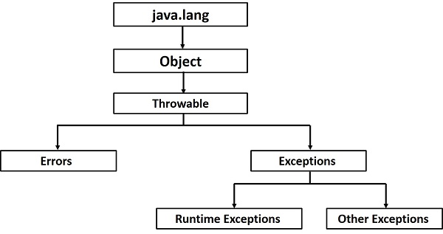
Java Exceptions
Runtime Exceptions are unchecked (no need for try/catch; no need to declare with throws declaration)

Slide 10
Custom Exceptions
Classes that extend RuntimeException are unchecked:
no try/catch needed
no throws declaration needed
The following custom Exception class extends Exception (not RuntimeException), so it is a checked Exception:
try/catch is mandatory (or the class will not even compile)
throws declaration is mandatory (or the class will not even compile)
Also let’s use the @throws Javadoc tag too, from the method/constructor that throws it
class IllegalChessMoveException extends Exception // not “extends RuntimeException” (unchecked)
{
IllegalChessMoveException(final String message)
{
super(message);
}
}

Slide 11
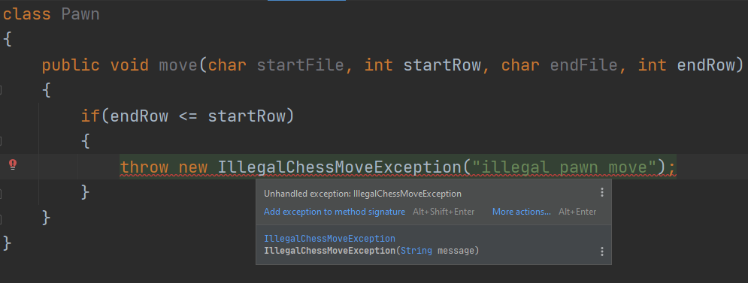
Checked Exception: must declare it throws

Slide 12
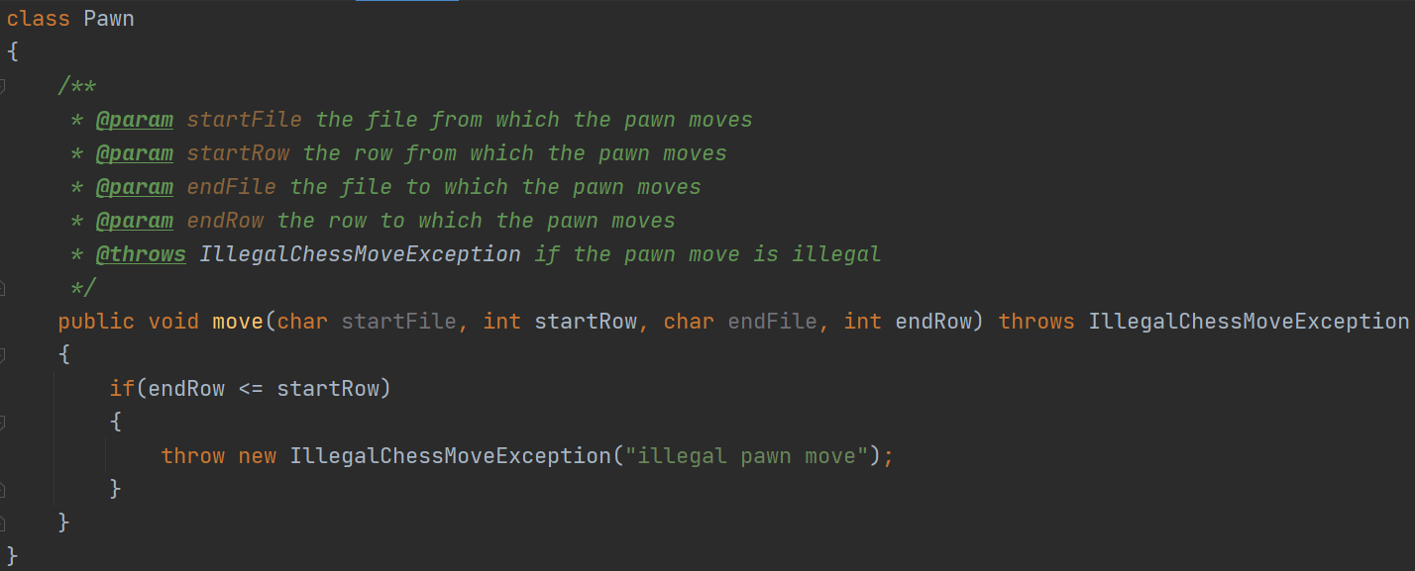
Checked Exception: must declare it throws

Slide 13
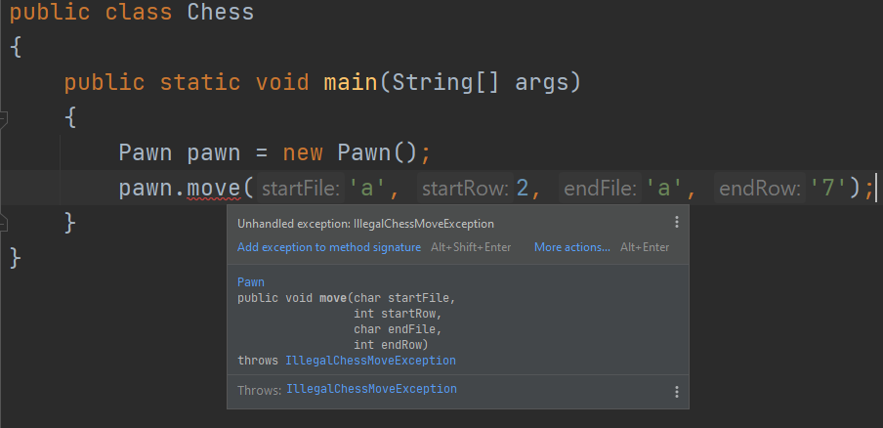
Checked Exception: must try/catch
Note that this will not even compile unless we wrap it in a try/catch (or change IllegalChessMoveException to unchecked by changing its parent to RuntimeException)

Slide 14
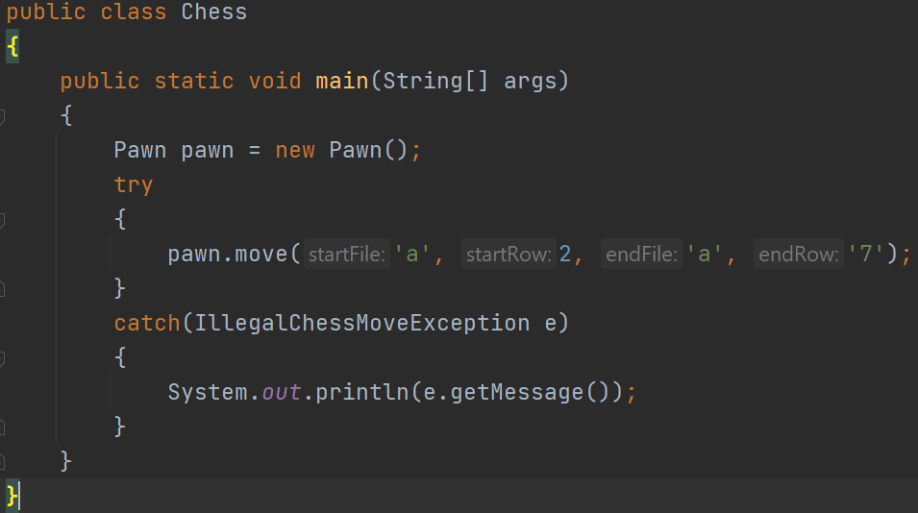
Checked Exception: must try/catch
It compiles now

Slide 15
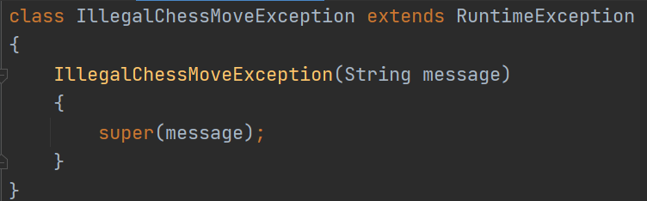
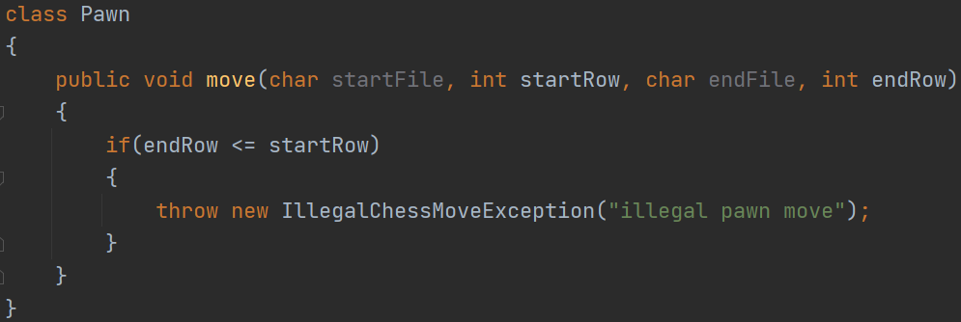
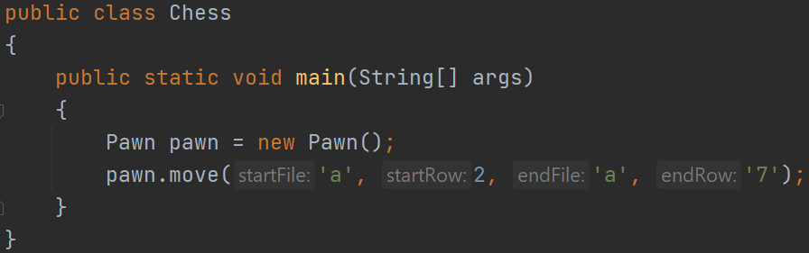
Unchecked Exception: try/catch is optional
move() throws declaration is also optional
Usually, it’s a bad idea to treat an unchecked Exception like a checked one

Slide 16
Constructor validation
Our constructor must validate parameter data before initializing instance variables
We can call our own set methods from our constructor, but only if we are careful: at a minimum those set methods should be private and/or final (more on this later)

Slide 17
Lab 4
Lab 4
Do with a different partner than previous labs
Each partner submits their own copy
Due before the start of next lesson
Just one lab this lesson
There is a quiz next lesson also

