Slide 1
COMP2501 Lesson 9
Programming Fundamentals Part 2

Slide 2
Main concepts to be covered
Inheritance
Subtyping
Substitution
Notes:
Objects First with Java
© David J. Barnes and Michael Kölling
2

Slide 3
Consider the following classes
Car
make
model
modelYear
numPassengers
color
kmPerLiter
Airplane
make
model
modelYear
numPassengers
color
wingspanFeet
maxCargoKg
Boat
make
model
modelYear
numPassengers
color
displacementL
skiPackage
What do you notice about the fields?
What design principle needs to be reconsidered?
Notes:
Objects First with Java
© David J. Barnes and Michael Kölling
3

Slide 4
Duplication Revisited
We discussed earlier that code duplication is something to avoid.
This applies across multiple classes as well.
The previous classes not only have duplication in the fields, but there would also be duplication in the constructors and methods, and the unit tests.
The duplication would cascade into other classes as well.

Slide 5
Collecting Cars, Airplane and Boats
If we were to create a fourth class (“Vehicle”) that acted as an umbrella type for the three other types, that class would also have duplication
Storage
ArrayList<Car>
ArrayList<Airplane>
ArrayList<Boat>
add(car)
add(plane)
add(boat)
displayCars()
displayPlanes()
displayBoats()
...

Slide 6
Inheritance
It is a mechanism where you can to derive a class from another class for a hierarchy of classes that share a set of attributes and methods.
In other words, it is the process of combining common features (in the parent class) while still maintaining class uniqueness (in the child).
Creating class hierarchies allows us to meet many of our design goals.

Slide 7
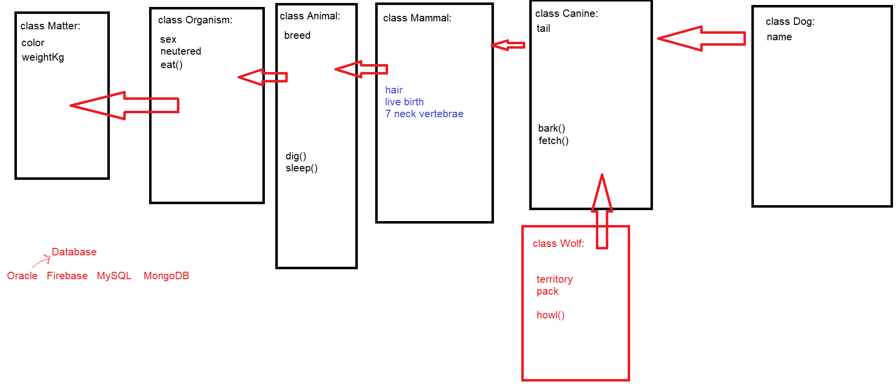
Inheritance Hierarchy

Slide 8
Inheritance Setup
Here way say Car, Airplane and Boat “inherit from” (or “extend” Vehicle
Superclass (Parent, Base)
Vehicle
make
model
modelYear
numPassengers
color
Subclass (Child, Derived)
Car
kmPerLiter
Airplane
wingspanFeet
maxCargoKg
Boat
displacementL
skiPackage

Slide 9
Using Inheritance - Subtyping
define one superclass : Vehicle
define subclasses for Car, Airplane, Boat
the superclass defines common attributes (via fields)
the subclasses inherit “common” things from the superclass
the subclasses add “unique” details
This is called SUBTYPING
Notes:
Objects First with Java
© David J. Barnes and Michael Kölling
9

Slide 10
Clarification
A subclass inherits any data/methods that are NOT PRIVATE from the superclass
This means the subclass cannot see the private fields of the superclass, but does see the non-private (i.e. public or package-private “default”) getters and setters, and other non-private members
How?
public class Car extends Vehicle
WARNING: Java supports only single class inheritance, which means that a class can have only one superclass.

Slide 11
toString() Revisited
for Debugging supertypes and subtypes can implement toString()
If we are going to display the contents of a subtype then its toString() implementation must also reference the superType toString() because much of the information is held in the supertype
Eg.,
@Override
public String toString() {
return "Car [kmPerLiter =" + kmPerLiter + ", toString()=" + super.toString() + "]";
}

Slide 12
super()
The keyword “super” is used within the subtype to reference non-private members of the supertype
super() – is a call to the supertype’s constructor
this is necessary since a subtype Object cannot exist unless a supertype Object is created first
E.g. when constructing a Car, first we construct a Vehicle
You can’t build a high rise building without building the first floor first.
Not only do we have class hierarchies, but we also have runtime Object hierarchies.
Supertype will implement a default constructor (if no constructor is provided) because super() call is implicit. Without it the code will not compile.

Slide 13
Demo
Enough talk! Let’s build Vehicle, Car, Airplane, and Boat.
we will cover in the demo
Constructors
Object hierarchy (not same as class hierarchy)
super();

Slide 14
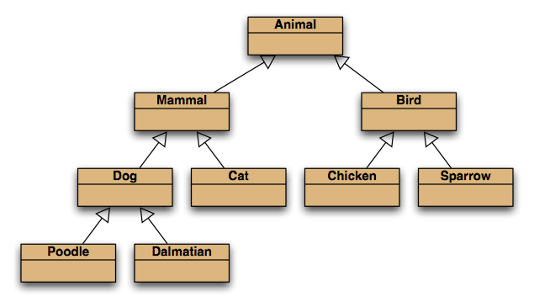


My favourite inheritance slide
“is a” relationships
Notes:
Objects First with Java
© David J. Barnes and Michael Kölling
14
inheritance hierarchies are nothing unusual. we see them all the time.
(a masters student is a students is a person...)

Slide 15
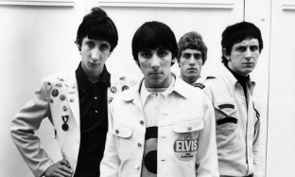
Using Inheritance - Substitution
But I'm a substitute for another guy I look pretty tall but my heels are high The simple things you see are all complicated I look pretty young, but I'm just back-dated, yeah
The Who, 1965
With an “is a” relationship SUBSTITUTION is possible
Subclass address can be stored in a superclass type reference
Eg.
Vehicle vehicle = new Car(...);
although it looks like a Vehicle its actually a Car
Why?
means any subtype can be “treated” as a supertype
IMPORTANT: The actual object type can never change. The above Car will always be a Car object. Only the reference type changes, not the address.

Slide 16
Substitution Benefit #1
eliminates more duplication
Eg.
List<Vehicle> vehicles;
can hold any subtype address, which means I can store Car, Airplane, and Boat references in the same ArrayList. I don’t need a separate ArrayList for each subtype
I need only one “add” method and only one “display” method now

Slide 17
Substitution Benefit #2
Come back next week.

Slide 18
“instanceof” Operator
not to be confused with instant coffee, this operator is used to reveal the actual object type
With substitution the actual object type can get lost
Vehicle vehicle = new Car(...);
for the rest of the program run it looks like a vehicle
this means that subtype methods cannot be called with a supertype reference
At some point we may want to get back to the original type so that method calls can be resolved
if(vehicle instanceof Car)
Car aCar = (Car)vehicle;
with the above cast we can now call Car methods

Slide 19
Demo again
Yadda, yadda, yadda! Let’s build the Storage class.

Slide 20
Substitution Issue: Casting
We can assign subtype to supertype …
… but we cannot assign supertype to subtype! Vehicle v; Car c = new Car(); v = c; // correct; this is substitution c = v; // compile-time error!
Casting fixes this: c = (Car)v; (only ok if the vehicle really is a Car!)
Runtime reminded that Vehicle v holds a Car address
Notes:
Objects First with Java
© David J. Barnes and Michael Kölling
20

Slide 21
WARNING: Casting
An object type in parentheses; e.g. Dog d = (Dog)animal;
Used to overcome 'type loss’: we can now use Dog methods.
The object is not changed in any way.
A runtime check is made to ensure the object really is of that type:
ClassCastException if it isn’t! e.g. Try to cast a Cat to a Dog.
Traditionally developers hate casting. It muddies up the code and causes complications down the road. Use it sparingly.
Notes:
Objects First with Java
© David J. Barnes and Michael Kölling
21

