Slide 1
MLOps Pipeline: Dry Bean Classification
- UCI Dry Bean: 13,611 samples, 16 shape features, 7 classes
- Stack: DVC - MLflow - Kubeflow Pipelines - Feast - Vertex AI
- Name / Reg. No.: ____________

Slide 2
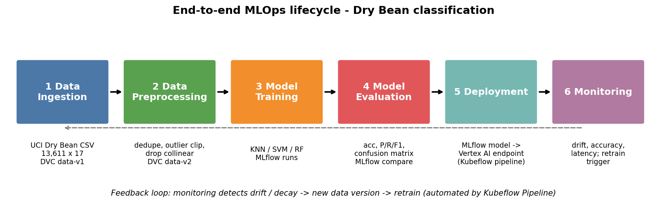
1. End-to-end lifecycle
- Ingest, preprocess, train, evaluate, deploy, monitor; drift triggers retraining

Slide 3
2. DVC data versions
- data-v1: original, 13,611 x 17, 3.8 MB
- data-v2: -68 duplicates, outliers clipped, 5 collinear features dropped: 13,543 x 12, 2.75 MB
- Git holds a tiny .dvc pointer; md5 logged in every MLflow run
- Demo: git diff data-v1 data-v2; dvc get --rev

Slide 4
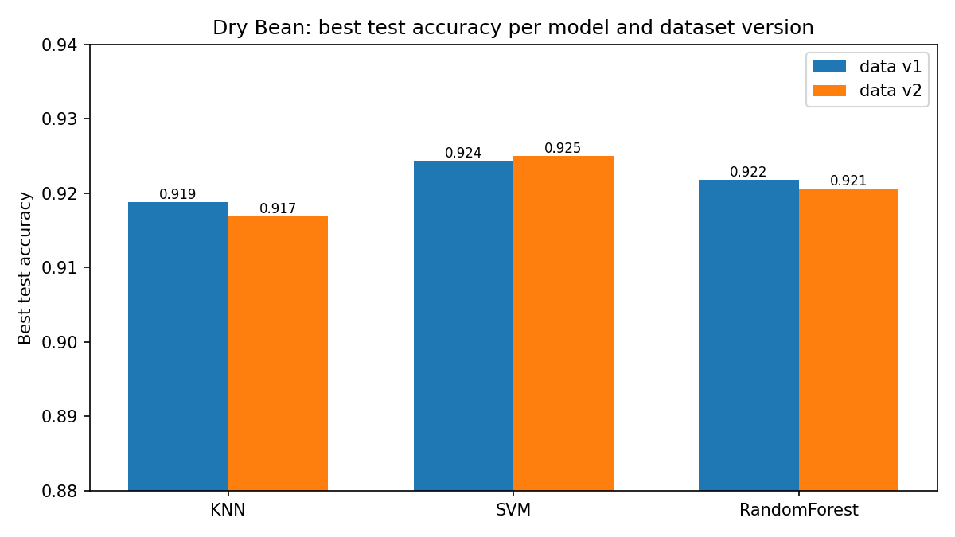
3. MLflow experiments (12 runs)
- KNN, SVM, RF x 2 settings x 2 data versions
- Best: SVM C=10, test acc 0.925, F1 0.925
- KNN-15 and RF-300: 100% train acc, overfit
- v2 gain is small: honest result
- Demo: mlflow ui, compare runs

Slide 5
4. Kubeflow pipeline
- data_collection, data_validation, train, evaluate, then deploy if accuracy >= 0.90
- KFP v2 compiled to YAML; run_local.py simulates it
- Containers = reproducible; parallel pods + caching = scalable; quality gate protects production

Slide 6
5a. Feast feature store
- Features: Area, AspectRation, ShapeFactor1
- One definition serves training (point-in-time join) and inference (online store)
- Demo: offline and online values identical, so no training/serving skew

Slide 7
5b. SageMaker vs Vertex AI
- Both: managed pipelines, registry, monitoring, endpoints
- SageMaker: Autopilot, serverless/async endpoints, best if data is on AWS
- Vertex AI: AutoML for more modalities, runs KFP YAML natively: our choice
- Cost: pay per node-hour; undeploy idle endpoints

Slide 8
Summary
- Lifecycle automated and versioned: data, code, experiments, features, deployment
- Next: cross-validation, live Vertex deployment, drift monitoring

