Slide 1

Technical Problem Solving
2014 -15

Slide 2
Description:
Teams will be required to answer a question by;
    Gathering data,
    Processing data, and
    Using this data to solve the given problem

Slide 3
Event and Team Parameters:
  Team of up to two
  Eye Protection: #4
  Time Limit: 50 minutes
  Up to 3 events at Regional, State and 2 at the National Tournament.

Slide 4
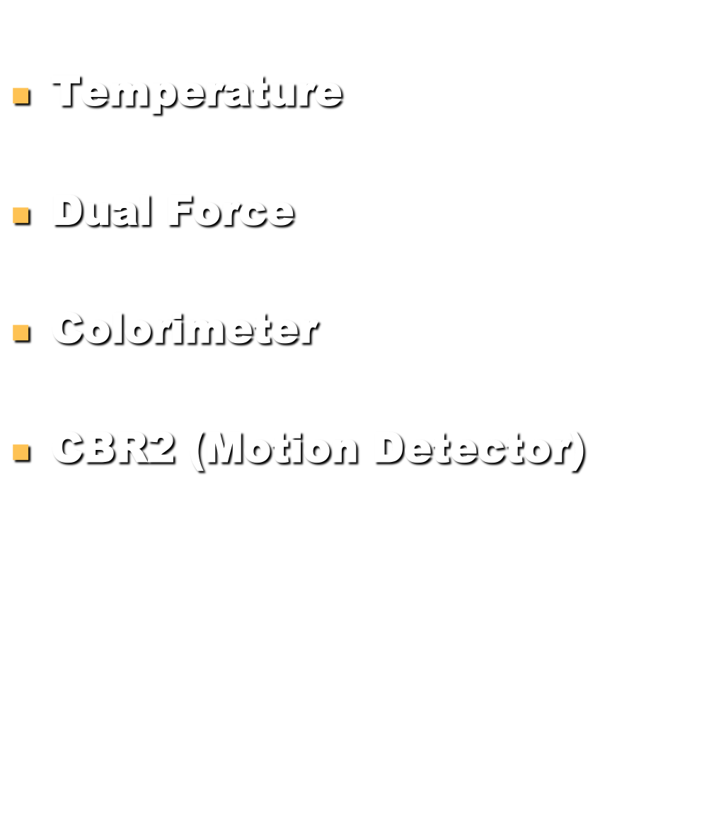
Possible Probes:

Slide 5
Event Topics
Physical Science/Physics/Chemistry
Topic 1 & 2 will focus on the Forensic patterns of the physical evidence associated with a crime scene. The teams will design, conduct, and analyze experiments to solve a proposed crime based on the physical evidence supplied.

Slide 6
2014 -15 TPS
Topic Related Terms

Slide 7
Science Principles
Beer’s Law
Newton’s Law of Cooling
Significant Figures
Random / Systematic Error

Slide 8
Mathematical Principles of Data Handling
  Stat Plot
    Line of Best Fit
    Regressions
  Statistics
    Mean, mode, median
    Standard Deviation
    Normal Distribution

Slide 9
Mathematics (cont.)
  Mathematical Modeling
    Residuals
    R-values
    Correlation coefficient
  Confidence Level
    Interpretation
    Extrapolation
    Significant Figures

Slide 10
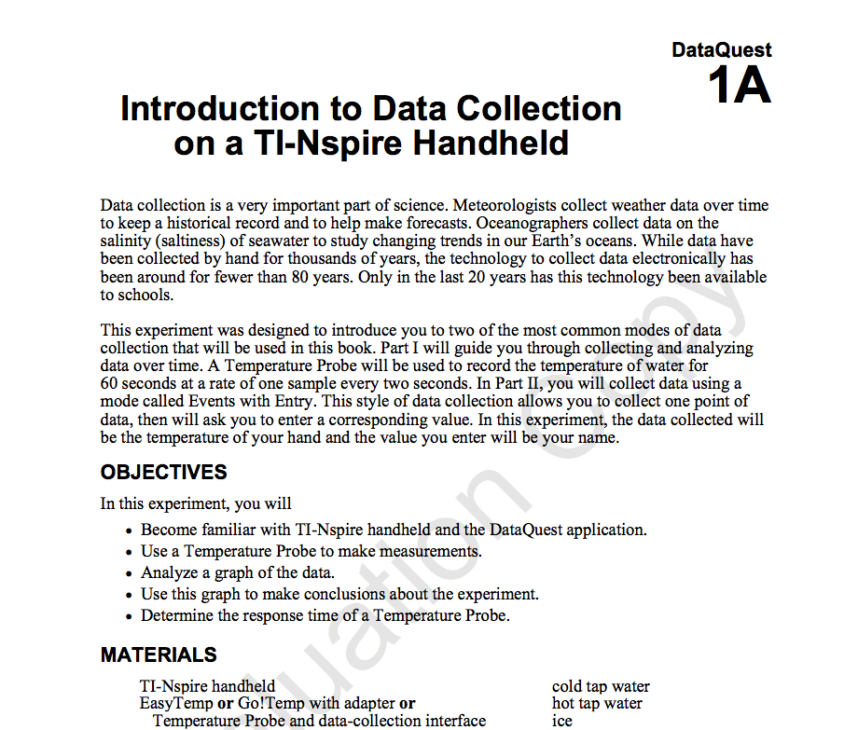
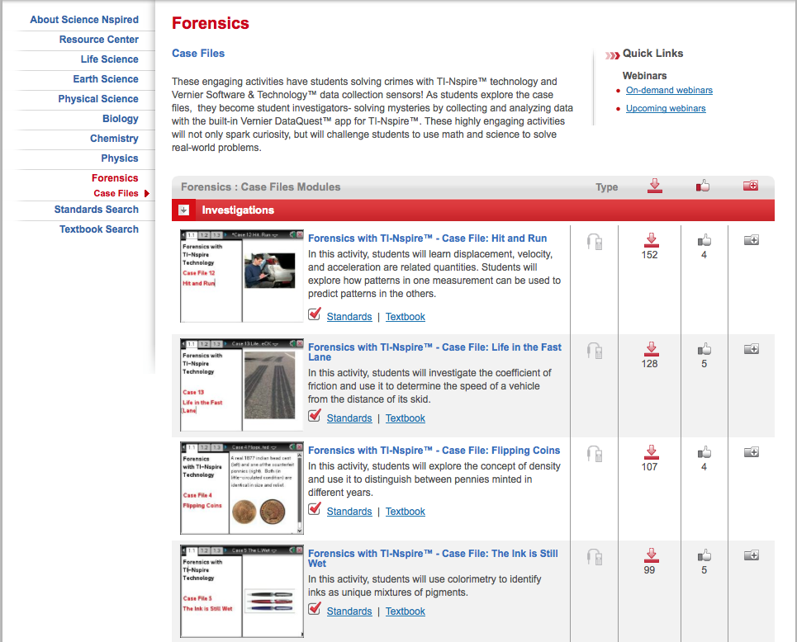

Sample Labs
Data Collection

Slide 11
Scoring
Scoring
2013
  Teams ranked based on the highest total points from the sum of the scores for two stations.
  Station scores based on accuracy (50%), procedure (30%), and content knowledge (20%)
2014
  Teams ranked based on the highest total points from the sum of the scores for two stations.
  Station scores based on accuracy (60%), procedure (20%), and content knowledge (20%)

Slide 12

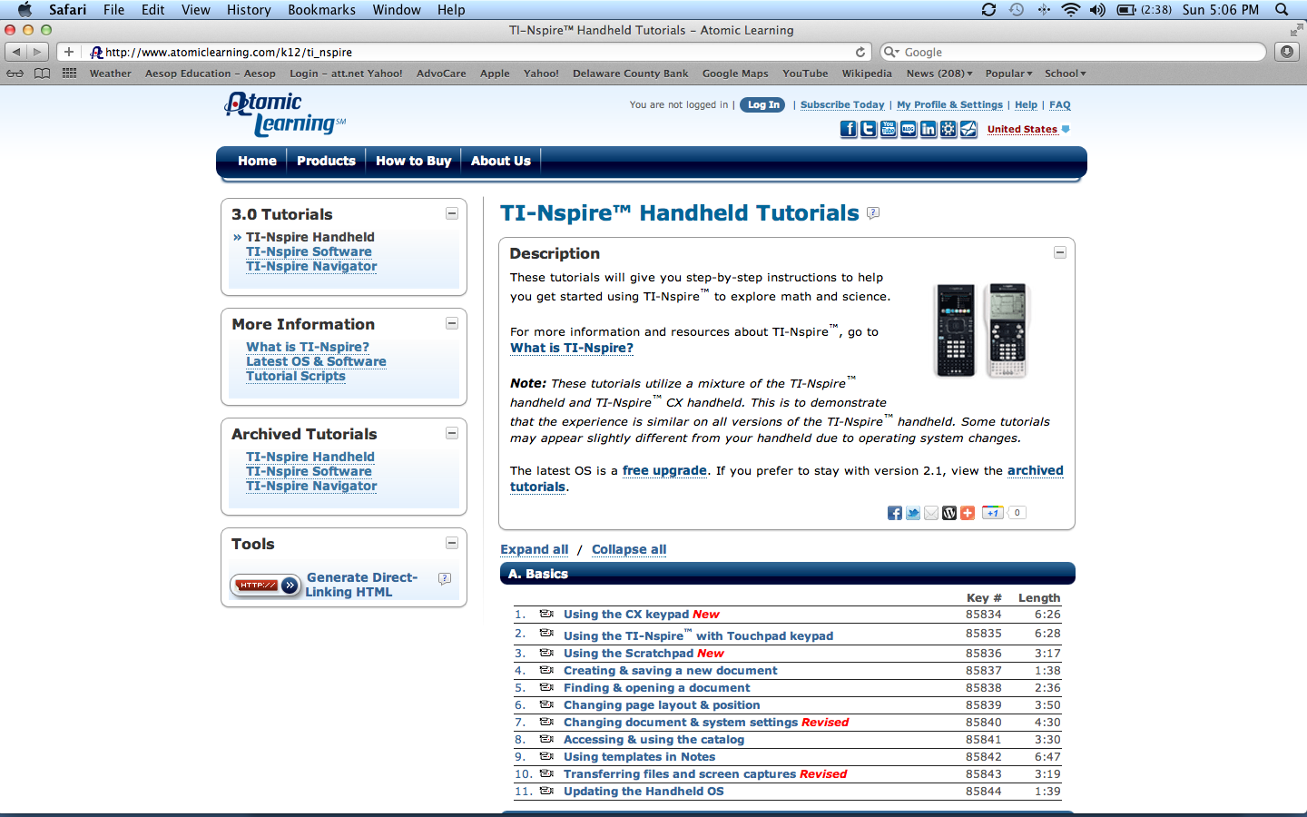

Resources
http://education.ti.com/en/tisciencenspired/us/forensics/case-files
http://www.vernier.com/
http://www.atomiclearning.com/k12/ti_Nspire
http://www.sonic.com

Slide 13

Contact Information

