Slide 1
Python 102
Lecture 1

Slide 2
Class Overview
Welcome
Syllabus and logistics

Slide 3
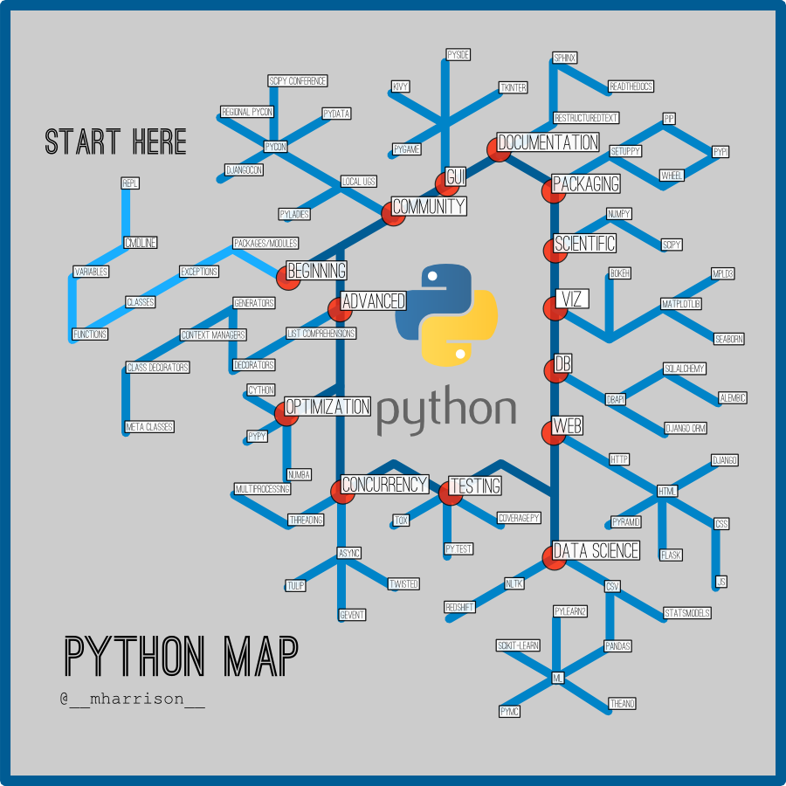
Roadmap

Slide 4
Introductions

Slide 5
Python Interpreter
REPL – read-eval-print loop AKA a language shell.
When you type python into your command prompt and hit enter, you move into the language shell.
Basically, the shell reads your input and stores it in a data structure in memory.
It then evaluates what you entered and processes the results.
It then prints out a response in terms of what it evaluated.
This is in contrast to compiled languages where you have to compile your code into a binary executable
Although there is the concept of compiled code in python – we’ll get to that when we cover modules and packages.

Slide 6
Try it out
Open up a command prompt
Type python and hit enter
You are now in the Python REPL / interpreter
Try printing something to the screen.
print(‘Hello world!’)
Now exit out of the interpreter:
exit()

Slide 7
Python 3 vs Python 2
We will be using python 3 in this class
I had to type python3 to get into my python 3 interpreter. If I just type python, that takes me to the python 2 interpreter.

Slide 8
IDLE
The interpreter is awesome for testing code and mocking out ideas / thoughts. You can also use it as a calculator if you’d like. But, what if you want to write a program and use it later? You don’t want to have to re-type it every single time.
IDLE is python’s default integrated development environment (IDE). It is a lightweight text editor we’ll be using in this lesson.

Slide 9
Try it out
Mac:
F4, type and run IDLE
PC:
Start Menu -> Python 3.5 -> IDLE (Python 3.5 64-bit)
Now, do File->New File
In this new file, enter print(‘Hello World’)
Now, save the file to somewhere on your computer as hello_world.py. I’d recommend a scratch work or temporary directory of sorts. Personally, I created a directory in /Users/czacny/Development/scratchwork
Now open up a command prompt. Run your new program by doing:
python[3] <path_to_your_file>/hello_world.py
Example on my computer: python3 /Users/czacny/Development/scratchwork/hello_world.py

Slide 10
Variables and Data Types
As you know, a variable is something that can be manipulated and or changed
To create a variable in python, you simply do:
variable_name = VALUE
Where VALUE is equal to what you want. Notice that unlike Java, C++, etc, you do not have to explicitly declare your type before you create your variable
Numeric types:
Integers
Floating Point
Complex (imaginary numbers)
Booleans
Can be True or False

Slide 11
Try it out - Integers
Open up IDLE and create a new file called variable_practice.py
Enter the following code:
test_integer = 12
second_test_integer = 67
combined_integer = test_integer + second_test_integer
print(combined_integer)
print(test_integer + second_test_integer)
Now, run your program
Notice that the two print() statements return the same result

Slide 12
Try it out – floating point numbers
Try adding this to your program and running it:
test_float = 3.14159
second_test_float = 213.45
combined_float = test_float + second_test_float
print(combined_float)
print(test_float + second_test_float)
Floating point arithmetic is a very advanced concept in computer science and is beyond the scope of this course, but know that at some point, for values with infinite precision like 1/3, the value will be truncated and rounded based on a set of rules. For most practical purposes, you will not need to worry about it, unless you are working with scientific data. In that case, I’d recommend you read and understand :
https://docs.python.org/3/tutorial/floatingpoint.html

Slide 13
Trying to break stuff
Will this Java code work?
Integer one = 123; Double two = 1.1; Integer answer = one + two;
Will this Python code work?
>>> one = 1234
>>> two = 1.1
>>> answer = one + two

Slide 14
Operators
Test using the standard operators to calculate values
There are a few non self explanatory ones:
% - modulo operator
** or pow()

Slide 15
Strings
format()
>>> my_first_string = 'I like'
>>> my_second_string = 'dogs'
>>> print('{} {}'.format(my_first_string, my_second_string))
>>> print('{1} {0}'.format(my_first_string, my_second_string))
>>> '{0:04d}'.format(12)
Slicing
Basically a way of getting sub strings.
>>> to_slice = 'ABCDEFG’
>>> to_slice[0:2]
'AB'
>>> to_slice[5:7]
'FG'
Very useful for parsing machine readable files / csvs with well-known fixed widths

Slide 16
Taking input from the user and type()
input() function
>>> user_input = input("Please enter an integer: ")
Please enter an integer: 123
>>> type(user_input)
<class 'str'>
>>> user_input + 4
Traceback (most recent call last):
File "<stdin>", line 1, in <module>
TypeError: Can't convert 'int' object to str implicitly
>>> int(user_input) + 4
127

Slide 17
Other Types
https://docs.python.org/3/library/stdtypes.html#built-in-types

Slide 18
Next Steps / Homework
Hacker Rank

