Slide 1
Mental Health Issues in the Tech Industry U.S.A.

Slide 2
What is the employee perception of prejudice against mental health care issues at work in the United States ?
Based on kaggle dataset:
https://www.kaggle.com/osmi/mental-health-in-tech-surve

Slide 3
Perception analysis is based on answer to two questions:
Do you think that discussing a mental health issue with your employer would have negative consequences?
Do you feel that your employer takes mental health as seriously as physical health?

Slide 4
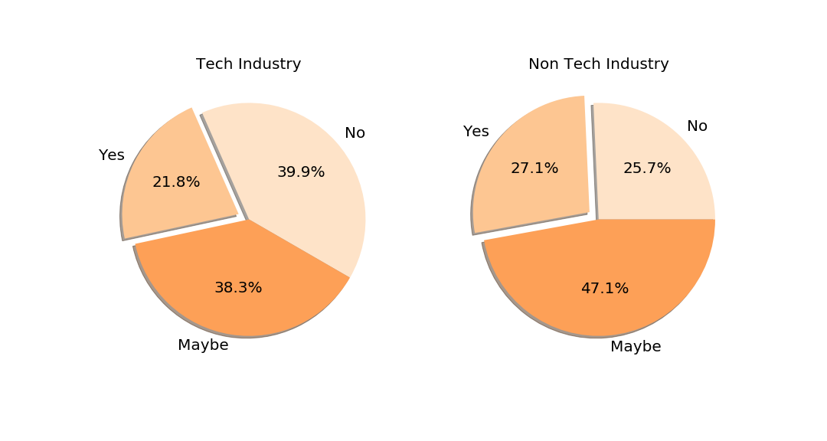
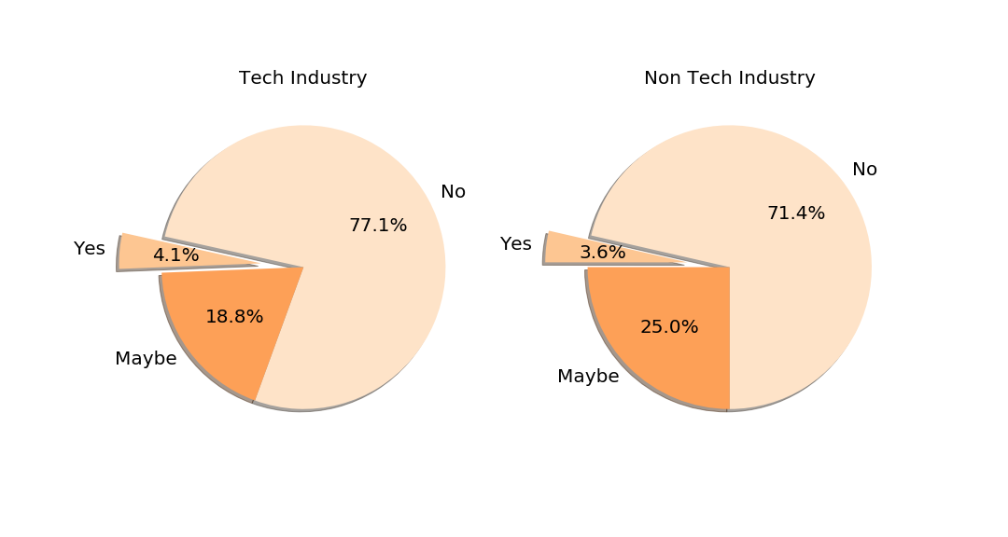
Tech Vs. Non-Tech
Do you think that discussing a mental health issue with
your employer would have negative consequences?
Do you think that discussing a physical health issue with
your employer would have negative consequences?
Discussing mental rather than physical health issues is considered as much more likely to have negative consequences by employees independent of tech or non tech industry
Tech industry wrokers show a little more optimism than others in regards to this question

Slide 5
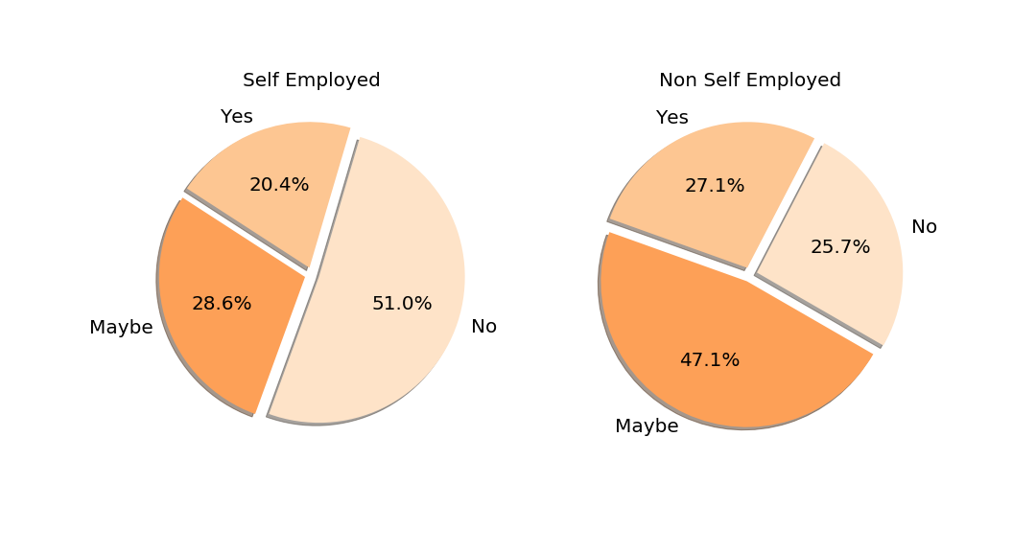
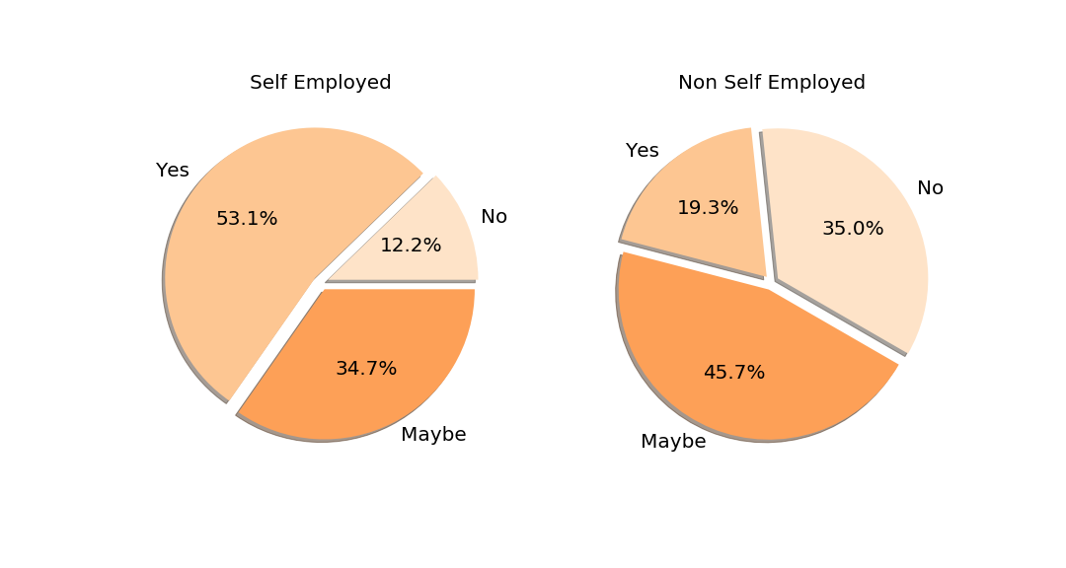
Tech Self Employed versus Other Employed
Do you think that discussing a mental health issue with
your employer would have negative consequences?
Do you feel that your employer takes mental health as seriously as physical health?
Both questions showing that self employed people are more optimistic about the openess in discussing mental health issues in the workplace.
The absence of a reporting hierarchy might play a role in these oppinions.

Slide 6
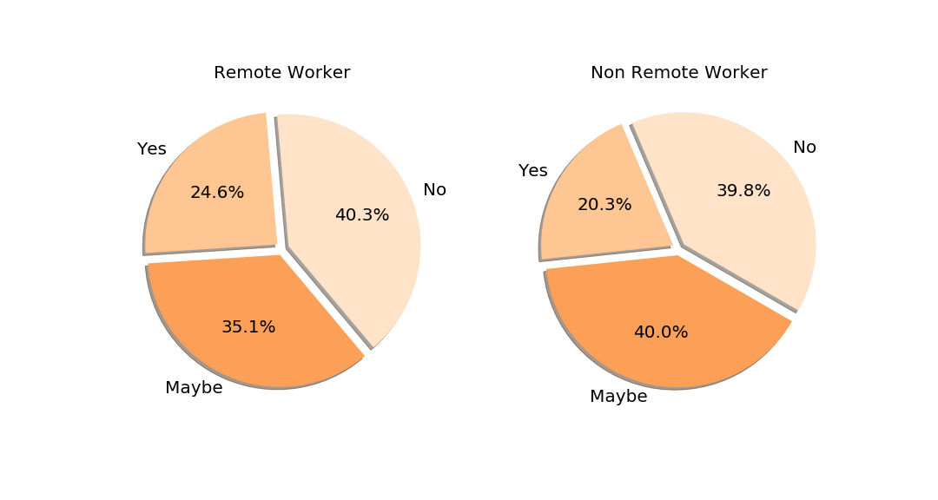
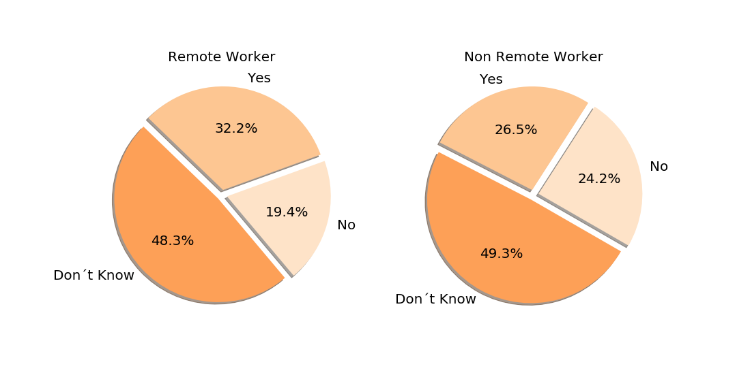
Tech Remote Workers versus Campus Workers
Do you think that discussing a mental health issue with
your employer would have negative consequences?
Do you feel that your employer takes mental health as seriously as physical health?
Remote Work is not a significant factor in determining workers oppinion on this subject.

Slide 7
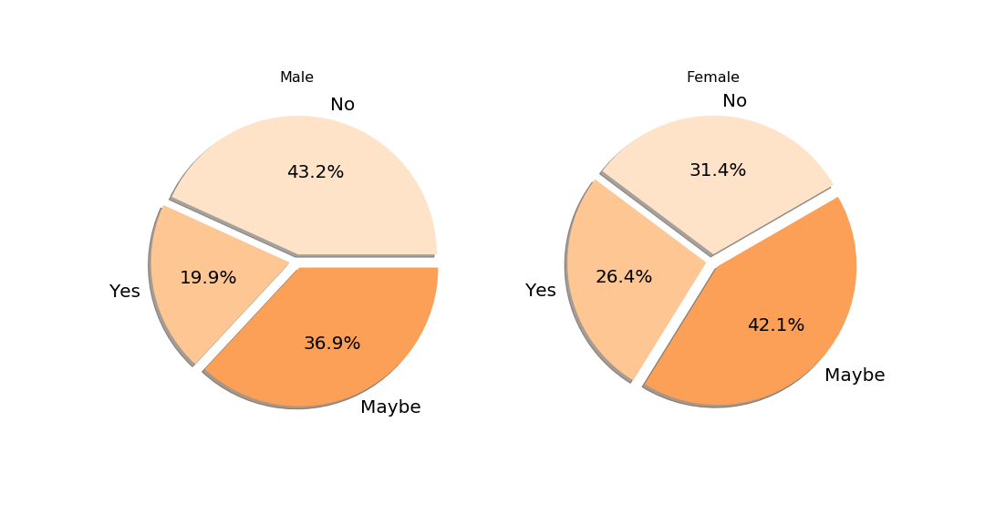
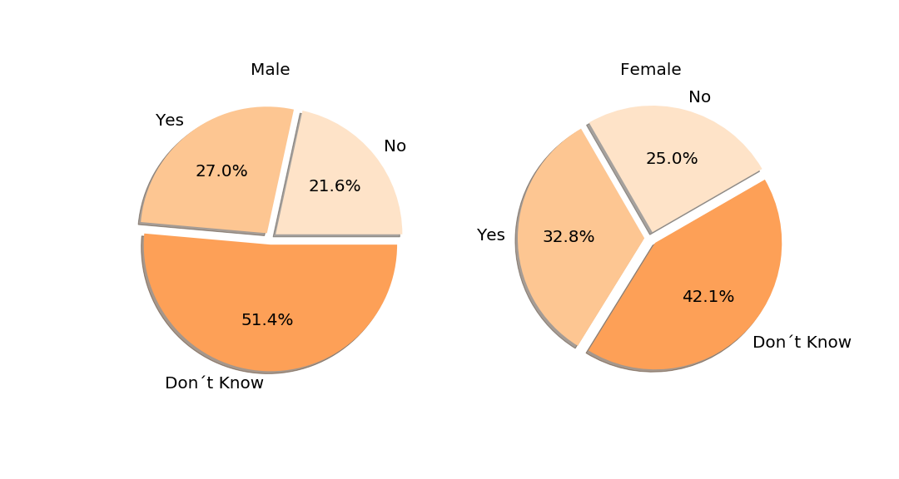
Tech Gender
Do you think that discussing a mental health issue with
your employer would have negative consequences?
Do you feel that your employer takes mental health as seriously as physical health?
Women are more pessimistic than man on the first question
On the second question results are similar.

Slide 8
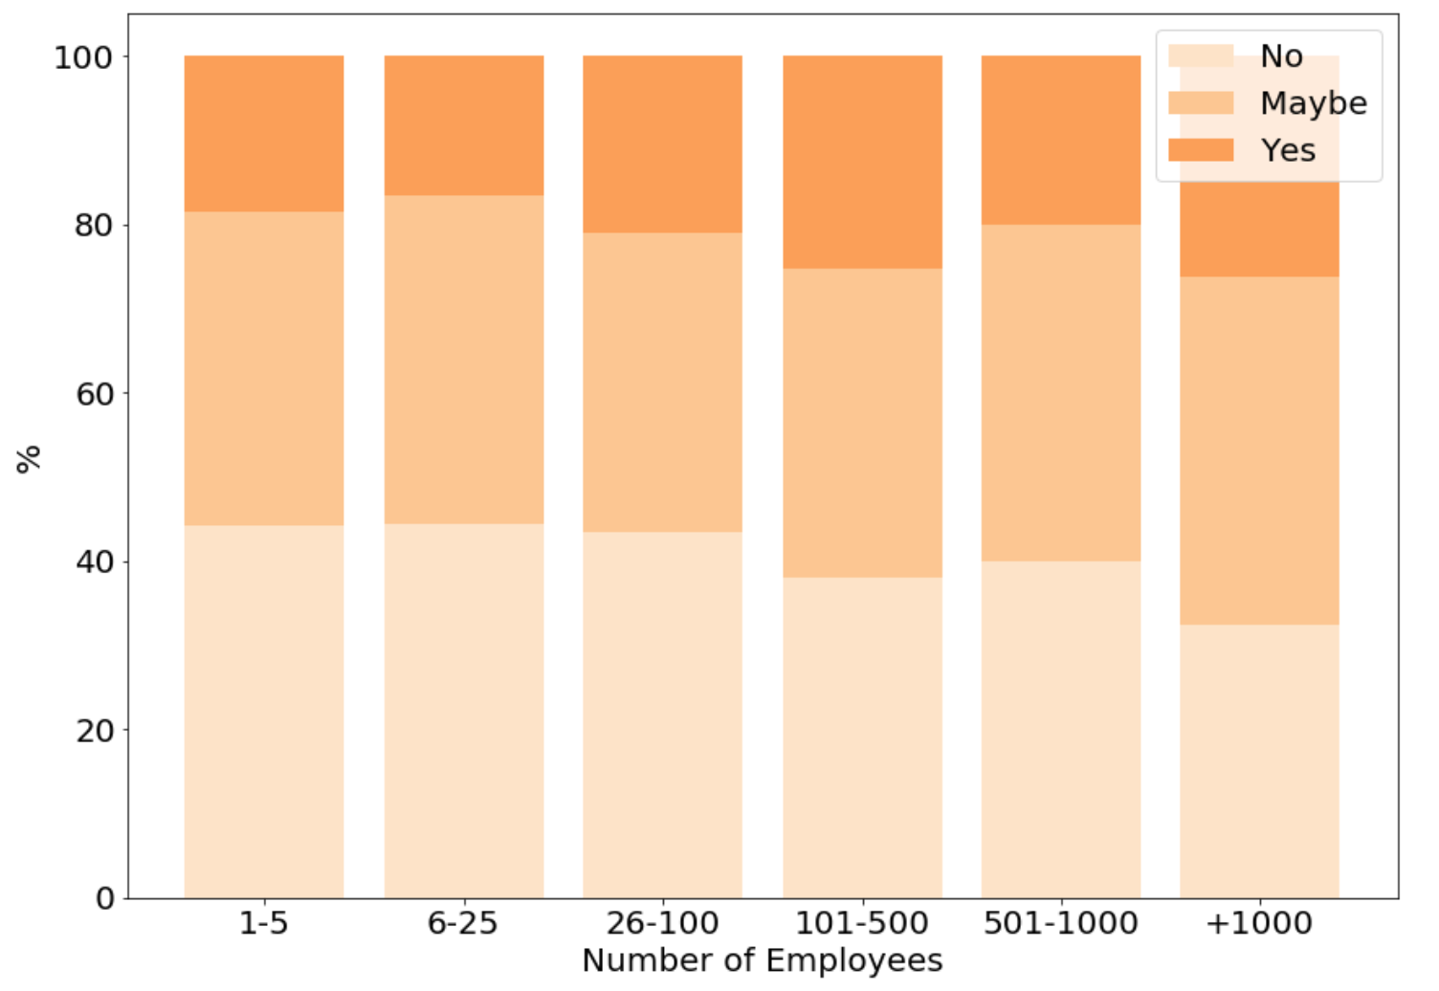
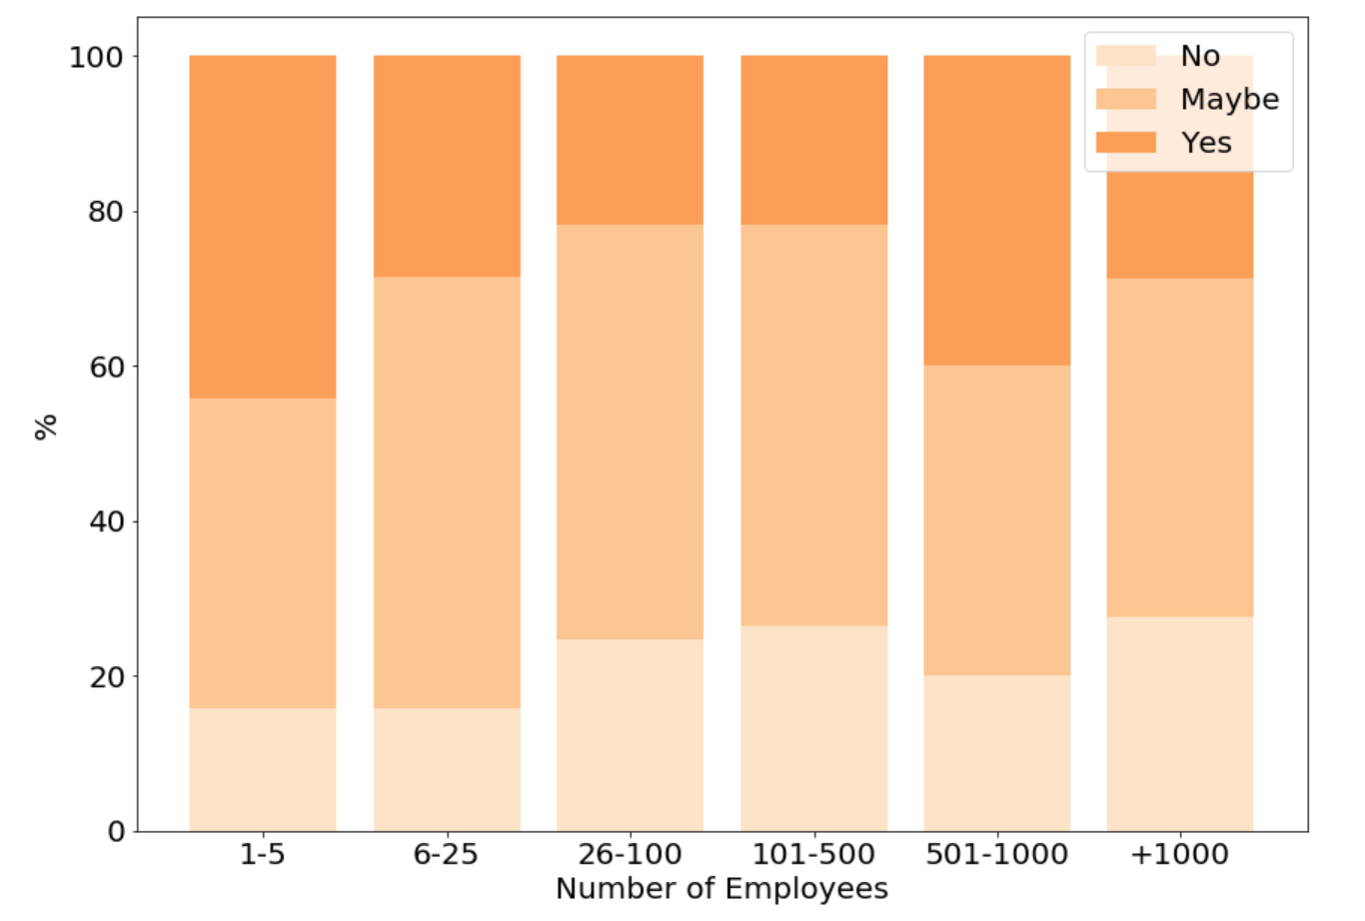
Tech Size of Company
Do you think that discussing a mental health issue with
your employer would have negative consequences?
Do you feel that your employer takes mental health as seriously as physical health?
In general, the larger the company, the less optmistic the employees are about their employer´s acceptance of mental health as a whole.

Slide 9
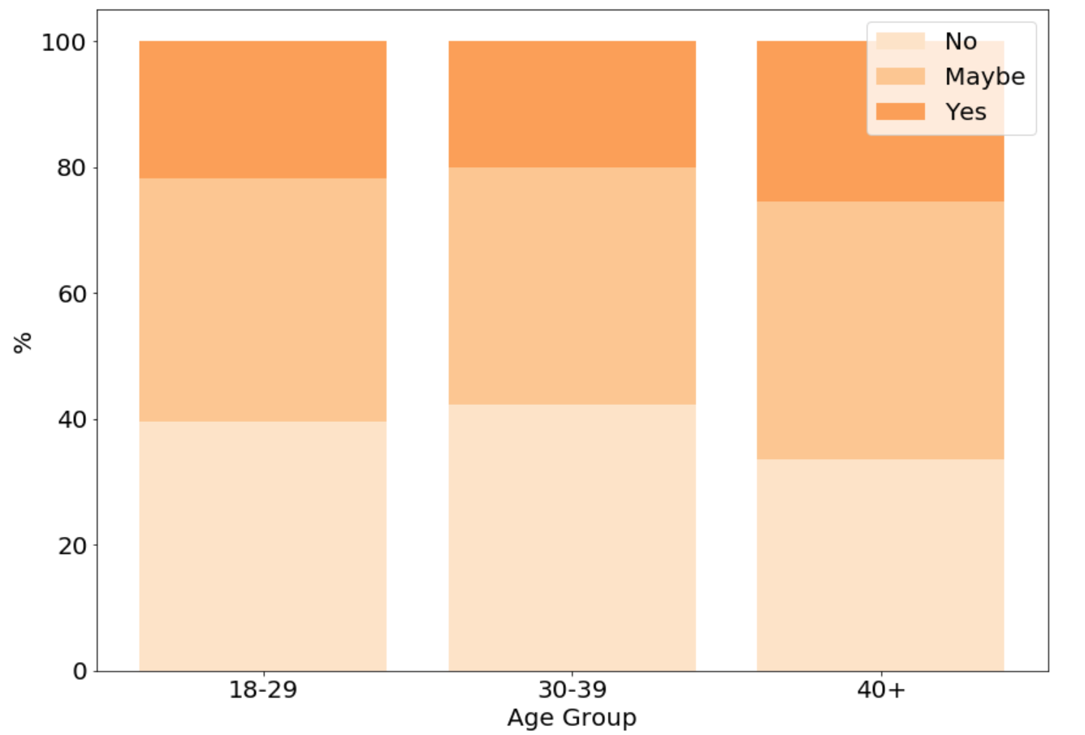
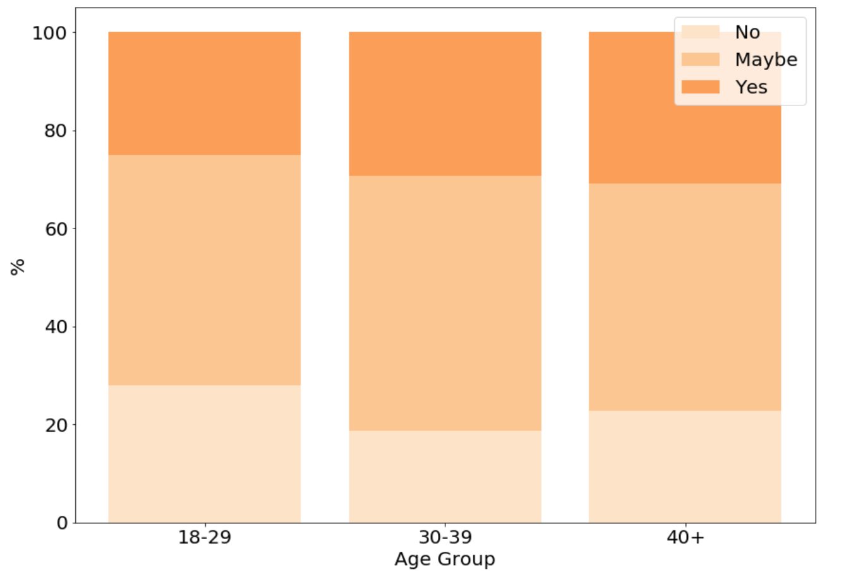
Tech by Age Group
Do you think that discussing a mental health issue with
your employer would have negative consequences?
Do you feel that your employer takes mental health as seriously as physical health?
Small differences between age groups.

Slide 10
In order to understand wether the perceptions are actually based on observation, answers to the additional question below have been analysed.
Have you heard of or observed negative consequences for co-workers with mental health conditions in your workplace?

Slide 11
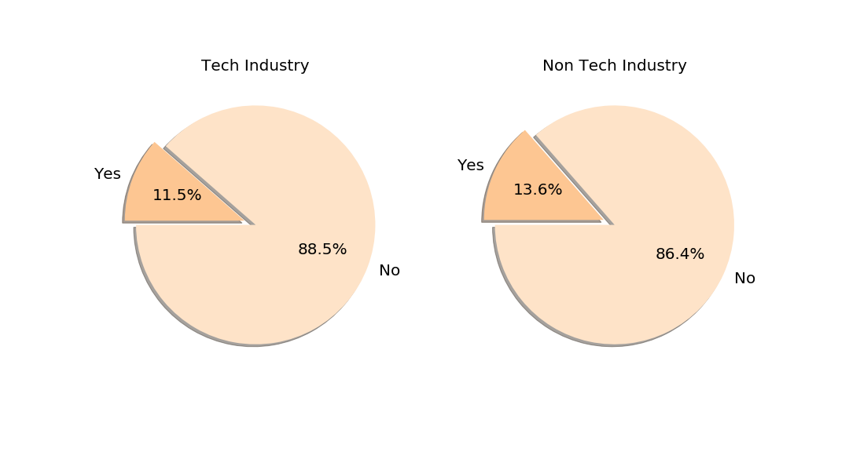
Tech Vs. Non-Tech
Have you heard of or observed negative consequences for co-workers with mental health conditions in your workplace?
In both sets, percentage of cases where is the worker actually had knowledge of real cases impacting the career is small.
This does not mean there aren´t more cases, given the “culture of silence” that is shown by the data in previous slides.

Slide 12
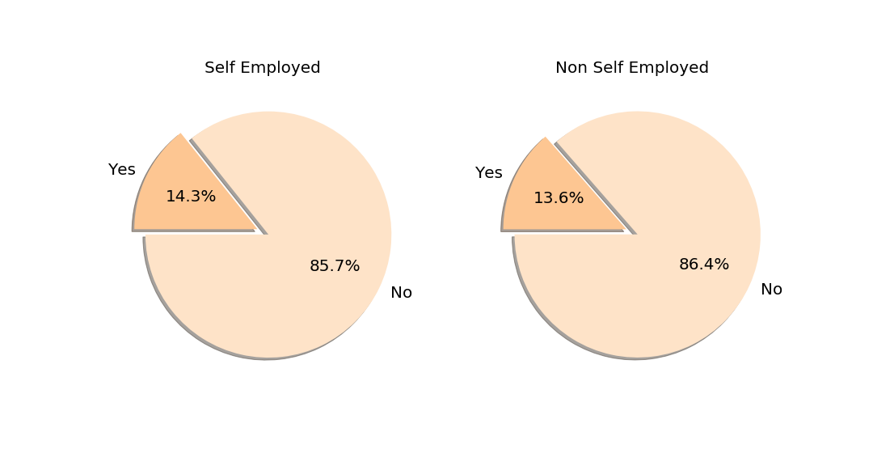
Tech Self Employed versus Other Employed
Have you heard of or observed negative consequences for co-workers with mental health conditions in your workplace?
Type of employment does not play a role in knowledge of these cases.

Slide 13
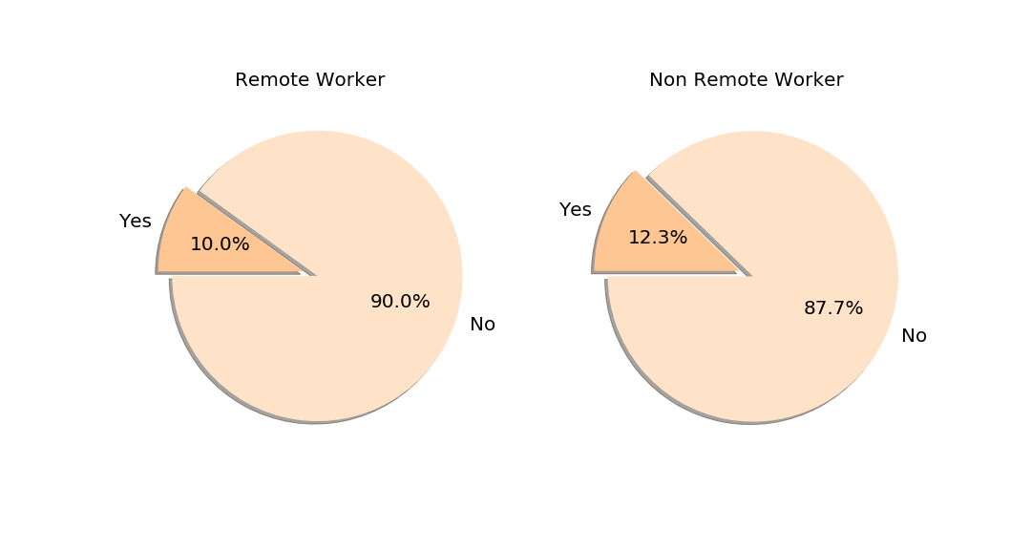
Tech Remote Workers versus Campus Workers
Have you heard of or observed negative consequences for co-workers with mental health conditions in your workplace?
Not a factor in awareness of these cases

Slide 14
Tech Gender
Have you heard of or observed negative consequences for co-workers with mental health conditions in your workplace?
Not a factor in awareness of these cases

Slide 15
Conclusions
Most employees in the US consider there is prejudice against mental illness in the work place. The tech industry is slightly more tolerant but prejudice is nevertheless clearly present.
Self employed people in tech tend to be more optimistic about the prejudice towards mental health issues than the ones employed by others.
Women are more prone than men to believe that reporting mental illness will harm their career.
People in bigger companies are more pessimistic about reporting mental health care problems than in smaller ones.
Above results are transversal through age groups.
The vast majority of workers reports no knowledge of cases where mental health issues had negative consequences to the worker, in spite of the conclusions above.
There is still a ”culture of silence” around mental health issues, as shown by the points above

Slide 16
Future Work
Analyse pending questions related to employee attitude towards mental illness discussion
Analyse employee awareness data and cross with employee perception.
Analyse specific group of people that actually report suffering mental illness.

