Slide 1
Simulation– multiple SNPs

Slide 2
Continuous traits
Total heritability = 0.2, 0.25, 0.3,[5e-6,5e-8]
Total Significant SNPs = 50, P=50,TP=45,FN=5,TPR=TP/P=45/50.
MAF – 5 groups: [0.05,0.1],[0.1,0.15],[0.15,0.2],[0.2,0.3],[0.3,0.4]
Effect sizes – [1.5,2] + rnorm(num_patients,Sd^2). Sd = [0,0.4]
Sample size: SS, MIX.
Step 1: given effect sizes, maf, get the variance in the regression model.
Step 2: given pre-specified sample sizes for the original study and replications, generate datasets.
Step 3: Achieve ABF using the derived function. P(H1)/p(H0) = 1e-5.

Slide 3
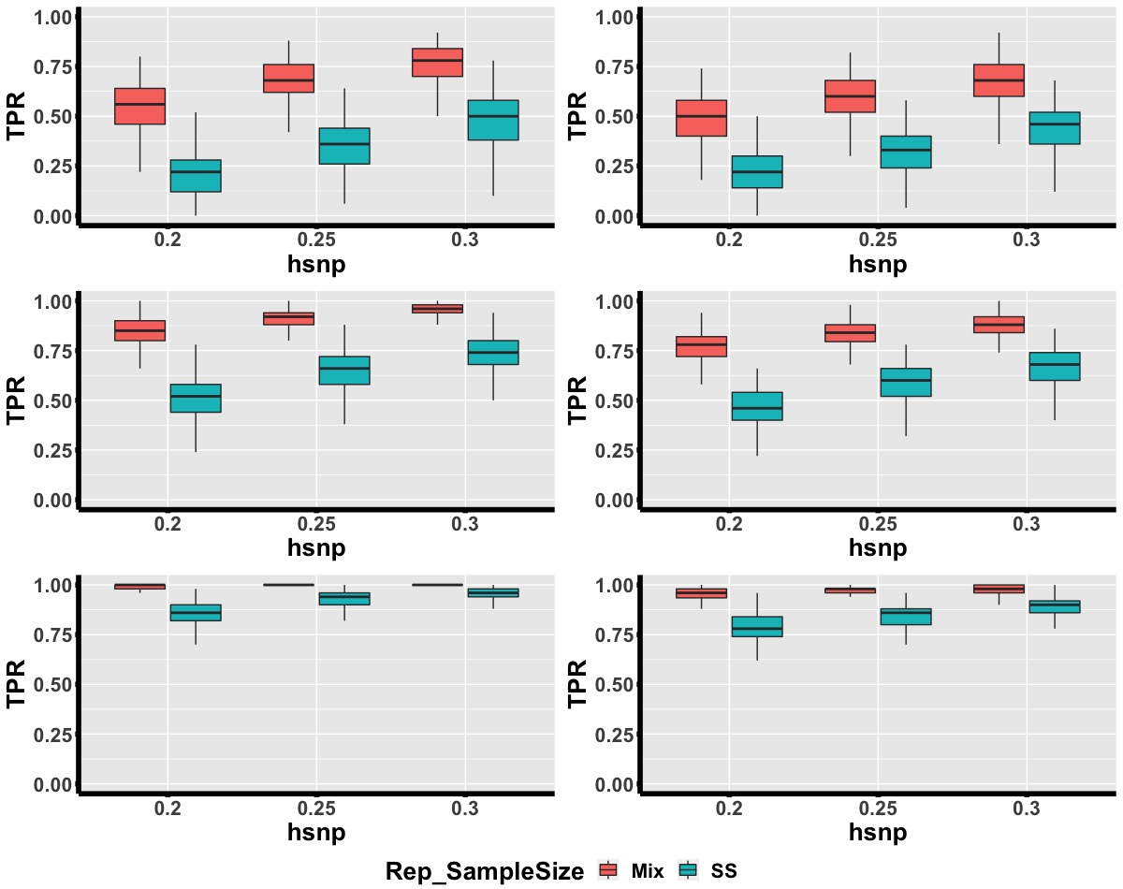
No Heterogeneity
Exist Heterogeneity
M=3
M=5
M=10

Slide 4
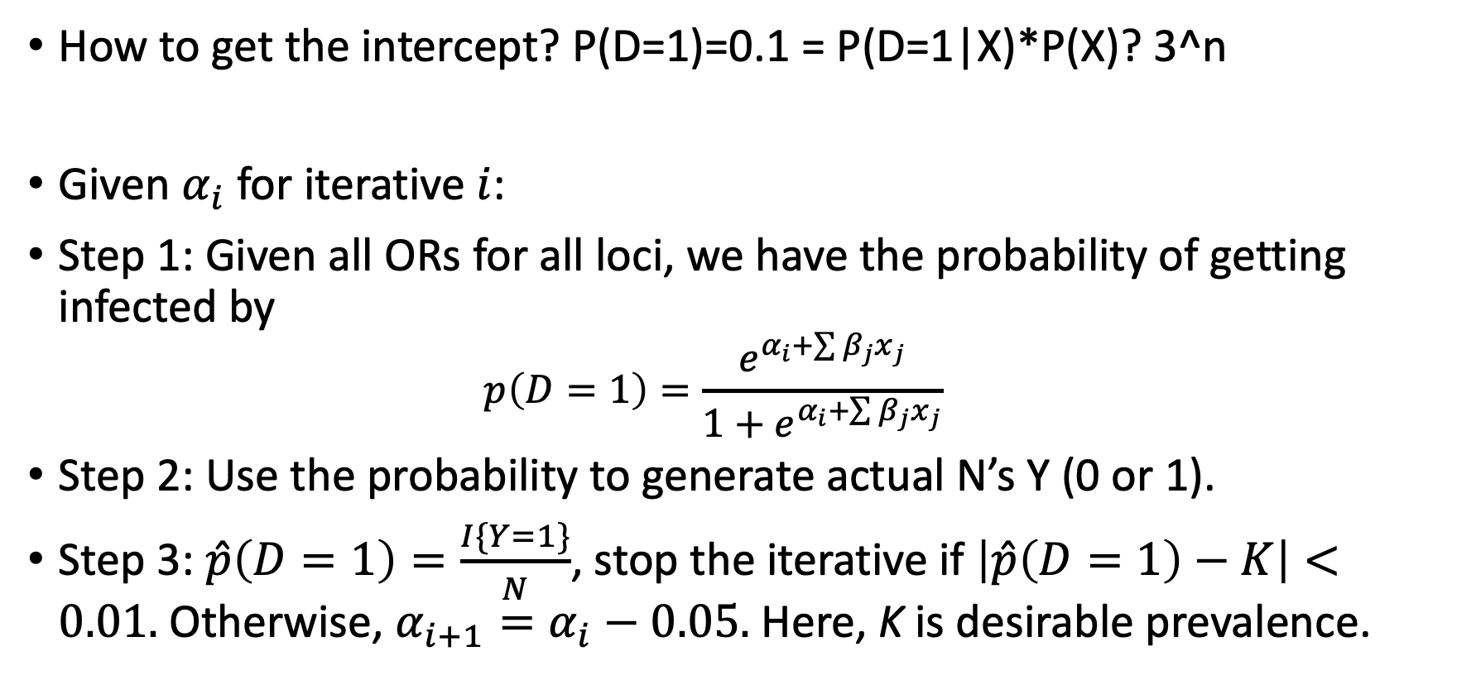
Case-Control (Binary traits)
How to get the intercept? P(D=1)=0.1 = P(D=1|X)*P(X)? 3^n
Given $α_{i}$ for iterative $i$:
Step 1: Given all ORs for all loci, we have the probability of getting infected by
$$p\left(D=1\right)=\frac{e^{α_{i}+\sum{β_{j}x_{j}}}}{1+e^{α_{i}+\sum{β_{j}x_{j}}}}$$
Step 2: Use the probability to generate actual N’s Y (0 or 1).
Step 3: $\hat{p}\left(D=1\right)=\frac{I\{Y=1\}}{N}$, stop the iterative if $\left|\hat{p}\left(D=1\right)−K\right|<0.01.$Otherwise, $α_{i+1}=α_{i}−0.05.$ Here, K is desirable prevalence.

Slide 5
Case-Control Setting
Prevalence= 0.01, 0.05, 0.1. 2500 people
(est. 0.01*2500=25cases,2475control, however, 0.1*2500=250cases,2250control. So phi(control/case rate) increases, therefore, power also increases. - > then detection rate becomes higher.)
Total Significant SNPs = 20
MAF – 5 groups: [0.05,0.1],[0.1,0.15],[0.15,0.2],[0.2,0.3],[0.3,0.4]
Effect sizes – 80% from [1.01,1.2], 20% from [1.2,1.5]+ rnorm(num_patients,Sd^2). Sd = [0,0.4].
Sample size: SS, MIX.
Step 1: given effect sizes, MAF, get the intercept in the logistic model.
Step 2: given pre-specified sample sizes for the original study and replications, generate datasets.
Step 3: Achieve ABF using the derived function.

Slide 6
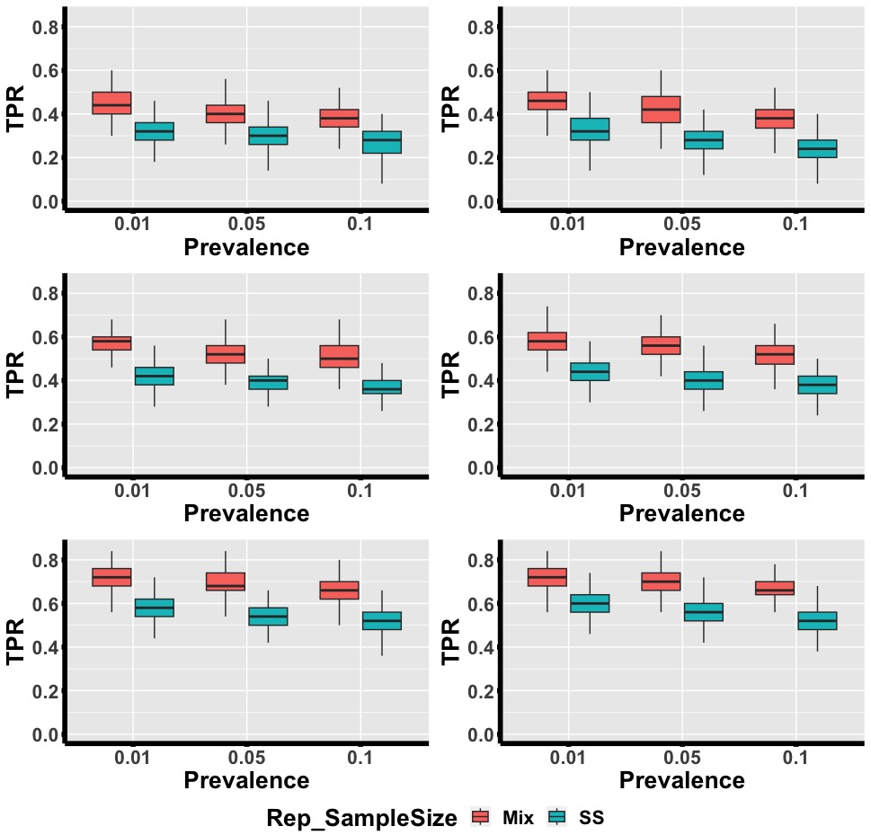
No Heterogeneity
Exist Heterogeneity
M=3
M=5
M=10

Slide 7
The next interest: Given the same power, will the values of MAF change the detection rate?
Detection Rate : The probability of detecting the signal. [for example, 0.8 means that we have 80% chance to detect and conclude the signal if we use our criterion (ABF).]
We will do both settings: continuous traits or binary traits.

Slide 8
Continuous traits (settings)
Variance of the error term (v=100 (large total heritability),200 (small total heritability )).
# of SNPs = 20, where 19 of them will be assigned effect sizes randomly from U(1,2), and 19 of them will be given MAF randomly from U(0.05,0.3).
The one we are interested will be set as the fixed power (0.6,0.8) and the fixed alpha level (5e-6,5e-8). Then we can get the heritability and achieve the effect size of this locus.
Then, we run the simulation as we have done before, and only check the performance of this loci. (How the detection rate changes given the various MAF?)
Other settings (n0=2500, 3 small replications, 500 repeated tests, significant if BF*(prior of H1/H0 >=3))

Slide 9
Binary traits (settings)
Prevalence rate (0.05, 0.1).
# of SNPs = 20, where 19 of them will be assigned effect sizes (OR) randomly from either 1.2 – 1.5 (20% of them) and 1.01 – 1.2 (80% of them) and 19 of them will be given MAF randomly from U(0.05,0.3).
The one we are interested will be set as the fixed power (0.6,0.8) and the fixed alpha level (5e-6,5e-8). Then we can get the heritability and achieve the effect size (OR) of this loci.
Then, we run the simulation as we have done before, and only check the performance of this loci. (How the detection rate changes given the various MAF?)
Other settings (n0=2500, 3 small replications, 500 repeated tests, significant if BF*(prior of H1/H0 >=3))

Slide 10
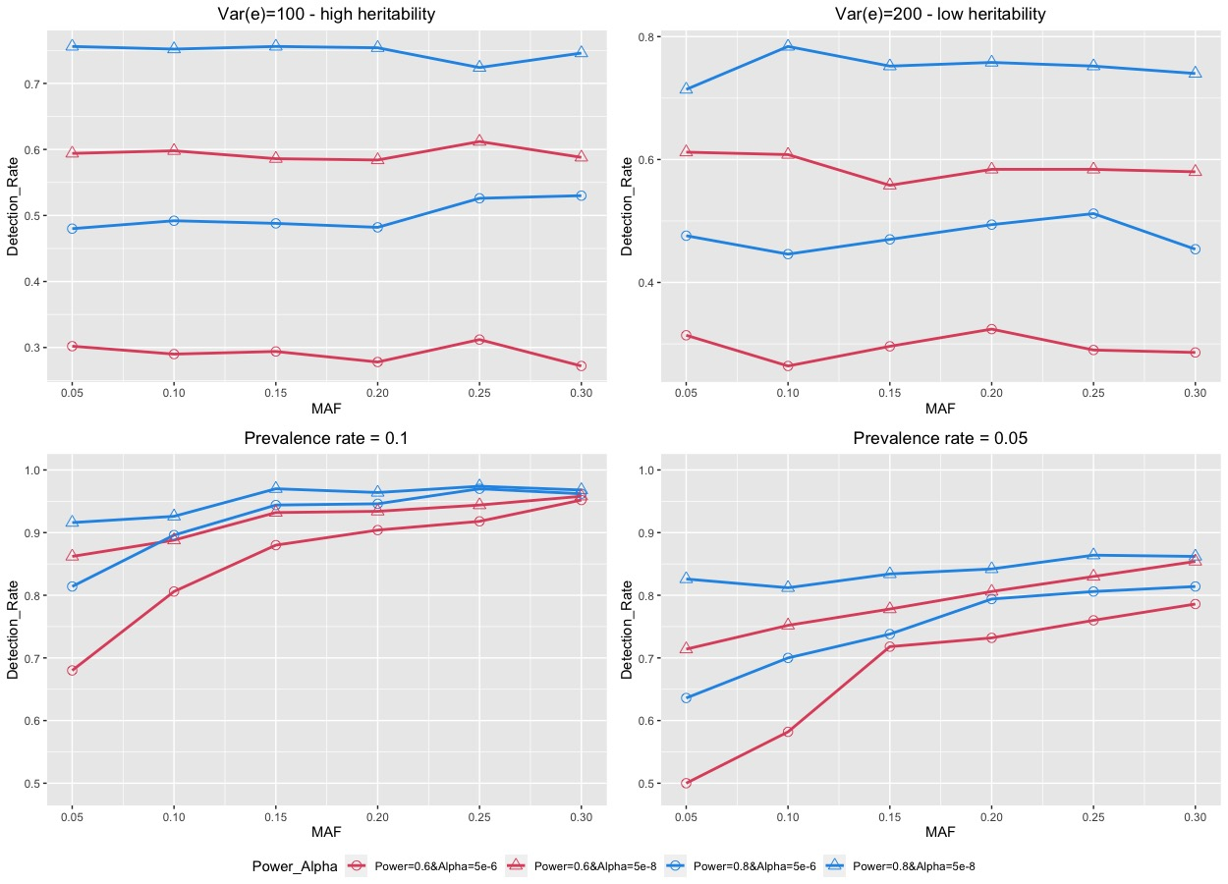

Slide 11
What if there exists correlation between effect sizes (coefficients)?
Correlated coefficients -> we have correlated studies.
Extend our BF to allow this scenario.
Idea: Get an estimated covariance matrix from a multiple linear regression (containing all replications and the original findings). Then, we use Monte Carlo simulation to get our BF value.

Slide 12
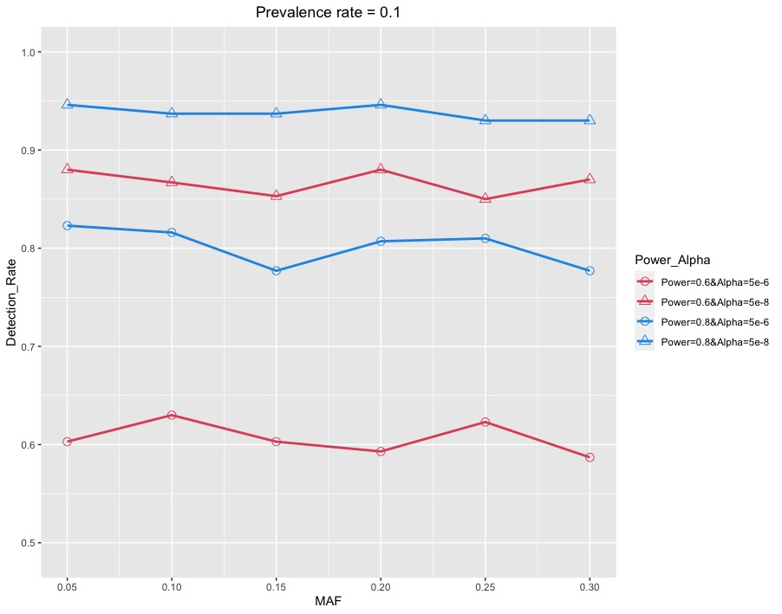
Fixed power – case control

Slide 13
Suppose we have n studies with different sample sizes, how can we use our method?
# SNPs = 100, ranked by their discovery power.
If n = 10, then we vary the sample sizes from 8000 to 500. (8000,7000,…,500)
We define the measurement: the coverage probability of the top 50 SNPs
We compare three methods:
“Pseudo-original” : pick the study with the largest sample size as the original study, then get the corresponding ABFs for each SNP.
“Simple mean” : pick ith study as the original, then use the remaining studies to get ABF_i for all SNPs for i=1,…,10. Then, ABF_simplemean = mean(ABF_1,ABF_2…,ABF_10).
“Weighted mean” : Incorporate weights to get ABF_weightedmean, where weight for study i = standardized[(sample size for study i / (sum of sample sizes for all studies))^(-1)]

Slide 14
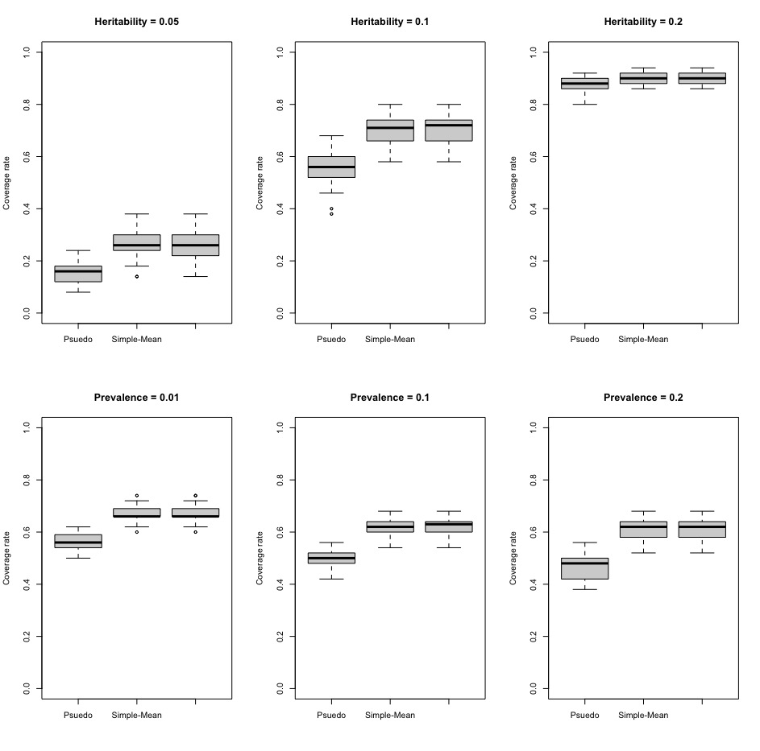
Results
Weighted-Mean
Weighted-Mean
Weighted-Mean
Weighted-Mean
Weighted-Mean
Weighted-Mean

