Slide 1
ELEC5306
Tutorial
https://canvas.sydney.edu.au/courses/21772/pages/course-contents

Slide 2
Tutorial 1
Digital Image

Slide 3
Introduction
Assuming knowledge:
Programming:, Matlab, Python, C++
Assignment:
Both assignments are programing assignments
Assignment 1:
20%, using Matlab. Individual
Assignment 2:
20%, using python. Individual or pair

Slide 4
Digital Image
Digital image:
Tensor 3 dimension (H,W,C), colorful image, rgb, (H,W,3)
RGB -> (W,H,3) -> W*H*3
YUV420P -> Y: W*H*1 U: W/2 * H/2 *1 V:W/2 * H/2=> 1.5*W*H

Slide 5
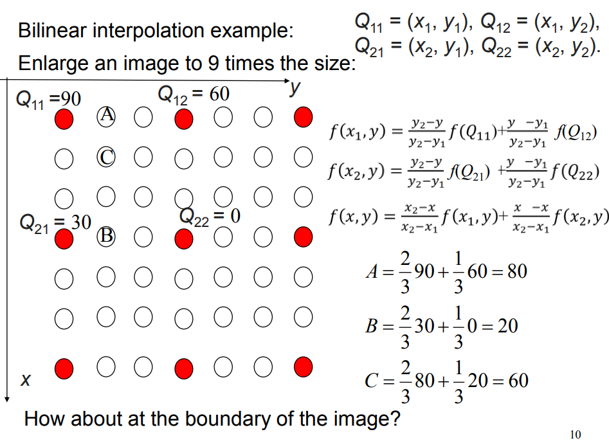
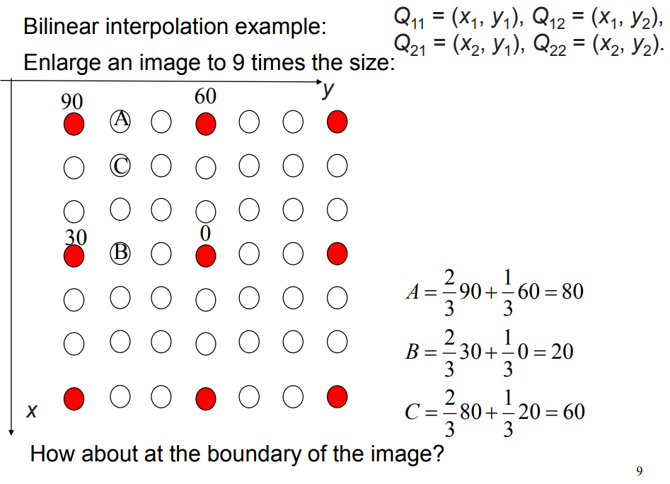
Bilinear Interpolation
Example 1
Example 2

Slide 6
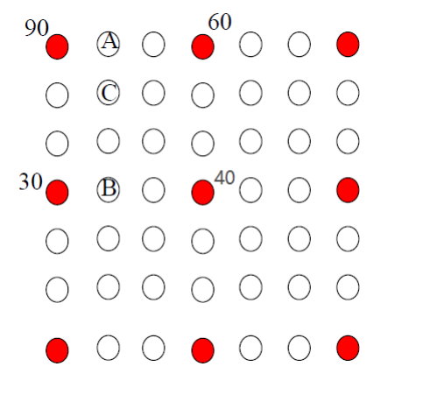
Question
Find the values of
A, B and C?
Answer:
A = (2/3)*90 + (1/3)*60 = 80;
B = (2/3)*30 + (1/3)*40 = 20+40/3
C = (2/3)*A+(1/3)*B = (2/3)*80 + (1/3)*(20+40/3) = 60+40/9=64.44
A = ⅔*90 + ⅓*60 = 80
B = ⅔*30 + ⅓*40 = 33.3333…
C = ⅔* 80 + ⅓ *33.33.. = 64.44

Slide 7
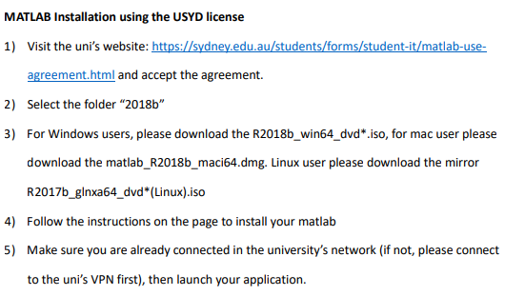
Matlab

Slide 8
Tutorial 2
Quality Assessment

Slide 9
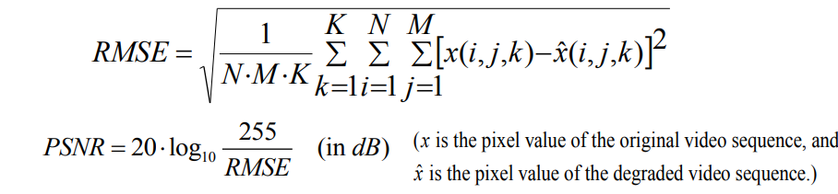
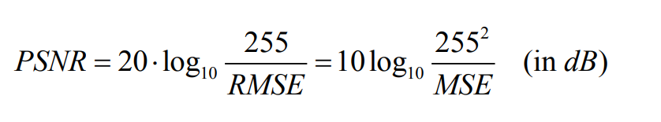
Euclidean Distance: http://rosalind.info/glossary/euclidean-distance/

Slide 10
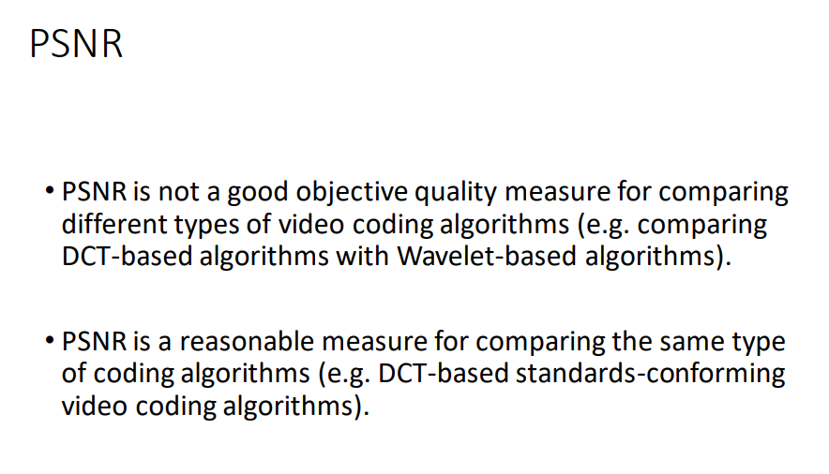

Slide 11
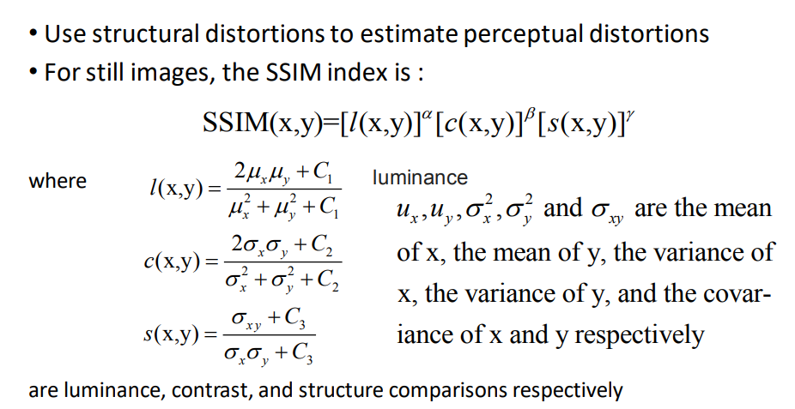

Slide 12
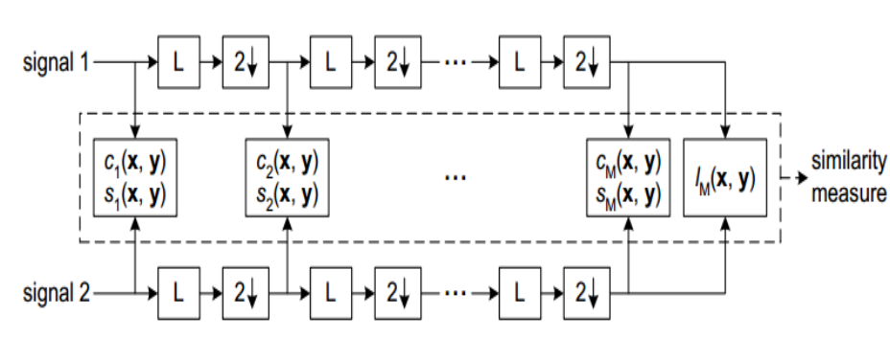
MS-SSIM

Slide 13
Tutorial 3
Lossless Coding

Slide 14
Notification
Wanli will hold discussion room 8:00-8:30 (from this week, please see anoncement in Canvas)
Please see the Binary Arithmetic Decoding (part-4) in this week lecture
From this week all content will be delivered online, please using Zoom
Assignment 1 will be released next week.

Slide 15
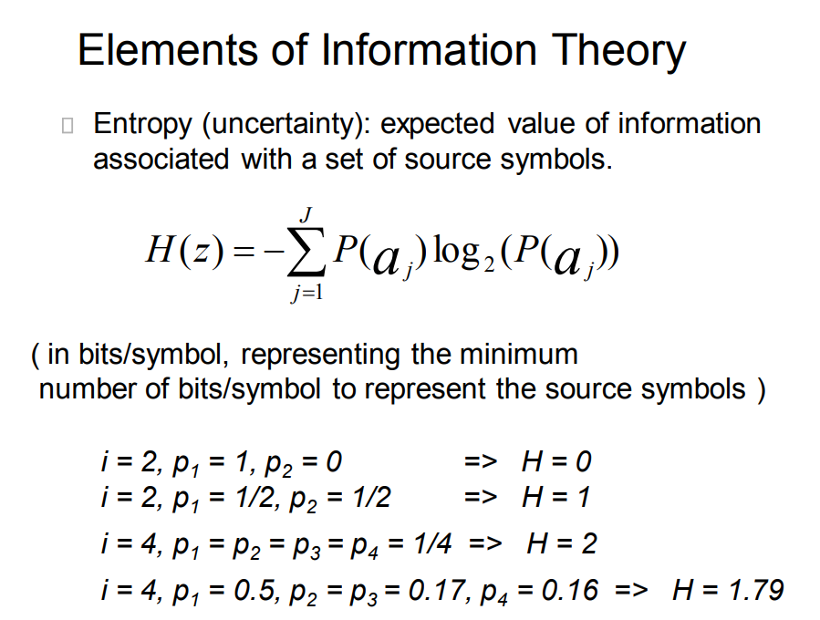

Slide 16
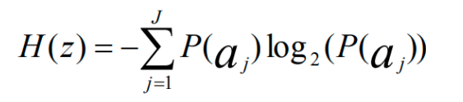
Question 1
i = 4, p1 = 0.4, p2= 0.18, p3 = p4 = 0.24, calculate the entropy H.
H = - (0.4*log(0.4) + 0.18*log(0.18) + 0.24*log(0.24)) + 0.24*log(0.24))

Slide 17
Huffman Tree
Tree doesn’t have to be identical, but different tree might have different bits length
To find out the most optimal tree for shortest bit length, you might need to use some efficient algorithm (Greedy search etc)
The bit length will be actually longer than its cross entropy
Cross entropy is ideally the most optimal solution (but it can be achieved )
Have probability (symbol) -algorithm-> Human Tree -> (symbol -> bits based on the human Tree)

Slide 18
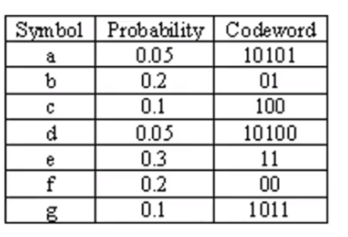
Huffman Coding
1
0.4
0.6
f:0.2
0.3
e:0.3
b:0.2
c:0.1
0.2
0.1
g:0.1
Entropy -0.05*log*0.5 - 0.2log0.2 + ..+ = 2.5…...
Average Coding rate: 0.05*5 + 0.2*2 +.... = 2.6
a:0.05
d:0.05

Slide 19
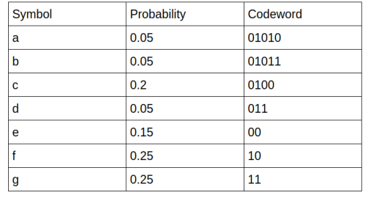
Huffman Coding
Draw the huffman tree, and answer the question: What’s the probability of “010”?
1
0.5
0.5
f:0.25
g:0.25
e:0.15
0.35
0.3
d:0.05
c:0.2
0.1
a:0.05
b:0.05

Slide 20
Question 3
Binary Arithmetic Coding: encoding of “0101” with probability of “0”=0.5 (P“1” = 0.5), show the final interval and the bit number after compressed.
“1”
“0”
“0”
0
0
0.25
0.25
“0”
“0”
“0”
“0”
0.375
0.3125
log2(0.3125-0.375)=4
0.5
0.25
0.335
“1”
“1”
“1”
“1”
1
0.5
0.5
0.375

Slide 21
Tutorial 4
Your first assignment

Slide 22
Paper Reading (20%)
Do the oral presentation, Presentation Date is 24th April in the lecture time
make a video, due day is not confirmed
Paper reading list is released
https://docs.google.com/document/d/1ATxO2U-LtW1R75kBDIOfyDptTfMCCOef03YSzaz902Y/edit?usp=sharing
You can pick up hard, middle and easy paper, our marking would be different
For example, if you pick a easy paper, you need to 100% understand this paper (including detail such as math prove) no mistakes allowed
In contrast, if you pick a hard paper, we will allow you have a little bit mistakes during understand.
The deadline of deciding paper should be next week Friday 12:00 pm

Slide 23
Assignment 1 is Released
Due: 1th May
Content：2 main files (part1.m, part2.m) 1 report (report.pdf) (less than 3 pages)
You can submit more than 3 files (e.g. function_1.m to support part1.m) we won’t punish, but we only run part1.m and part2.m and check report.pdf for marking.
What should you do：
Part1.m: complete task 1
Part2.m: complete task 2
Report.pdf: Objective, Introduction, Methodology, Simulation Results, Discussion, Conclusion, References (optional), etc

Slide 24
Assignment 1
Read YUV file
https://www.google.com/search?q=read+yuv+file+matlab&oq=read+yuv+file+matlab&aqs=chrome..69i57j0l2.4401j0j7&sourceid=chrome&ie=UTF-8#kpvalbx=_aa59XufRNd-E4-EPj-KhuAY22
Qutization:
Round your continues value to discrete value
Optimize the distance

Slide 25
Tutorial 5
Quantization and Deep Learning

Slide 26
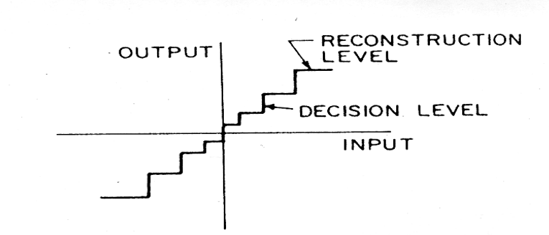
Quantization (2nd part)
Goal： quantize continues value to discrete
The decision level can be either equal (linear) or inequal(non-linear)
There are two challenges
Less quantization error
Psnr, msssim (big)
Less bits usage
Bits (less)
3
2 2.3 2.8 3

Slide 27
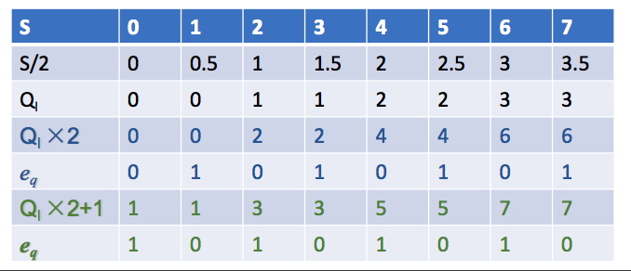
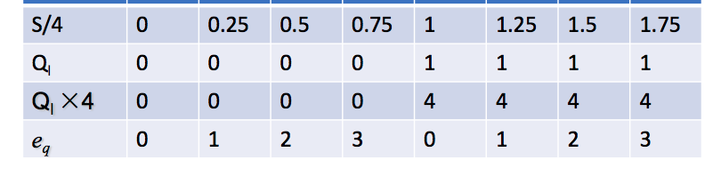
Quantization
In this case, I want to quantize these numbers with 2 bits (00, 01, 10, 11)
In this case, I want to quantize these number with 1 bit (0, 1)
P 0.4 0 0 0.1 0.2 0 0.3 0
Normally if you use less bits, normally your reconstruct qulatily would be less

Slide 28
Quantization
P 0.4 0 0 0.1 0.2 0 0.3 0
S 0 1 2 3 4 5 6 7
E = 0 1 2 3 0 1 2 3
D = 0.9 + 1.2 = 2.1
D0 = S0, Dlast = 7
N < Dj + D -> rj
N > Dj + D -> rj+1

Slide 29
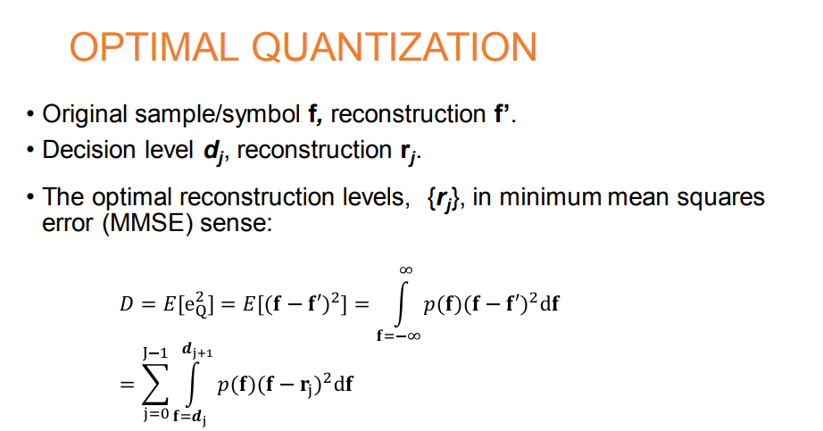

Decide the optimal decision boundary

Slide 30
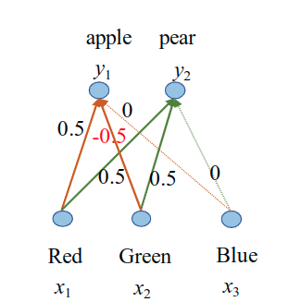
Neural Network
Regression: y = f(x), y is a continue number
Classification: y = f(x), y is discrete vector
A simple example for neural network
V = [x1, x2, x3] = > y
Example :
V = [1,0,1] -> y1
1*0.5+0*-0.5 + 1*0 =0.5
1*0.5 + 0*0.5 + 0*1 = 0.5
=>[0.5, 0.5 ]
[1,0,1] => [0.5, 0.5]
Backpropagation :
Gradient descent
Chain Rule
=> optimize the weight to better perform the task

Slide 31
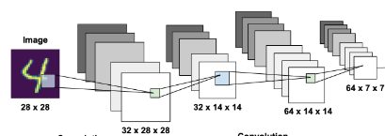
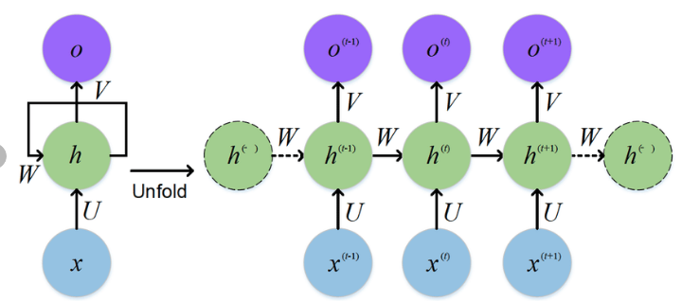
CNN & RNN

Slide 32
Build Neural Network using pytorch
Input data x, label y
Build a neural network f
f(x, y).train() -> f with a optimized weight
Y’ = f(x’) , x’ is test data, y is test label
Tensorflow, pytorch mxnet, caffe, matlab..
Python ,c++, ….
We only provide code with pytorch

Slide 33
Tutorial 6
Your first CNN in Colab

Slide 34
Paper Reading
You need to submit：
Group ID
Marking form
Presentation time
QA
https://canvas.sydney.edu.au/courses/21772/discussion_topics/395402

Slide 35
If you want to install the environment in yours
Install anaconda on windows:
https://docs.anaconda.com/anaconda/install/windows/
Install cuda on windows: (optional： If you have a GPU in your machine)
https://docs.nvidia.com/cuda/cuda-installation-guide-microsoft-windows/index.html
Install pytorch with anaconda:
https://medium.com/@bryant.kou/how-to-install-pytorch-on-windows-step-by-step-cc4d004adb2a

Slide 36
Tutorial 7
Your assignment 2

Slide 37
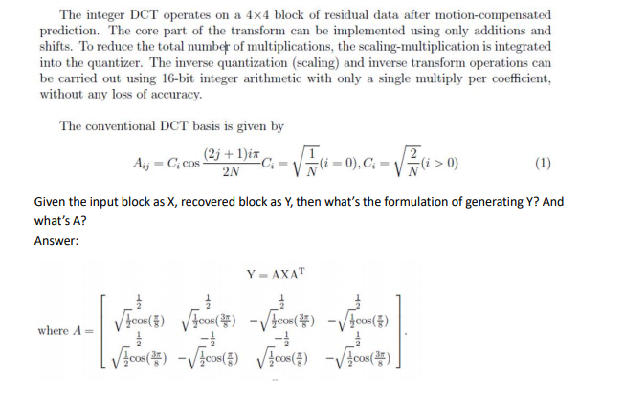
DCT example

Slide 38
Tutorial 8
Your assignment 2

Slide 39
Assignment 2
Dataset
https://www.dropbox.com/s/i1o74xou8bm74al/data.zip?dl=0
You can only use the data we provide for assignment not extra data
But you can re-split the data into the way you prefer
Code
https://github.com/chriszhenghaochen/ELEC5306
This is the main code
baseline-model
https://drive.google.com/open?id=1ETnahHe9EoZzCWXFvfqa6EUz8O3ty2di
colab-code
This help you to run your code in colab
https://drive.google.com/open?id=1ETnahHe9EoZzCWXFvfqa6EUz8O3ty2di

Slide 40
Tutorial 9
Improve your neural network

Slide 41
Assignment 2
code:
You need to provide the README file
You need to make sure that your code can read the test list as structure we give to you
Presentation
10mins +-1 mins + 2mins(discussion)
You have to tell us the contribution of each members in your team during the presentation
You need to submit a backup video like lastime, upload your video into the youtube and submit the link.
Report
We list in the marking rubuic

Slide 42
Video concept
Topic
You need register topic then do video, we would check the discussion when we marking if
Marking
In this time you require to have fully understanding with the topic your choose
Penalty
You shouldn’t choose the same topic others choose by others first
If you are second person to choose the topic you will receive 30% deduction
If you are the third one to choose the topic you will receive 60% deduction
If your presentation slides have more than 20% as the person(s) who choose the topic before you, it counts as plagiarism (The university treat this problem very serious, normally you will directly fail the unit,
(see https://www.sydney.edu.au/students/academic-dishonesty.html)
You can’t choose the same topic you have done it in ELEC5304, If you do so, you will receive 0% for both units.
You don’t register any topic you will receive a 0% in anyhow

Slide 43
Data
Data is probably the most important thing in the network,
1-1. you can’t change the test data loader, but you can write your own training dataloader 1-2 Argumentation: 1. random crop, 2. random flip, 3. add guassian noise,
Ref: Pytoch transform https://pytorch.org/docs/stable/torchvision/transforms.html
Ref: https://arxiv.org/pdf/1512.02325.pdf sec 3.6
More data is not guarantee to give a better results, but emperically it will improve
You can only the data we give you, remember you can re-split the val and training

Slide 44
Overfitting and network design for better Bp
I would personally suggest do not add to much parameters for your network (aka make your newtwork too big), otherwise it is easy to get you network overfiting.
Normally the deeper network is much harder to train and converge. But there is something you can do
2-1 Use normalization：it can make your output to be a better distribution that good for back-propagation
BN in torch: https://discuss.pytorch.org/t/batch-normalization-of-linear-layers/20989
BN paper: https://arxiv.org/abs/1502.03167
2-2 Use skip connection
Skip connection: https://arxiv.org/pdf/1512.03385.pdf (resnet)
Torch x = x + f(x)
3-3 Use dropout
http://jmlr.org/papers/v15/srivastava14a.html
https://stackoverflow.com/questions/53419474/using-dropout-in-pytorch-nn-dropout-vs-f-dropout

Slide 45
What you can do during the training
Select a better learning rate:
Too big, it converge fast but it might jump over the best optimized point
Too small it converge slow and it might stuck on certain local optimized
Try different way of decay
This will help you to discover different local optimize
Try different Batch size
This is will be especially helpful if you use a Batch Norm
Try different optimizer
SGD
Adam
……...

Slide 46
Last word for you
Keep tuning and reading more papers to get your idea!
Good luck

