Slide 1
Event detection for EPMs

Slide 2
Training Set
Prepared by Jacobs18
8943 sentences
11 labels
ProQuest Newsstand data

Slide 3
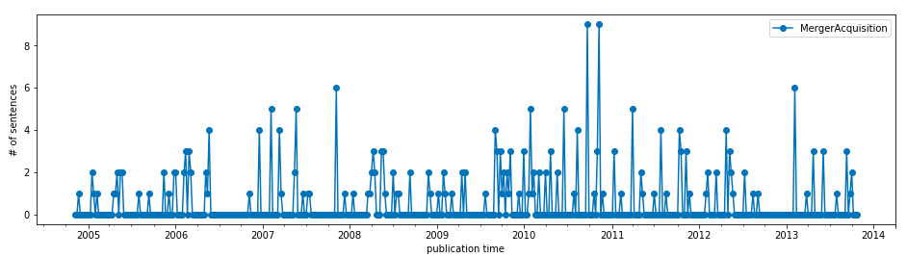
Results
Train set (7d aggregate)

Slide 4
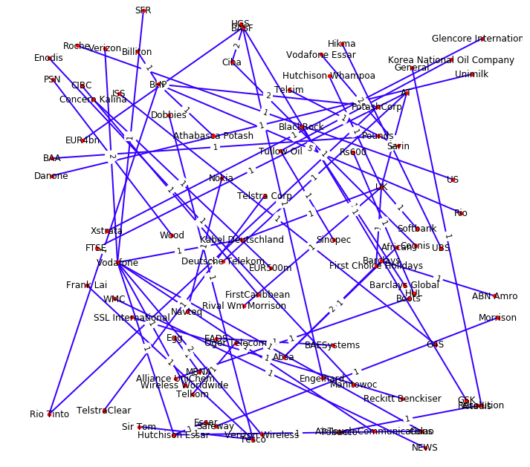
Results
Train set: M&A sorted by entities

Slide 6
Training Set

Slide 7
Training Set

Slide 8
Training Set

Slide 9
Approach
Multi-label classification
Linear SVM
Multi-feature pipeline
TFIDF, n-grams
…

Slide 10
Results
Per-sentence classification (multi-label)

Slide 11
Results
Per document classification (Multi-label)

Slide 12
Events Pipeline (
Is the source relevant? (classifier?)
MongoDB
Event report
Type(s)?
Who?
When?

