Slide 1
High Level Design
Presentation Layer
Webbrowser
rtc.js rtc.html
AJAX JSON polled requests
rtcMain.py
reads events
updates DB
perform RTC
Business Logic
rtcXXX.py
retrieves data for GUI
Python Classes (JSON returned)
Encapsulation
Layer
cats.py ( Cisco API Tools, hides API complexity)
rtcdb.py
(interface to RTC DB)
APIs
ISE
Dababase e.g mySQL
AMP
SW
Umbrella

Slide 2
rtcMain.py - details
rtcMain multithreaded process, 3 threads AMP, SW, UMB
each thread reads every X seconds from API via cats
Based on config, increments penalty for user and MAC
Insert event with details into event table
If RTCthreshold exceeded: apply ANC policy
rtcMain.py
Python Classes (JSON returned)
cats.py ( Cisco API Tools, hides API complexity)
rtcdb.py
(interface to RTC DB)
mac | user | observable | eventstring
mac=x | john | domain SHA IP | json
Events tables
ampevents
swevents
umbevents
AMP
SW
Umbrella
ISE
user | penalty
john | 75
mac | penalty
mac=x | 75
users table
hosts table

Slide 3
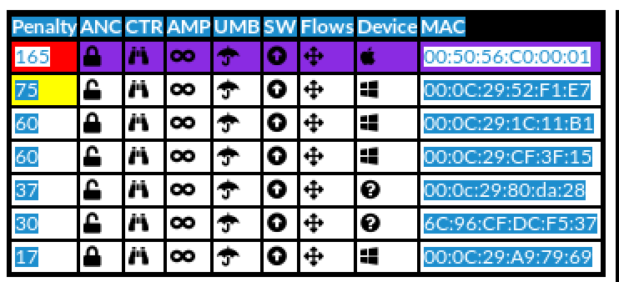
rtcGetHosts.py, rtcGetUsers.py
Webbrowser
rtc.js
AJAX Javascript polls
at regular intervals
updates GUI
rtcGetHosts.py
rtcGetUsers.py
CGI script - serves requests from presentation layer
Gathers information on hosts, users, penalties, events
from DB but also some realtime info via APIs
cats.py ( Cisco API Tools, hides API complexity)
rtcdb.py
(interface to RTC DB)
mac | user | observable | eventstring
mac=x | john | domain SHA IP | json
Events tables
ampevents
swevents
umbevents
AMP
SW
Umbrella
ISE
user | penalty
john | 75
mac | penalty
mac=x | 75
users table
hosts table

Slide 4
rtcQ.py, rtcUQ.py
Webbrowser
rtc.js
Manual quaratine or unquarantine of host (MAC)
rtcQ.py
rtcUQ.py
CGI script - serves requests to perform manual quarantine or unquarantine of endpoint
cats.py ( Cisco API Tools, hides API complexity)
AMP
SW
Umbrella
ISE

Slide 5
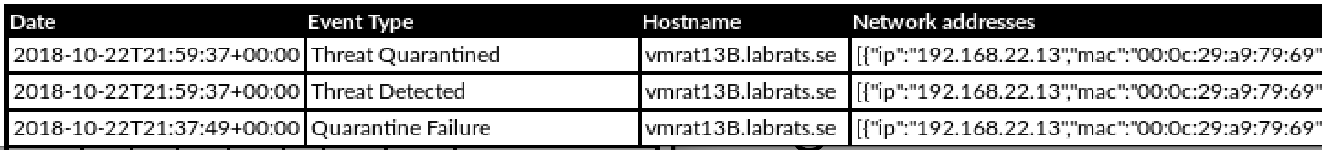
rtcAMPevents.py, rtcSWevents.py, rtcUMBevents.py, rtcFLOWS.py, rtcISEsessions.py
Webbrowser
rtc.js
On-Demand requests for live info on AMP, UMB, SW or ISE via API for display
CGI scripts - serve requests from presentation layer
Gathers information from API
rtcAMPevents.py
rtcSWevents.py
rtcUMB.py
cats.py ( Cisco API Tools, hides API complexity)
AMP
SW
Umbrella
ISE

Slide 6
rtcAMPeventsdetails.py, rtcSWeventDetails.py, rtcUMBeventDetails.py,
Webbrowser
rtc.js
On-Demand requests for details of specific recorded event (raw JSON presented)
CGI scripts - serve requests from presentation layer
Gathers information from DB
rtcAMPeventDetails.py
rtcSWeventsDetails.py
rtcUMBeventDetails.py
rtcdb.py
(interface to RTC DB)
mac | user | observable | eventstring
mac=x | john | domain SHA IP | json
Events tables
ampevents
swevents
umbevents

Slide 7
rtcGetXconfig.py, rtcUpdateXconfig.py,
Webbrowser
rtc.js
Managing config of API parameters for ISE, AMP, SW
Managing Reading/Writing from DB
x= AMP, SW, UMBRELLA,
rtcGetXconfig.py
rtcUpdateXconfig.py
rtcdb.py
(interface to RTC DB)
iseconfig
ampconfig
swconfig
umbconfig

Slide 8
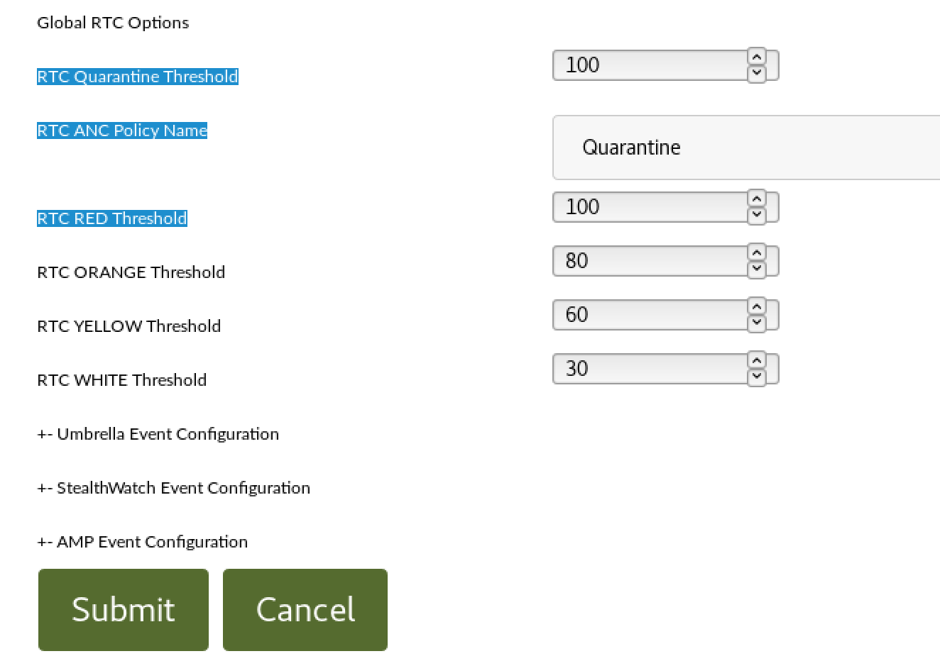
rtcGetconfig.py, rtcUpdateconfig.py,
Webbrowser
rtc.js
Managing rtC global config options
rtcGetconfig.py
rtcUpdateconfig.py
rtcdb.py
(interface to RTC DB)
rtcconfig

Slide 9
To consider
Currently a host or user will only get a penalty once for the same observable
e.g. If SHA256 observed N times on host/user will only get 1*penalty
e.g. if host/user connects to the same CNC domain many times, only 1*penalty
This should be configurable? Depending on type of IOC, penalty should accumulate for the same observable

Slide 10
Known Issues/Challenges
Umbrella API rate-limiting
have observed status code 429 with no data (API rate limit exceeded) when polling every minute
ISE pxGrid request for specific host returns empty
sometimes failed if subsequent requests, e.g. in loop
Retrieving events within specific time window
issues observed with Umbrella API and SW API (returns events waaay outside window).... still works because we don’t let the same observable accrue penalty more than once (see predvious slide). still irritating because it clutters logs.

Slide 11
Must fix
Security! No login to app ☺ and No input validation
Errorhandling, logging need improving
Some redundancies can be removed by adding library functions

Slide 12
Requirements (1)
python3
webserver, mysql
python3 mysqlconnector
websockets

Slide 13
Where to put files
rtc.js, rtc.html, rtc.css put in web server directory (e.g. /var/www/html)
rtc*.py put in cgi-bin directory (e.g. /usr/lib/cgi-bin)
rtcMain.py can be in any directory since not cgi-script, but cgi-bin will work
*.json (contains username password for mysql connection) in same directory as cgi-bin

