Slide 1
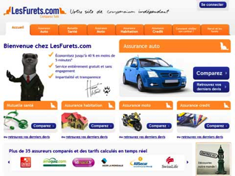
Reporting
Daily MI
Daily MI
Daily MI
DATA WARE HOUSE
Olap + Reporting
HOT DATA
Quotes
&
Tracking
ETL
15-90 days only
COLD DATA
Files Storage
XML Files

