Slide 1
Project 2
Brayden Faulkner and Christina Hinton

Slide 2
Program Basics
This program was written in C#
Libraries were avoided throughout most the program
Used a porter stemmer written by Kamil Bartocha
Uses a dictionary to keep track of how often each word appears in a file
TF-IDF is calculated in the Overseer class
Runtime is around 30 seconds

Slide 3
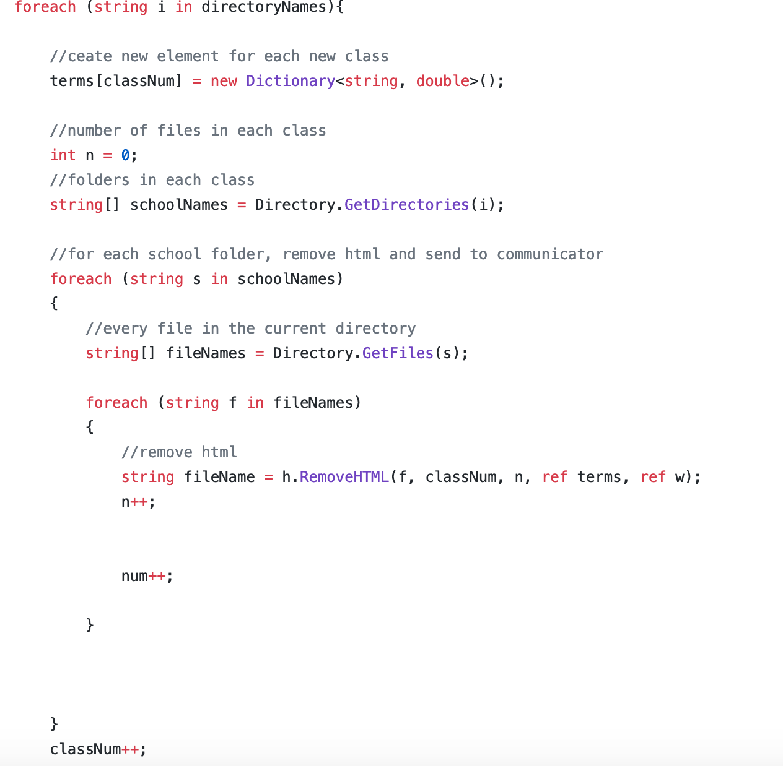
File Processor
Find word frequency for both
Keeps track of which class each file is in and returns them to observer
https://github.com/chrmhint/DataMiningProject/blob/master/DataMiningProject/FileProcessor.cs

Slide 4
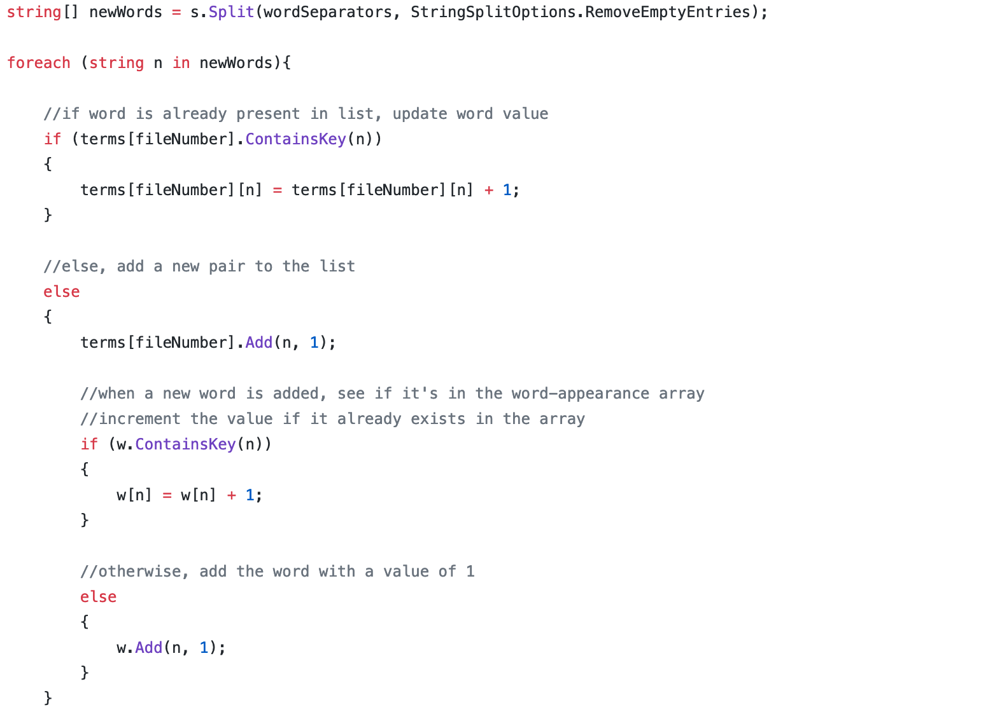
Counting words
Word count is checked in StopWordRemover.cs
Count stored in a dictionary called terms
https://github.com/chrmhint/DataMiningProject/blob/master/DataMiningProject/StopWordRemover.cs

Slide 5
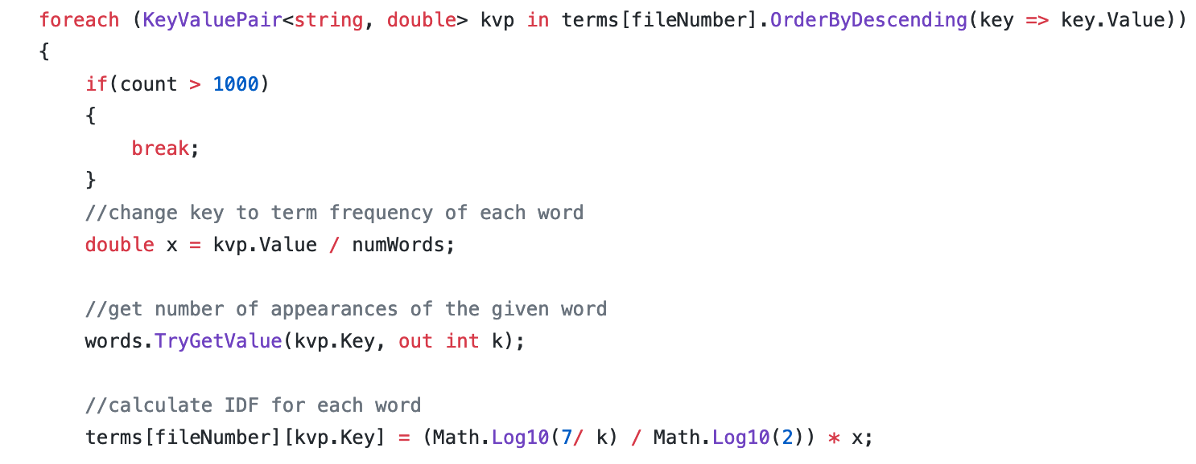
TF-IDF
Calculated manually by the overseer class as seen here
https://github.com/chrmhint/DataMiningProject/blob/master/DataMiningProject/Overseer.cs

Slide 6
Results
Words that likely appeared in all documents tended to have low TF-IDF’s across all classes
Words with high TF-IDF tended to be specific for that class, such as “midterm” for the course class
The other class had some unexpected high ranking words such as “murder” and “handgun”

