Slide 1
Frontend
CLIQZ for Firefox
Mixer
Rich Header
lucian@cliqz.com & thuy@cliqz.com
April 2015

Slide 2
Contents
CLIQZ for Firefox
Mixer
Rich Header
Exercises

Slide 3

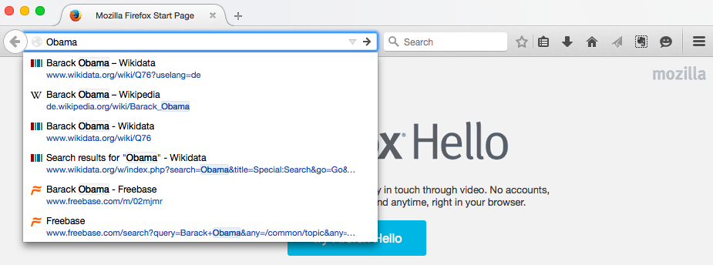

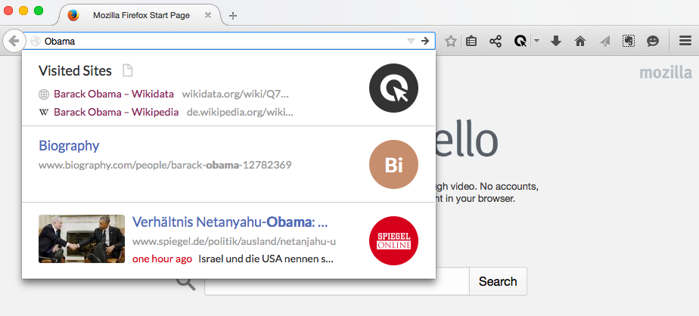
Default
Firefox
CLIQZ

Slide 4




Static
resources
CDN
uCrawl
Write
Telemetry
S3
Querylog
Extension
Mixer
Big Machine
Rich Header
News
Notes:
CLIQZ for Firefox in a bigger picture

Slide 5
Browser Extension ?
Themes
Language packs
Firefox
Add-ons
Plugins (Acrobat reader, Java, Flash,…)
Traditional
Extensions
Add-on SDK
Bootstrapped

Slide 6
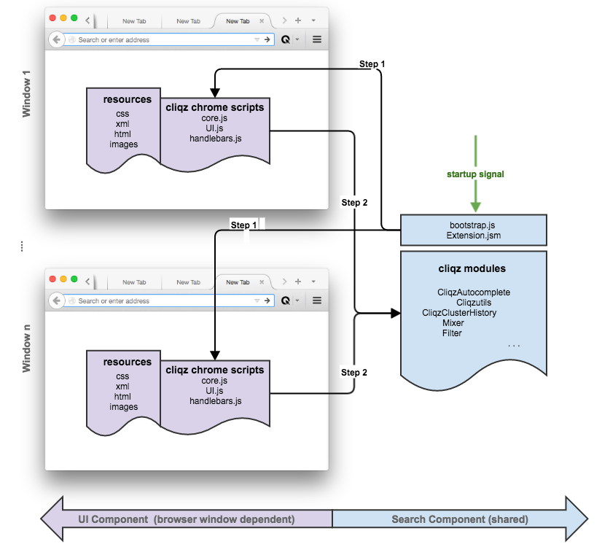
Notes:
How it works

Slide 7
History
Pattern
Cluster
CliqzAutocomplete
Generic
GO Mixer
Mixer
Deduplicator
Notes:
Cluster – github

Slide 8
Mixer
Written in GO – super fast
3-7 totally independent machines
Individual cache

Slide 9
Rich Header
Matches a query to an result
User friendly interface
Easily configurable
Centralized cache

Slide 10
Demo
BM results
Smart CLIQZ
History Clustering

Slide 11
Exercise 1
Install the extension and try it out
Fork the extension code, and install your own NewUI version
If that was you developing the extension:
a) what would you change?
b) what are the difficulties?

Slide 12
Exercise 2
Requirement: when users query your name, the extension shows your profile.
Please write code in the front-end to do so.
Note: you can choose to have the data coded inside the extension, or from the rich-header.

Slide 13
☺

