Slide 1
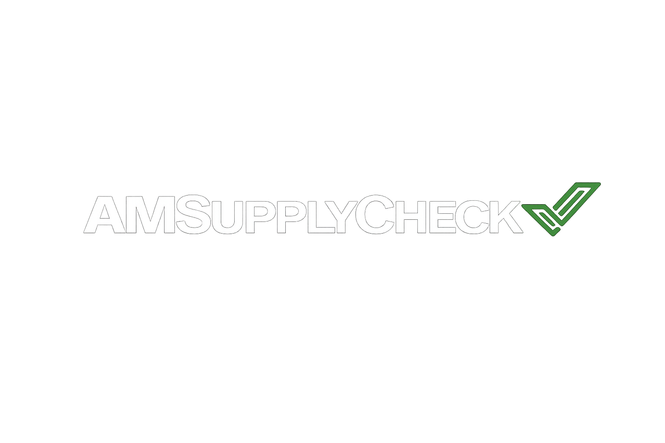
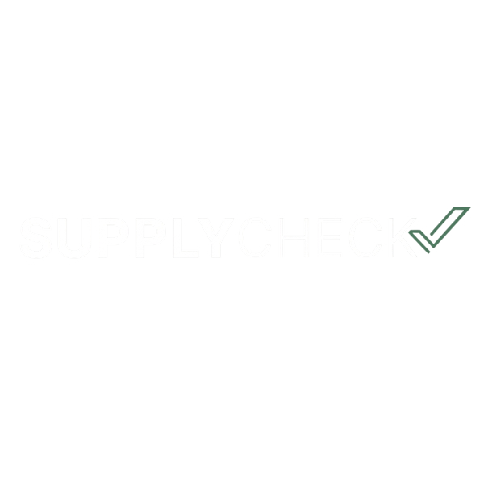
What is SupplyCheck?
1
A search engine that helps engineers and buyers find and compare 3D printing suppliers worldwide — based on technology, material, location, and price.
👤
Buyer
Uploads specs
SupplyCheck
Matches & compares
🏭
Supplier
Gets the lead
100+
Suppliers listed worldwide
Free
For buyers to compare
Direct
Users go to website directly

Slide 2



Meet the Founders
2
Insert image
Insert image
Insert image
Rasmus Henriksen
Kristoffer Ryelund
Christian Groth
Co-Founder & CMO
Co-Founder
Co-Founder & CEO/CMO

Slide 3

How It Works for Suppliers
3
We drive qualified leads directly to your website.
SUPPLIER DASHBOARD PREVIEW
More Visibility
Your company appears when buyers search for your technologies and materials
248
Impressions
34
Clicks
Qualified Leads
We match the right customers to your specific capabilities and capacity
Recent Searches Matching You
Pay Per Lead
SLS - Nylon PA12
Sweden
You only pay for the leads we deliver — $50 per qualified lead
FDM - ABS
Denmark
Performance Dashboard
MJF - Nylon PA11
Norway
Track impressions, clicks, and leads with detailed analytics

Slide 4
Pricing
4
Recommended
FREE LISTING
6-MONTH PLAN
12-MONTH PLAN
$0
forever
$800
$133/month + $50/lead
$1000
$83/month + $50/lead
✔ Basic company profile
✔ Custom profile with logo
✔ Everything in 6-month plan
✔ Listed in supplier directory
✔ Website link & images
✔ Custom profile with logo
✔ Appear in search results
✔ Verified supplier badge
✔ Verified supplier badge
✖ No logo or website link
✔ Analytics dashboard
✔ Full analytics dashboard
✖ No verified badge
✔ Lead tracking
✔ Priority search ranking
✖ No analytics dashboard
✔ Priority search ranking
⭐ Guaranteed 2 paying customers
within the 12-month period
✖ No priority ranking

