Slide 1
Chapter 1 IT Audit Overview

Slide 2
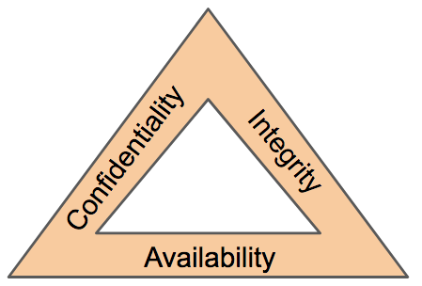
Basic principle of information security
ISO/IEC 27001 Information Security Management System (ISMS)
An Information Security Management System (ISMS) is a structured and systematic approach to managing an organization's information security processes, policies, and controls. It provides a framework for establishing, implementing, monitoring, reviewing, maintaining, and continually improving information security within an organization. The most widely recognized standard for ISMS is ISO/IEC 27001.
https://www.sirim-qas.com.my/our-services/management-system-certification-related-services/iso-iec-27001-information-security-management/
Notes:
An Information Security Management System (ISMS) is a structured and systematic approach to managing an organization's information security processes, policies, and controls. It provides a framework for establishing, implementing, monitoring, reviewing, maintaining, and continually improving information security within an organization. The most widely recognized standard for ISMS is ISO/IEC 27001.
Here are key components and elements of an Information Security Management System:
Policy and Objectives:
An ISMS begins with the development of an Information Security Policy that outlines the organization's commitment to information security. This policy sets the foundation for the security objectives and principles.
Risk Assessment and Management:
Risk assessment is a fundamental component of an ISMS. It involves identifying, analyzing, and evaluating risks to the organization's information assets. The organization then implements risk management measures to mitigate or accept identified risks.
Security Controls:
ISMS specifies the selection and implementation of security controls to address identified risks. These controls can be technical, organizational, or procedural and are designed to safeguard information assets.
Documentation and Procedures:
Detailed documentation, including policies, procedures, guidelines, and records, is a crucial part of ISMS. Documentation helps ensure consistency and traceability in implementing security measures.
Training and Awareness:
Training and awareness programs are essential for educating employees about information security policies and procedures and ensuring their compliance.
Incident Response:
ISMS includes plans and procedures for responding to security incidents, breaches, or vulnerabilities. These procedures help the organization mitigate and recover from security events effectively.
Continuous Improvement:
One of the core principles of an ISMS is continuous improvement. Organizations regularly assess and review their information security processes and controls, making adjustments as necessary to enhance security.
Monitoring and Measurement:
ISMS relies on monitoring and measuring key performance indicators and security-related metrics to track the effectiveness of security controls and processes.
Compliance and Audit:
Organizations using ISMS often engage in regular internal and external audits to ensure compliance with security standards, regulations, and their own policies.
Certification (ISO/IEC 27001):
Many organizations seek ISO/IEC 27001 certification, a globally recognized standard for ISMS, to demonstrate their commitment to information security to stakeholders, clients, and partners.
Management Commitment:
Top management's commitment and involvement are crucial for the success of an ISMS. Their support and resources help ensure that information security is a priority for the organization.
Third-Party Relationships:
ISMS considers the security of third-party vendors and partners who have access to the organization's information. Vendor risk management is often included in ISMS practices.
An ISMS provides a systematic and holistic approach to managing information security, enabling organizations to identify and mitigate risks and protect their information assets effectively. It is a dynamic system that evolves with changing threats, technologies, and business requirements.

Slide 3
ISMS
Defines policies, methods, processes, and tools to ensure sustainable information security in companies and government agencies.
This includes the introduction of specific procedures and the implementation of organizational and technical measures that must be continuously controlled, monitored, and improved.

Slide 4
Goal of ISMS
The goal is to ensure:
beyond the IT department, an appropriate level of protection for the confidentiality, availability, and integrity of information within the entire organization or the defined scope.
basis for systematic implementation of information security within a company and for compliance with security standards.
Potential threats relating to information security are identified, analyzed, and mitigated, making them controllable.

Slide 5

Basic terms
Information System
vs
Information Technology
Notes:
Information technology (IT) is the use of computers to create, process, store, retrieve and exchange all kinds of data^{[1]}and information.
Information systems encompasses the tools that organizations use to collect, manage, and analyze data.
Information System (IS) and Information Technology (IT) are related concepts, but they are not the same. They serve different purposes and encompass different aspects of the technology and information field. Here's a breakdown of the key differences between them:
Definition:
Information System (IS): An Information System is a broader and more comprehensive concept. It refers to a system that collects, processes, stores, and disseminates information to support decision-making and other business processes within an organization. It includes both technology and the people, processes, and data involved in managing information.
Information Technology (IT): Information Technology, on the other hand, specifically focuses on the technology and hardware/software components used to manage and process data and information. IT is a subset of IS and deals with the technology infrastructure and tools used to handle information.
Scope:
Information System: IS encompasses not only technology but also the organization's processes, people, and data that are used to support the flow of information. It includes the strategic planning, design, development, implementation, and management of information systems.
Information Technology: IT is more limited in scope and primarily deals with the hardware, software, networks, and technology services that facilitate data storage, retrieval, and processing.
Purpose:
Information System: The primary purpose of an IS is to support business operations, decision-making, and strategic planning by providing relevant, accurate, and timely information. IS integrates technology with the human and organizational aspects to achieve these goals.
Information Technology: IT serves the purpose of managing and maintaining the technology infrastructure of an organization, ensuring that hardware and software components work effectively to process and store data.
Components:
Information System: IS includes various components, such as databases, software applications, hardware, networks, people, procedures, and data. It involves the integration of these components to create an effective system for managing information.
Information Technology: IT primarily deals with the hardware and software components, including servers, computers, software applications, databases, and networking devices.
Examples:
Information System: An example of an IS could be an Enterprise Resource Planning (ERP) system that integrates various business processes, including finance, human resources, and inventory management, into a unified system.
Information Technology: An example of IT could be the installation and maintenance of servers, software applications, and network infrastructure within an organization.
In summary, while Information Technology is a subset of Information Systems, Information Systems encompass a wider range of components, including people, processes, data, and technology, and have a broader scope related to the management of information within an organization.

Slide 6
Basic terms
Information Security
vs
Information Technology Security
Notes:
Information Security and Information Technology Security are closely related concepts, but they have different scopes and focuses. Here's an explanation of the key differences between them:
Scope:
Information Security (InfoSec): Information Security is a broader concept that encompasses all aspects of protecting information, which includes not only digital data but also physical documents, people, and processes. It deals with the protection of information from a wide range of threats, including physical theft, unauthorized access, and cyberattacks. InfoSec includes policies, procedures, and controls to ensure the confidentiality, integrity, and availability of information.
Information Technology Security (IT Security): Information Technology Security, often referred to as IT Security or Cybersecurity, is a subset of Information Security. It specifically focuses on securing the digital and technological components of information, such as computers, networks, software, and data. IT Security is concerned with safeguarding these elements against unauthorized access, breaches, and cyber threats.
Components:
Information Security: InfoSec includes physical security measures (e.g., locks and access control systems), policies and procedures (e.g., document classification and handling guidelines), and human factors (e.g., employee training and awareness programs) in addition to the technological security measures.
Information Technology Security: IT Security primarily deals with the security of technology infrastructure, such as firewalls, antivirus software, encryption, intrusion detection systems, and access controls.
Focus:
Information Security: InfoSec has a broader focus on protecting information assets, which can encompass both digital and physical aspects. It also considers business continuity and disaster recovery planning.
Information Technology Security: IT Security is primarily concerned with protecting digital assets and ensuring the confidentiality, integrity, and availability of data and systems. It focuses on preventing and mitigating cyber threats.
Threats and Risks:
Information Security: InfoSec considers a wider range of threats, including physical threats like theft, environmental hazards, and employee errors, in addition to cyber threats.
Information Technology Security: IT Security primarily deals with cybersecurity threats, such as malware, hacking, data breaches, and denial of service attacks.
Examples:
Information Security: An example of InfoSec would be the implementation of a secure document storage and access control system within an organization, encompassing physical and digital security measures.
Information Technology Security: An example of IT Security would be the deployment of a firewall, intrusion detection system, and encryption methods to protect a company's computer network and sensitive digital information.
In summary, Information Security is a broader concept that includes the protection of information in various forms, while Information Technology Security is a subset of Information Security that specifically deals with safeguarding digital information and technology components from cyber threats and breaches.

Slide 7
Information Security (InfoSec): Information Security is a broader concept that encompasses all aspects of protecting information, which includes not only digital data but also physical documents, people, and processes. It deals with the protection of information from a wide range of threats, including physical theft, unauthorized access, and cyberattacks. InfoSec includes policies, procedures, and controls to ensure the confidentiality, integrity, and availability of information.
Information Technology Security (IT Security): Information Technology Security, often referred to as IT Security or Cybersecurity, is a subset of Information Security. It specifically focuses on securing the digital and technological components of information, such as computers, networks, software, and data. IT Security is concerned with safeguarding these elements against unauthorized access, breaches, and cyber threats.

Slide 8
Information Security
Information security encompasses everything that protects a company’s information assets against threats (e.g., cyberattacks, sabotage, espionage, and natural disasters) and the resulting harm to its business or reputation.
Any kind of format: electronic, written, or printed form
Information security refers not only to the security of the technology used BUT
Organizational issues such as access authorizations and responsibilities.
Information security is not the sole responsibility of the IT department, but must be implemented in all areas of the company, starting with management.
Source: https://www.myrasecurity.com/en/knowledge-hub/information-security-management-system-isms/

Slide 9
What Are the Protection Goals of Information Security?
Confidentiality: Confidential information may only be viewed and disclosed by authorized persons. Access to this information must therefore be appropriately secured. Confidentiality is violated if an attacker is able eavesdropping communications
Integrity: Information must be protected from undetected manipulation in order to preserve its accuracy and completeness. Integrity is violated if, for example, an attacker is able to modify research data without detection.
Availability: Information, services, or resources must be available and usable for legitimate users at all times. Availability can be disrupted, for example, by a DDoS attack that deliberately overloads systems.

Slide 10




Other Information Security Goals

Slide 11
Implementation of ISMS
Protection of sensitive information
Maintaining business continuity
Meeting compliance requirements
Verifiability of information security
Improved cost-effectiveness and cost reduction

Slide 12
Control & Audit of Information Systems
IT Audit Overview
Legal and Ethical Issues for IT Auditors
IT Deployment Risks
Information Technology Risks and Controls
Managing the IT Function
IT Networks and Telecommunications Risks
E-Business Risks
Using Computer Assisted Audit Tools and Techniques
Conducting the IT Audit
Fraud and Forensic Auditing
Contemporary Information Systems Auditing Challenges
Humanistic Aspects of Information Systems Auditing
Information Systems Project Management Audits
Meeting
compliance requirements

Slide 13

Information Security Assessment
vs
Information Security Audit
Notes:
Information Security Assessment and Information Security Audit are two different processes used to evaluate and enhance an organization's information security measures. While they share similarities and goals, they differ in scope, methodology, and purpose. Here's a comparison of the two:
Information Security Assessment:
Objective:
An Information Security Assessment is designed to identify vulnerabilities, risks, and weaknesses in an organization's information security environment. It focuses on understanding the current state of security and potential issues.
Scope:
Assessments can be comprehensive or focused on specific areas of information security, such as network security, application security, or social engineering. The scope is flexible and adaptable to the organization's specific needs.
Methodology:
Assessments involve a variety of techniques, including vulnerability scanning, penetration testing, risk analysis, and security best practice reviews. These methods help uncover vulnerabilities and threats.
Frequency:
Assessments are often conducted periodically, in response to specific security concerns, or when significant changes occur in the IT environment. They can be scheduled as needed.
Output:
The output of an Information Security Assessment is typically a detailed report that identifies vulnerabilities, security gaps, and potential risks. It also provides recommendations for improving security posture and mitigating identified issues.
Information Security Audit:
Objective:
An Information Security Audit is a structured examination and verification of an organization's information security policies, controls, and practices. The primary objective is to ensure compliance with established standards, regulations, and internal policies.
Scope:
Audits typically focus on predefined security controls, policies, and procedures, often based on regulatory requirements, industry standards, or internal policies. The scope is often more rigid and compliance-oriented.
Methodology:
Audits involve a thorough review and verification of security controls to ensure that they are being implemented and followed as required. Auditors may examine documentation, interview personnel, and assess adherence to established processes.
Frequency:
Information Security Audits are usually scheduled events and are often conducted on a regular basis (e.g., annually) to ensure continuous compliance and adherence to security standards.
Output:
The output of an Information Security Audit is an audit report that outlines the findings related to compliance with standards and policies. It highlights any non-compliance issues, areas for improvement, and recommendations for corrective actions.
In summary, Information Security Assessments focus on identifying vulnerabilities and risks in an organization's security environment, often with the aim of improving security. Information Security Audits primarily center on verifying compliance with established security standards, regulations, and internal policies. Both processes are essential for maintaining strong information security, and they can complement each other when conducted in parallel.

Slide 14
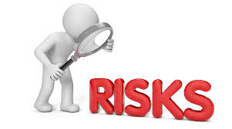
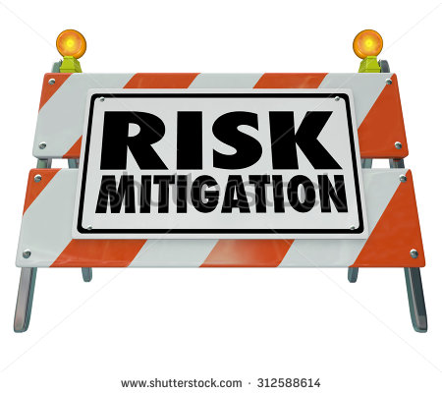
What is an Information Security Assessment?
Key activities that involves the management of RISK
Basically Risk Assessment
Identifying gaps for improvement
An uncertainty condition that might lead to a loss/harm

Slide 15
Risk Assessment
Independent activity to review, various process in order to identify, measure, monitor and decide on acceptable level of risks.
Identification of risks (internal and external)
Evaluation of effectiveness of control system
Populating the risk matrix prior to Auditing process.
The advantages of risk based audit approach are that the organizations become proactive rather than being purely reactive, preventing the undesired effects and promoting the continual improvements. Prevention setup is automatic when a management system is risk-based. (source: https://www.e-qms.co.uk/advantages-of-risk-based-audit-approach/)

Slide 16

Class Activity
Identifying security risks surrounding you!!!

Slide 17
Overview of Information security assessment/ Risk assessment
Information system provide numerous benefits and efficiencies but those benefits come with risks.
In managing information security the following risk-based approach involves:
Identifying and categorizing the information assets and information system.
Selecting and implementing appropriate security control
Assessing the controls for effectiveness
Authorizing the systems by accepting the risk based upon the selected security controls
Monitoring the security controls on continual basis

Slide 18
Methods for conducting Information security assessments
Examination – verify, inspect and review
Interview – discussion to obtain evidence
Test – use tools, put specific assessment objects under specific conditions

Slide 19
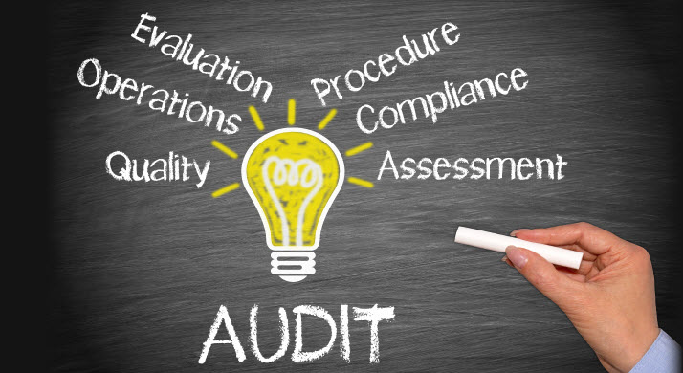
What is an Information Security Audit?
Independent assessment through structured examination of an organization’s internal policies, controls and activities.
To determine compliance with stated policies.
To provide reasonable assurance that organization are compliant with applicable regulation and other industry requirements.
Notes:
Information Security Audit:
Objective:
An Information Security Audit is a structured examination and verification of an organization's information security policies, controls, and practices. The primary objective is to ensure compliance with established standards, regulations, and internal policies.
Scope:
Audits typically focus on predefined security controls, policies, and procedures, often based on regulatory requirements, industry standards, or internal policies. The scope is often more rigid and compliance-oriented.
Methodology:
Audits involve a thorough review and verification of security controls to ensure that they are being implemented and followed as required. Auditors may examine documentation, interview personnel, and assess adherence to established processes.
Frequency:
Information Security Audits are usually scheduled events and are often conducted on a regular basis (e.g., annually) to ensure continuous compliance and adherence to security standards.
Output:
The output of an Information Security Audit is an audit report that outlines the findings related to compliance with standards and policies. It highlights any non-compliance issues, areas for improvement, and recommendations for corrective actions.
In summary, Information Security Assessments focus on identifying vulnerabilities and risks in an organization's security environment, often with the aim of improving security. Information Security Audits primarily center on verifying compliance with established security standards, regulations, and internal policies. Both processes are essential for maintaining strong information security, and they can complement each other when conducted in parallel.

Slide 20
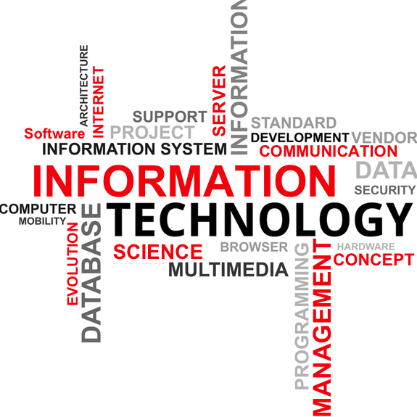

Types of audit
Financial audits
Management compliance audits
Operational audits
Investigation audits
Information system audit
Information technology audits
Information security audit

Slide 21
Information System Audits
Examination of various controls within an information system infrastructure/components against policy/standard.
Collection of evidence and evaluation towards design, functions of controls, implemented information system, practices and its operations.
Determine whether the information system safeguard assets, maintain data integrity, operate effectively and efficiently toward meeting its objectives.
It can be conducted independently or along with other type of audit e.g: financial audit.

Slide 22
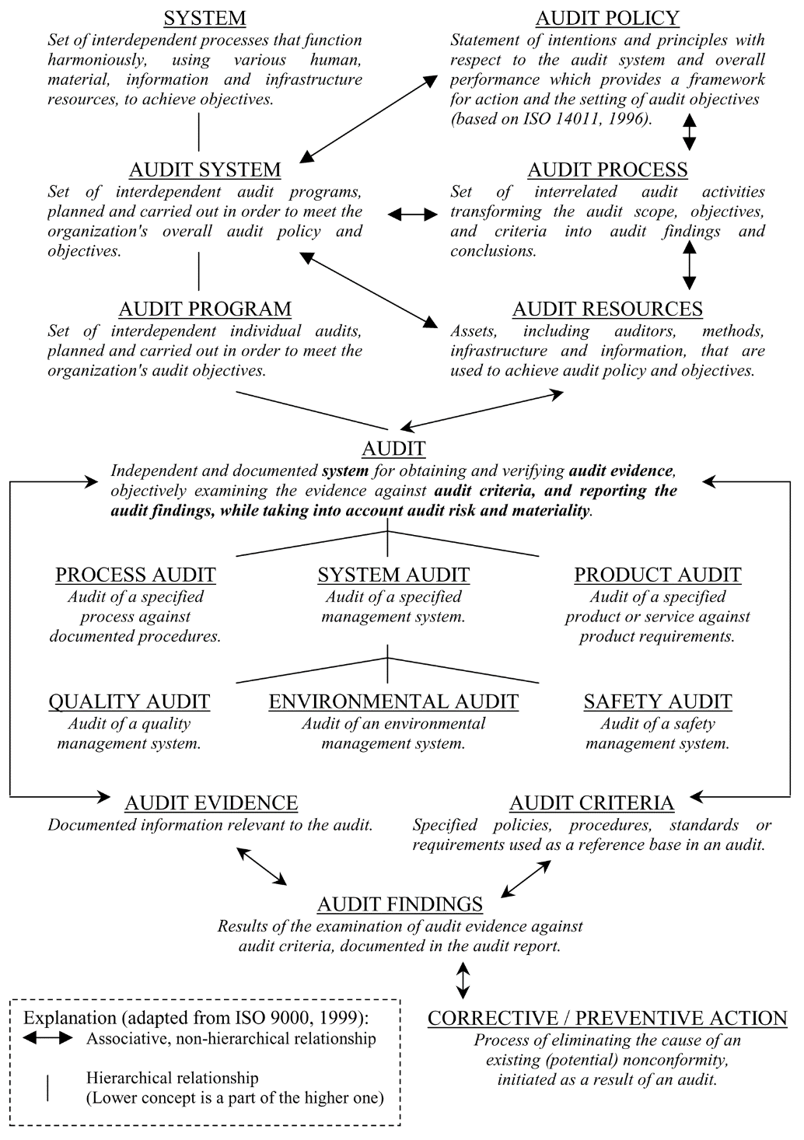
Ecosystem of Information System Audit
Source: Stanislav Karapetrovic and Walter Willborn,Generic audit of management
systems: fundamentals,Managerial Auditing Journal 15/6 [2000] 279±294

Slide 23
Information system audit coverage
As IT auditors you MUST be well versed in all of this issues:
Hardware security issues
Software security issues
Information Security Audit requirements
Conducting an information system audit
Risk-based information systems audit
Auditing disaster recovery plan
Auditing in the multiple type of IT technology
Security testing
Information Security Grading such as ISecGrade framework/ISO 27000

Slide 24
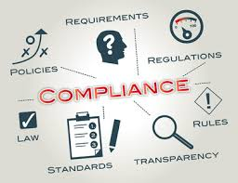
What is Compliance?
Simple word but Enigma aka Problem within many organization.
In definition: “the act or process of complying to a desire, demand, proposal, or routine or to force” Merriam-Webster Online
NCR
Non-compliance Report
Non-conformity Report

Slide 25

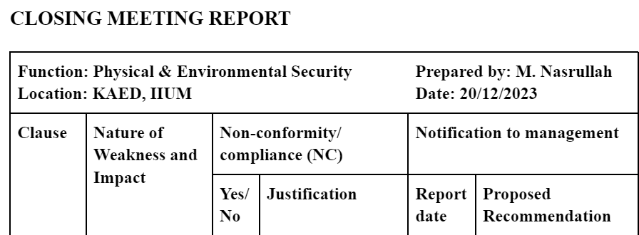
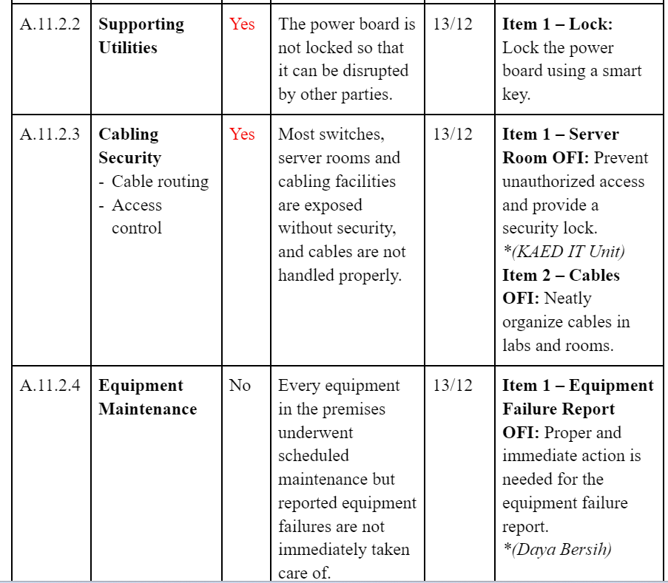

Slide 26
Why are governance & compliance important to business entity?
Ensure employees use IT/IS in a productive manner
Protect organization's reputation prevent disputes or legal problems from arising
Encourage employees not to commit crimes using IT/IS
Protect the personal information of customers and employees so thieves don’t steal their identity or money
Ensure the organisation is safe from cyber criminals by stopping them from committing crimes against IT/IS (like crashing Internet banking)

Slide 27
Contd..Why are governance & compliance important to business entity?
Ensure that contracts concluded electronically are binding. Confidentiality and Integrity
Give others authorized access to information to enable them to enforce their rights
Monitor the online activities of others in a limited responsible way
Protect intellectual property in digital form
Ensure that electronic evidence we have will carry evidentiary weight
Manage records and information as the law required
Source: https://www.michalsons.com/blog/why-it-governance-risk-and-compliance-is-important/19096 Retrieved 5th Feb 2018

Slide 28


What if an organization does not comply with compliance laws?
Licensing
Legal penalties
Out from industry
Reputation
Lost of profit
Trust

Slide 29
Security Assessment (Risk) vs Security Audit
Although there seem to be many similarities, they are some stark differences:
Failure – Audits are more clear cut (pass or fail). Final say. IS security assessment normally not associate with pass or fail. Provide chance for improvement or mitigation.
Management – Risk could be mitigated unlike audit, the NCR could be subject for improvement.
Blame – Audit findings might place blame on specific individuals or group. Risk assessment are non attributive. Don’t view individual as being directly responsible.
Consequences – Audit have negative consequences. Non compliance will result in serious legal penalties. Have sense of fear.
Scope – Audit scope are bigger and specific as compared to risk as it follows certain standard policies.

Slide 30
Additional Differences Audit vs Assessment
Audit | Assessment
Independent evaluation | Independent but NOT necessary (some influence)
Follow rigorous (extremely thorough and careful) approach and are conducted according to accepted principles | Can follow wide spectrum of principles
Auditors must be qualified | Assessors not necessary to be a qualified as auditors
If passed the department/organization will be issued a certificate/confirmation | No certificate will be issued
Concern on the past result and performance. | Considers previous and current results as well as expected performance

Slide 31


