Slide 1
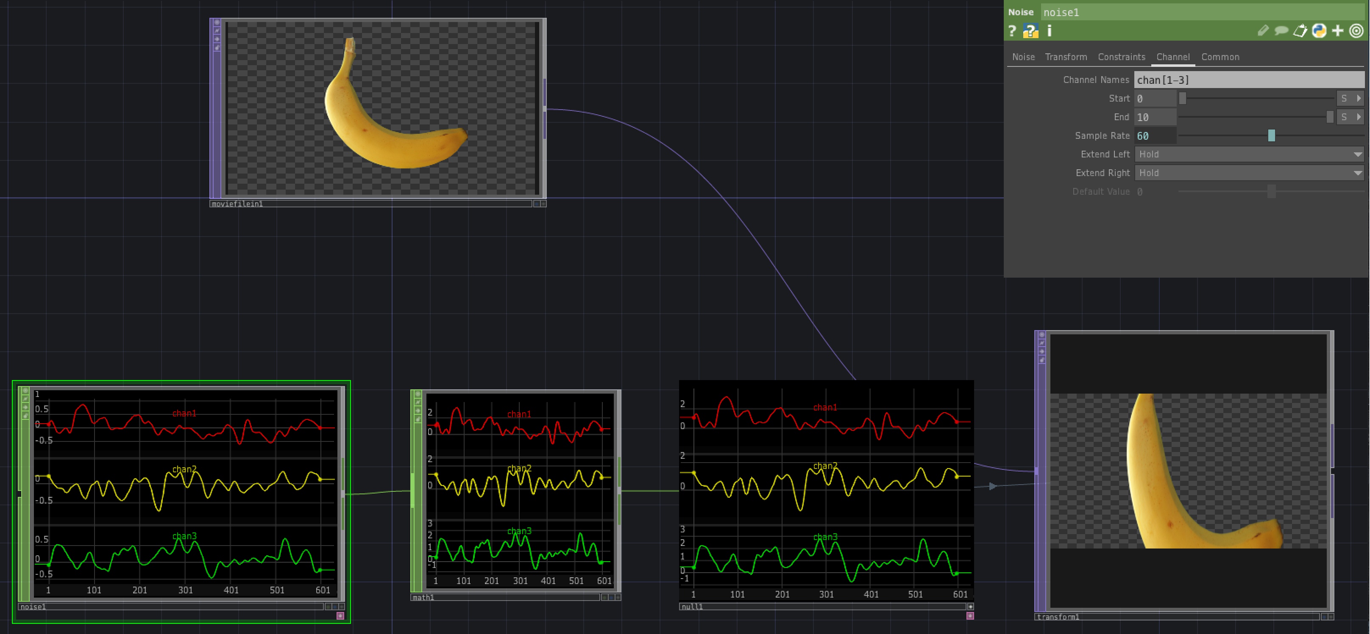
Channel Operators (CHOPs) in TouchDesigner
David Meredith
dave@create.aau.dk

Slide 2
Sources
User guide page on CHOPs
https://derivative.ca/UserGuide/CHOP

Slide 3
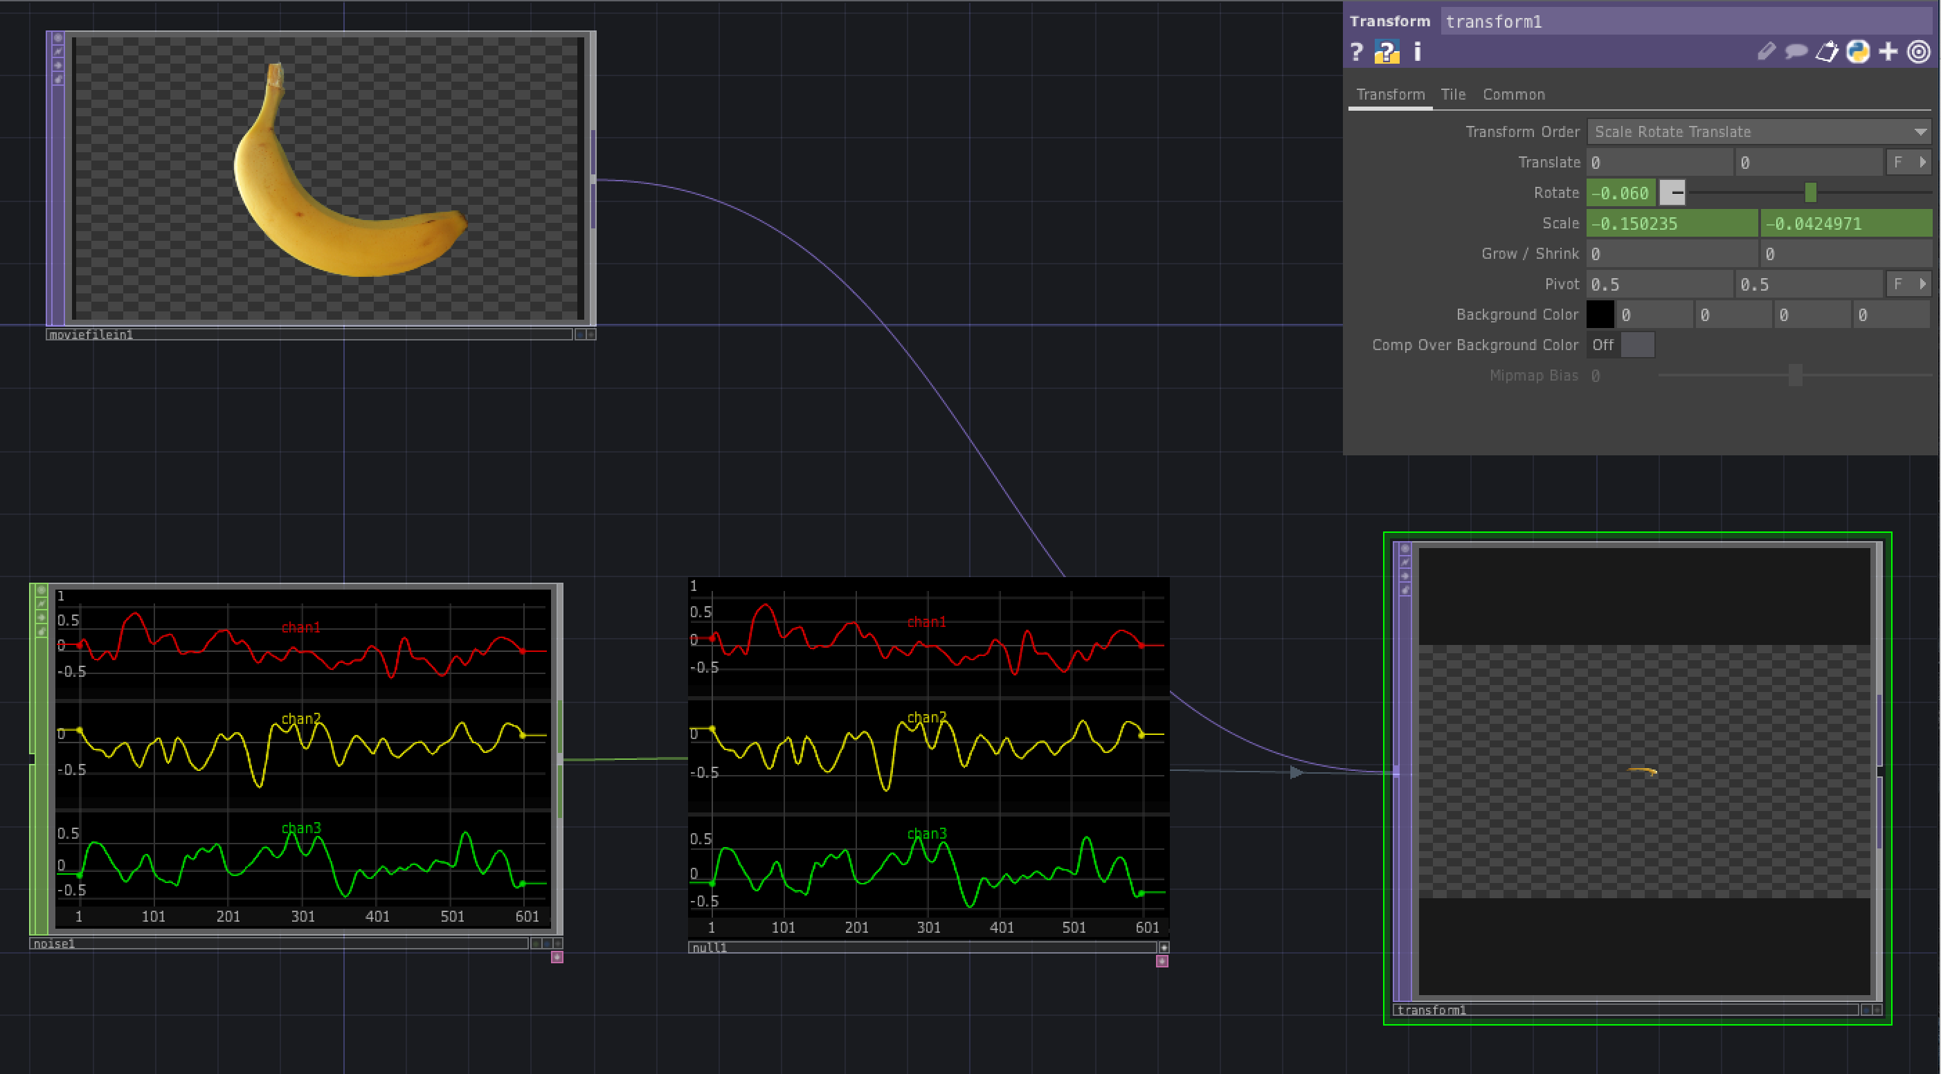
Channel Operators (CHOPs)
CHOPs allow you to process any data in the form of a digital signal or a collection of signals
They can be used to process motion data, audio, MIDI, data from input devices or, indeed, any streams of numerical data
Each CHOP can contain 1 or more channels
A CHOP modifies a channel and passes the data on to the next node in the network
CHOPs control parameters in other nodes through exporting and channel references
Remember to export from a null CHOP so that you can precede it with other CHOPs if necessary without having to change the export

Slide 4
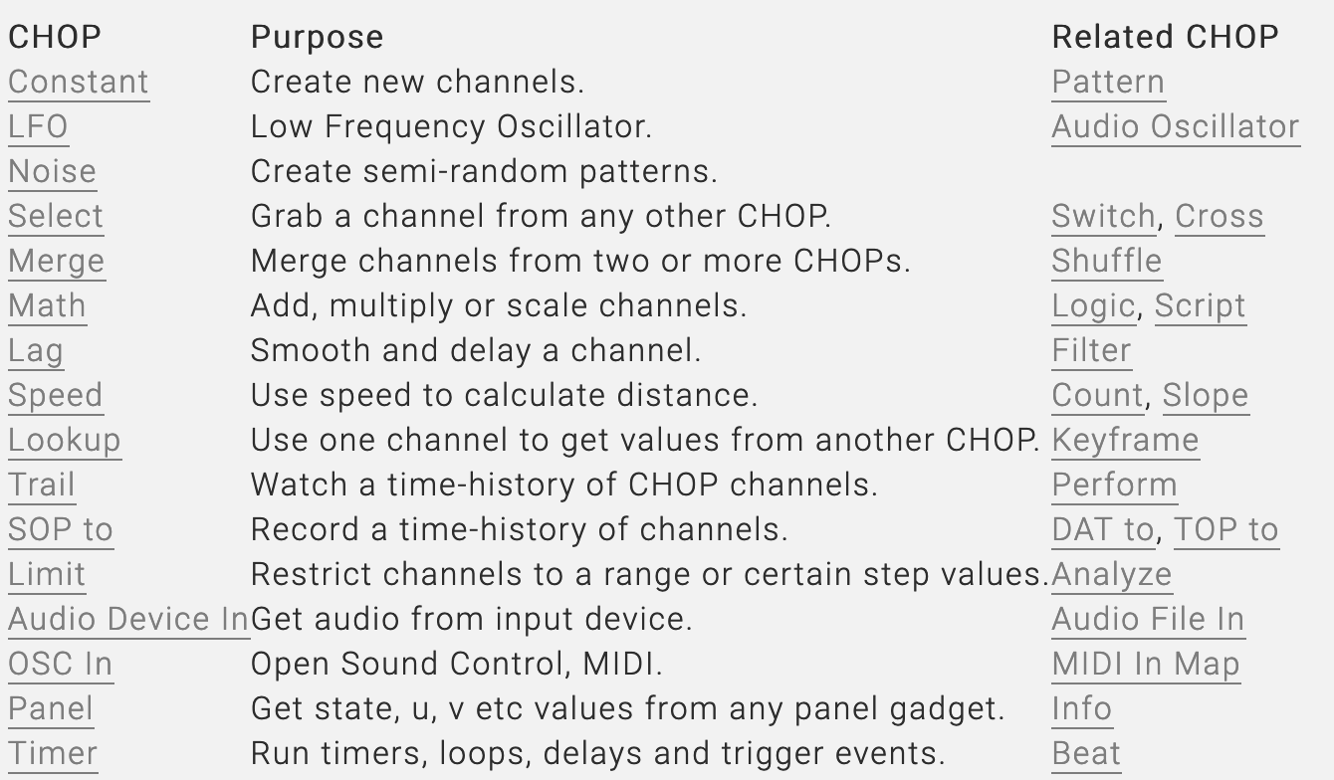
Sweet 16 CHOPs
These 16 CHOPs are commonly used and you should familiarize yourselves with them

Slide 5
CHOPs create and process channels
CHOPs are “procedural networks”
means they can be chained together so that the output of one CHOP flows into the input of one or more other CHOPs
data flows automatically once for each frame (i.e., 60 times per second, by default)
Generator CHOPs create CHOP channels from scratch
e.g., Constant CHOP, Wave CHOP, Timing CHOP, Noise CHOP
CHOPs can also take data from
sliders, buttons, menus, XY-controlers, XYZ values from clicking in 3D viewers
hardware devices via MIDI or OSC protocols
other processes or applications via pipes

Slide 6
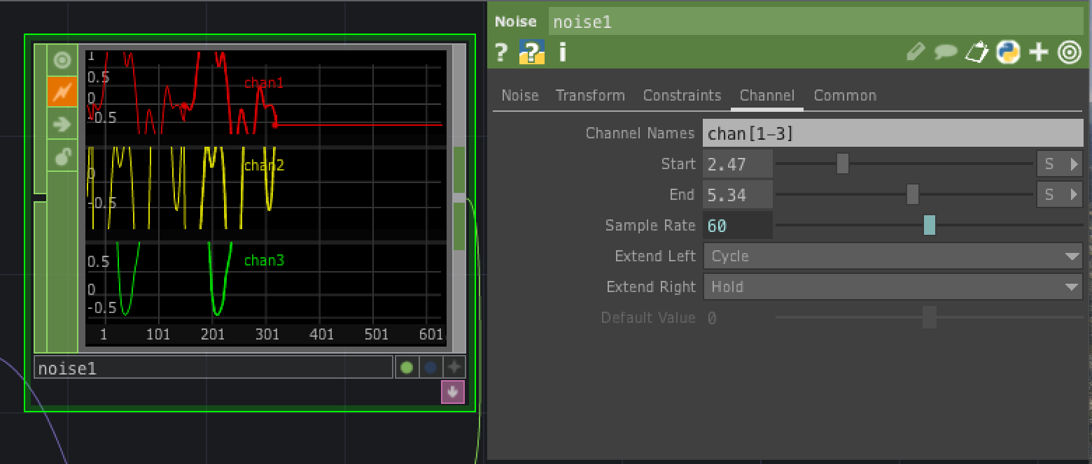
Parts of a CHOP
A CHOP contains
a set of Channels
control Parameters
a sample rate
some on/off flags
a start/end interval
The channels in a CHOP can represent motion, MIDI, audio, color maps, roll-off curves or lookup tables
Any data that can be represented as a sequence of numbers can be represented as a CHOP channel
The numbers themselves are called samples
CHOP parameter values can often be expressed in a variety of units – samples (indices), frames, seconds
the unit is usually selected in a menu to the right of the parameter whose value is being set
Sample indices start at 0 and each sample corresponds to a frame
Sample rate is used if a CHOP contains time-dependent motion or audio data
audio has a much higher sampling rate (typically 44.1kHz) than animated motion (typically 30-60 Hz)

Slide 7
Flags
Display flag marks CHOP to be displayed in a CHOP viewer
Export flag toggles CHOP channel exports
Lock flag locks CHOP so that it can be manually edited
Bypass flag disables CHOP and lets input flow straight through the CHOP unmodified
Clone immune flag prevents CHOP from being automatically modified when a modification takes place in a clone of it
All channels in a single CHOP have the same start-end interval that extends from a start index to an end index
Every CHOP has a comment field that lets you add an explanatory note
The info pop-up lists channel names, intervals, sample rates etc.
Extend conditions determine what you get when a value is requested whose index is outside the start-end interval

Slide 8
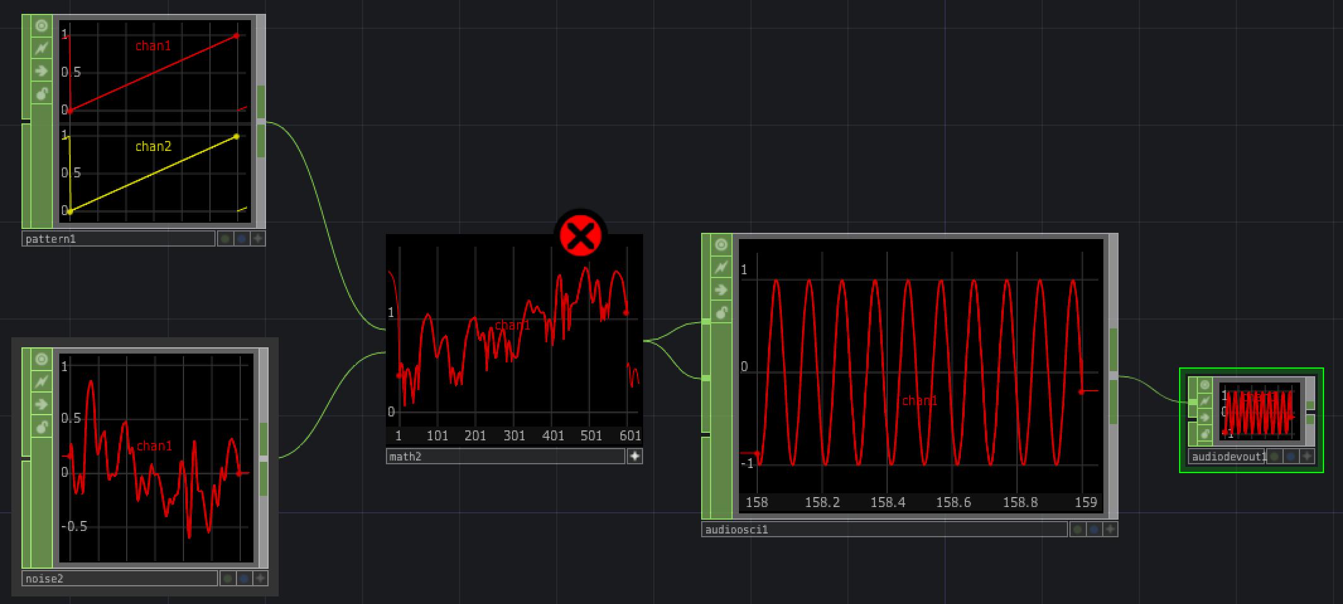
Inputs and outputs
A CHOP receives channels at its inputs, then cooks, which may combine values at the inputs, and then outputs the resulting channels to other CHOPs
Each data channel is an array of numerical values, not keyframed or interpolated segments
some CHOPs retain interpolated segments internally (e.g., Keyframe CHOP and Spline CHOP)
If a CHOP’s inputs are not changing and control parameters are not time-dependent, then the CHOP will not cook on each frame
Example shows how to combine a noise CHOP and a pattern CHOP to control pitch of an audio oscillator

Slide 9
Importing and exporting CHOP channels
Preferred way to export a channel to a parameter is to export it by dragging the channel onto the parameter
You can export CHOP data channels to numerical parameters in any other operator
You can turn off exporting with the Export flag

Slide 10
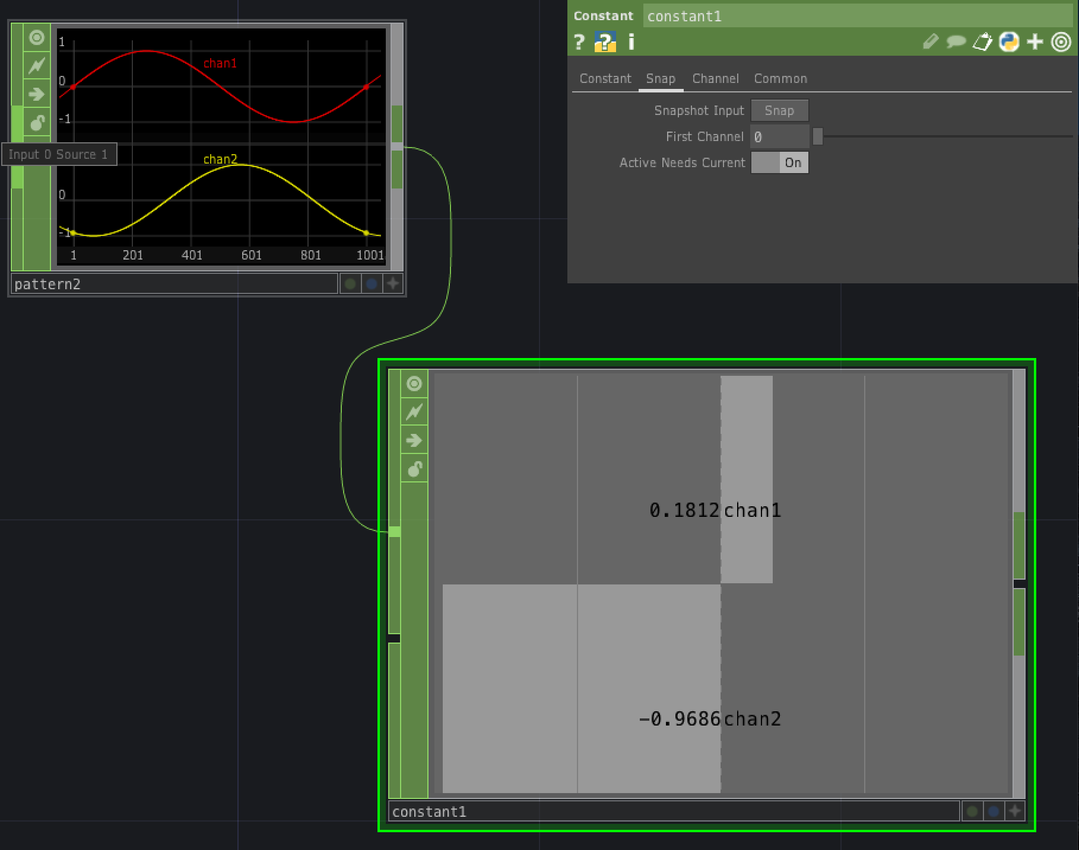
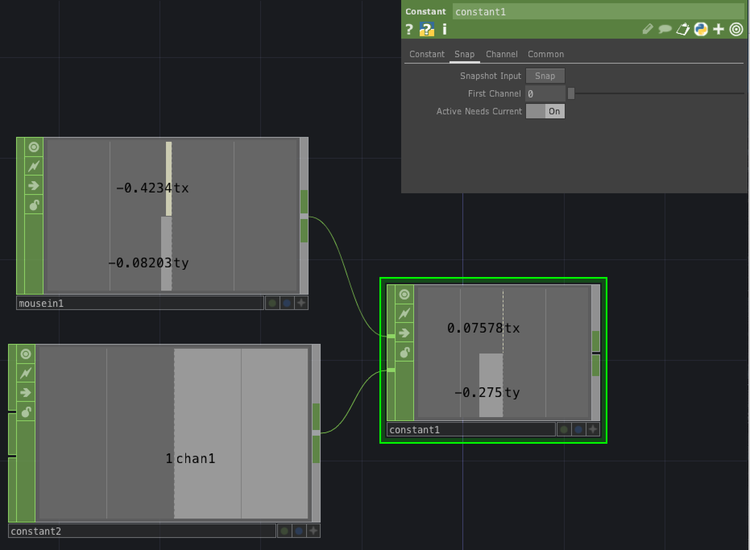
Constant CHOP https://derivative.ca/UserGuide/Constant_CHOP
Constant CHOP creates new constant- value channels
Each channel can be named and assigned a different value on the Constant parameter page
Interval is 1 sample long with one sample at index 0, corresponding to frame 1
You can change this on the Channel page, where you can choose for the CHOP not to be a single sample, adjust sample rate etc.
Usually used without input, but channel names and values can be set by pressing the Snapshot Input button on the Snap page (see above left for example)
Constant page
Create/delete channels with the +/- button or by writing expressions in the Name box, e.g.,
geo[1-5:2]:s[xyz]
Snap page
If second input is > 0, then press Snap button, then sends first input to output
Try with Mouse In CHOP attached to first input and constant CHOP with value greater than 0 attached to second input

Slide 11
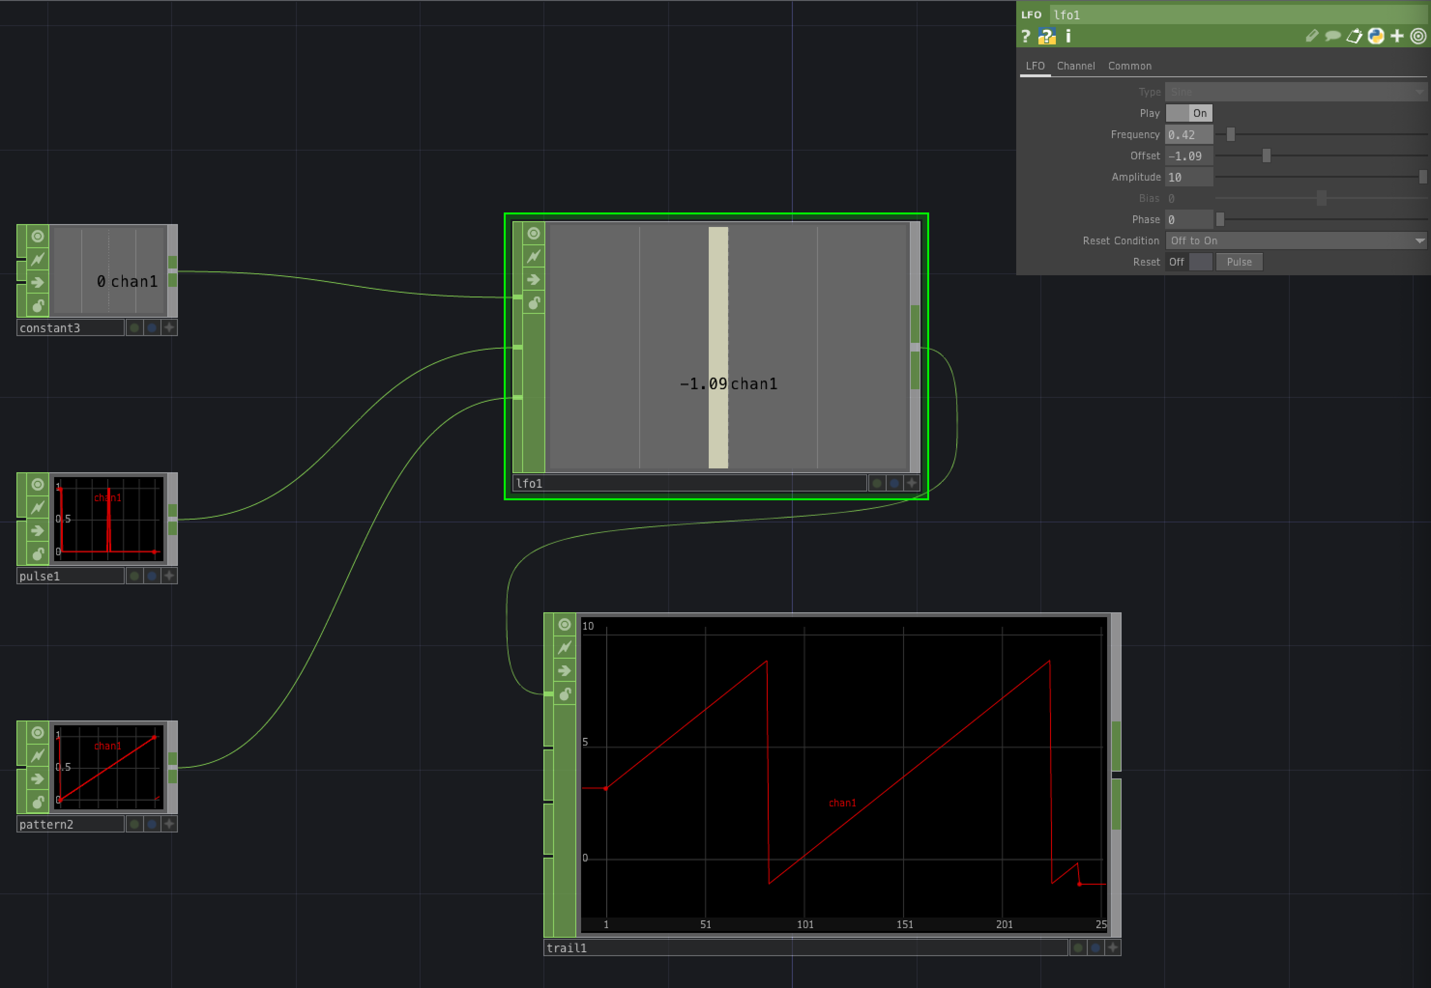
LFO CHOP https://derivative.ca/UserGuide/LFO_CHOP
LFO CHOP generates waves in real time by either
synthesizing common waveforms like sine or pulse
or repeating a prepared incoming curve
Steps through the waveform at a rate that depends on Frequency parameter and Octave Control input
Watch behaviour by attaching a Trail CHOP to its output and changing the Frequency parameter
Can take three inputs
Octave Control: controls how much the frequency is multiplied – 0 -> no change; 1 -> x 2 (increase octave by 1), -1 -> /2 (decrease octave by 1)
Reset: 2nd input causes oscillator to restart when input value is greater than 0
Source wave: can use this input to replace the waveform defined in Type parameter
LFO can serve as a general repeater and time-scaler
Change the frequency to alter the time-scaling
This is a time-sliced CHOP, meaning that it speeds up and slows down as the frequency is changed (cf. Wave CHOP)
LFO CHOP is designed for non-audio frequencies

Slide 12
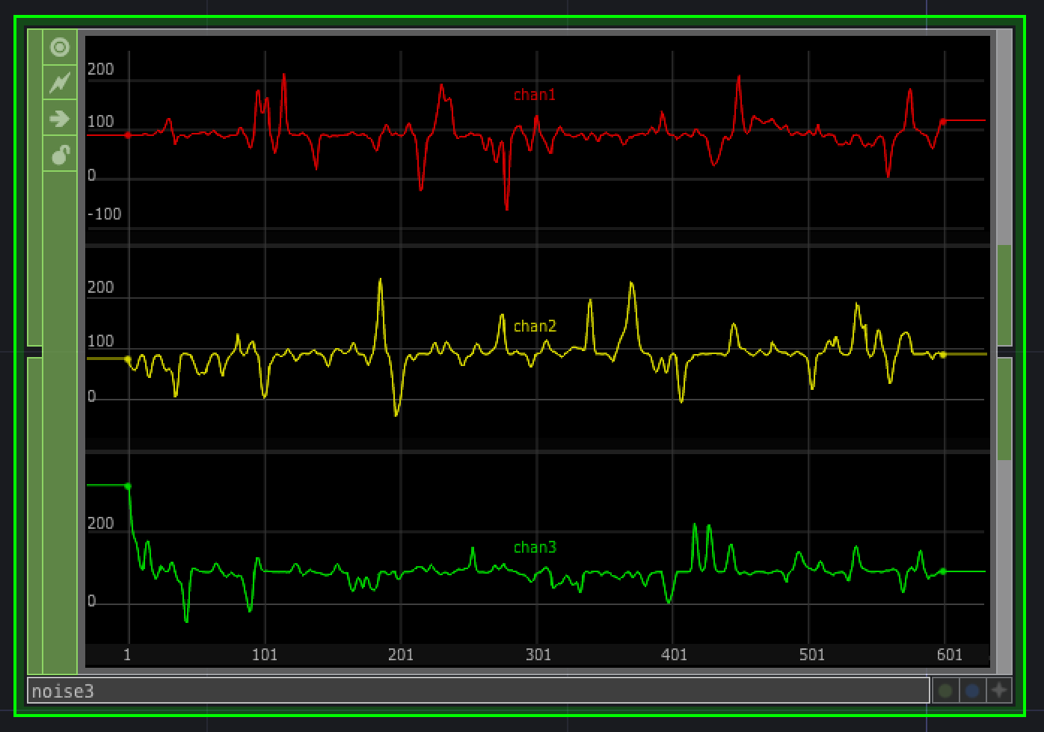
Noise CHOP https://derivative.ca/UserGuide/Noise_CHOP
Noise CHOP creates an irregular wave that never repeats, with values approximately in the range [-1,1]
It can generate both smoothed curves and signals in which each sample is intended to be independent of the previous one
You can create several curves with different shapes
You can adjust period, amplitude, harmonics, etc.

Slide 13
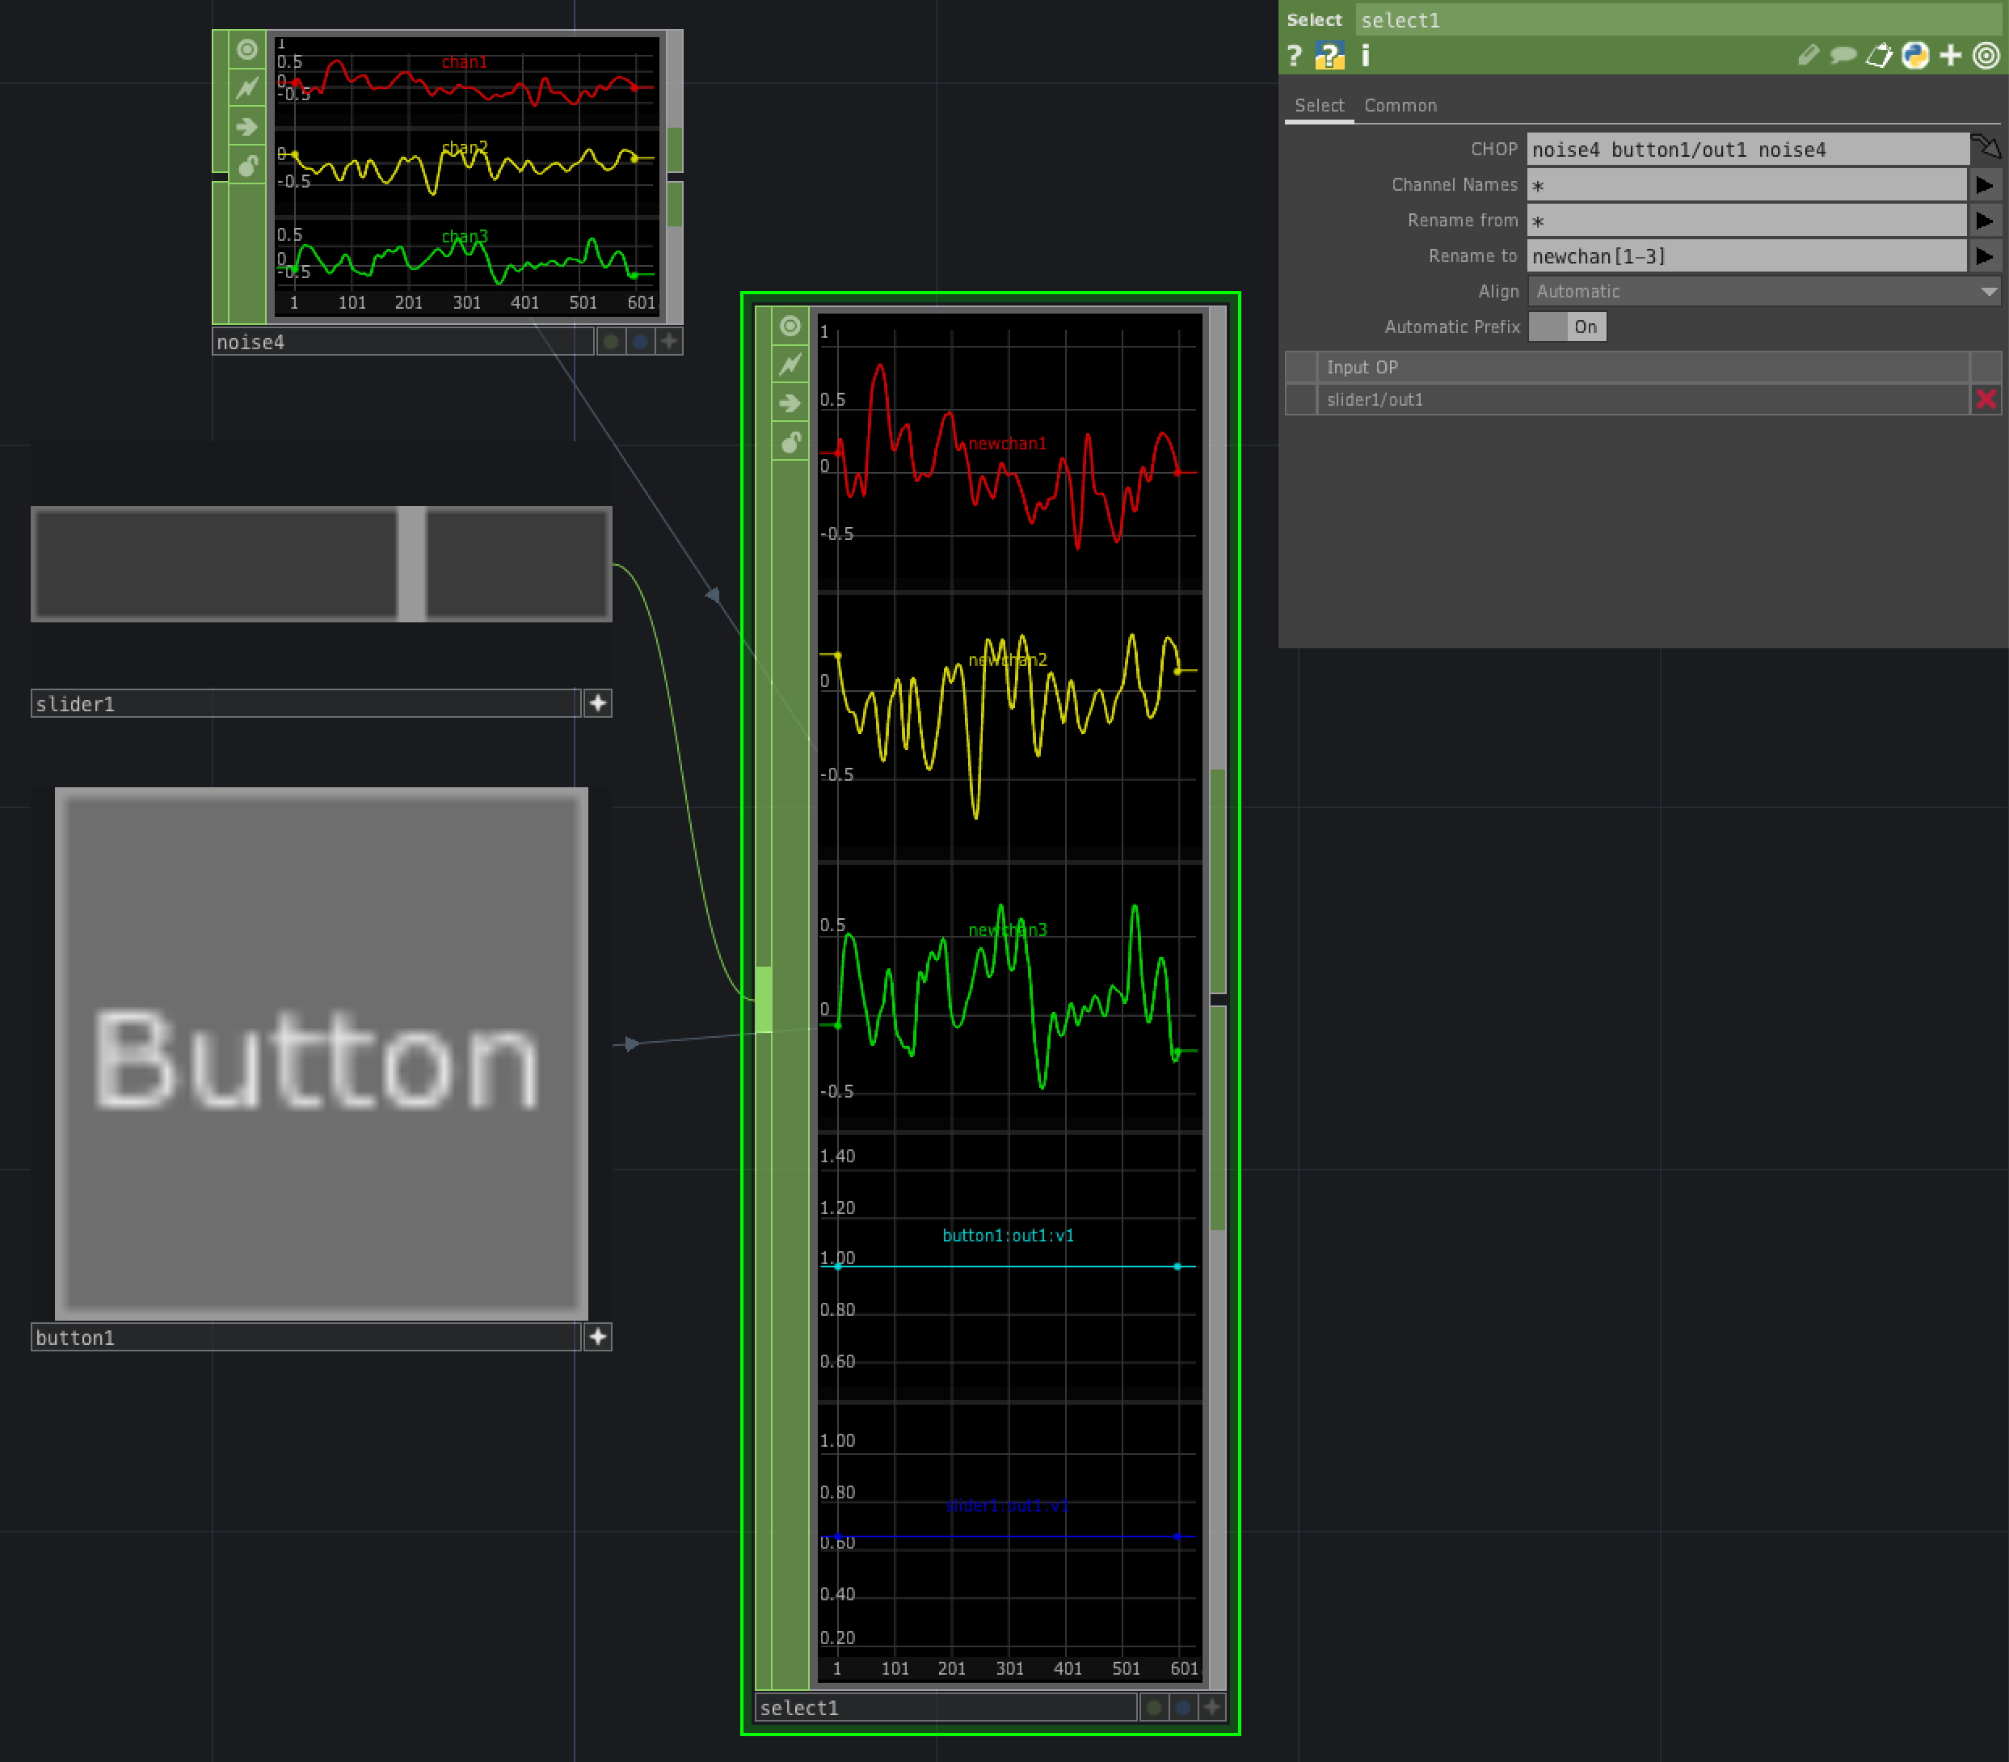
Select CHOP https://derivative.ca/UserGuide/Select_CHOP
Selects and renames channels from other CHOPs
You can select channels from control panel gadgets like sliders and buttons
Retrieves channels from one or more CHOPs
Selects only the channels you specify
e.g., “c2 c5 c3 c3” will select four channels of which the last two will be identical
You can get channels either
from the CHOP and Channel Name parameters, or
from a CHOP connected to the input

Slide 14
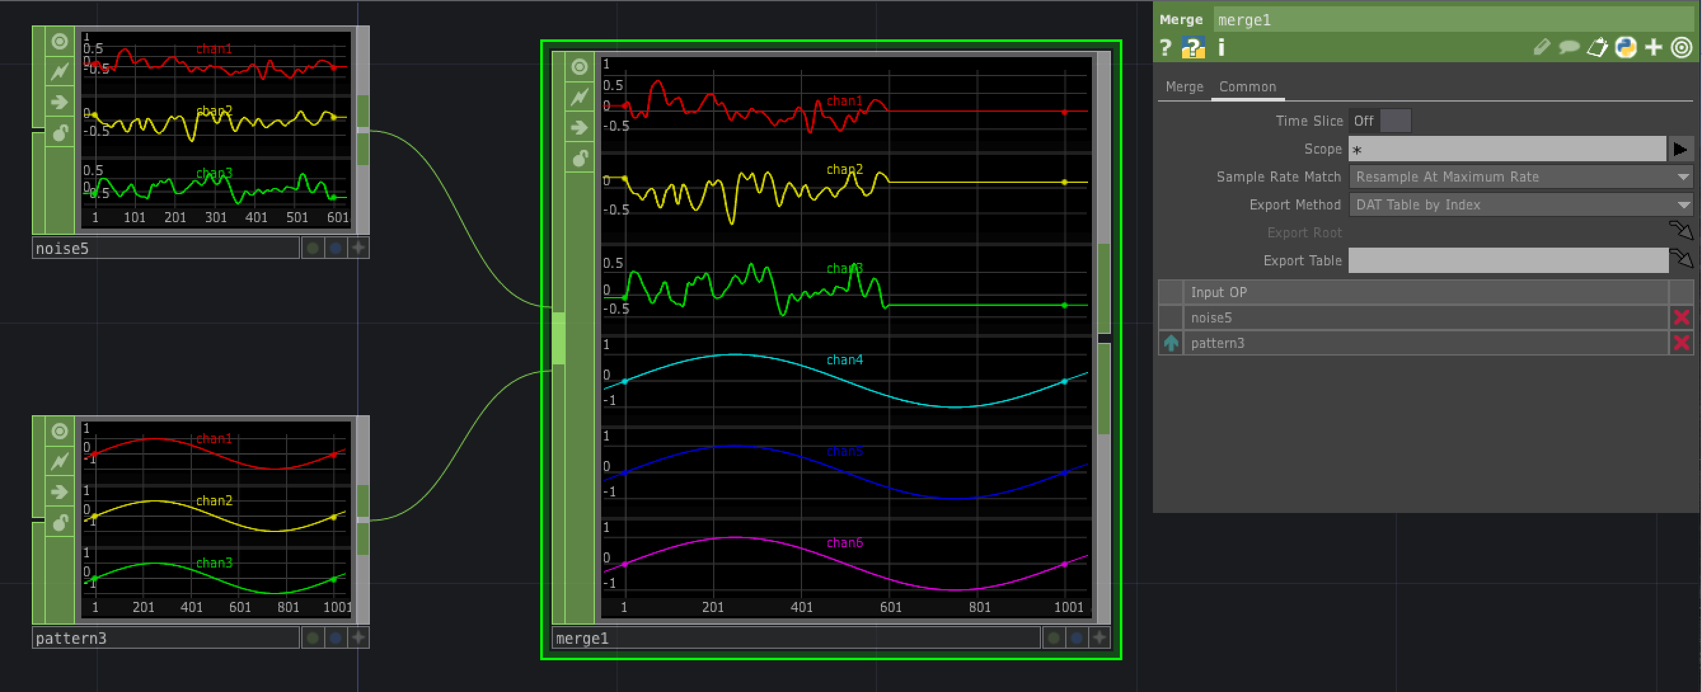
Merge CHOP https://derivative.ca/UserGuide/Merge_CHOP
Takes multiple inputs and merges them into a single output
All channels in the input appear in the output, in the order in which they appear in the input
If two or more input channels have the same name, then they are renamed using the method specified in the Duplicate Names menu on the Merge parameter page

Slide 15
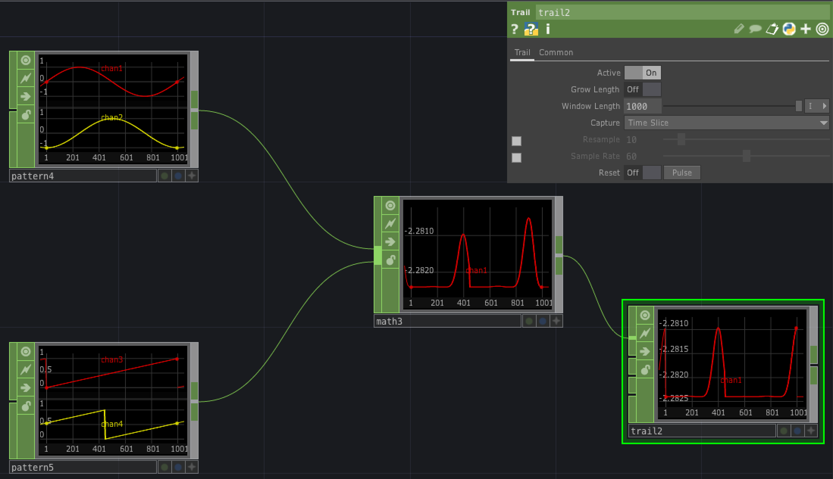
Math CHOP https://derivative.ca/UserGuide/Math_CHOP
Performs arithmetic operations on channels
Channels of a CHOP can be combined into one channel
Several CHOPs can be combined into one CHOP
OP page
Channel Pre OP defines operation to carry out first on channels, applied to each sample individually
Combine Channels combines, for each input CHOP, all the channels it contains using the specified operator
Remember this occurs after the Pre OP has been applied sample-wise to all the channels in the input
Combine CHOPs combines the result of Combine Channels using the specified operator, to get a single curve
Channel Post OP gives the option to apply a final sample-wise operation to all the samples individually
Mult-Add page lets you offset and scale sample values individually
Range page lets you do linear scaling and map output to a specified range

Slide 16
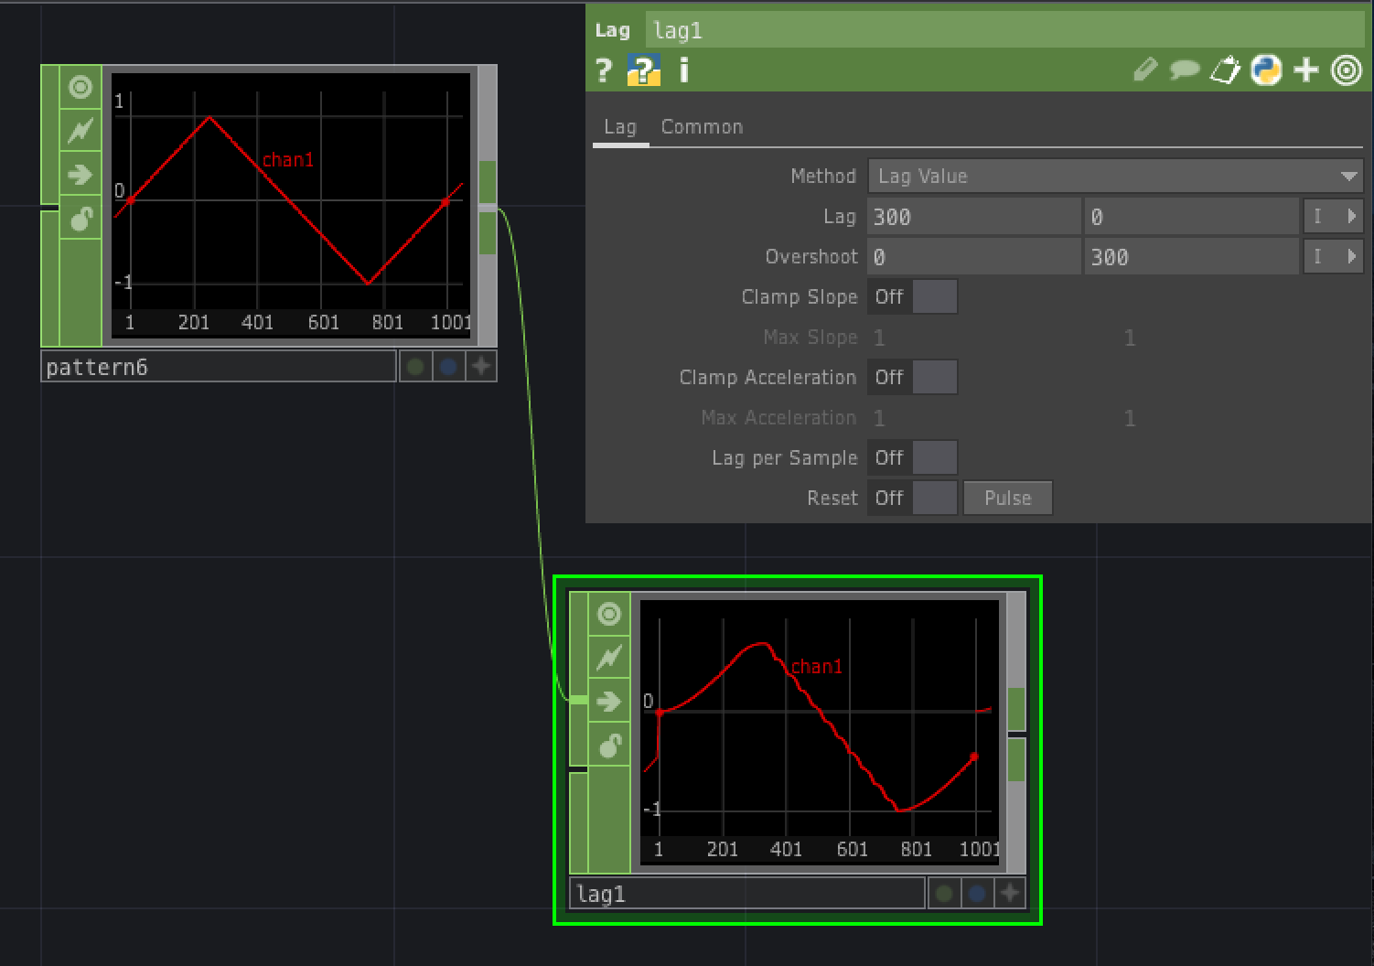
Lag CHOP https://derivative.ca/UserGuide/Lag_CHOP
Adds lag and overshoot to channels
Can also limit velocity and acceleration of channels
Lag slows down rapid changes in input channels
Overshoot amplifies changes in input channels
Lag and Overshoot parameters have two values:
First one determines what happens input channel is rising
Second determines what happens when input channel is falling

Slide 17
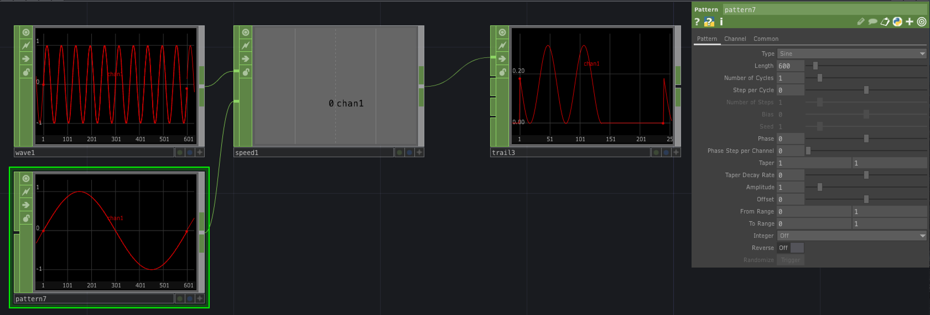
Speed CHOP https://derivative.ca/UserGuide/Speed_CHOP
Converts a rate into a cumulative value
e.g., a speed in units per second into a distance (units)
Technically, it integrates the input signal, i.e., calculates the cumulative area under the curve of sample value against time
If you send a Constant CHOP whose channel value is 1 into a Speed CHOP, then the value of the Speed CHOP will increase by 1 every second
Use a Trail CHOP to see the effect
You can reset the Speed CHOP by pressing its reset parameter or by sending a value greater than 0 into the second input
Set the Reset Value parameter to determine the initial value after reset
If a wave is sent into the second input that is greater than zero for half of its period, then the speed chop is set at its reset value for this interval

Slide 18
Exercises
Create a network using an Audio Oscillator CHOP and an Audio Device Out CHOP. Use a Constant CHOP, a Speed CHOP, a Math CHOP and a Pattern CHOP to make it so that the output audio signal consists of short periods in which the frequency rises alternating with silence.
Create a network in which you use a Composite TOP to composite two images (e.g., the banana and the first Nature movie). The background of the overlay image should be transparent so that you can see the fixed layer image behind it. Now add a Mouse In CHOP and set it up so that the mouse position determines the position of the overlay over the fixed layer texture in the Composite TOP. When you move your mouse, you should see a corresponding movement in the Overlay.
Make a composite of a radial ramp and a movie file. Control the phase of the ramp with an LFO. Control the octave of the LFO with a step pattern that increases from 0 to 1 and then to 2 over the length of the timeline.

