Slide 1
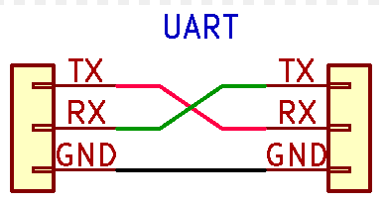
Modular CanBus Controller
Sensor Ground
Sensor Ground
Sensor
Can low
Can high
Sensor Data
12V-5V
Can Bus Chip
Micro Controller
5V Out
12V
Ground
Can be chassis ground
Relay
12V Switched
Light, fan ect
12V
Ground

