Slide 1

Kent Lab BI3001 Projects 2023:
Plotting CFDs
Cumulative Frequency Distributions
Complete Fecking Disaster
Computing Frustrating Data
Contemptible Futile Derangement
Cute Fluffy Ducklings
ድምር ድግግሞሽ ስርጭቶች

Slide 2
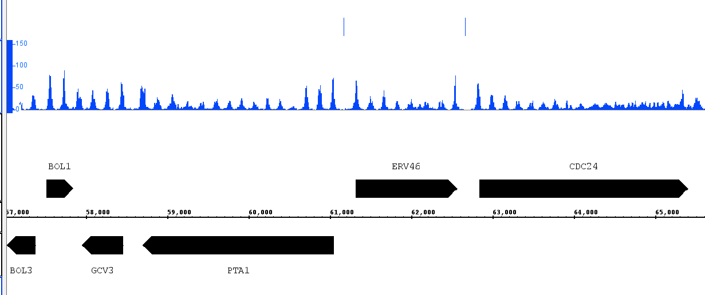
From this plot of nucleosome positions together with some ChIP-exo data for Abf1 we might hypothesise that Abf1 sits with NFRs?
ChIP-exo Abf1 locations
150bp particle
read frequency
NFR
NFR
Chromosome position (bp)
We need a method to GENERALISE the MNase-seq data patterns for ALL Abf1 sites…?

Slide 3
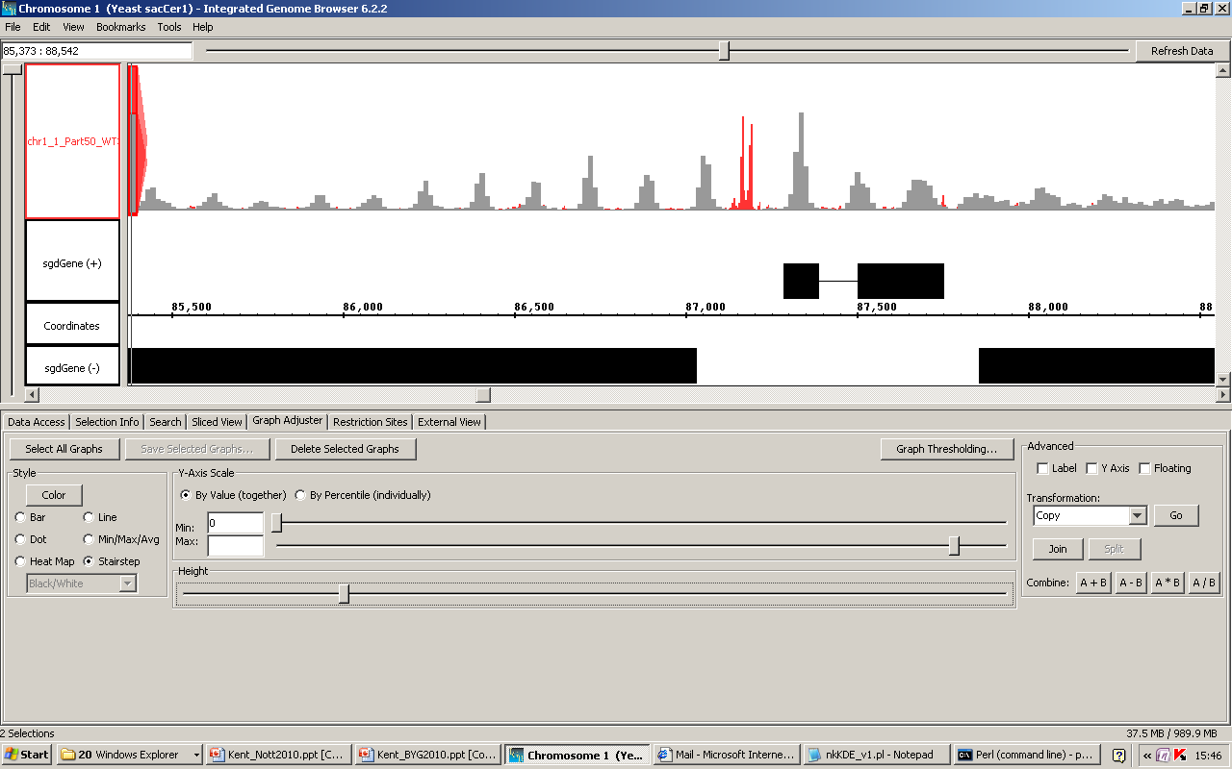
One method is to line up plots, for all locations in the genome bound to a factor… and to SUM the data.
Abf1
site
+
Location 1
Technically this is taking a set of frequency distributions and calculating a CUMULATIVE FREQUENCY DISTRIBUTION (CFD)
Frequency of sequence reads
=
+
Location 2
Keep going for all locations in the genome
+
Location 3

Slide 4
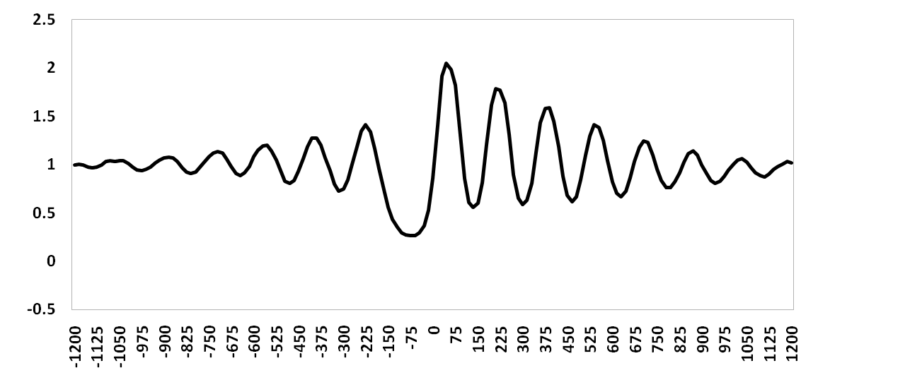


The NULL HYPOTHESIS would be that there is NO common pattern in frequency distribution data at a set of locations - in this case a CFD will just sum to a flat background average.
Abf1
site
NULL HYPOTHESIS:
“No common structure”
i.e. a flat line:
+
Location 1
Frequency of sequence reads
=
NFR
Cumulative read frequency
+
Location 2
Abf1
sites
Keep going for all locations in the genome
+
Location 3

Slide 5
We sometimes find that the null hypothesis ends up in the bin! Here we might conclude that Abf1, on average, occurs within an NFR and is surrounded by positioned nucleosomes.
CUMULATIVE FREQUENCY DISTRIBUTION (CFD)
+
Location 1
Frequency of sequence reads
=
NFR
Cumulative read frequency
+
Location 2
Abf1
sites
+
Location 3
n = 724 yeast Abf1 locations

Slide 6
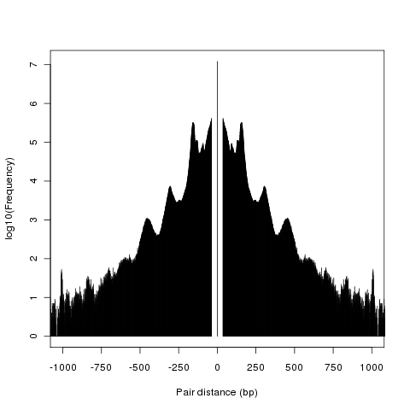
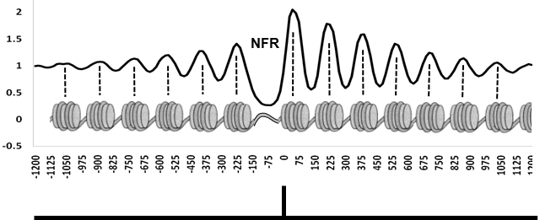
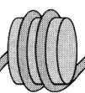
So, this a CFD plot using MNase-seq data for nucleosomes – “chromatin particles” of MNase-protection size = 150bp (“Part150”)…
1000
750
450bp peak
500
300bp peak
250
150bp peak
0
6
5
4
3
2
1
0
log₁₀ aligned read frequency

Slide 7
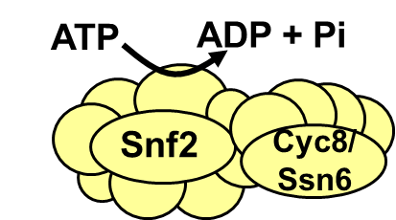
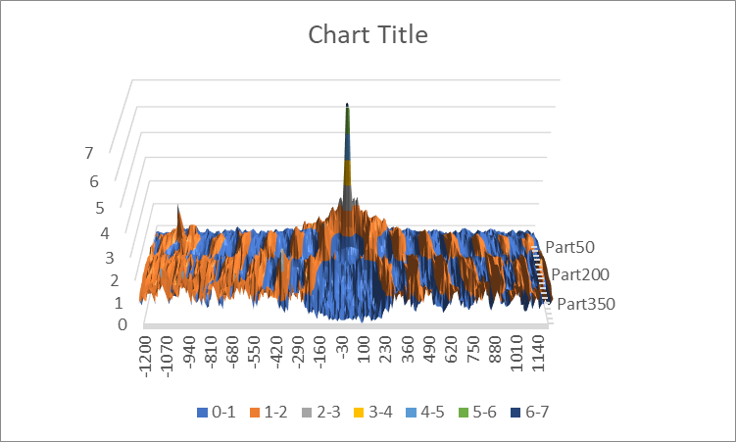
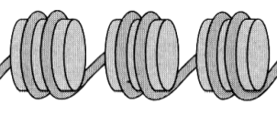
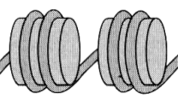


We can plot frequency distributions of reads of any “Chromatin Particle Size” from this dataset just by extending the PartN variable into the z-axis on a CFD graph!
1000
750
Paired read end-to-end distance (bp)
450bp peak
500
300bp peak
250
150bp peak
0
6
5
4
3
2
1
0
log₁₀ aligned read frequency

Slide 8
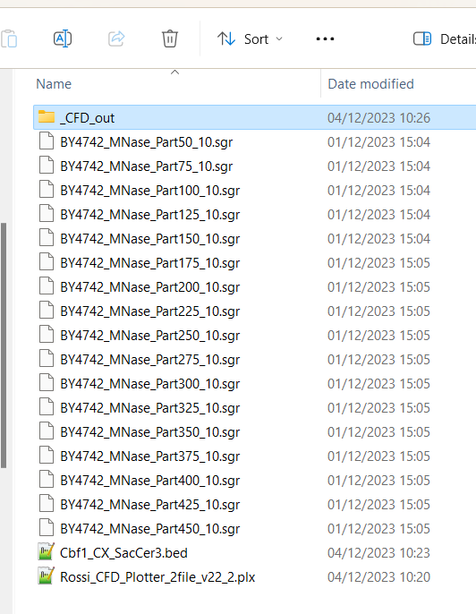
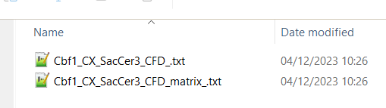
CFD Plotting:
Step 1. Place your .sgr files, one or more x_SacCer3.bed files and a “CFD_Plotter” Perl script in folder and run.
You should get some info on screen and a _CFD_out folder containing two files for each .bed:

Slide 9
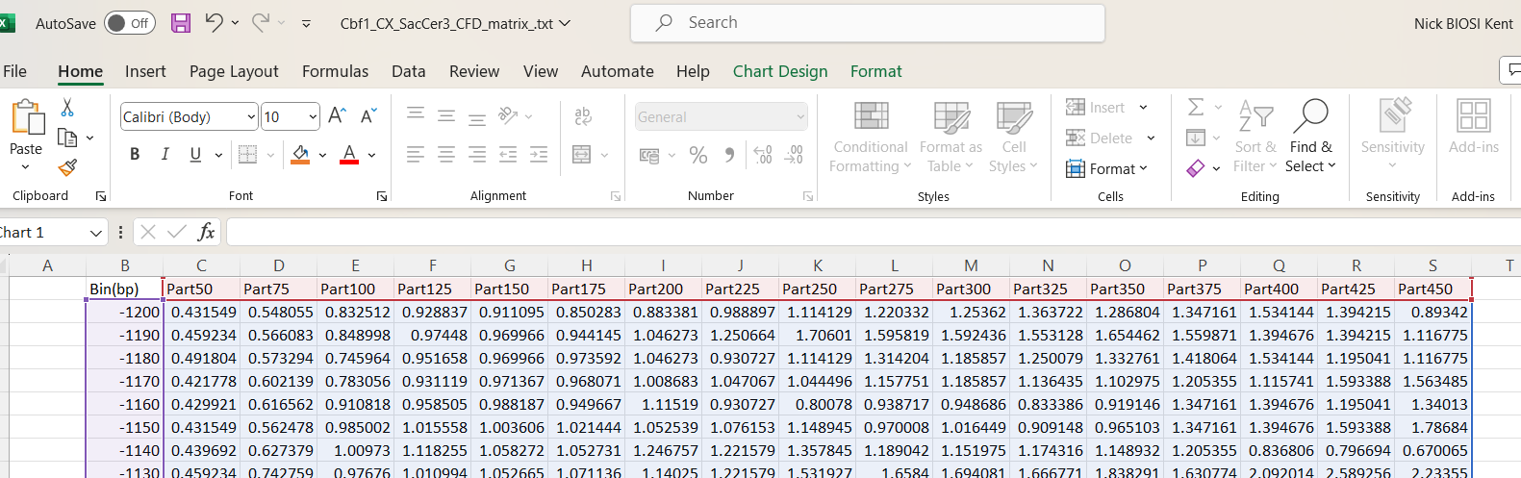
CFD Plotting:
Step 2. Open Excel and use the Open Wizard to select an x_CFD_Matrix.txt file (you might have to select “All Files” and select Tab as a delimiter).
Step 3. Reorder any PartN columns so that they run in ascending numerical order with respect to N

Slide 10
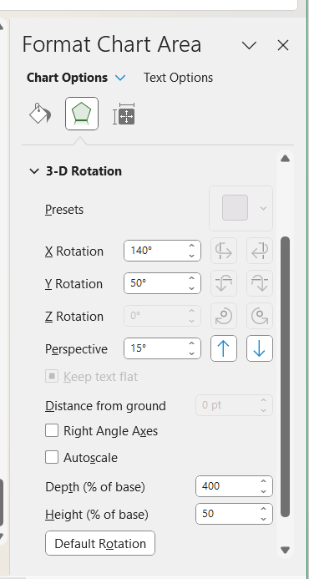
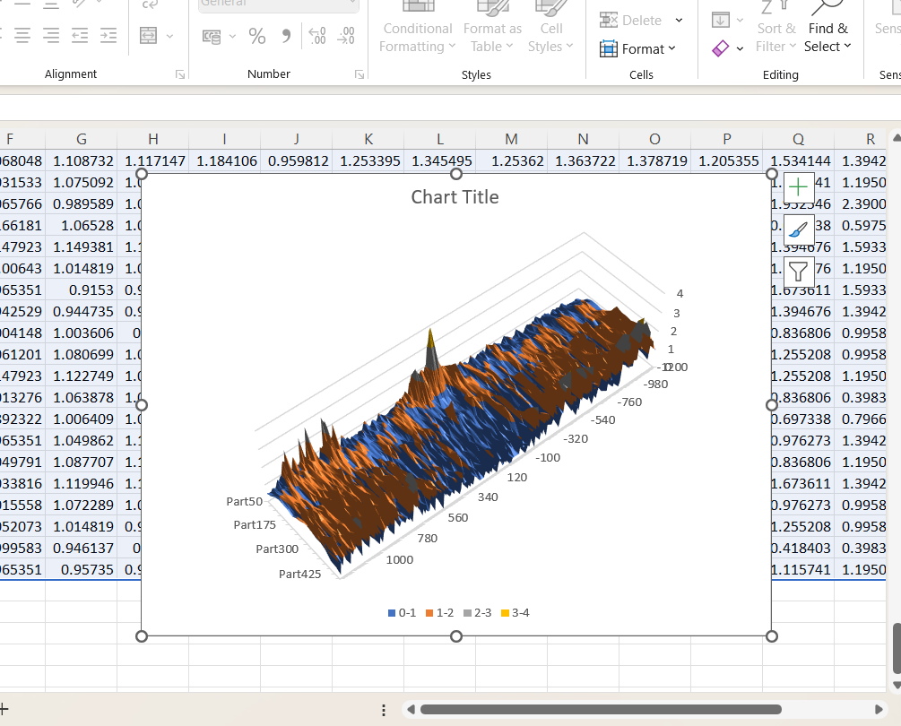
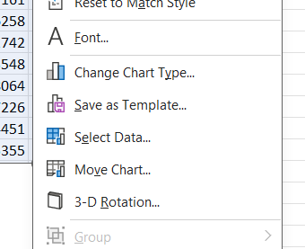
CFD Plotting:
Step 4. Insert a Surface Graph.
Right click on chart edge to select 3-D rotation…
Turn Autoscale off; Rotate and play!

Slide 11
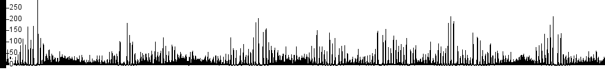

What calculations is the “CFD_Plotter” script actually doing?
150bp
Imagine three sites for which we want a CFD:
Site 1
Site 2
Site 3
e.g. read mid-point frequency values centred on the site bin and 2 bins either side:
Site 1:
30 | 4 | 0 | 9 | 15
BUT – if we want to compare PartN data or data between different experiments we need to NORMALISE the values to some common baseline
Site 2:
29 | 5 | 1 | 6 | 40
Site 3:
5 | 1 | 0 | 2 | 9
bins (bp)
-20
-10
10
20
0bp
Cumulative Frequencies:
64 | 10 | 1 | 17 | 64
bins (bp)
-20
-10
10
20
0bp

Slide 12
Kent Lab normalisation:
150bp
Site 1
Site 2
Site 3
e.g. read mid-point frequency values centred on the site bin and 2 bins either side:
Site 1:
30 | 4 | 0 | 9 | 15
150bp (+/- 20%) reads in bins JUST from Sites 1-3:
=64+10+1+17+64
=156
No of 10bp bins surrounding Sites 1-3
= 3 * 5 =15
Normalisation factor: mean read mid-point frequency per bin surrounding Sites 1-3
= 156/15
= 10.4
(divide CFD by 10.4!)
Site 2:
29 | 5 | 1 | 6 | 40
Site 3:
5 | 1 | 0 | 2 | 9
bins (bp)
-20
-10
10
20
0bp
Cumulative Frequency
Distribution:
64 | 10 | 1 | 17 | 64
Normalised Cumulative Frequency
Distribution:
6.2 | 1.0 | 0.1 | 1.6 | 6.2
bins (bp)
-20
-10
10
20
0bp

Slide 13
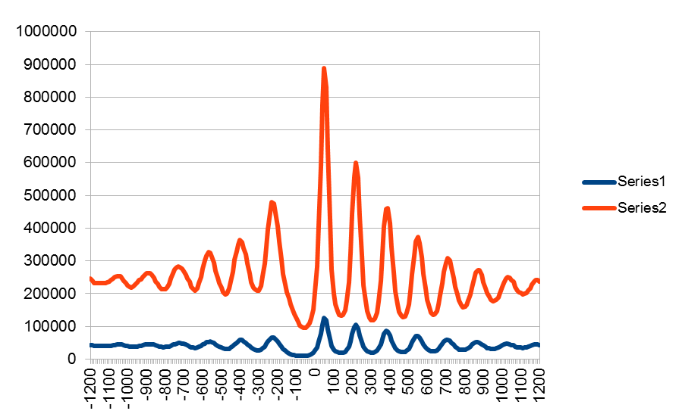
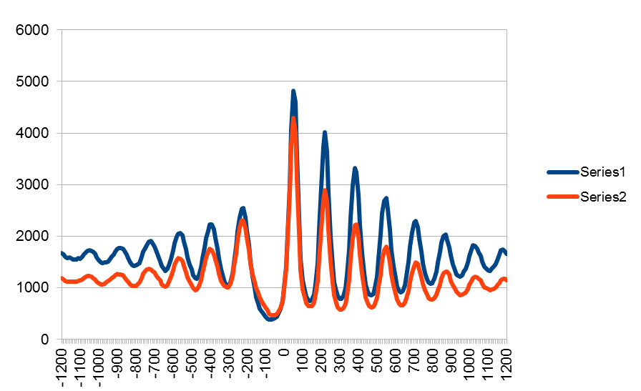
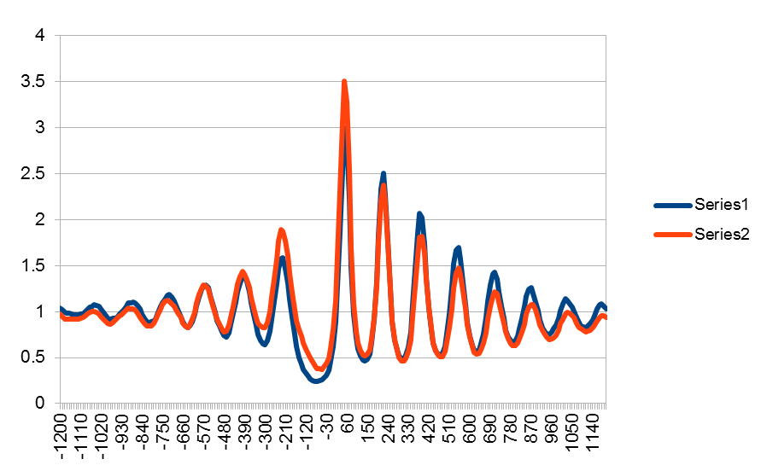
1
Cumulative read mid point frequency
The Kent Lab normalisation method, applied to two bio-replicate experiments but with different read depth, is shown in Panel 3 for Part150 data – it works (and has the effect of scaling “random noise”/null hypothesis to a y-axis value of 1.0)
2
Read-depth normalised...
3
Kent Lab normalised...
Position relative to site (bp) – n = 4200

Slide 14
Now you understand the axes….?
y – axis: Normalised cumulative MNase-seq paired-read mid-point frequency
z – axis: Chromatin particle (“Part”) MNase protection size (bp)
x – axis: Position (bp) relative to ChIP-exo binding sites (n = ?)

