Slide 1

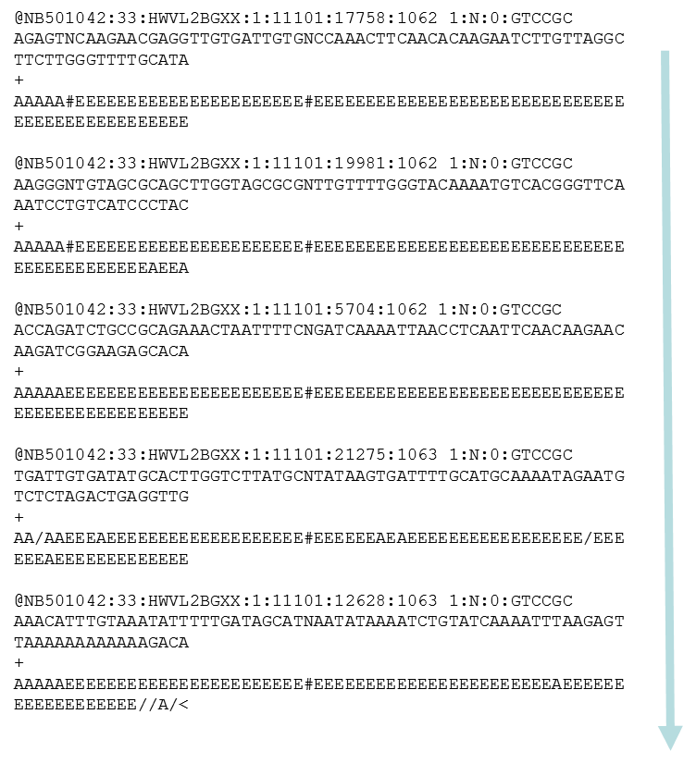
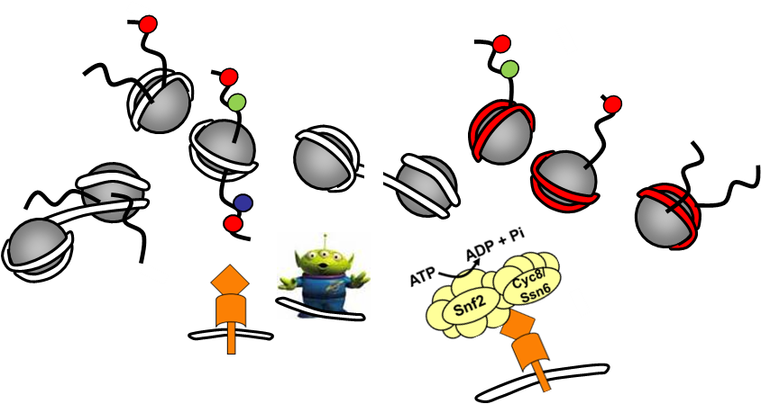
Kent Lab BI3001 Projects 2023:
Sequence to Particles

Slide 2
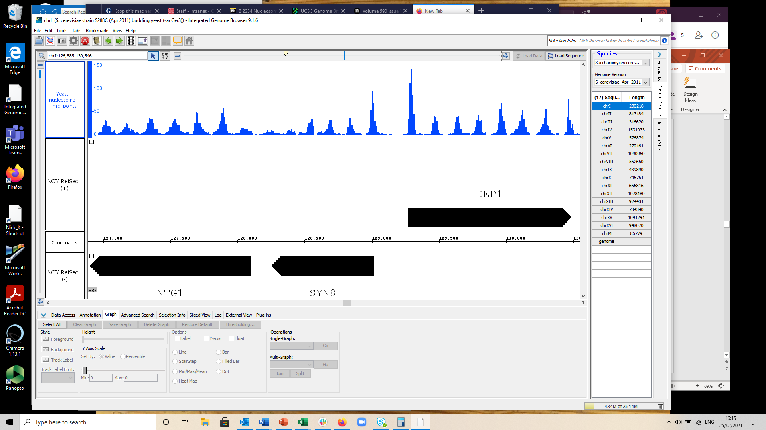
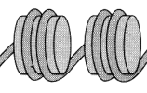

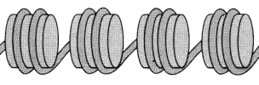
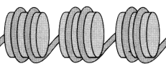
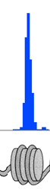
Chromatin “particles”?!
In Kent Lab MNase-seq, an example of a nuclease-protected “particle” might be a nucleosome
Read
frequency
The evidence/data: a peak in a frequency distribution of MNase-seq sequence read mid-points plotted relative to a location in the yeast genome
The actual molecule:

Slide 3

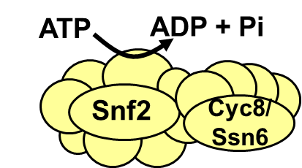
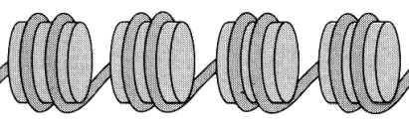


MNase-seq: in vivo nuclease PROTECTION mapping of chromatin
Experimental procedure
The process:
Purify DNA
((
((
((
((
((
((
NGS
Detergent+ MNase
Fragments of DNA PROTECTED from digestion
Livingcells
MNase digestion of chromosomes in vivo

Slide 4
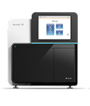
Purified DNA for your FYP has been sequenced using Illumina NGS in 2x36bp (paired-end mode)

Slide 5
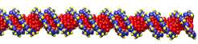
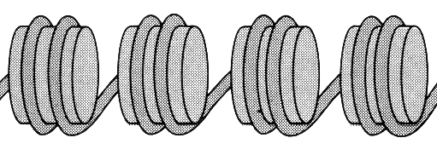
Illumina PAIRED-END MODE sequencing recovers both DNA SEQUENCE and SIZE information from nuclease protected fragments
Sequencing Primer 1
Illumina adaptor
5׳
3׳
Particle DNA
Illumina adaptor
3׳
5׳
Mid-point
Sequencing Primer 2
Sequence “read” no.1
Sequence “read” no.2
End-to-end
Distance (or ISIZE in .sam) when aligned back to the source genome =
~150bp for a nucleosome

Slide 6
DNA sequences from the millions of MNase-digested fragments in an experiment are output as two .fastq files:
Read 1
Primer
Read 1: 36 bases
5׳
3׳
3׳
5׳
Read 2: 36 bases
Read 2 Primer
Read 1 file:
BY4742_MNase_s_1_1.fastq
Read 2 file:
BY4742_MNase_s_1_2.fastq
Template 1:
Template 2:
Template 3:
Etc.

Slide 7
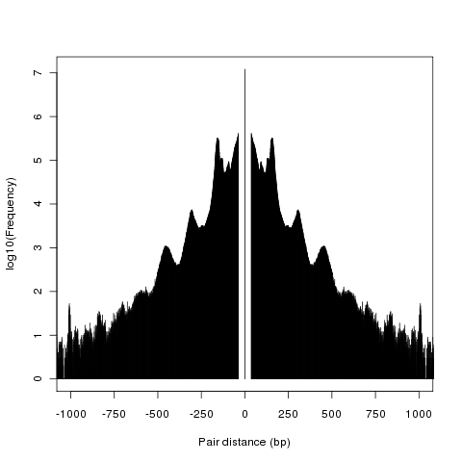
Raw data processing Step 1: Sequence reads are aligned and sorted relative to the SacCer3 reference genome
BY4742_MNase_Sorted.sam
1000
bowtie-1.3.1
samtools-1.18
750
Paired read end-to-end distance (bp)
450bp peak
500
300bp peak
250
150bp peak
0
4
3
2
1
0
log₁₀ aligned read frequency
ISIZE in .sam

Slide 8
The aligned and sorted sequences end up in .sam format
D3P26HQ1:178:D1A3WACXX:1:1101:11793:2878 147 gi|330443391|ref|NC_001133.9| 135529 255 28M = 135397 160 TGCAGGTGTATTGCTGAGGGAATTCGGA GGGGGGGGHE?GFIGHHHHFDDB;F@@@ XA:i:0 MD:Z:28 NM:i:0
The .sam format is a huge tab-delimited text file which identifies the chromosome, start position and insert-size associated for each paired read.

Slide 9
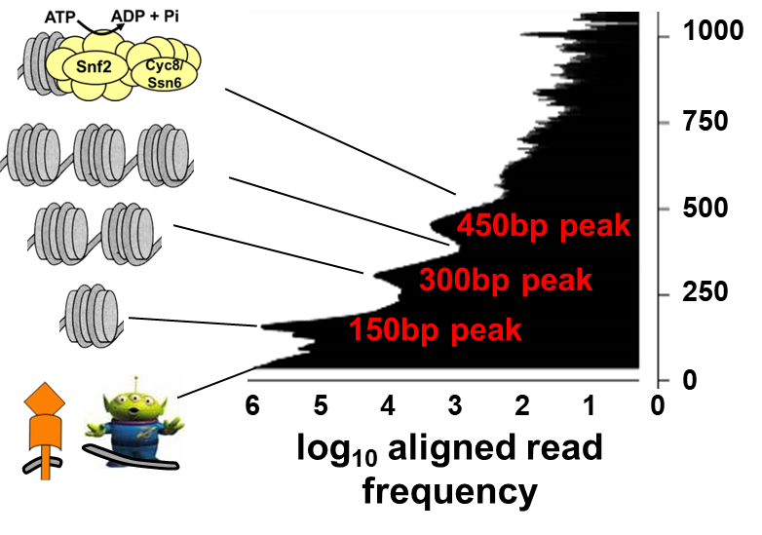
Raw data processing Step 2: chromosome and position data is sorted from the .sam file according to insert (“Particle”) size…
Xxx_Part450_10.sgr
Xxx_Part425_10.sgr
Xxx_Part400_10.sgr
Xxx_Part375_10.sgr
Xxx_Part350_10.sgr
Xxx_Part325_10.sgr
Xxx_Part300_10.sgr
Xxx_Part275_10.sgr
Xxx_Part250_10.sgr
Xxx_Part225_10.sgr
Xxx_Part200_10.sgr
Xxx_Part175_10.sgr
Xxx_Part150_10.sgr
Xxx_Part125_10.sgr
Xxx_Part100_10.sgr
Xxx_Part75_10.sgr
Xxx_Part50_10.sgr
BY4742_MNase_Sorted.sam
SAM2PartN_genome_sgr_full_v22_2.plx

Slide 10
… at the same time the mid-points of the read pairs are calculated and binned into a frequency distribution across the genome.
:
chr9 12135 4
chr9 12150 4
chr9 12165 7
chr9 12180 10
chr9 12195 12
chr9 12210 44
chr9 12225 101
chr9 12240 108
chr9 12255 41
chr9 12270 21
chr9 12285 19
chr9 12300 8
chr9 12315 9
chr9 12330 7
:
Each output .sgr file is just a three-column tab-delimited text file. Column 1 lists the chromosome ID; column 2 lists the position along that chromosome in x bp bins; column 3 lists the frequency of sequence read mid-point positions found in that bin within the aligned data smoothed to 3 bin MA.
Xxx_Part200_15.sgr
e.g. in this 15bp bin (position 12225 – 12240 on chr9) there were 101 read mid-points which map here

Slide 11
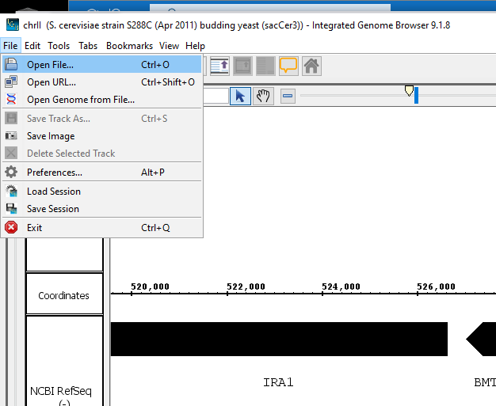
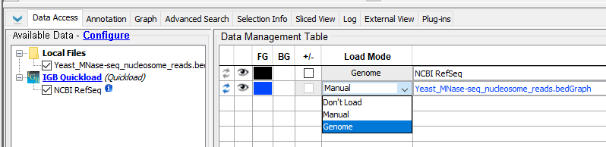
MNase-seq frequency distributions (.sgr files) and Rossi files (…SacCer3.bed) can be plotted together using IGB:
Open:
.sgr
.bed
Set Load Mode to “Genome” in Data Access, and play with Graph to make pretty

Slide 12

The Part150 .sgr files should map the nucleosomes!
A peak in the frequency distribution reveals the specific positioning of a nucleosome within the genome – the height of the peak is roughly proportional to the probability of finding a nucleosome at that genomic position in the population of cells
Highly-positioned nucleosome
Positioned nucleosome
Region of poorly-positioned nucleosomes
Linker DNA
Read
frequency
Nucleosome-Free Region
ChrI (bp)
Chromosome position (bp)

Slide 13
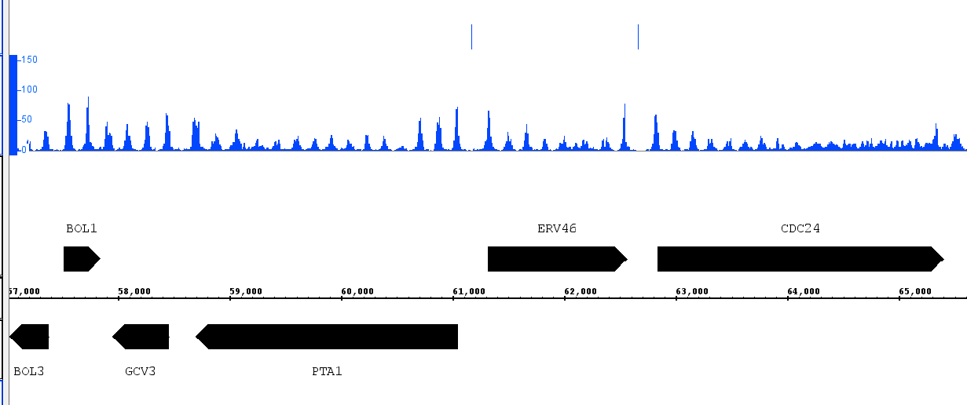
From this plot of nucleosome positions together with some ChIP-exo data for Abf1 we might hypothesise that Abf1 sits with NFRs?
ChIP-exo Abf1 locations
150bp particle
read frequency
NFR
NFR
Chromosome position (bp)

