Slide 1

Get It Done
A homework management program from the award winning
Procrastination Group Labs
Get It Done
A homework management program by
Procrastination Labs Group
Marcos Chen Sriya Sarkar
Sandra Song Donovan Toure
Marcos Chen
Sriya Sarkar
Sandra Song
Donovan Toure
Notes:
SRIYA

Slide 2
Ethnography

Slide 3
ROUND 1
Dibner was observed for its location/environment
MAGNET was similarly observed
Notes:
SANDRA
we wanted to concentrate on NYU Poly students in general at first
we related to that demographic, and it was the most accessible for us

Slide 4
ROUND 2
Focus placed on MAGNET
Focus on people, not the physical environment
Notes:
SANDRA
We focused on MAGNET because
more diverse work was being done
More group, in-person interaction
People were more open to being interviewed
We also changed our interview approach to focus on people and their issues, rather than asking them about the physical environment like we were doing before

Slide 5
Idea Stack

Slide 6
Insights
User interviews and observations - insights
Money can be a motivator
Distractions are obstacles to finishing work
Deadlines are the main drivers to finishing an assignment
Notes:
SRIYA
Money as a motivator was one of our very first insights but we did not end up pursuing that direction
We instead focused on helping students stay focused on their work and better manage their time to meet deadlines
*explain the first pivot

Slide 7
Insights (cont’d)
Procrastination
Our original stance: cure it!
Evolved stance:
It’s a psychological state
Focus on work management
Notes:
SRIYA
Our evolved stance:
Procrastination is a psychological state, rather than an actual activity
It’s not something we can combat with just an app
Based on that, we decided to concentrate on a product that would help students manage their work better

Slide 8
Problem
Through further interviews, we found our users had three main problems:
They got overwhelmed by the scope of large projects
They were disorganized
The did not know how to start
Notes:
SRIYA

Slide 9
Problem Statement
Students who have no process for studying will become disorganized and procrastinate.
Notes:
SRIYA
This problem statement evolved from one of our initial insights

Slide 10
Inspiration
Studying apps (i.e. iStudiez)
Organization apps (i.e. Evernote)
Calendar apps
School Open API Concept
Notes:
DONOVAN
We looked at studying, organization, and time management tools in general.

Slide 11
Goals
Be simple and easy
Be able to integrate seamlessly with students' school-related work flow
Help students manage their project/work
Create an online community for students to discuss academic problems and share resources
Allow students to receive feedback on works in progress
Help students clarify concepts and material they do not understand
Stop procrastination
Notes:
DONOVAN
Being simple and easy
Help students manage their projects and/or work
And to Stop Procrastination

Slide 12
Customer Definition
Higher education students who are working on creative, idea based assignments
Higher education students who want to be more organized and are bad at time management
Notes:
DONOVAN

Slide 13
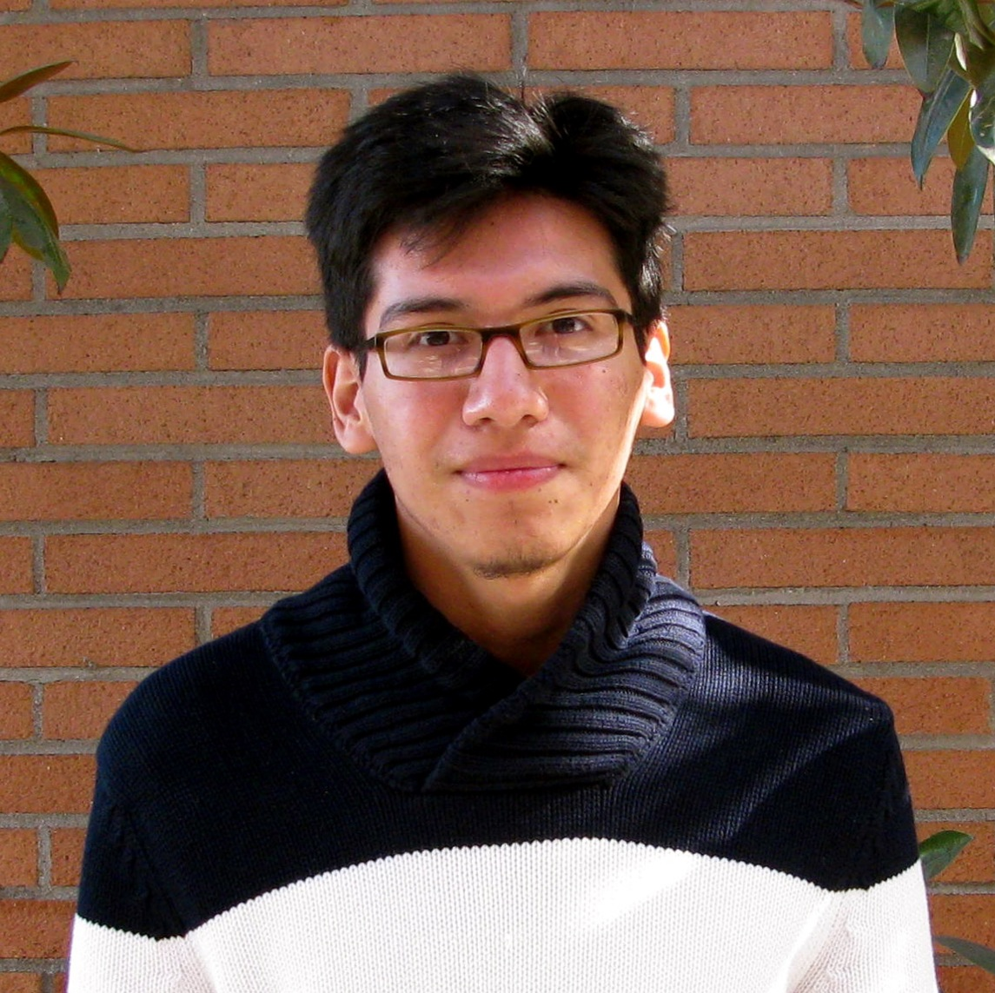
Personas
Eduardo
A digital media grad student who gets easily overwhelmed with big projects.
“I want to do a good job in my classes because I need a good job after graduating, but I never know how to start my big projects. As a result, I end up leaving everything until the last minute.”
Notes:
DONOVAN
PAIN POINTS:
Doesn’t know how to start big projects
He gets overwhelmed easily
Can’t find a balance between work and school
CURRENT STUDY HABITS:
When he gets an assignment, he doesn’t touch it until the weekend
He discusses it with his friends to get a better idea of what to do
If he runs into a problem or concept he doesn’t understand, he searches Google
GOALS:
Wants to accomplish his assignments as best he can to accumulate experience and expand his portfolio
Get a well-paying job in the US after graduating
CURRENT TOOLS AND TECHNOLOGY:
Google Calendar
NYU Classes
Evernote

Slide 14

Personas
Nancy
A grad student in Industrial Design who has trouble
managing her work
“I’m always working on multiple projects at the same time, and I get overwhelmed by the work for them all. Probably because I have a hard time organizing the materials for them.”
Notes:
DONOVAN
PAIN POINTS:
Can’t manage multiple projects at the same time
Trouble organizing work for all her various classes
CURRENT STUDY HABITS:
She’s working on her thesis and taking other classes in addition
She multitasks by working on several assignments at once; when she gets distracted during one assignment, she moves on to another
GOALS:
She wants to work in a creative role, maybe as a Product Designer
CURRENT TOOLS/TECHNOLOGY:
Her notebook that she carries everywhere
Evernote
Rescue Time
Google Apps

Slide 15
Narratives
Common functions in all narratives:
Breakdown function of assignments and/or things to do
Consolidate all work for an assignment
Ability to see one’s progress
Messaging/discussion function
Notes:
DONOVAN
among the narratives we found these common desired features

Slide 16
Prototypes

Slide 17
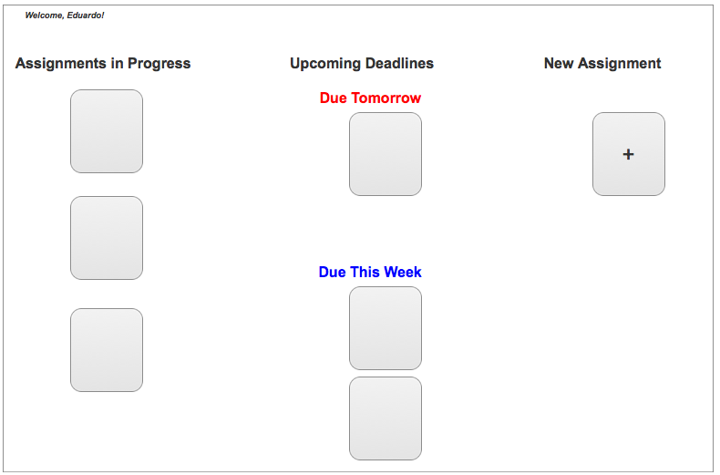
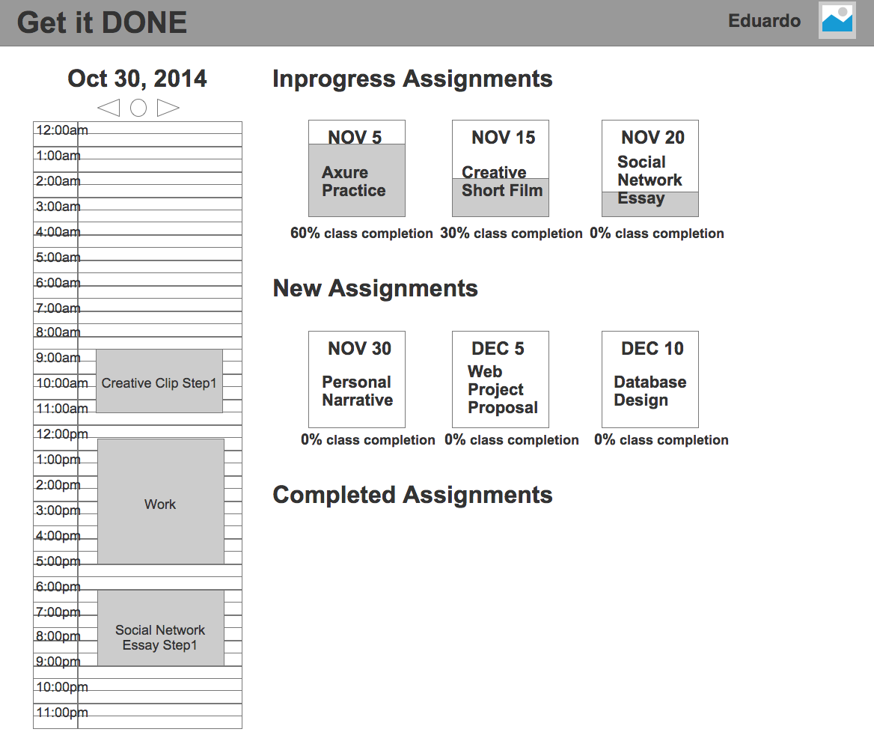
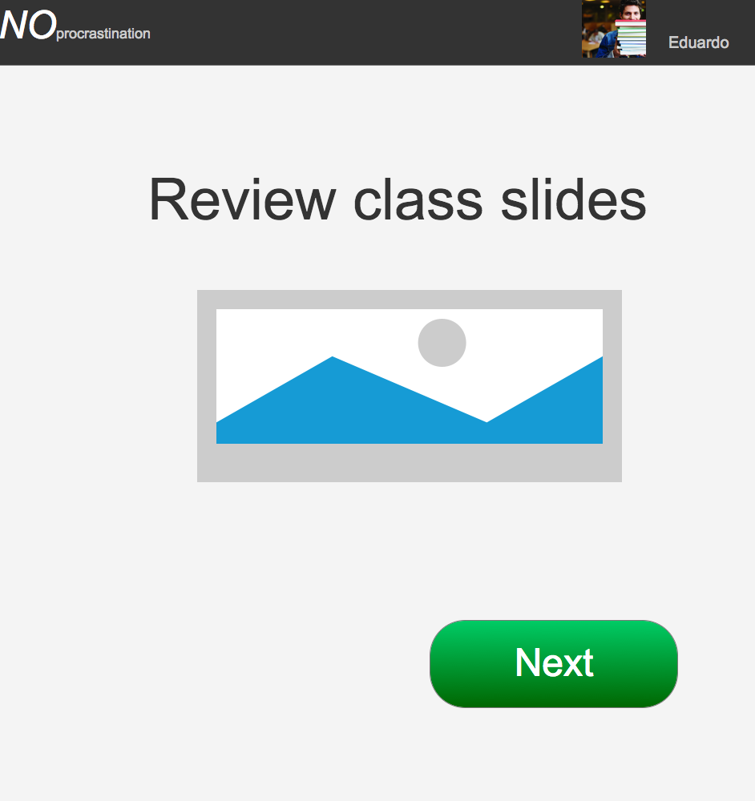
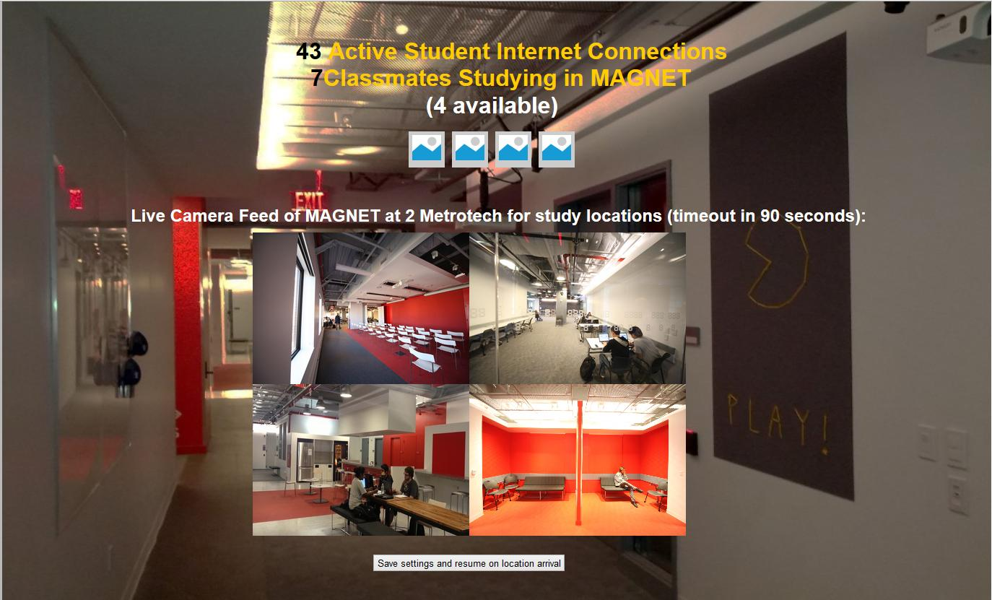
Notes:
DONOVAN

Slide 18
Testing
Results
People preferred to schedule their assignments
Study tools are seen as more as a distraction than aid
Takeaways
Our assumptions and hypotheses were inconclusive
Re-evaluation of product and approach
Notes:
DONOVAN
we had prototypes that were described as easy to use and difficult to use--yet users did not find the easy prototype desirable and did not find the difficult to use prototype usable--yet it had desirable features for users
If students are shown an easy way to breakdown and manage their assignments then they will be more engaged and less likely to procrastinate.
Creative-based students are more willing to use this solution more than non-creatives.

Slide 19
Re-iteration
Users liked progress bars, calendars, and the dashboard features
Clarified flow and breakdown
Different colors to highlight importance of tasks
More functionality: resubmit and reschedule
Notes:
MARCOS
We focused on Marcos’ prototype
用我的prototype
喜歡progress, calendar, dashboard
不喜歡: flow不清楚
We made breakdown process the central feature
breakdown process：核心功能
reschedule,
-
We incorporated the professor’s input into the breakdown process. In our new and improved product, the professor would supply a basic breakdown that the user could select to follow or modify.
We made sure to include the features our users liked from our previous user tests: progress bars, calendars, and the dashboard features

Slide 20
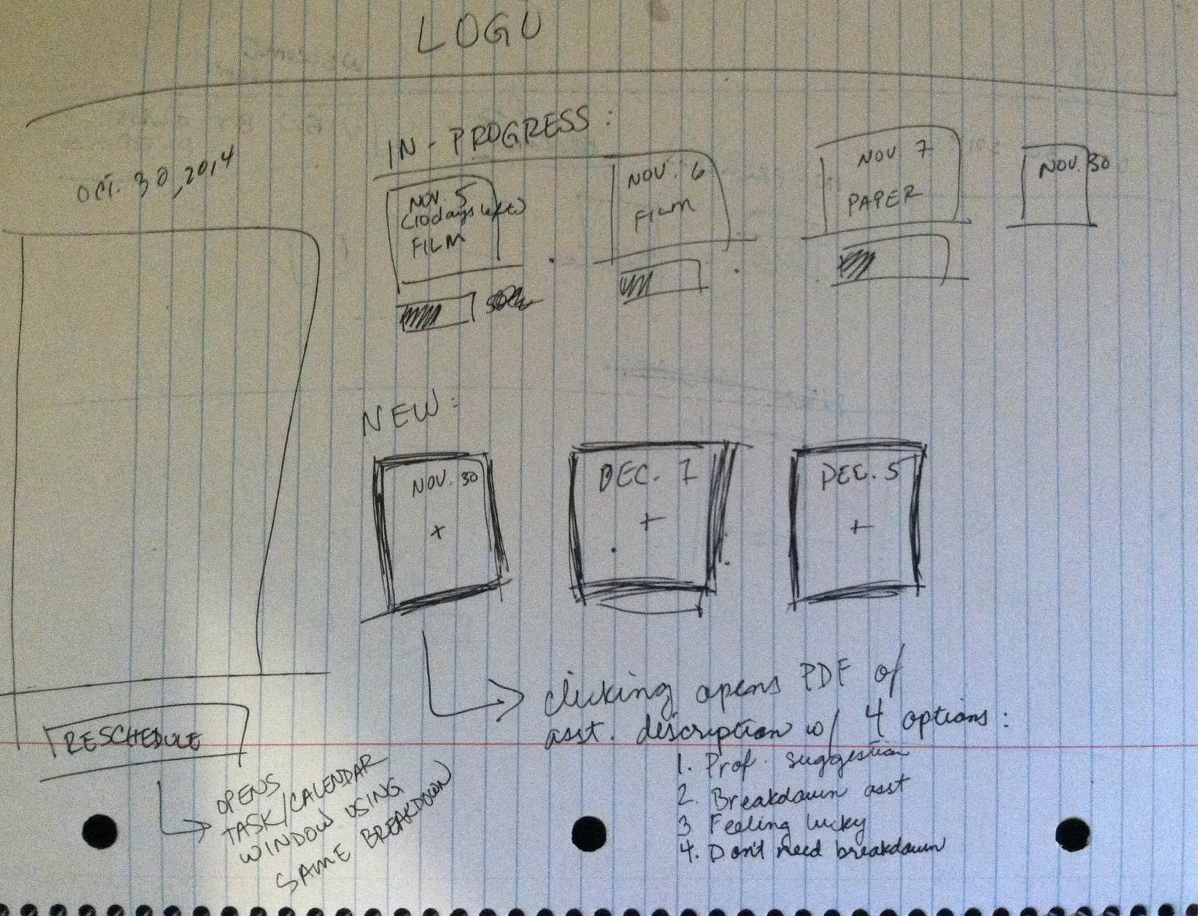
Paper & Axure Prototypes
Notes:
MARCOS

Slide 21
Next Steps

Slide 22
Talk with Psychologists and Educators to learn more about the psychological dynamics of procrastination
Revise our breakdown process and features based on what we learn
Improve the UI
Notes:
SANDRA
We’ll learn more by:
Talking to school psychologists and educators that study this

