Slide 1

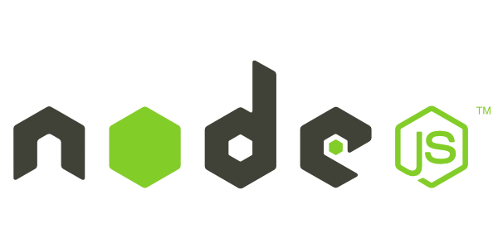
‘Node's goal is to provide an easy way to build scalable network programs’
- (nodejs.org!)
Chinmay Kulkarni
@chromonav

Slide 2
History
It was created by Ryan Dahl in 2009.
Runs on V8
Stable And Production ready (now).
Is Open Source, Cross Platform
Single threaded, Event driven architecture.

Slide 3
What is v8
The V8 JavaScript Engine is an open source JavaScript engine developed by The Chromium Project for theGoogle Chrome web browser

Slide 4
Introduction: Basic
Not just server side javascript.
Interpreter for Javascript with inbuilt, robust packaging system and low level libs for various tasks.
Asynchronous , event driven.
Excellent Performance
Command line tool
In ‘Node.js’ , ‘.js’ doesn’t mean that its solely written JavaScript. It is 40% JS and 60% C++.

Slide 5
Installing Nodejs
Download the package from official site and install. As simple as that :)
Open terminal
Type node and hit enter
you are done

Slide 6
Introduction: Advanced (& Confusing)
Event driven, non-blocking* architecture.
No DOM
Programs for Node.js are written in JavaScript but not in the same JavaScript we are use to. There is no DOM implementation provided by Node.js, i.e. you can not do this:
var element = document.getElementById(“elementId”);
Everything inside Node.js runs in a single-thread.

Slide 7
NODE vs PHP
setTimeout(function(){
console.log("world!");
}, 2000);
console.log("hello");
<?php
//helloworld.php
echo "hello";
sleep(2);
echo "world!";
?>

Slide 8
Some Theory: Non-Blocking I/O
Traditional I/O
var result = db.query(“select x from table_Y”);
doSomethingWith(result); //wait for result!
doSomethingWithOutResult(); //execution is blocked!
Non-traditional, Non-blocking I/O
db.query(“select x from table_Y”,function (result){
doSomethingWith(result); //wait for result!
});
doSomethingWithOutResult(); //executes without any delay!

Slide 9
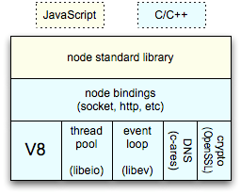
Some Theory: Event-loops
Event-loops are the core of event-driven programming, almost all the UI programs use event-loops to track the user event, for example: Clicks, Ajax Requests etc.
Client
Clients send HTTP requests
to Node.js server
Event loop returns
result to client
Event loop
(main thread)
An Event-loop is woken up by OS,
passes request and response objects
to the thread-pool
Long-running jobs run
on worker threads
Response is sent
back to main thread
via callback
C++ Threadpool
(worker threads)

Slide 10
Example-1: Getting Started & Hello World
Install/build Node.js.
(Yes! Windows installer is available!)
Open your favorite editor and start typing JavaScript.
When you are done, open cmd/terminal and type this:
‘node YOUR_FILE.js’
Here is a simple example, which prints ‘hello world’
var sys = require(“sys”);
setTimeout(function(){
sys.puts(“world”);},3000);
sys.puts(“hello”);
//it prints ‘hello’ first and waits for 3 seconds and then prints ‘world’

Slide 11
What can you do with Node.js ?
HTTP
TCP
DNS server.
Static File Server.
Web Chat Application

Slide 12
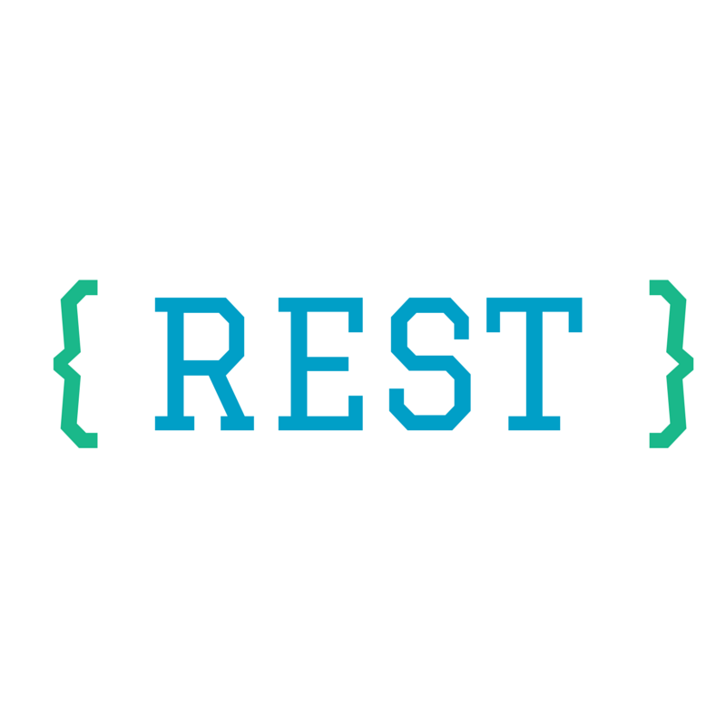




Node is everwhere

Slide 13
Demo 1 : Simple HTTP Server
Creating simple http server that gives response hello world

Slide 14
Node.js Ecosystem
Heavily relies on modules, in previous examples require keyword loaded the http module.
Creating a module is easy, just put your JavaScript code in a separate js file and include it in your code by using keyword require, like:
var modulex = require(‘./modulex’);
Libraries in Node.js are called packages and they can be installed by typing
npm install “package_name”; //package should be available in npm registry @ nmpjs.org
NPM (Node Package Manager) comes bundled with Node.js installation.

Slide 15
NPM
NPM makes it easy for JavaScript developers to share and reuse code, and it makes it easy to update the code that you're sharing
Important commands:
npm install
This command installs a package, and any packages that it depends on. If the package has a shrinkwrap file, the installation of dependencies will be driven by that.
b. npm init
This will ask you a bunch of questions, and then write a package.json for you.It attempts to make reasonable guesses about what you want things to be set to, and then writes a package.json file with the options you've selected.

Slide 16

Doubts??

Slide 17
Express JS
Fast, unopinionated, minimalist web framework for Node.js
npm install express
Supported by StrongLoop (acquired by IBM)
23000+ github stars ☺

Slide 18
DEMO 2: SIMPLE EXPRESS SERVER
Creating simple EXPRESS server that gives response hello world

Slide 19
DEMO 3: Understanding Express Features
Creating EXPRESS SERVER demonstrating its features

Slide 20
Templating Languges
Jade
Ejs
Handlebars
Mustache
Dust
Ember

Slide 21

Mongo and mongoose in brief

Slide 22
MongoDB
Node.js and MongoDB are a pair made for each other.
JSON everywhere
Schema less
Structure of a single objects
No complex joins
Ease of scale-out: MongoDB is easy to scale
Uses internal memory for storing the (windowed) working set, enabling faster access of data

Slide 23
Mongoose
MongoDB ODM (Object Document Mapper)
Easy to use, simple
http://mongoosejs.com/

Slide 24
DEMO 4: Express Hackathon Starter Boilerplate Understanding
Understanding the boilerplate

Slide 25
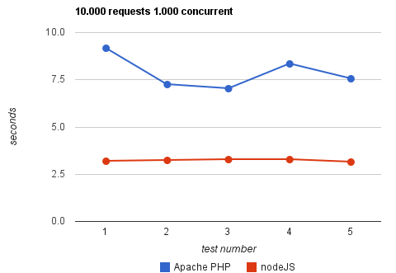
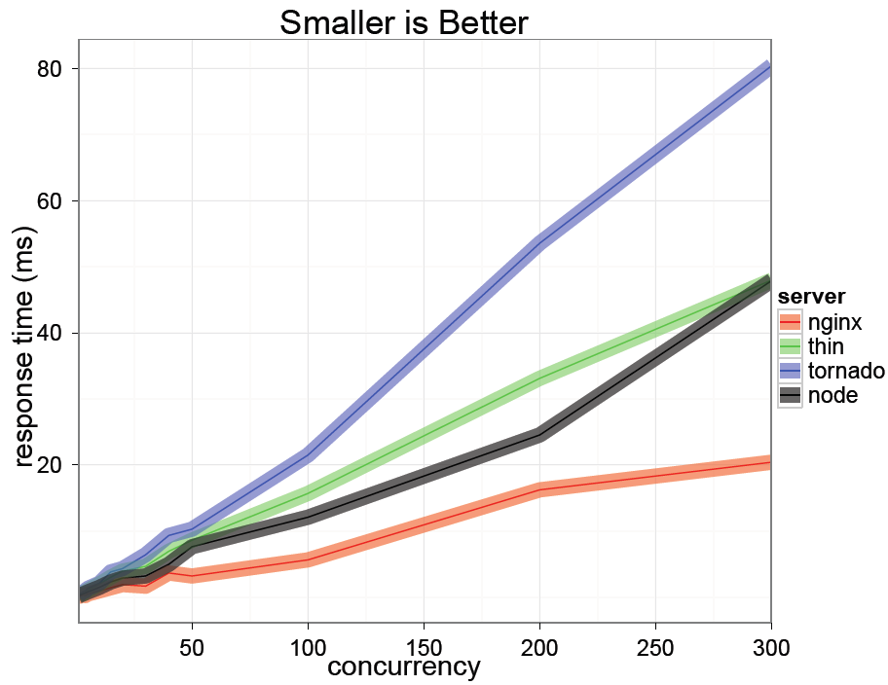
Some Node.js benchmarks
Taken from: http://code.google.com/p/node-js-vs-apache-php-benchmark/wiki/Tests
A benchmark between Apache+PHP and node.js, shows the response time for 1000 concurrent connections making 10,000 requests each, for 5 tests.
Taken from: http://nodejs.org/jsconf2010.pdf
The benchmark shows the response time in milli-secs for 4 evented servers.

Slide 26
NodeJs Disadvantages
Cannot be hosted on shared hosting. Needs Virtual Private Servers or NodeJS Paas
Not enough mature blogging platforms based on NodeJS

Slide 27
Appendix-1: Who is using Node.js in production?
Yahoo!
LinkedIn :
eBay
Dow Jones
LinkedIn
https://github.com/joyent/node/wiki/Projects,-Applications,-and-Companies-Using-Node

Slide 28
Appendix-2: Resource to get started
Watch this video at Youtube: http://www.youtube.com/watch?v=jo_B4LTHi3I
Read the free O’reilly Book ‘Up and Running with Node.js’ @ http://ofps.oreilly.com/titles/9781449398583/
Visit www.nodejs.org for Info/News about Node.js
Watch Node.js tutorials @ http://nodetuts.com/
For Info on MongoDB: http://www.mongodb.org/display/DOCS/Home
For anything else Google!

Slide 29
When to use Node.js?
Node.js is good for creating streaming based real-time services, web chat applications, static file servers etc.
If you need high level concurrency and not worried about CPU-cycles.
If you are great at writing JavaScript code because then you can use the same language at both the places: server-side and client-side.
More can be found at: http://stackoverflow.com/questions/5062614/how-to-decide-when-to-use-nodejs

Slide 30
Appendix-3: Some Good Modules
Express – to make things simpler e.g. syntax, DB connections.
Jade – HTML template system
Socket.IO – to create real-time apps
Nodemon – to monitor Node.js and push change automatically
CoffeeScript – for easier JavaScript development
Find out more about some widely used Node.js modules at: http://blog.nodejitsu.com/top-node-module-creators

Slide 31
THANKYOU

