Slide 1
IAPR 2020
Special project
Team 36
Xiaoqi MA
Qi YAN

Slide 2
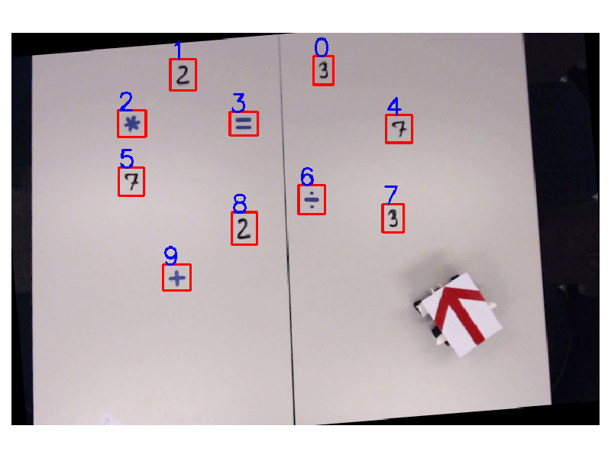
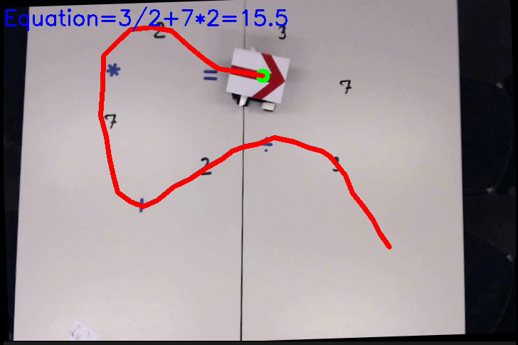
Workflow
Video input
Video output
Initialization
Tracking & update
Bounding box detection
Initial symbol detection
Tracking the robot
Detect the passed-over elements
Symbol re-detection to satisfy equation constraints
Notes:
Firstly, the workflow of our project is straightforward. After the video input step, we first extract the bounding boxes that contain the digits and operators. We then do a initial symbol detection for all the bounding boxes.
After initialization, the robot starts moving and we track its trajectory in order to detect the passed-over bounding boxes. If it’s necessary, the symbol will be detected again to satisfy the equation constraints. After all these, we output the annotated images as a video.

Slide 3
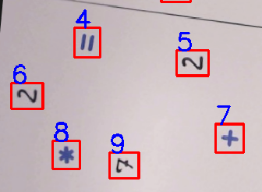

Initialization
Segmentation for bounding box
Initial symbol detection
Notes:
Specifically, the first step of initialization is the segmentation for bounding boxes. After binarization and morphological processing, we use the labelling to find the regions in the image,which help us segment the objects. Because there exist some irrelevant objects such as lines of dashed in the middle, we set the threshold about the area of region to choose the bounding boxes correctly.
Then, for each bounding box, we do a symbol detection to classify its correct number or operation. If the digits and operators are marked with different colors, we construct different models to do classifications. Basically, we send the bounding box image to its corresponding classifier. Based on the dataset MNIST, we implement the convolutional neural network (CNN) to detect the number. As for the operators, we provide two ideas, one is CNN based on the dataset augmented by ourselves, the other is use the fourier descriptor and Bayes classifier. If the operators and numbers cannot be separated by their colors, this kind of classification might not be sufficient. So we use a simple re-detection mechanism for correction, which will be introduced later.

Slide 4
Tracking and update
Tracking the robot
Use red arrows for current position
Build trajectory using linear segment
Detect the passed-over bounding box
Detect by threshold related to bbox. distributions.
Symbol re-detection to satisfy equation constraints
Equation constraints: first one is digit; last one is equal
No two consecutive digits or operators
Notes:
When the robot starts to move, we first localize the robot by the red arrow. We segment the arrow separately due to its red color in HSV space. Then from these positions, we build a trajectory using linear segment between successive two robot positions.
From the trajectory, the passed-over bounding boxes are detected. We compare the position of the robot with that of the bounding box. The last linear segment of trajectory should be close enough to the target bounding box. Also to avoid detecting 2 consecutive duplicate bounding boxes, we mark the position of the last detected bounding box, and make sure that the robot goes far away enough before it detects the next bounding box.
At last, despite the symbol detection in the initial stage, we implement the so-called symbol re-detection mechanism. During the tracking, if the equation constraints are not satisfied, we do a re-detection. Simply put, we resend the current bounding box of interest to the correct classifier with the help of equation constraints.

Slide 5
Robustness test
Because the lack of the test dataset, we do the robustness test in our model.Through adjusting the rotate angle, lightness and size of our model,we adjust relevant parameters to increase detect accuracy.
For the dataset which we used to train the convolutional neural network, we do data augmentation to increase robustness of our network.By the operation of shift,rotation,change of lightness of train data sets, we want to detect correctly in different situations.

