Slide 1
Advancing Proactive Spatial Planning in U.S. Ports and Warehouses with Agent-Based AI and 3D Simulation
AI Catalysts
Sep 15, 2025

Slide 2
Problem Statement
We lack the capability to predict and simulate process or construction changes within 3D models, resulting in a reactive approach to spatial and equipment planning. By applying AI techniques, we can shift to proactive spatial planning and simulation.
Current Challenges in Spatial Planning
Limitation Category | Legacy WMS/ERP & Static 3D Simulation | Agent-Based AI & 3D Simulation Platform
Scenario Evaluation | Limited, pre-defined, manual | Automated, real-time, dynamic
Data Integration | Siloed, batch updates | Unified, ingesting real-time and manual data
Manual Parameter Use | Error-prone, low transparency | Structured, auditable, context-rich
Constraint Management | Rudimentary, fixed | Advanced, dynamic, multi-objective optimization
Proactive/Reactive Orientation | Reactive—respond after disruptions | Proactive—anticipate and resolve in advance
Visualization & Collaboration | Basic visual tools | Immersive 3D, collaborative, scenario-comparative
Scalability & Adaptability | Difficult, requires heavy customization | Modular, cloud-based, enterprise-wide scaling
Solution Capabilities Overview
Configurable Inputs
Constraint Solving
AI Agents
Visualization
Manual parameters (container count, asset availability, constraints) are structured for simulation, enabling flexible scenario design and model input.
Dynamic constraint management allows the system to recommend revised parameters when operational limits are exceeded, supporting proactive planning and risk mitigation.
Agentic AI simulation and optimization analysis unlocks new intelligence for users, setting this solution apart from traditional tools like WMS and ERP.
Scalable and reusable across industries, with rich 3D visualization for real-time insights into operational bottlenecks and optimization opportunities.

Slide 3









Technical Flow architecture
Port Warehouse Operations Management System
Simulation feedback system
Data Sources
Interpret, Ingest, Transform
Agentic AI Management
Simulator data persistence
Operational Introspection Agent
User defined Parameters
Queries with Parameters
Intent Classifier for Routing to different Agent types and maintain topic focus
Multi-Agent Routing Classifier
LLM
Media and Result Storage
Simulation media
Optimization Metrics
Operational Metrics
External Data Sources
The process ends once the user approves the simulation and its constraints.
FlexSim
Simulation Business Logic Agent
External Sources Transformer
Oracle SCM/ERP
Data mapper based on the source type
Initiate Parameter Processor
Set up optimized schedules for trucks, cranes, and workers factoring in time, 3D space, material, and equipment restrictions, by considering equipment-level quality control checks after specified durations.
Run simulations and preserve the analysis outputs as videos in 3D warehouse layout formats for better interpretability.
SAP EWM/TM
Convert to the custom simulation machine readable format
Establish the warehouse structure in line with constraints concerning storage blocks, containers, roads, and space.
Begin container inventory control by generating outbound container orders at deterministic time intervals, using inter-arrival times to simulate real-world truck arrivals.

Slide 4
Application Demo

Slide 5
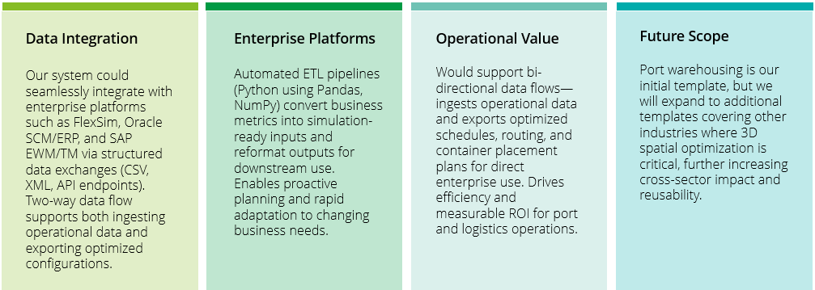
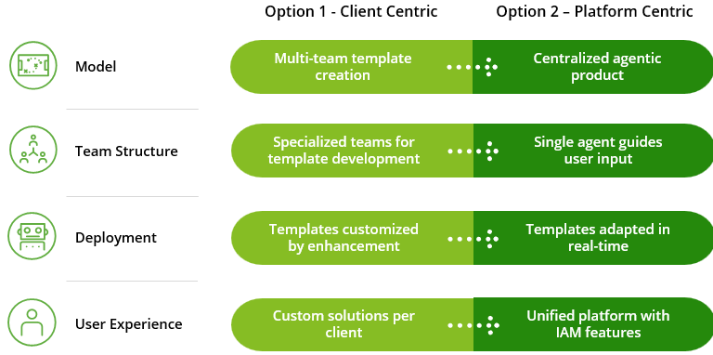
Scalable Architecture and Industry Impact
Scalable, reusable, and impactful—our solution enables rapid digital transformation and delivers measurable ROI across logistics and warehousing.
Scalable Design
Reusability
Cross-industry reach
Industry Impact
Built on a serverless, modular, and agentic AI architecture, our solution is highly scalable and easily configurable. This enables broad deployment across diverse sectors such as maritime logistics, air cargo hubs, defense logistics, and industrial/3
Plug-and-play simulation modules allow rapid reconfiguration for various layouts, equipment, and operational constraints, supporting quick customization for new client needs.
analytics 2d bar graph showing growth and industry impact trends, plus automation icon for scalability and plug-and-play features, gear or puzzlepiece for reusability.
Reusable optimization logic for scheduling, equipment allocation, and spatial planning accelerates deployment and solution development for future clients and industries.
Enterprise Integration & Future Scope
Evaluating Two Strategic Business Plans
Designed for future scalability and interoperability across enterprise systems.
This comparison highlights key business considerations for each plan.

Slide 6
Burnt cost till date :50k USD Expected monthly Burn Cost : 50-55k USD ( full fledged team thought so far) Resources Expenses:3-10k USD monthly
Team structure we planned for now is towards 2 developers 1 sr. Dev / architect / manager 1 QA lead / automation / scrum master 1 junior QA 1 Product/ BA (optional for now)
1 DevOps ( as per requirements)

