Slide 1
BloodLink
Where Blood Finds Life
1
SDG 3: Good Health & Well-being
CSE 4402 | Visual Programming Lab

Slide 2
Our Team
PRESENTED BY
1
2
[
3
2
Sunbim Haque Niloy
ID : 230041205
Md Woasif Mehmud Issmam
ID :230041213
Samin Sawban Rayed
ID : 230041217
CSE 4402: Visual Programming Lab | Islamic University of Technology

Slide 3
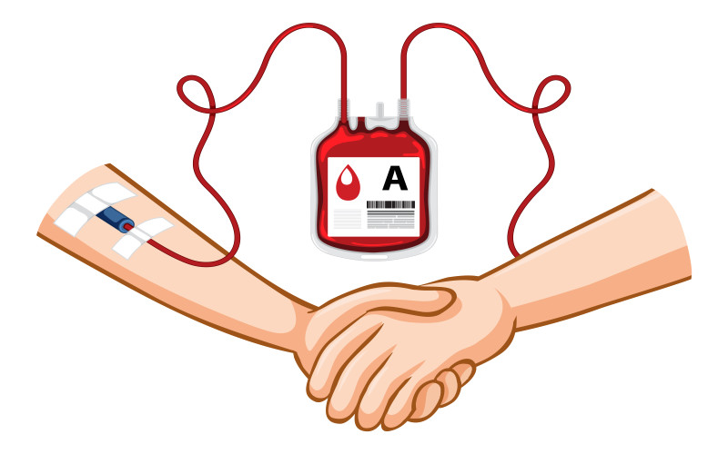
The Problem
PROBLEM STATEMENT
When someone urgently needs blood in Bangladesh:
Every Minute Counts
They post on Facebook — hundreds share but nobody actually coordinates
Many donors are unavailable, too far away, or recently donated
Hospitals have no real-time visibility on donor availability
Rare blood groups (O−, AB−) are nearly impossible to find quickly
Valuable time is lost — and lives are at risk
Average delay:
30 – 60 min
Rare group shortage:
Critical
Current method:
Facebook posts
Coordination:
None
3

Slide 4
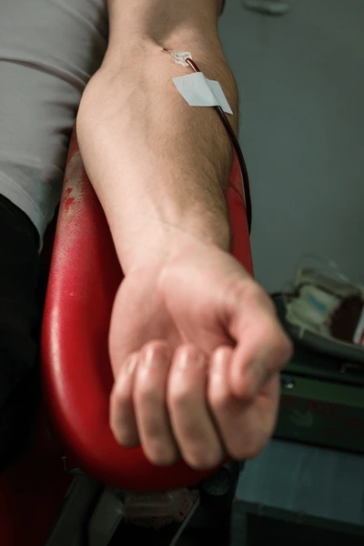
BloodLink
INTRODUCTION
Emergency Blood Response & Donor Coordination Platform
BloodLink is an emergency blood response platform that reduces the time required to locate eligible blood donors during critical medical situations through intelligent donor prioritization, eligibility assessment, and real-time emergency coordination.
4
[ Insert app logo / concept image ]
SDG Alignment
SDG 3: Good Health and Well-being
Reducing emergency response time saves lives

Slide 5
DIFFERENTIATION
What Makes BloodLink Different?
❌ Typical Blood Management System
✅ With BloodLink
✕ Search donors by blood group — returns a flat unranked list
✓ Smart Donor Matching — ranks by blood type, district, availability & last donation date
✕ No eligibility check — any donor appears regardless of health status
✓ Eligibility Engine — enforces age ≥ 18, weight ≥ 50 kg, 56-day cooldown automatically
5
✕ No request workflow — status unknown after submission
✓ Full Request Lifecycle — PENDING → MATCHED → ACCEPTED → FULFILLED with audit trail
✕ Donor availability assumed — no way to toggle or verify
✓ Real-Time Status Toggle — donor sets Available / Busy / Out of Town / Medical Hold
✕ No notification system — requester must follow up manually
✓ In-App Notifications — donor alerted on match; requester updated on acceptance
✕ No analytics — admin has zero visibility into demand or trends
✓ Admin Dashboard — BarChart & PieChart of blood group demand from live DB data

Slide 6






Goals & Objectives
Primary Goal: Build a complete, role-based blood donor coordination desktop application in Java + JavaFX.
PROJECT OBJECTIVE
01
Smart Donor Search
02
Secure Authentication
Filter donors by blood type, district, and availability — with eligibility check applied automatically.
Role-based login for Donor, Requester, and Admin — each with a tailored JavaFX interface.
03
Request Lifecycle
04
Eligibility Engine
Full Create → Match → Accept/Decline → Fulfilled workflow for every blood request.
Rule-based engine validates age, weight, last donation date — outputs result with reason.
6
05
Admin Analytics
06
In-App Notifications
Statistics panel showing request trends, blood group demand, and donor activity — using stored DB data.
Notification panel for donors when matched; requesters informed of donor response in real time.

Slide 7






Core Features
FEATURES
Emergency Blood Request
Smart Donor Matching
Requester submits: blood group, units needed, urgency, hospital, district. System timestamps and queues the request immediately.
Algorithm filters donors by blood compatibility + district + availability status + last donation date. Returns a ranked, eligible list.
Eligibility Checker
Donor Status Toggle
7
Rule engine checks: age ≥ 18, weight ≥ 50 kg, 56-day cooldown since last donation. Returns Eligible / Not Eligible with reason text.
Donors update status: Available / Busy / Out of Town / Medical Hold. Only Available donors appear in search results.
Request Lifecycle Tracker
In-App Notification Panel
Every request moves through: PENDING → MATCHED → ACCEPTED / DECLINED → FULFILLED / CANCELLED. Full audit trail in DB.
When a donor is matched, they see an in-app notification. Requester is updated when donor accepts or declines. No email API needed.

Slide 8





Advanced Features
FEATURES
Donor Achievement Badges
OOP: Badge hierarchy with Strategy pattern
Bronze → Silver → Gold → Platinum badges based on verified donation count. Stored in DB, shown on donor profile. Motivates repeat donors.
Admin Statistics Dashboard
JavaFX: BarChart + PieChart components
Charts showing most-requested blood groups, monthly request volume, fulfillment rate — all computed from existing DB records via SQL aggregates.
Blood Group Demand View
8
JavaFX: TableView with ObservableList
Admin sees a table: for each blood group, count of pending requests vs available donors — a simple SQL JOIN rendered as a sortable TableView.
Donation Cooldown Tracker
Business Logic: date arithmetic + UI binding
System calculates days since last donation and shows colour-coded status: Ready (green), Cooling Down (amber), Blocked (red) on donor profile.
Password Reset & Profile Edit
JavaFX: Form validation + event handlers
Donors and requesters can update contact info, address, and password securely through a validated form with confirmation dialogs.

Slide 9
User Roles
FEATURES
DONOR
REQUESTER
ADMIN
9
› Register with blood group, district, health info
› Submit emergency blood request with urgency
› View all requests and donor registry
› Toggle availability status anytime
› View ranked list of matched eligible donors
› Manage users: approve, suspend, reset
› View and respond to match notifications
› Track request status in real time
› View analytics: demand charts, statistics
› Track donation history & cooldown status
› Mark request as Fulfilled when complete
› Manually escalate or close requests
› View earned achievement badges on profile
› View history of all past requests
› Access full system audit log

Slide 10
Module Breakdown
ARCHITECTURE
M1
Authentication Module
M2
Donor Management Module
M3
Request & Matching Module
• Login screen with role detection
• Donor profile: CRUD operations
• Emergency request form
• BCrypt password verification
• Status toggle with DB update
• Eligibility engine (Strategy pattern)
• Session management (Singleton)
• Donation history viewer
• Donor ranking algorithm
• Registration with validation
• Cooldown date calculator
• Match notification trigger
10
M4
Request Lifecycle Module
M5
Notification Module
M6
Admin & Analytics Module
• Status transitions: PENDING → FULFILLED
• In-app notification on match
• User management dashboard
• Donor accept/decline response
• Unread badge counter on nav bar
• Blood group demand BarChart
• Requester fulfillment confirmation
• Mark as read on open
• Monthly requests LineChart
• Full status audit trail
• Notification history panel
• Fulfillment rate statistics

Slide 11
Screen Design Concepts
UI / UX
⬤ ⬤ ⬤ Login Screen
⬤ ⬤ ⬤ Donor Dashboard
Role selector: Donor / Requester / Admin
Profile card: name, blood group, badge tier
Email + password fields with validation
Status toggle: Available / Busy / Hold
Animated error label on wrong credentials
Notification inbox with unread count
Link to registration form
Donation history timeline
11
⬤ ⬤ ⬤ Request Form
⬤ ⬤ ⬤ Admin Dashboard
Blood group dropdown, urgency selector
Summary cards: Active / Pending / Donors
Hospital name, district, units needed
BarChart: requests by blood group
Deadline date picker
TableView: all requests with filters
Submit → Live matched donor list
User management panel with search

Slide 12






Technology Stack
TECHNICAL TOOLS
Java 17
JavaFX 17
Core Language
GUI Framework
OOP, interfaces, generics, lambda, collections — full Java ecosystem without Spring complexity.
Scene graphs, FXML layouts, CSS styling, TableView, Charts, Dialogs — everything for a rich desktop UI.
Scene Builder
MySQL 8
12
UI Designer
Database
Drag-and-drop FXML layout tool. Decouples UI design from controller logic — demonstrates MVC discipline.
Relational DB with normalised schema. SQL joins for matching; aggregates for analytics. JDBC connection.
BCrypt Hashing
Git & GitHub
Security
Version Control
Passwords stored as BCrypt hashes — never plaintext. Demonstrates security-aware development practice.
Feature branches, pull requests, commit history. Javadoc + README. Professional development workflow.

Slide 13
Tentative Timeline
TIMELINE
Wk 1–2
Planning & Requirements
Use case diagrams, DB schema design, UI wireframes, team task allocation
Wk 3–4
Authentication & DB Setup
MySQL schema, JDBC layer, BCrypt login, registration, session management
\
Donor & Request Modules
Wk 5–6
Donor profile CRUD, status toggle, blood request form, basic matching query
13
Wk 7–8
Matching & Eligibility
Eligibility engine, donor ranking algorithm, match notification system
Wk 9–10
Lifecycle & Notifications
Full request lifecycle, accept/decline flow, notification inbox, cooldown UI
Wk 11
Admin Dashboard & Charts
Analytics screen, BarChart/PieChart, user management, achievement badges
Wk 12
Testing, Docs & Demo Prep
Bug fixes, Javadoc, README, GitHub cleanup, final demo rehearsal

Slide 14
THANK YOU
14
BloodLink — Emergency Blood Response & Donor Coordination Platform

