Slide 1
Façade Design Pattern

Slide 2
Convenient higher-level interface to a larger body of code
Hides actual complexity
Simplified presentation of API - Improves usability
Decouples class from code that utilizes it
Notes:
provides a convenient higher-level interface to a larger body of code
Hiding actual complexity
Improves usability because of simplified presentation of API
Not only simplifies the class interface, but also decouples class from code that utilizes it

Slide 3
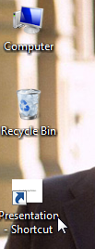
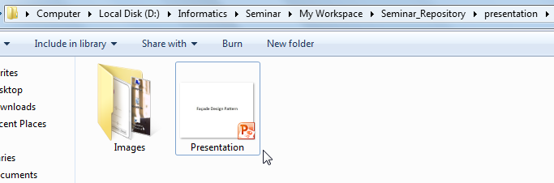
Example

Slide 4
Example - jQuery
Group of facades – makes programming easier and faster
Notes:
Being used by people knowingly or unknowingly in jQuery
jQuery essentially serves as a group of facades to make our lives as programmers easier

Slide 5
Example - jQuery
Group of facades – makes programming easier and faster
facades for $.ajax()
$.get( url, data, callback, dataType );
$.post( url, data, callback, dataType );
$.getJSON( url, data, callback );
Notes:
Being used by people knowingly or unknowingly in jQuery
jQuery essentially serves as a group of facades to make our lives as programmers easier

Slide 6
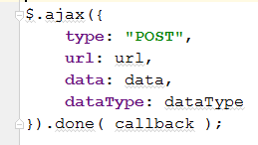
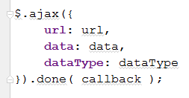

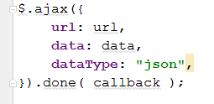
Behind the scenes

Slide 7
Project – 1 : drawr-bootstrap

Slide 8
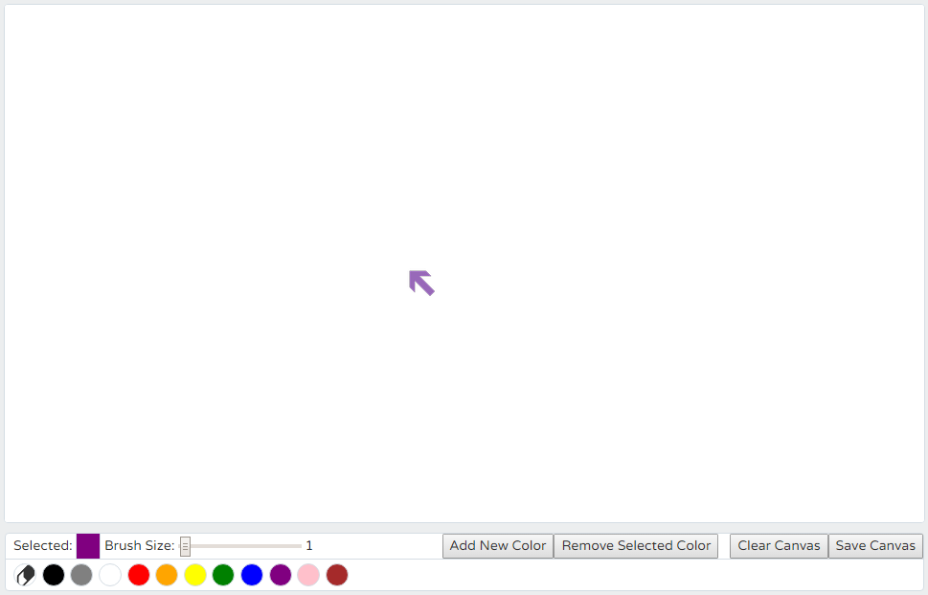
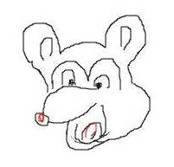
drawr-bootstrap
First Screen

Slide 9
drawr-bootstrap: features
Customizable drawing tool
Toolbar
Brush/Eraser thickness
Color Palette
Add new color
Remove a color
Clear canvas
Save canvas

Slide 10
Several event listeners & handlers
$('#palette').on('click', 'li', function () {…}
$('#erase').click(function () { …}
$('#thickness').change(function () {…}
$('#eraserthickness').change(function () {…}
$('#save').click(function () {…}
$('#clear').click(function () {…}
$('#addcolor').click(function () {…}
$('#removecolor').click(function () {…}
$('#attachcolor').click(function () {…}
$('#cancelcolor').click(function () {…}
$('.colorslider').change(function () {…}
paintSurface.mousedown(function (e) {…}
paintSurface.mousemove(function (e) {…}

Slide 11
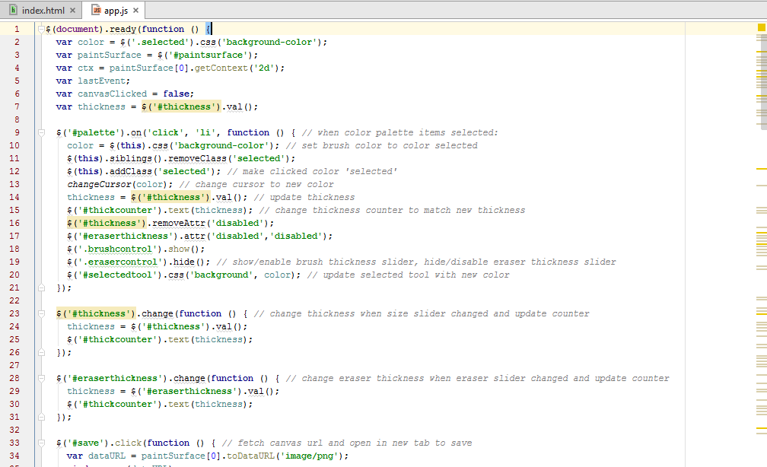
Original Version
app.js

Slide 12
Limitations
All event listeners/handlers defined in a single function
Confusing! No abstraction
Browsers’ compatibility not checked
app.js

Slide 13
Façade utilized
Simplify an interface for listening to events
Common method to provide safe and cross-browser compatible solution
Notes:
Simplify an interface for listening to events
Create a common method that can be used in one’s code which does the task of checking for the existence of features so that it can provide a safe and cross-browser compatible solution

Slide 14
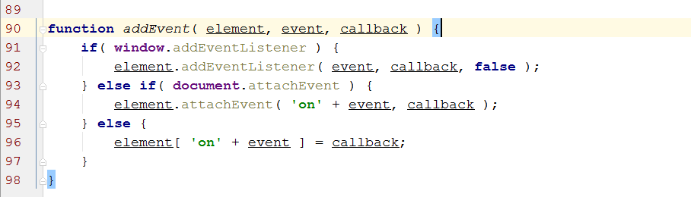
a simple facade that masks the various browser-specific methods
app.js

Slide 15
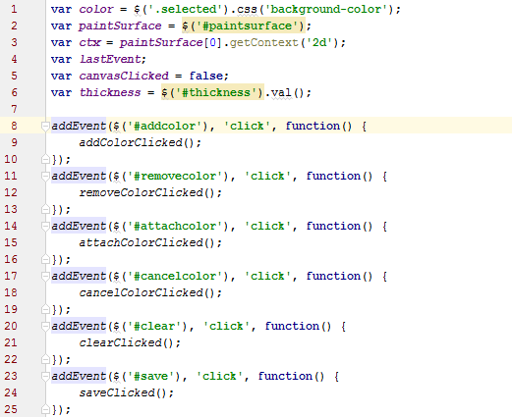
app.js

Slide 16
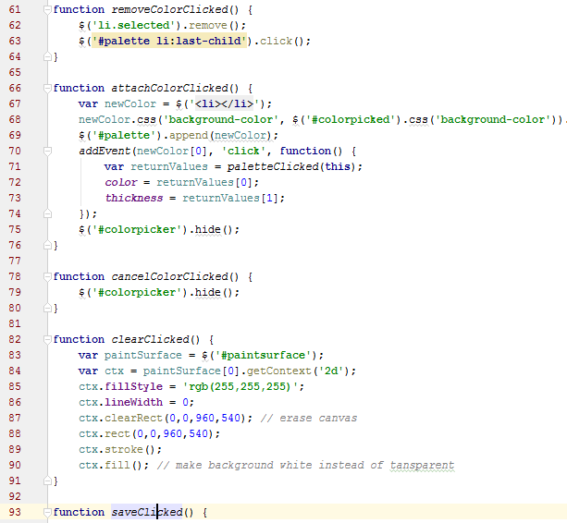
Achieving abstraction
eventHandler.js

Slide 17
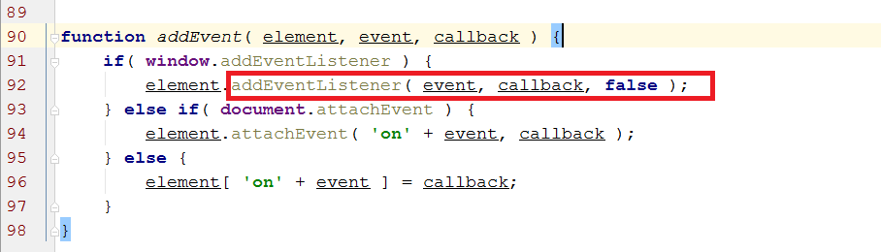

a simple facade that masks the various browser-specific methods

Slide 18
References
w3schools

