Slide 1
Project – 1 : drawr-bootstrap

Slide 2
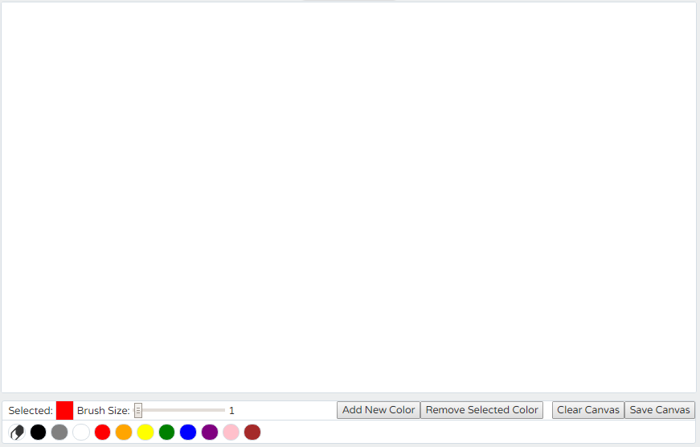
drawr-bootstrap
First Screen

Slide 3
drawr-bootstrap: features
Customizable drawing tool
Toolbar
Brush/Eraser thickness
Color Palette
Add new color
Remove a color
Clear canvas
Save canvas

Slide 4
Several event listeners & handlers
$('#palette').on('click', 'li', function () {…}
$('#erase').click(function () { …}
$('#thickness').change(function () {…}
$('#eraserthickness').change(function () {…}
$('#save').click(function () {…}
$('#clear').click(function () {…}
$('#addcolor').click(function () {…}
$('#removecolor').click(function () {…}
$('#attachcolor').click(function () {…}
$('#cancelcolor').click(function () {…}
$('.colorslider').change(function () {…}
paintSurface.mousedown(function (e) {…}
paintSurface.mousemove(function (e) {…}

Slide 5
Event listeners - Challenges

