Slide 1
Façade Design Pattern

Slide 2
Introduction
Convenient higher-level interface to a larger body of code
Hides actual complexity
Simplified presentation of API - Improves usability
Decouples class from code that utilizes it
Notes:
provides a convenient higher-level interface to a larger body of code
Hiding actual complexity
Improves usability because of simplified presentation of API
Not only simplifies the class interface, but also decouples class from code that utilizes it

Slide 3

Example

Slide 4
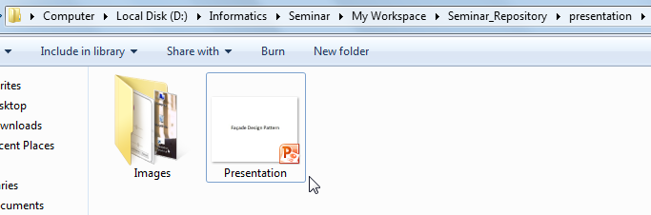
Example

Slide 5
Example - jQuery
Group of facades – makes programming easier and faster
Notes:
Being used by people knowingly or unknowingly in jQuery
jQuery essentially serves as a group of facades to make our lives as programmers easier

Slide 6
Example - jQuery
Group of facades – makes programming easier and faster
facades for $.ajax()
$.get( url, data, callback, dataType );
$.post( url, data, callback, dataType );
$.getJSON( url, data, callback );
Notes:
Being used by people knowingly or unknowingly in jQuery
jQuery essentially serves as a group of facades to make our lives as programmers easier

Slide 7
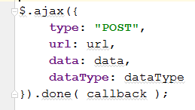
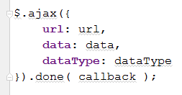

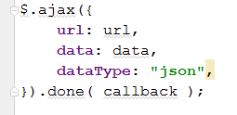
Behind the scenes

Slide 8
Project : drawr-bootstrap^{[1]}

Slide 9
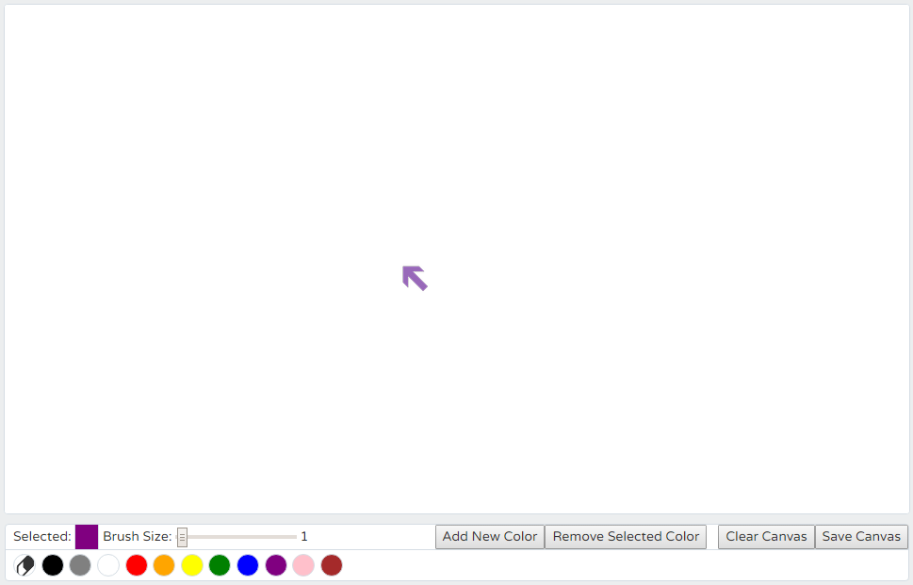

drawr-bootstrap
First Screen

Slide 10
drawr-bootstrap: features
Customizable drawing tool
Toolbar
Brush/Eraser thickness
Color Palette
Add new color
Remove a color
Clear canvas
Save canvas

Slide 11
Several event listeners & handlers
$('#palette').on('click', 'li', function () {…}
$('#erase').click(function () { …}
$('#thickness').change(function () {…}
$('#eraserthickness').change(function () {…}
$('#save').click(function () {…}
$('#clear').click(function () {…}
$('#addcolor').click(function () {…}
$('#removecolor').click(function () {…}
$('#attachcolor').click(function () {…}
$('#cancelcolor').click(function () {…}
$('.colorslider').change(function () {…}
paintSurface.mousedown(function (e) {…}
paintSurface.mousemove(function (e) {…}

Slide 12
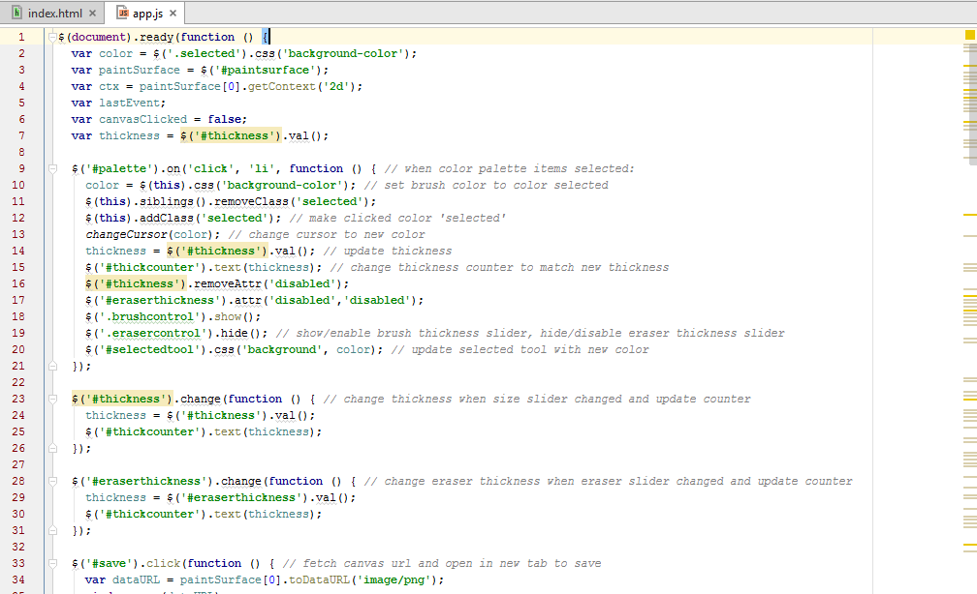
Original Version
app.js

Slide 13
Limitations
All event listeners/handlers defined in a single function
Confusing! No abstraction
Browsers’ compatibility not checked
app.js

Slide 14
Façade utilized
Simplify an interface for listening to events
Common method to provide safe and cross-browser compatible solution
Notes:
Simplify an interface for listening to events
Create a common method that can be used in one’s code which does the task of checking for the existence of features so that it can provide a safe and cross-browser compatible solution

Slide 15
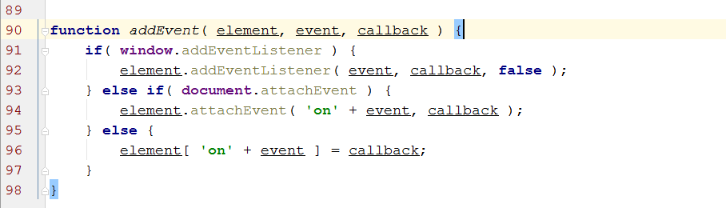
a simple facade that masks the various browser-specific methods
app.js

Slide 16
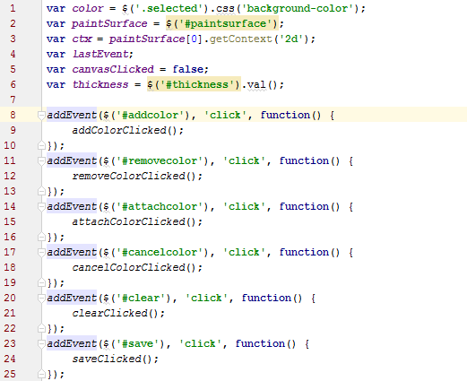
app.js

Slide 17
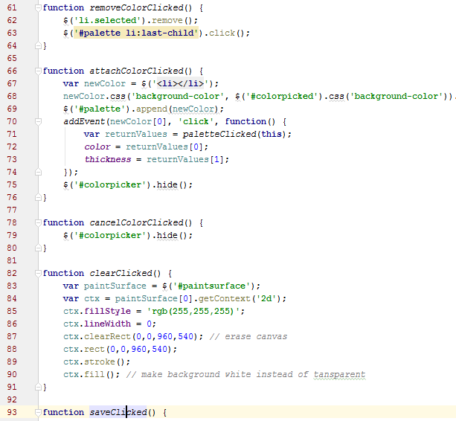
Achieving abstraction
eventHandler.js

Slide 18
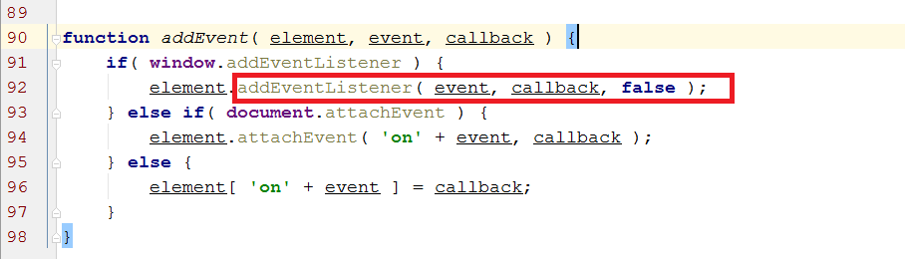

a simple facade that masks the various browser-specific methods

Slide 19
Composite Design Pattern

Slide 20
Introduction
Group of objects should be treated in the same way as a single instance of an object.
Same behavior applied to an object or a group of objects
Code resuability

Slide 21
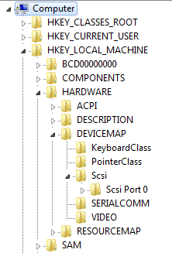
Example
Component
Leaf
Component
Leaf
Component

Slide 22


Example - jQuery
Same methods available to be applied to an element or collection of elements
Single Element
Collection of Elements
Notes:
Being used by people knowingly or unknowingly in jQuery
jQuery essentially serves as a group of facades to make our lives as programmers easier

Slide 23
drawr-bootstrap
First Screen

Slide 24
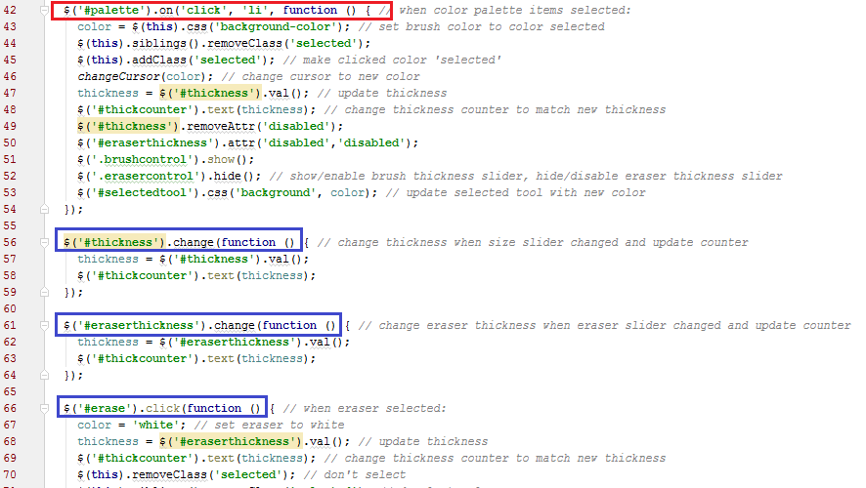
Original version
Component with collection of list elements
Single element component

Slide 25
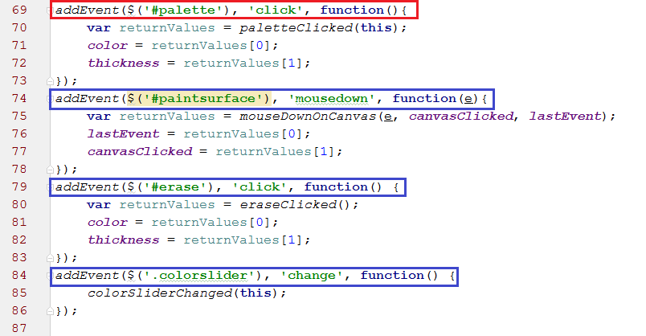
Refactored version
Component with collection of list elements
Single element
component

Slide 26
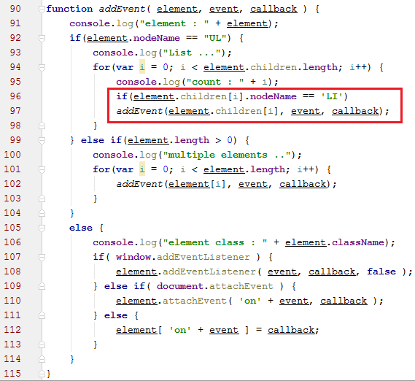
Refactored version
Recursion for
Collection components

Slide 27
References
[1] https://github.com/flamingveggies/drawr-bootstrap

