Slide 1
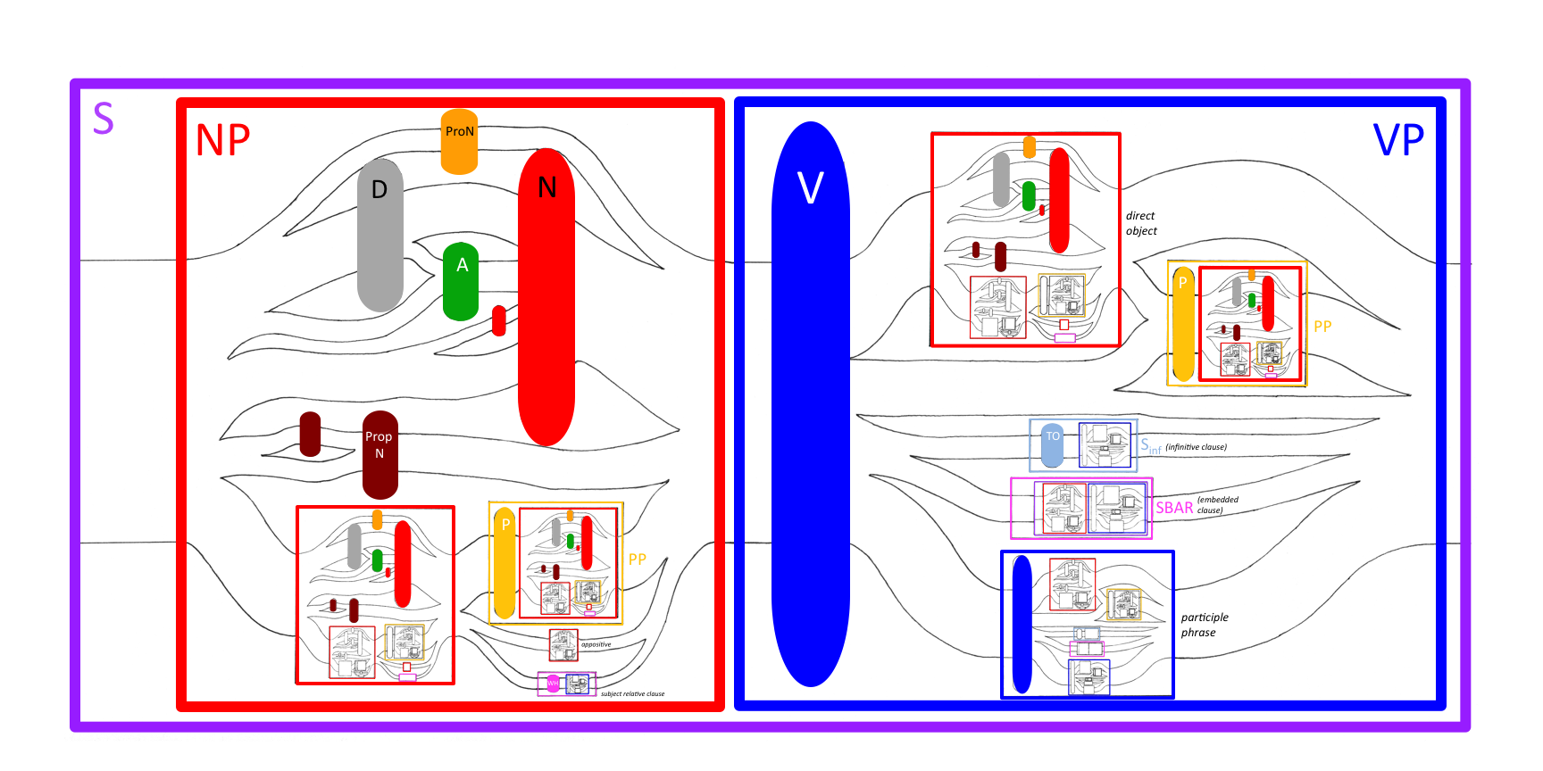
A VISUAL REPRESENTATION OF THE ENGLISH LANGUAGE. By David Temperley
Table 1. Syntactic rules
and their probabilities.
Par- ent | Expansion | Count | P(Par ->Exp)
NP | NP PP | 43862 | .192
 | D N | 42193 | .185
 | N | 32758 | .143
 | ProN | 20932 | .092
 | PropN | 15897 | .070
 | Adj N | 15512 | .068
 | PropN PropN | 14881 | .065
 | D Adj N | 13840 | .061
 | NP N | 11299 | .049
 | NP SBAR | 9287 | .041
 | N N | 8104 | .035
VP | V NP | 30694 | .265
 | V VP | 27964 | .242
 | V PP | 14296 | .124
 | V | 11213 | .097
 | V SBAR | 11213 | .097
 | V Sinf | 10518 | .091
 | V NP PP | 9832 | .085
PP | P NP | 103708 | 1.000
S | NP VP | 56066 | .843
 | VP | 10459 | .157
SBAR | S | 9731 | .544
 | WHNP S | 8162 | .456
ADVP * | Adv | 17331 | 1.000
Sinf | TO VP | 11932 | 1.000
*The expansion ADVP->Adv could not be included, since no higher-level expansion includes ADVP.
Table 2. Symbols used and
their Treebank equivalents
and descriptions.
Symbol | TB sym-bol(s) | Description
A | JJ | adjective
D | DT | determiner
N | NN, NNS | noun
NP | NP | noun phrase
P | IN | preposition
PP | PP | prepositional phrase
ProN | PRP | pronoun
PropN | NNP, NNPS | proper noun
S | S | clause/sentence
SBAR | SBAR | parent of S
Sinf | S/VP | infinitive clause
TH | IN | “that”
TO | TO | “to”
V | VB, VBD, VBP, etc. | verb
VP | VP | verb phrase
WH | WHNP | relative pronoun
This poster presents a graphic representation of syntactic probabilities in written English. The probabilities were extracted from the Wall Street Journal portion of the Penn Treebank (Marcus et al., 1993)—about 1 million words of syntactically-annotated text. (The corpus was slightly modified for this purpose.)
The corpus can be used to define a probabilistic context-free grammar, in which each expansion of a constituent is assigned a probability. The diagram represents only the 25 most frequently-occurring expansions; these account for about 65% of all constituent tokens in the corpus (see Table 1 at right).
The diagram consists of a network of paths, boxes, and ovals. Paths represent syntactic expansions; boxes represent constituents; ovals represent preterminals (noun, verb, etc.). Each box has a path entering its left side and exiting its right side (consider the large NP on the left as an example). The path may split into several sub-paths, representing possible expansions. If the height of the path (i.e. the distance across in the vertical dimension as it enters the box) is H, the height of each sub-path is P × H, where P is the probability of the expansion. For example, the probability of the expansion NP → ProN (Pronoun) is .092, so the height of the ProN sub-path is .092 × the height of the NP path. Smaller ovals and boxes represent the “children” to which the larger constituent expands. (The height of each oval and box is 2.14 x the height of the path through it.) When multiple expansions involve the same child, their paths are merged into a single path whose height is the sum of the sub-paths; for example, the NP expansions [D N] and [D A N] both involve D, so their paths (going into D) are merged. Each smaller constituent also shows its internal structure; the probabilities of elements within it are correctly represented with respect to the immediate parent and higher-level constituents as well.
The diagram represents many important facts about English. It shows, for example, the relative probability of different kinds of verb complements and adjuncts: direct object, infinitive VP, embedded clause, and prepositional phrase. The diagram also clearly shows the recursive nature of English: The eye naturally recognizes, for example, the appearance of NP at different hierarchical levels. More problematically, the diagram represents English as being context-free, in that the probabilities of expansions of a constituent are the same regardless of its syntactic context. In fact, English is not context-free in this sense: For example, a subject NP is much more likely to expand to a pronoun than an object NP. In this sense, the diagram oversimplifies the true probabilities of English syntax.
Reference: Marcus, M., Santorini, B.,
& Marcinkiewicz, M. 1993. Building a
large annotated corpus of English: The Penn Treebank. Computational Linguistics, 19:313—330.

