Slide 1
Can Metadata be Quantified?
Statistics and Analytics
for Libraries
Presented at the 2015 DPLAFest
by Corey A Harper
2015-04-18

Slide 2
Project Proposal: Quantified Metadata?
Notion of “Record Completeness”
Metadata Distributions
Field Population Statistics
Usage Statistics
Natural Language Processing
  Query Language
  Full Text of Metadata
  Full Text of Heading
Regression Analysis
2015-04-18
Harper - Can Metadata be Quantified? - DPLAFest 2015

Slide 3

Math-Nerdery Warning
2015-04-18
Harper - Can Metadata be Quantified? - DPLAFest 2015

Slide 4
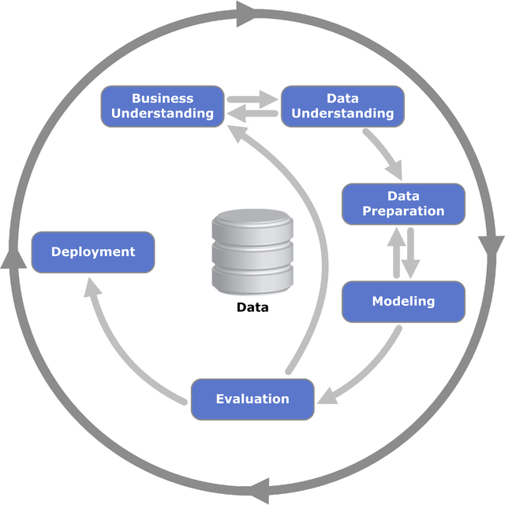
CRISP-DM
"CRISP-DM Process Diagram" by Kenneth Jensen
Own work. Licensed under CC BY-SA 3.0 via Wikimedia Commons
http://commons.wikimedia.org/wiki/File:CRISP-DM_Process_Diagram.png
2015-04-18
Harper - Can Metadata be Quantified? - DPLAFest 2015

Slide 5
Toolkit
Tableau – Business Intelligence
R – Stats Analysis
Python
  SciPy, NumPy, Pandas, etc
  NLTK
jq, awk, sed, grep, sort, uniq, tr, wc, etc.
2015-04-18
Harper - Can Metadata be Quantified? - DPLAFest 2015

Slide 6
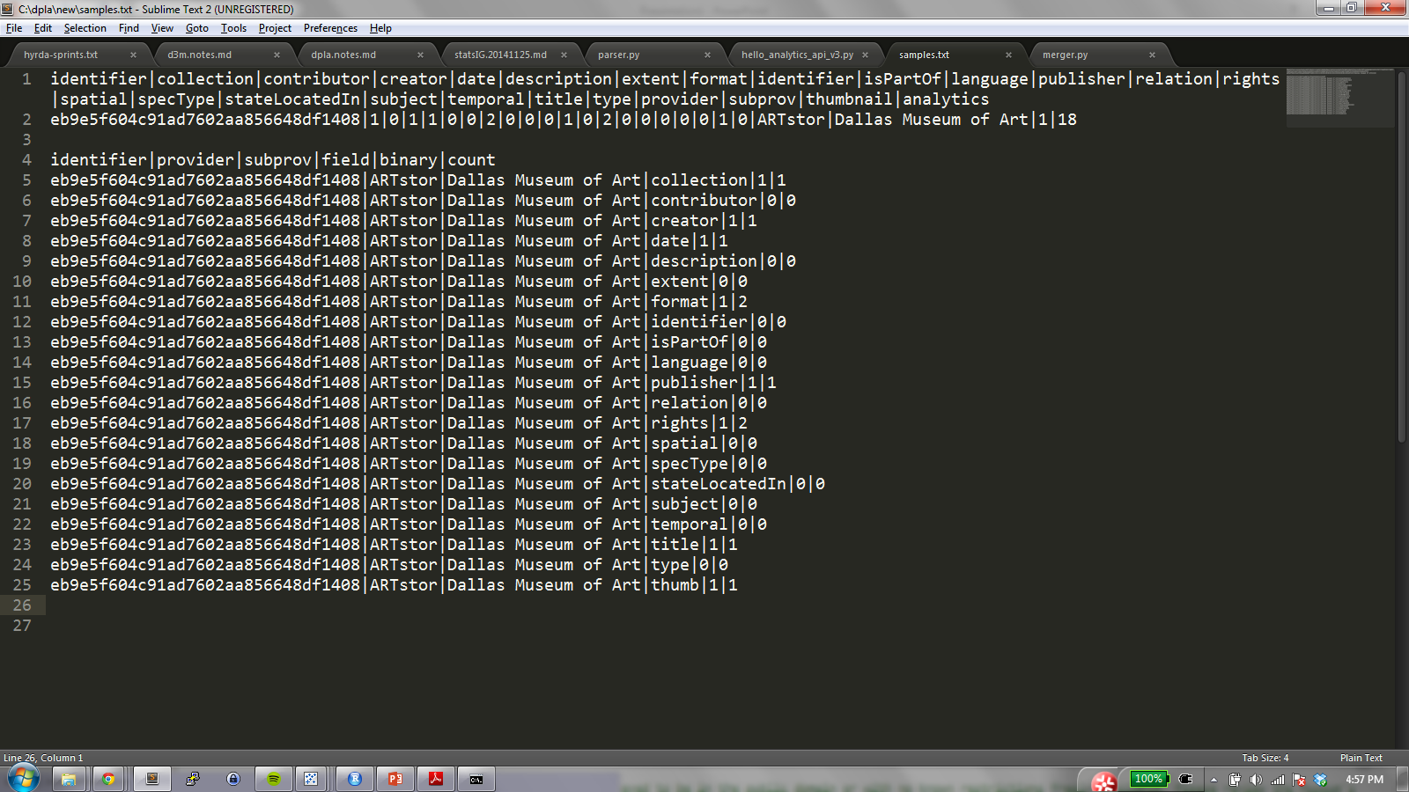
Parsed into “Long” & “Wide” formats
2015-04-18
Harper - Can Metadata be Quantified? - DPLAFest 2015

Slide 7
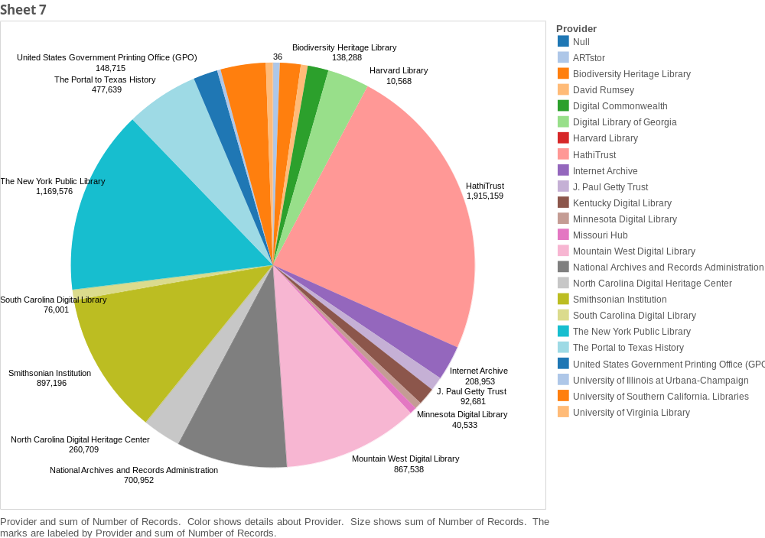
Distribution by Provider
2015-04-18
Harper - Can Metadata be Quantified? - DPLAFest 2015

Slide 8
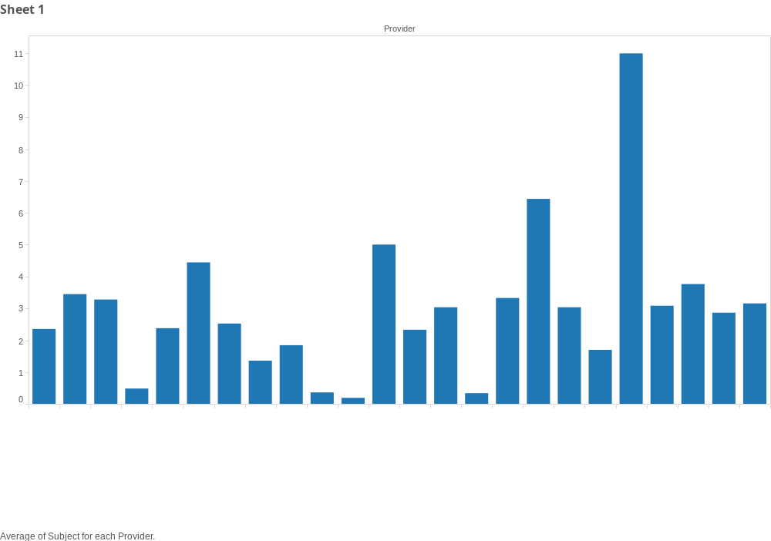
Average # of Subjects by Provider
2015-04-18
Harper - Can Metadata be Quantified? - DPLAFest 2015

Slide 9
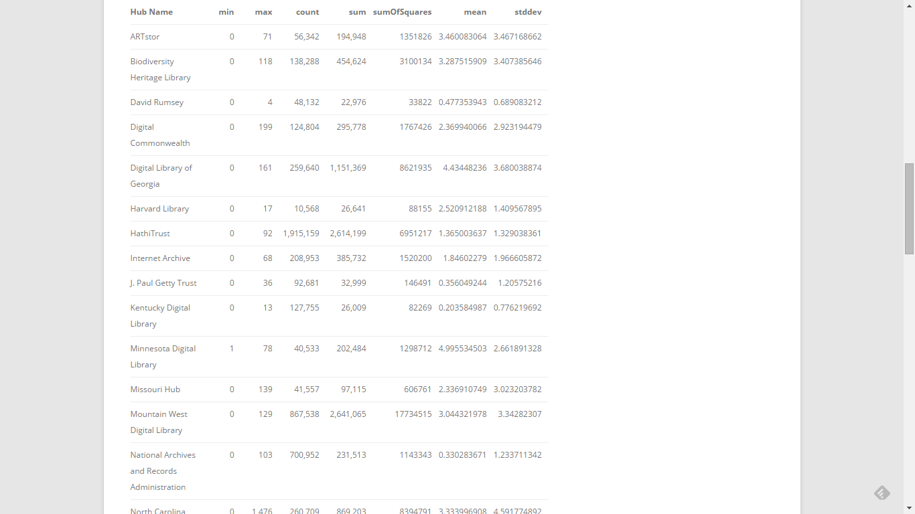
Mark Phillips Recent Work
http://vphill.com/journal/post/5553
2015-04-18
Harper - Can Metadata be Quantified? - DPLAFest 2015

Slide 10
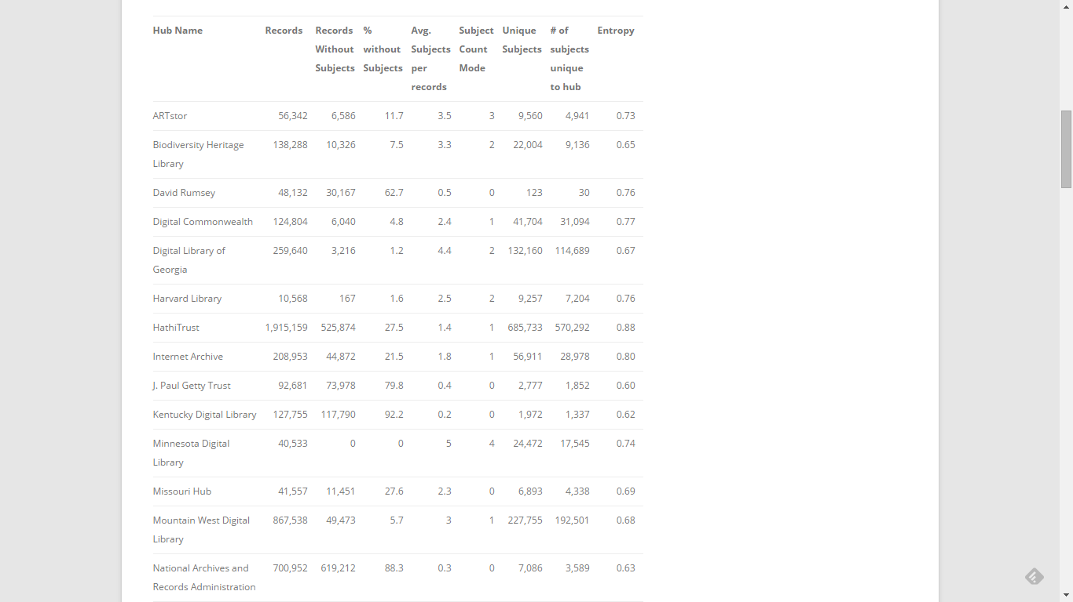
http://vphill.com/journal/post/5557
2015-04-18
Harper - Can Metadata be Quantified? - DPLAFest 2015

Slide 11
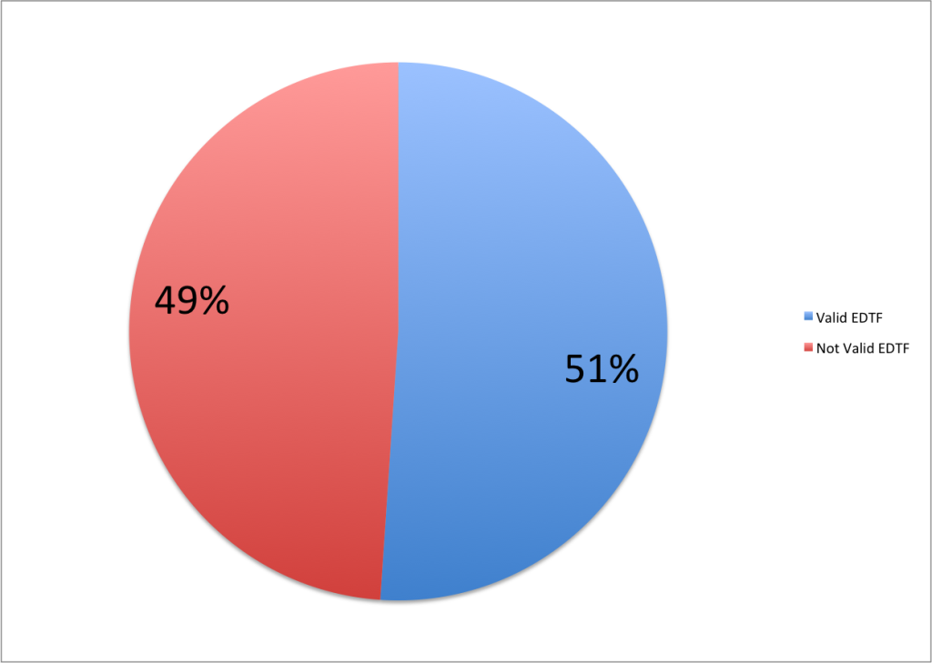
Extended Date Time Format
http://vphill.com/journal/post/5669
2015-04-18
Harper - Can Metadata be Quantified? - DPLAFest 2015

Slide 12
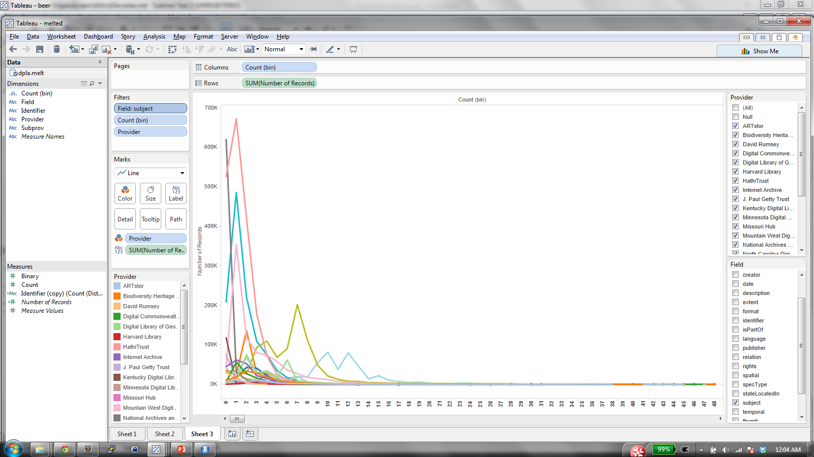
Distributions of Field Counts by Provider
2015-04-18
Harper - Can Metadata be Quantified? - DPLAFest 2015

Slide 13
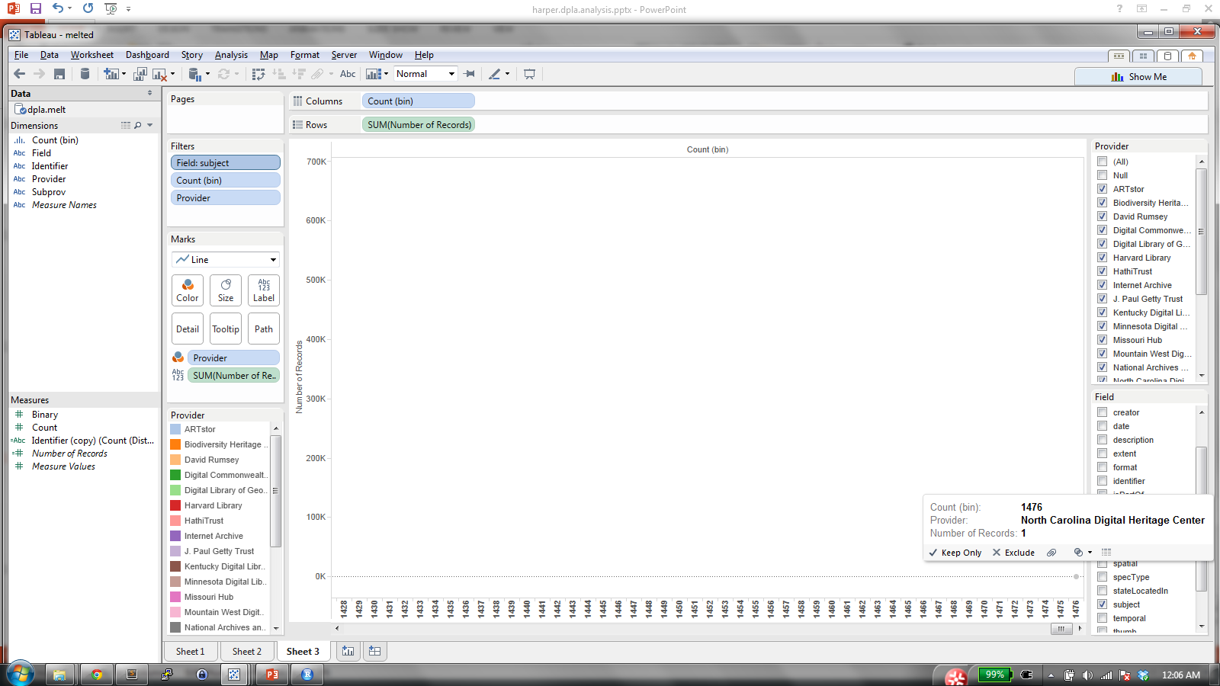
Outliers
Also: 3,800 IDs; 480 Spatials; 24 Languages
2015-04-18
Harper - Can Metadata be Quantified? - DPLAFest 2015

Slide 14
Implicit Metadata
Usage Data
Query Terms
Top Facets (Empty Search)
Referral Patterns
Metadata Topic Maps
2015-04-18
Harper - Can Metadata be Quantified? - DPLAFest 2015

Slide 15
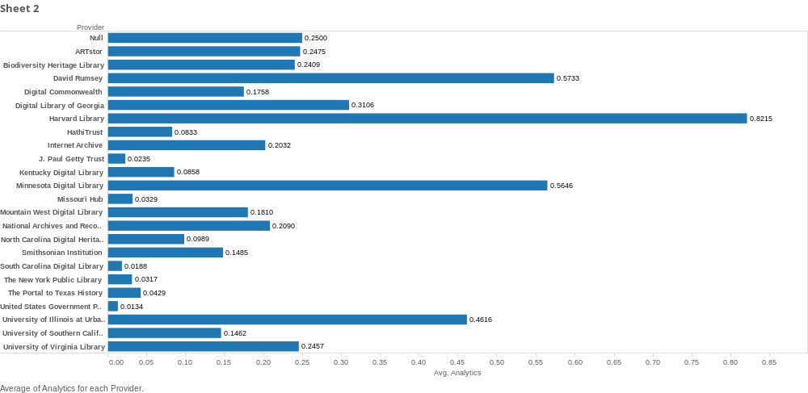
Average Hits Per Record by Provider
2015-04-18
Harper - Can Metadata be Quantified? - DPLAFest 2015

Slide 16
But remember: huge head / long tail
/item/c5cf1632a8a2c137c9b0e7b093024e0a|5159
/item/b6532388a7eee02db4ccb3d31a76a3df|3198
/item/16de95ea0eb35060576385966aed3f3f|3171
/item/ecdafcf9b06be6efed042e40b3923e57|2066
/item/1619731699db08a2c2f8584e12729e72|1984
/item/123c3ea1d7f099da675ce7c3a6c0ca4b|1827
/item/100b1a8594ff7d162e13ff9dfca27c3d|1145
/item/9824dc12222f81e6040f85db570a2a32|1097
/item/b3d8c3ad9a97610d77eb9c53c7def845|1022
/item/295501959544528b1ef79330dcb598ed|939
/item/5ac8b70fb26a52ad8168efead00afea1|882
/item/280233fc9e42a02d32d268fe284a7613|843
/item/7ba1d607106bf46b1c3775498f4de5ba|718
2015-04-18
Harper - Can Metadata be Quantified? - DPLAFest 2015

Slide 17
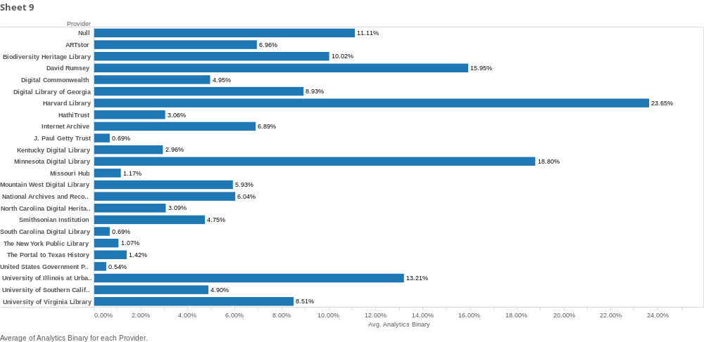
2015-04-18
Harper - Can Metadata be Quantified? - DPLAFest 2015

Slide 18
Regression Analysis
> setwd("C:/dpla/new")
> dpla2 <- read.csv("dpla.merged2.csv", sep="|")
> Lin_m1b<- lm(analytics~ subject, data=dpla2)
> screenreg(Lin_m1b, single.row=TRUE)
==================================
Model 1
----------------------------------
(Intercept) 0.10 (0.00) ***
subject 0.01 (0.00) ***
----------------------------------
R^2 0.00
Adj. R^2 0.00
Num. obs. 8012390
==================================
*** p < 0.001, ** p < 0.01, * p < 0.05
2015-04-18
Harper - Can Metadata be Quantified? - DPLAFest 2015

Slide 19
Complex Regressions!
> dpla2$thumbnail <- factor(dpla2$thumbnail)
> Lin_giantb<- lm(analytics~ collection + contributor + creator + date + description + extent + format +
+ isPartOf + language + publisher + relation + rights + spatial + specType + stateLocatedIn +
+ subject + temporal + title + type + provider + thumbnail, data=dpla2)
> screenreg(Lin_giantb, single.row=TRUE)
=============================================================================
Model 1
-----------------------------------------------------------------------------
(Intercept) 0.00 (0.01)
collection -0.04 (0.00) ***
contributor 0.01 (0.00) ***
creator 0.01 (0.00) ***
date 0.00 (0.00)
description 0.01 (0.00) ***
extent 0.05 (0.00) ***
format 0.04 (0.00) ***
isPartOf -0.03 (0.01) ***
language -0.01 (0.00) *
publisher -0.02 (0.00) ***
relation -0.03 (0.00) ***
rights 0.18 (0.00) ***
spatial 0.00 (0.00)
specType -0.05 (0.00) ***
stateLocatedIn 0.00 (0.02)
subject 0.02 (0.00) ***
temporal 0.05 (0.00) ***
title -0.03 (0.00) ***
type 0.09 (0.01) ***
2015-04-18
Harper - Can Metadata be Quantified? - DPLAFest 2015

Slide 20
(Continued)
providerBiodiversity Heritage Library 0.17 (0.02) ***
providerDavid Rumsey 0.29 (0.02) ***
providerDigital Commonwealth -0.11 (0.02) ***
providerDigital Library of Georgia 0.01 (0.02)
providerHarvard Library 0.53 (0.03) ***
providerHathiTrust -0.24 (0.02) ***
providerInternet Archive -0.06 (0.02) ***
providerJ. Paul Getty Trust -0.19 (0.02) ***
providerKentucky Digital Library -0.18 (0.02) ***
providerMinnesota Digital Library 0.26 (0.02) ***
providerMissouri Hub -0.18 (0.03) ***
providerMountain West Digital Library -0.02 (0.02)
providerNational Archives and Records Administration 0.01 (0.02)
providerNorth Carolina Digital Heritage Center -0.17 (0.02) ***
providerNull -0.11 (0.44)
providerSmithsonian Institution -0.04 (0.02)
providerSouth Carolina Digital Library -0.29 (0.03) ***
providerThe New York Public Library -0.15 (0.02) ***
providerThe Portal to Texas History -0.33 (0.01) ***
providerUnited States Government Printing Office (GPO) -0.29 (0.02) ***
providerUniversity of Illinois at Urbana-Champaign 0.21 (0.02) ***
providerUniversity of Southern California. Libraries -0.82 (0.02) ***
providerUniversity of Virginia Library -0.07 (0.03) *
thumbnail1 -0.01 (0.00) **
-----------------------------------------------------------------------------
R^2 0.00
Adj. R^2 0.00
Num. obs. 8012390
=============================================================================
*** p < 0.001, ** p < 0.01, * p < 0.05
2015-04-18
Harper - Can Metadata be Quantified? - DPLAFest 2015

Slide 21
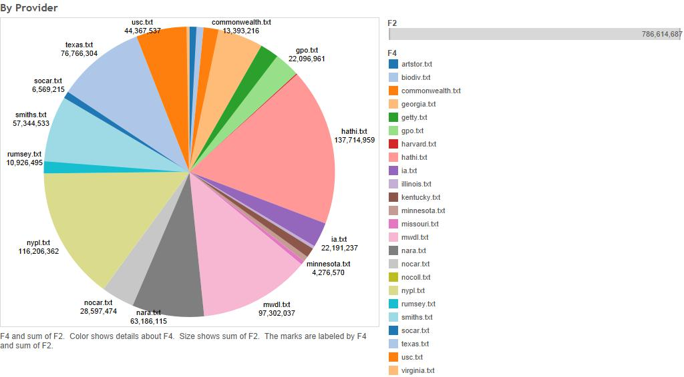
Text Analytics
2015-04-18
Harper - Can Metadata be Quantified? - DPLAFest 2015

Slide 22
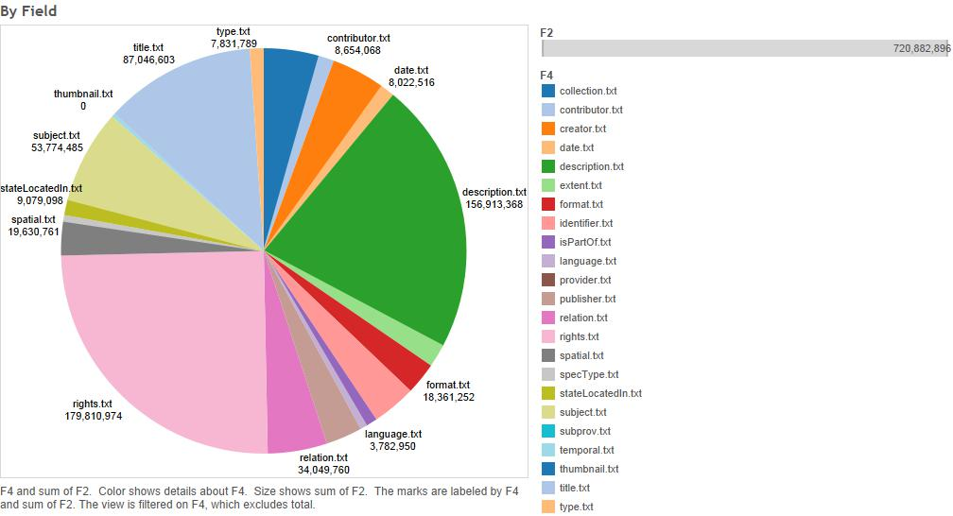
25% of Words are in Rights Statements!
2015-04-18
Harper - Can Metadata be Quantified? - DPLAFest 2015

Slide 23

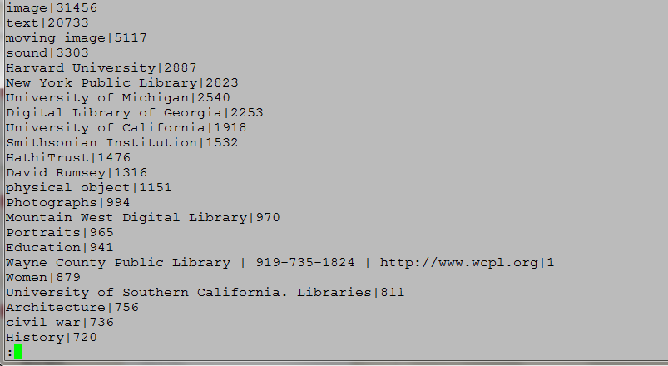
Over 356k unique subject queries
2015-04-18
Harper - Can Metadata be Quantified? - DPLAFest 2015

Slide 24
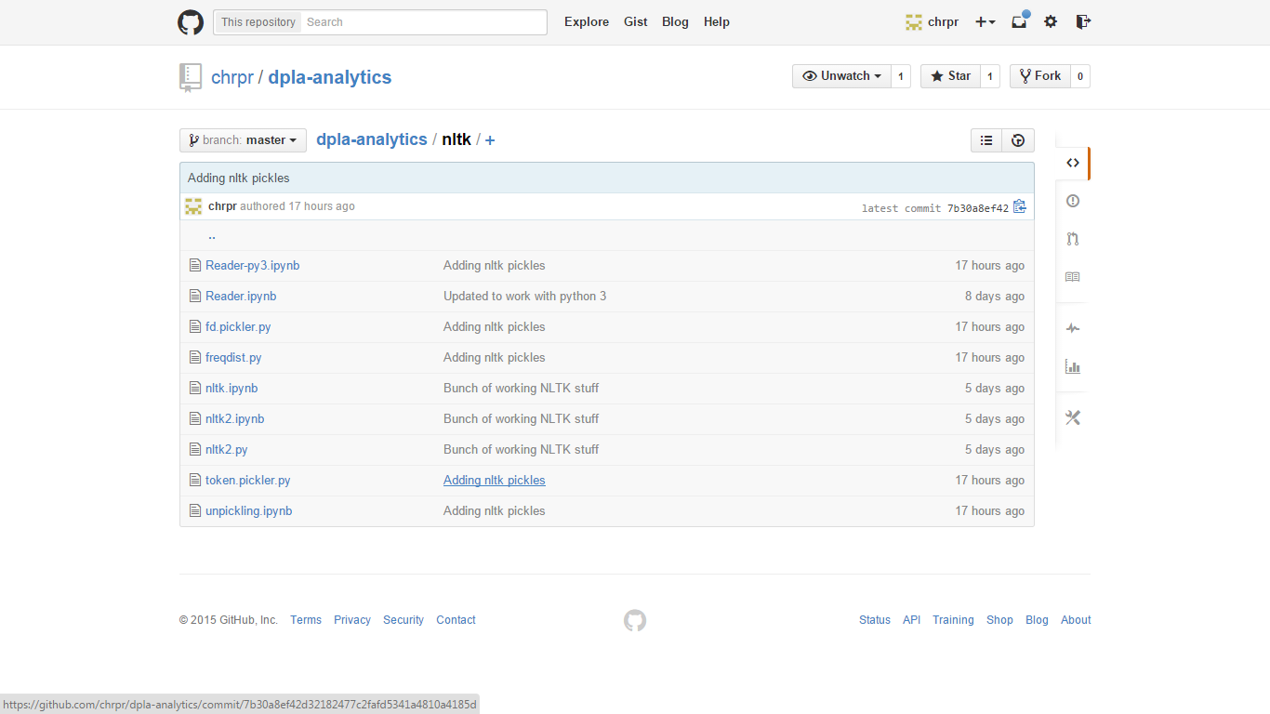
iPython Notebooks on Github
2015-04-18
Harper - Can Metadata be Quantified? - DPLAFest 2015

Slide 25
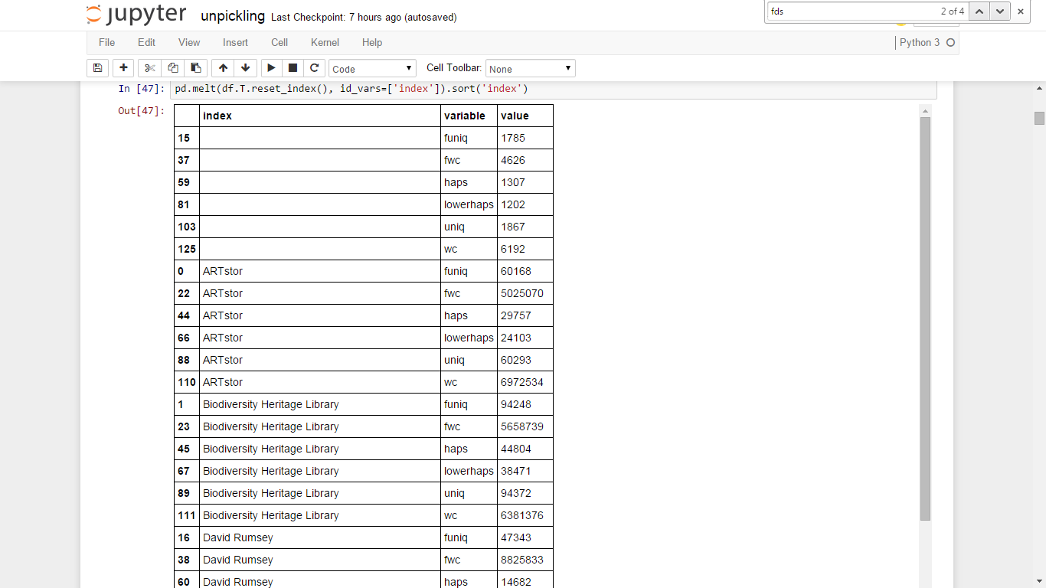
Why to Melt
2015-04-18
Harper - Can Metadata be Quantified? - DPLAFest 2015

Slide 26
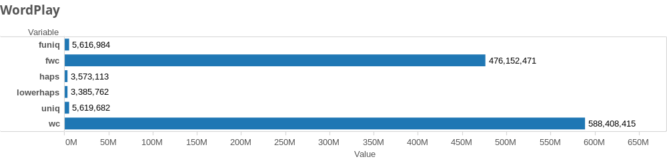
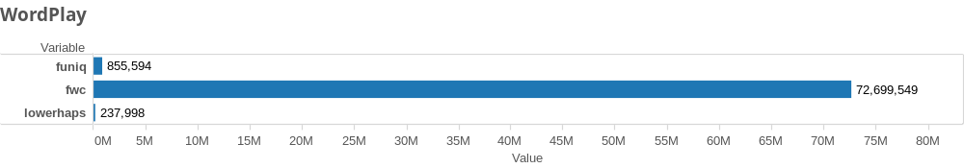
In case that’s gone
2015-04-18
Harper - Can Metadata be Quantified? - DPLAFest 2015

Slide 27
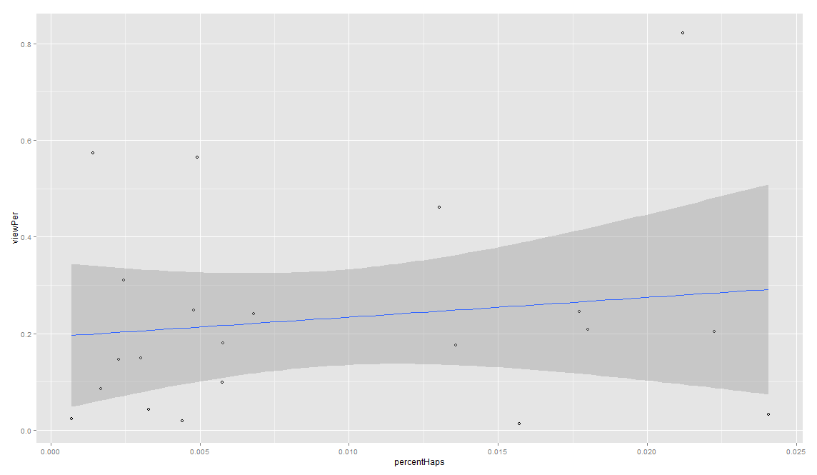
Collection Level Relationships
2015-04-18
Harper - Can Metadata be Quantified? - DPLAFest 2015

Slide 28
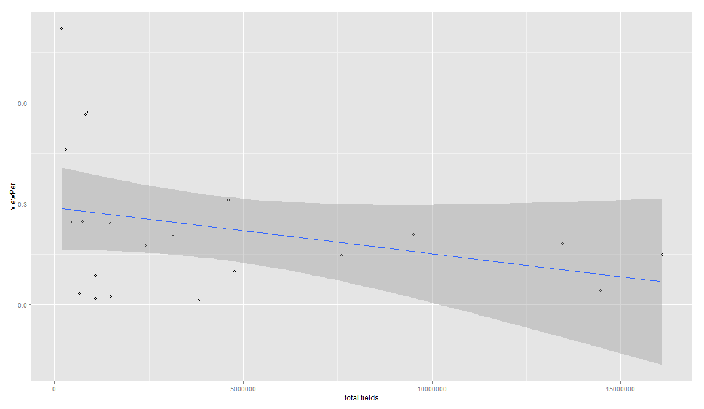
Inverse Relationship? (Also, Heteroskedastic)
2015-04-18
Harper - Can Metadata be Quantified? - DPLAFest 2015

Slide 29
Remember This?
providerBiodiversity Heritage Library 0.17 (0.02) ***
providerDavid Rumsey 0.29 (0.02) ***
providerDigital Commonwealth -0.11 (0.02) ***
providerDigital Library of Georgia 0.01 (0.02)
providerHarvard Library 0.53 (0.03) ***
providerHathiTrust -0.24 (0.02) ***
providerInternet Archive -0.06 (0.02) ***
providerJ. Paul Getty Trust -0.19 (0.02) ***
providerKentucky Digital Library -0.18 (0.02) ***
providerMinnesota Digital Library 0.26 (0.02) ***
providerMissouri Hub -0.18 (0.03) ***
providerMountain West Digital Library -0.02 (0.02)
providerNational Archives and Records Administration 0.01 (0.02)
providerNorth Carolina Digital Heritage Center -0.17 (0.02) ***
providerNull -0.11 (0.44)
providerSmithsonian Institution -0.04 (0.02)
providerSouth Carolina Digital Library -0.29 (0.03) ***
providerThe New York Public Library -0.15 (0.02) ***
providerThe Portal to Texas History -0.33 (0.01) ***
providerUnited States Government Printing Office (GPO) -0.29 (0.02) ***
providerUniversity of Illinois at Urbana-Champaign 0.21 (0.02) ***
providerUniversity of Southern California. Libraries -0.82 (0.02) ***
providerUniversity of Virginia Library -0.07 (0.03) *
thumbnail1 -0.01 (0.00) **
-----------------------------------------------------------------------------
R^2 0.00
Adj. R^2 0.00
Num. obs. 8012390
=============================================================================
*** p < 0.001, ** p < 0.01, * p < 0.05
2015-04-18
Harper - Can Metadata be Quantified? - DPLAFest 2015

Slide 30
Collection Level Regressions
Call:
lm(formula = viewPer ~ subPer + rightsPer + fieldPer + wordsPer +
lowerhaps + vocab + percentHaps, data = subset)
Residuals:
Min 1Q Median 3Q Max
-0.29686 -0.08433 -0.02314 0.07128 0.50919
Coefficients:
Estimate Std. Error t value Pr(>|t|)
(Intercept) 0.1075073344 0.2302971752 0.467 0.648
subPer 0.0547648277 0.0649222572 0.844 0.414
rightsPer 0.0091999235 0.0794976919 0.116 0.910
fieldPer -0.0120774738 0.0308122667 -0.392 0.701
wordsPer 0.0020356961 0.0029568263 0.688 0.503
lowerhaps 0.0000010125 0.0000011198 0.904 0.382
vocab -0.0000010012 0.0000008494 -1.179 0.260
percentHaps 5.6208629550 9.3564384507 0.601 0.558
Residual standard error: 0.2355 on 13 degrees of freedom
Multiple R-squared: 0.2049, Adjusted R-squared: -0.2232
F-statistic: 0.4787 on 7 and 13 DF, p-value: 0.8335
2015-04-18
Harper - Can Metadata be Quantified? - DPLAFest 2015

Slide 31
Stats Terms Explained!!
Heteroskedasticity: Non Constant Variance
R²: Coefficient of determination
σ²: Variance (Standard Error of Est.)
T- & P-Stats: Statistical Strength of Relationship
Note: all regressions so far have been use less. Either low R² or high P/T-Stats.
2015-04-18
Harper - Can Metadata be Quantified? - DPLAFest 2015

Slide 32
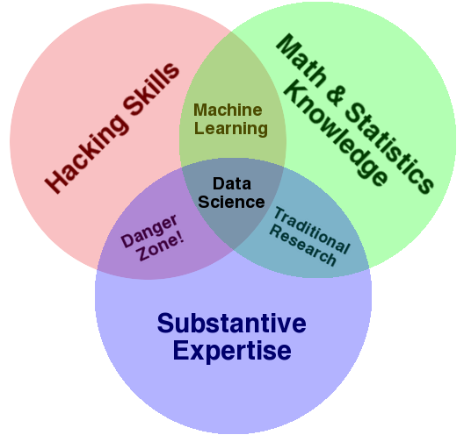
Data Science Venn Diagram
http://drewconway.com/zia/2013/3/26/the-data-science-venn-diagram
2015-04-18
Harper - Can Metadata be Quantified? - DPLAFest 2015

Slide 33
Possibilities & Next Steps
Exploratory Data Analysis. More.
Words per Record
Topic Maps
Analytics by referrer
Bi- and Tri-gram Tokenization, Hapaxes
Map Reduce & Hadoop
Data Cleanup and QA
Contains query strings or top facets
2015-04-18
Harper - Can Metadata be Quantified? - DPLAFest 2015

Slide 34
Thanks!
corey.harper@nyu.edu
212.998.2479
@chrpr
2015-04-18
Harper - Can Metadata be Quantified? - DPLAFest 2015

