Slide 1
Statistical DPLA
Metadata counting and
word analysis
Presented at the DLF 2015 Forum
by Corey A Harper
2015-10-28

Slide 2
Project Proposal: Quantified Metadata?
Notion of “record completeness”
Field distributions and statistics
Usage data and query language
Natural language processing
  Query language
  Full text of records
  Full text of fields
Term & bi-gram frequency
Topic modeling (Latent Dirlichlet
2015-10-28
Harper - Statistical DPLA - DLF 2015 Forum

Slide 3
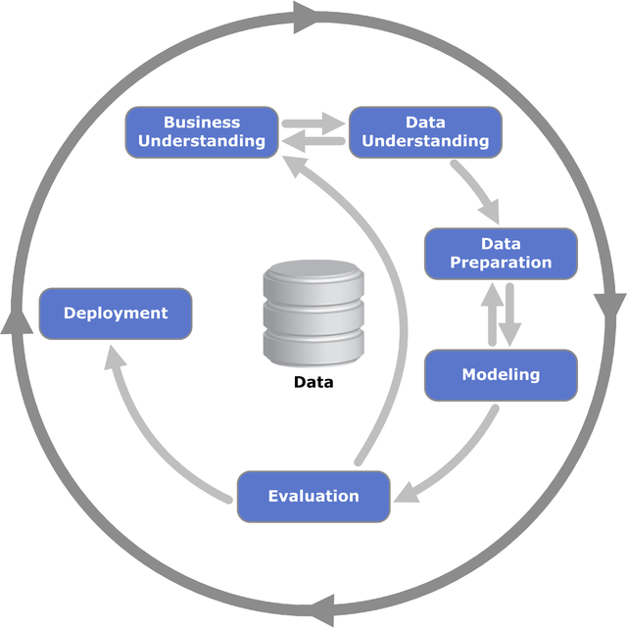
CRISP-DM
"CRISP-DM Process Diagram" by Kenneth Jensen
Own work. Licensed under CC BY-SA 3.0 via Wikimedia Commons
http://commons.wikimedia.org/wiki/File:CRISP-DM_Process_Diagram.png
2015-10-28
Harper - Statistical DPLA - DLF 2015 Forum

Slide 4
Toolkit
Tableau – Business intelligence & viz
R – Stats Analysis, some viz
Python
  SciPy, NumPy, Pandas, etc
  NLTK, Gensim
First cuts at D3, plot.ly
jq, awk, sed, grep, sort, uniq, tr, wc, etc.
2015-10-28
Harper - Statistical DPLA - DLF 2015 Forum

Slide 5
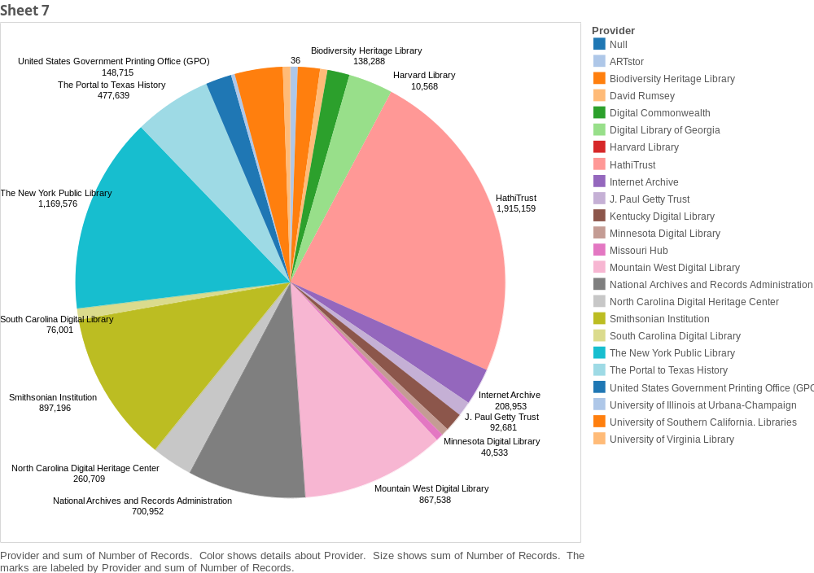
Distribution by Provider
2015-10-28
Harper - Statistical DPLA - DLF 2015 Forum

Slide 6
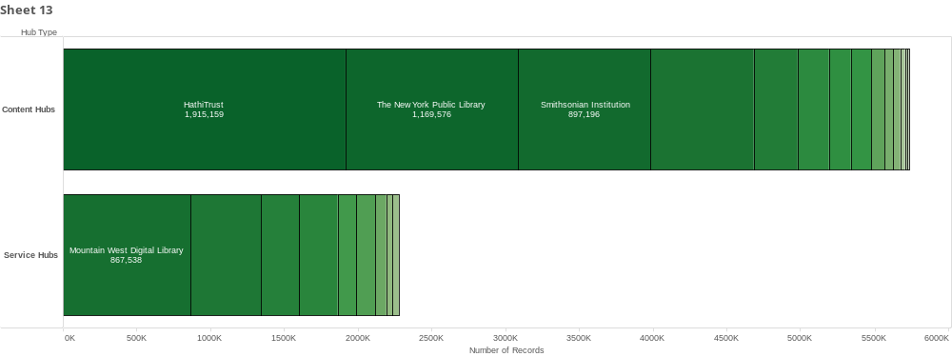
2015-10-28
Harper - Statistical DPLA - DLF 2015 Forum

Slide 7
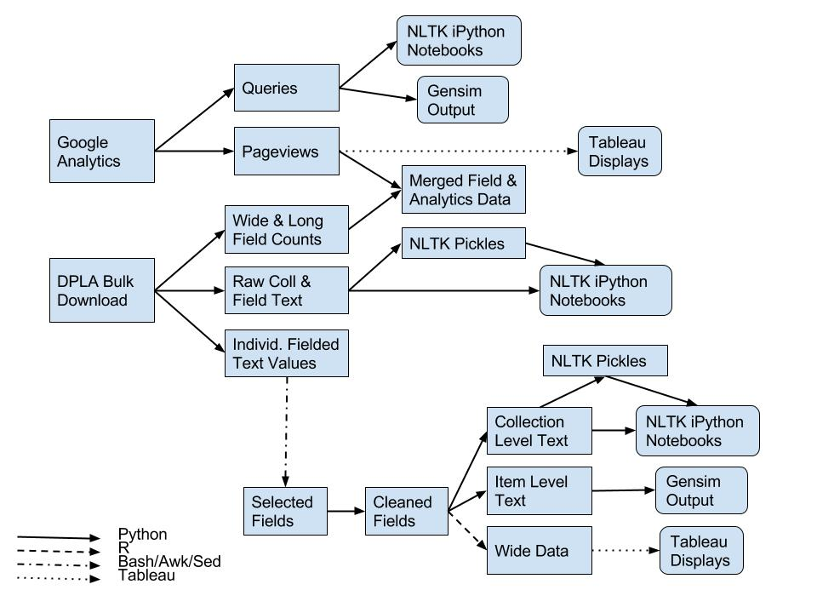
Irreproducible Data Pipelines
2015-10-28
Harper - Statistical DPLA - DLF 2015 Forum

Slide 8
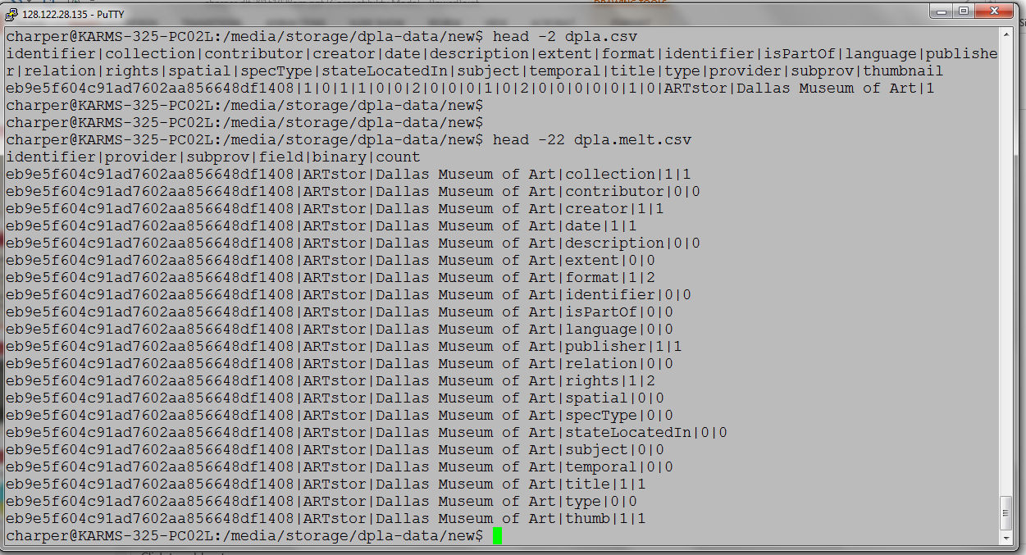
Parsed into “Long” & “Wide” formats
2015-10-28
Harper - Statistical DPLA - DLF 2015 Forum

Slide 9
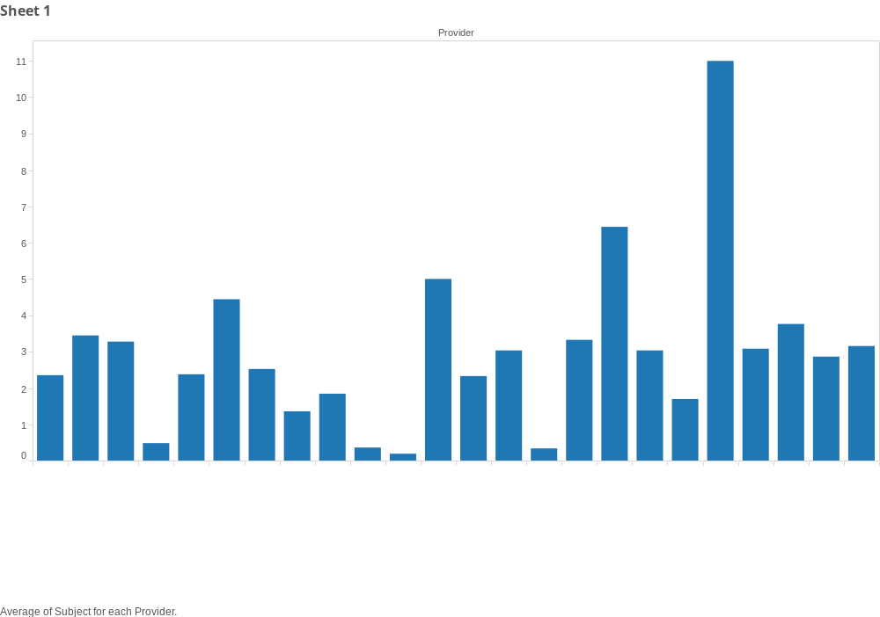
Average # of Subjects by Provider
2015-10-28
Harper - Statistical DPLA - DLF 2015 Forum

Slide 10
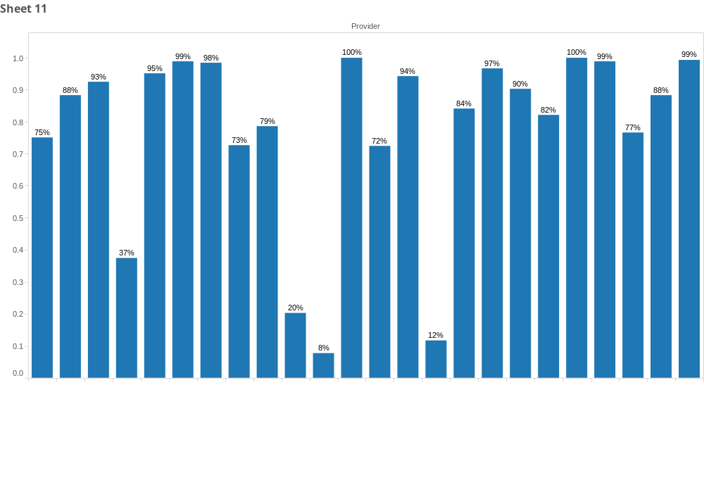
Percentage of records with Subject
2015-10-28
Harper - Statistical DPLA - DLF 2015 Forum

Slide 11
Further Subject Analysis
Content Hubs:
  72% of records have at least one subject
  Average subjects per record = 2.3
Service Hubs: 90%, 4.73
Overall: 77.3%, 2.99
2015-10-28
Harper - Statistical DPLA - DLF 2015 Forum

Slide 12
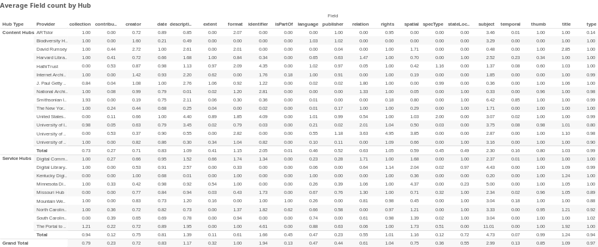
2015-10-28
Harper - Statistical DPLA - DLF 2015 Forum

Slide 13
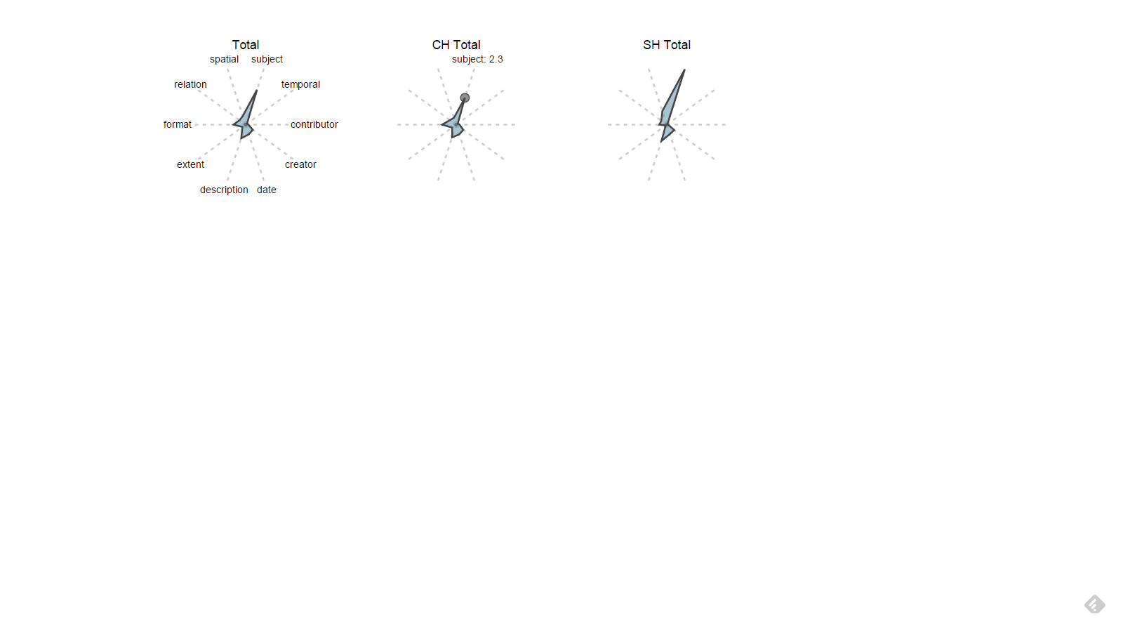
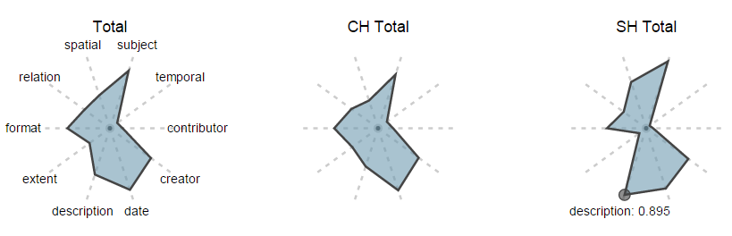
Star Plots in D3
Average Field Count
Percentage with at least 1
2015-10-28
Harper - Statistical DPLA - DLF 2015 Forum

Slide 14
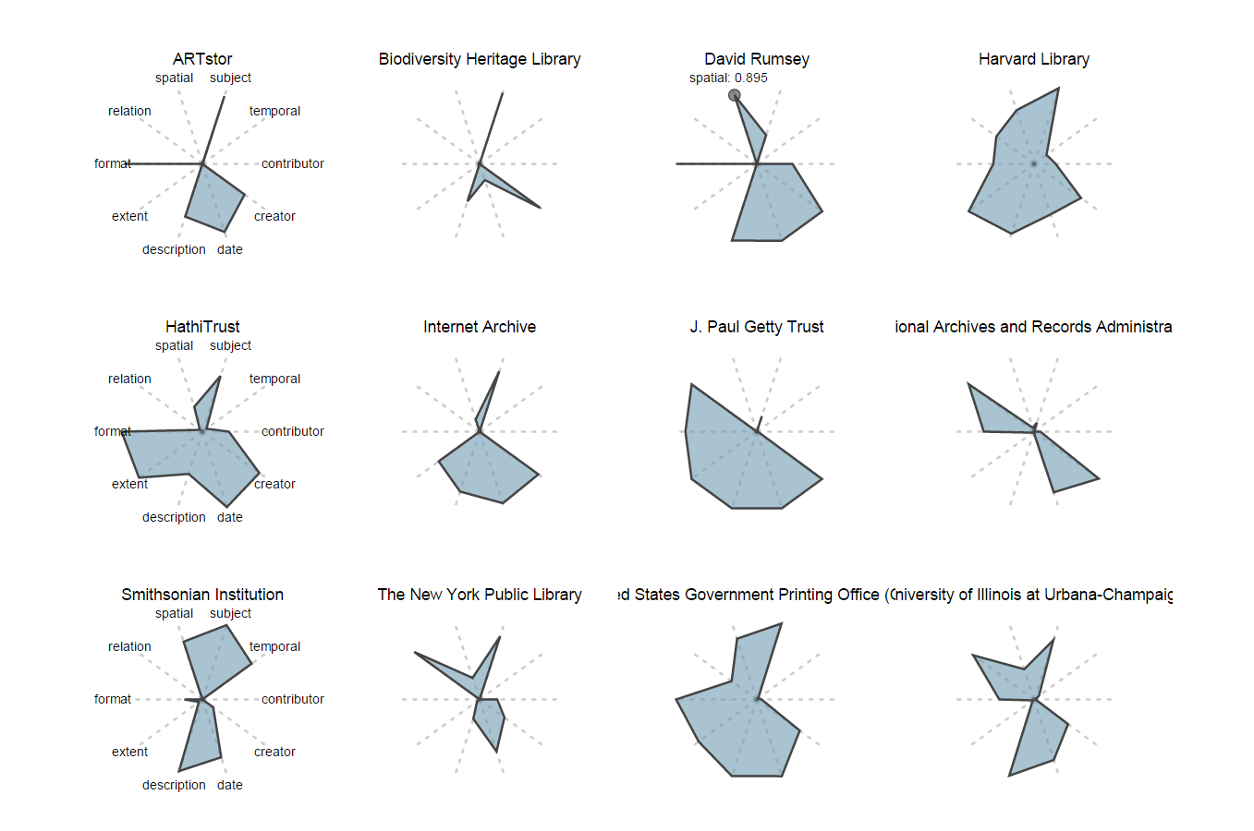
Rumsey is Peak Spatial!
https://github.com/kevinschaul/d3-star-plot
2015-10-28
Harper - Statistical DPLA - DLF 2015 Forum

Slide 15
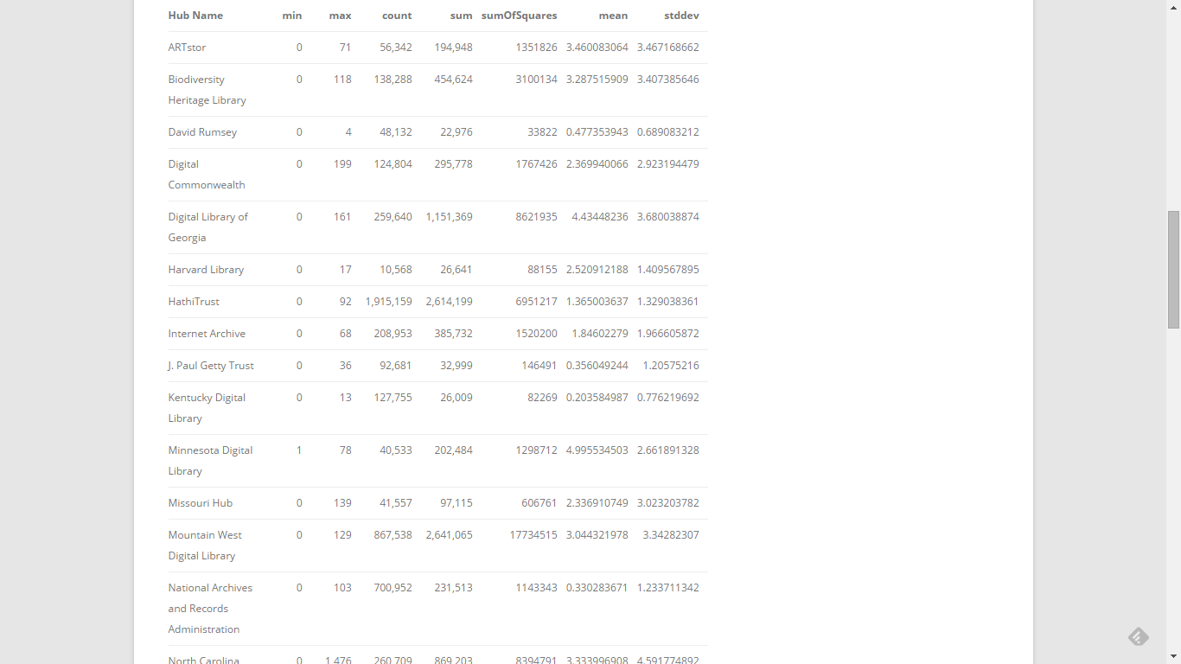
Mark Phillips Recent Work
http://vphill.com/journal/post/5553
2015-10-28
Harper - Statistical DPLA - DLF 2015 Forum

Slide 16
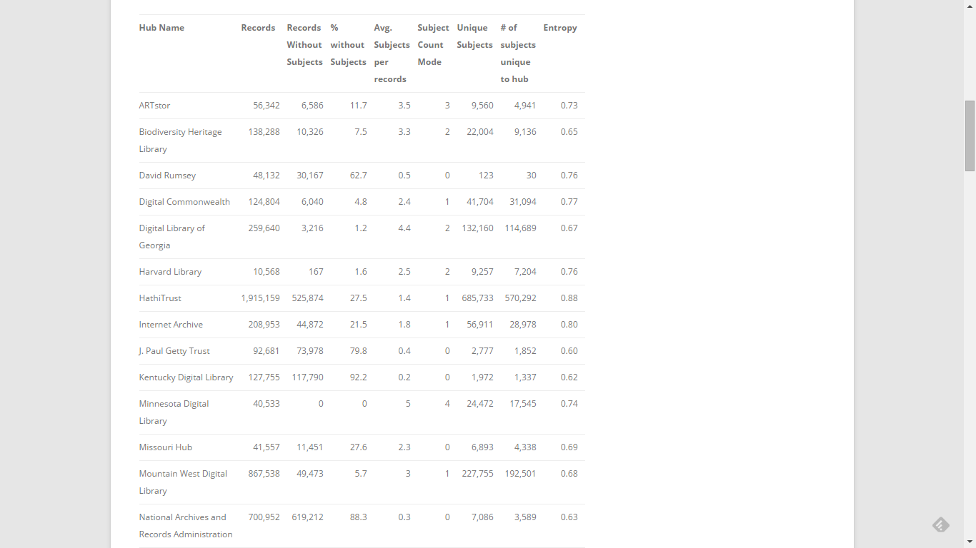
http://vphill.com/journal/post/5557
2015-10-28
Harper - Statistical DPLA - DLF 2015 Forum

Slide 17
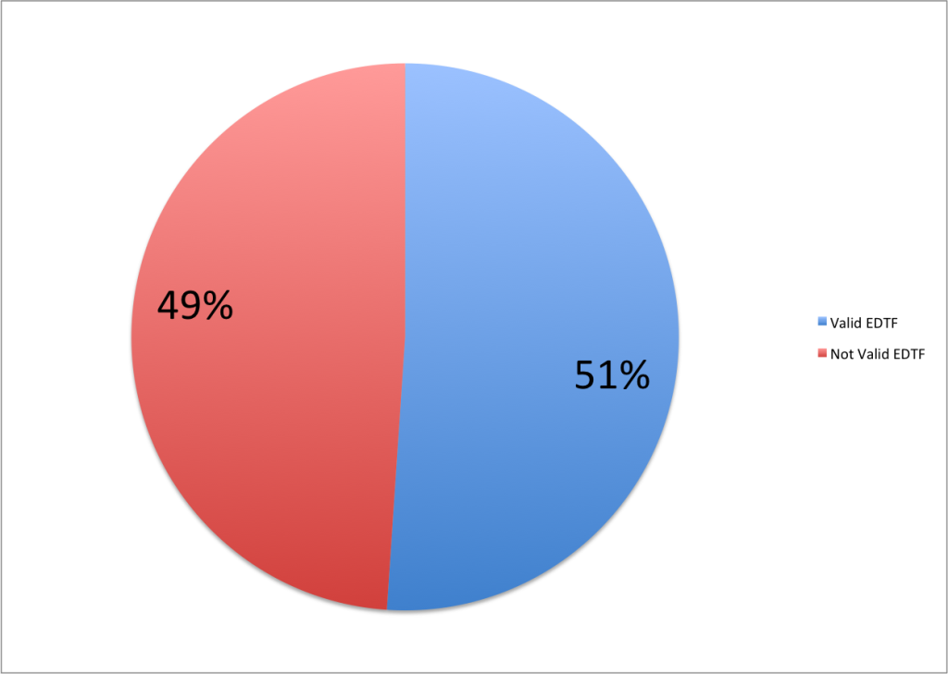
Extended Date Time Format
http://vphill.com/journal/post/5669
2015-10-28
Harper - Statistical DPLA - DLF 2015 Forum

Slide 18
More Recently
Deeper dive into EDTF
(including levels & patterns):
http://vphill.com/journal/post/5690/
Characteristics of subjects:
http://vphill.com/journal/post/5730/
2015-10-28
Harper - Statistical DPLA - DLF 2015 Forum

Slide 19
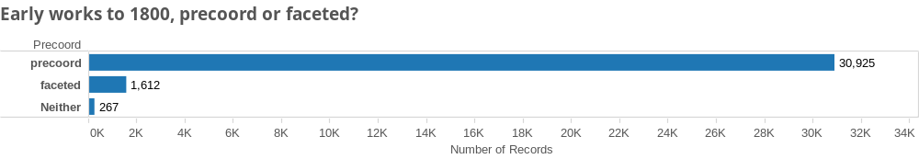
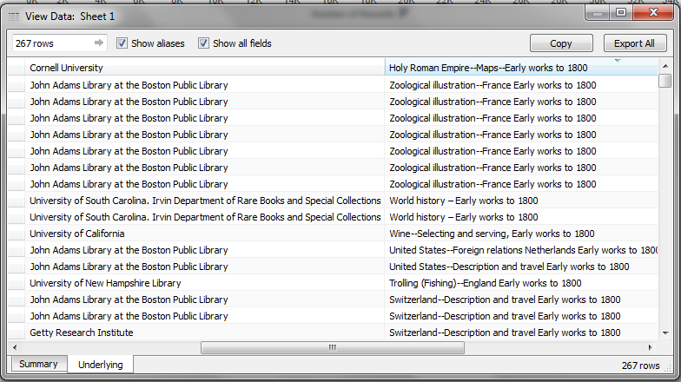
Early works to 1800
2015-10-28
Harper - Statistical DPLA - DLF 2015 Forum

Slide 20
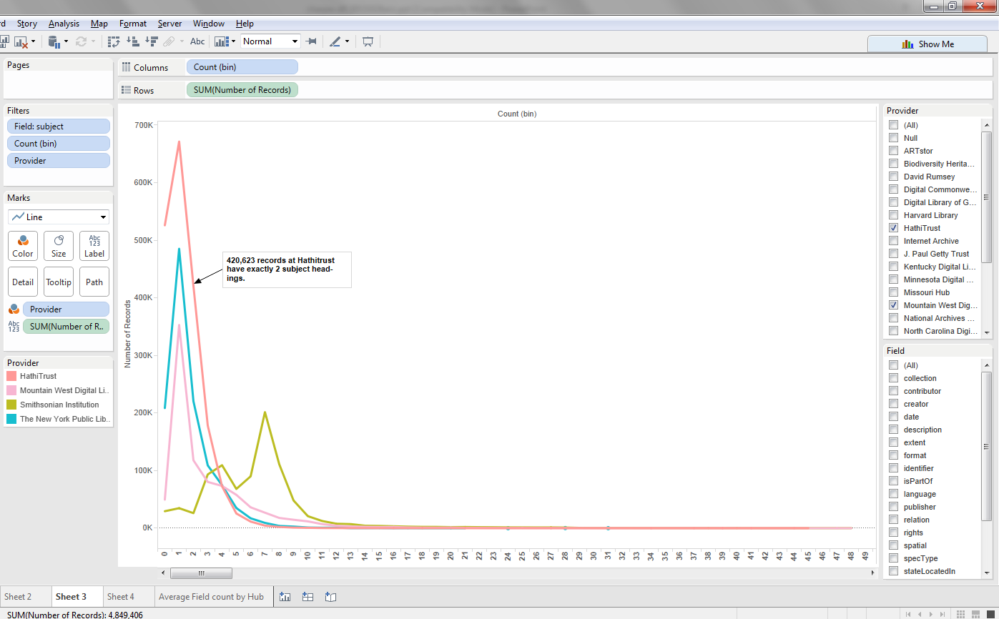
Distributions of field counts by provider
2015-10-28
Harper - Statistical DPLA - DLF 2015 Forum

Slide 21
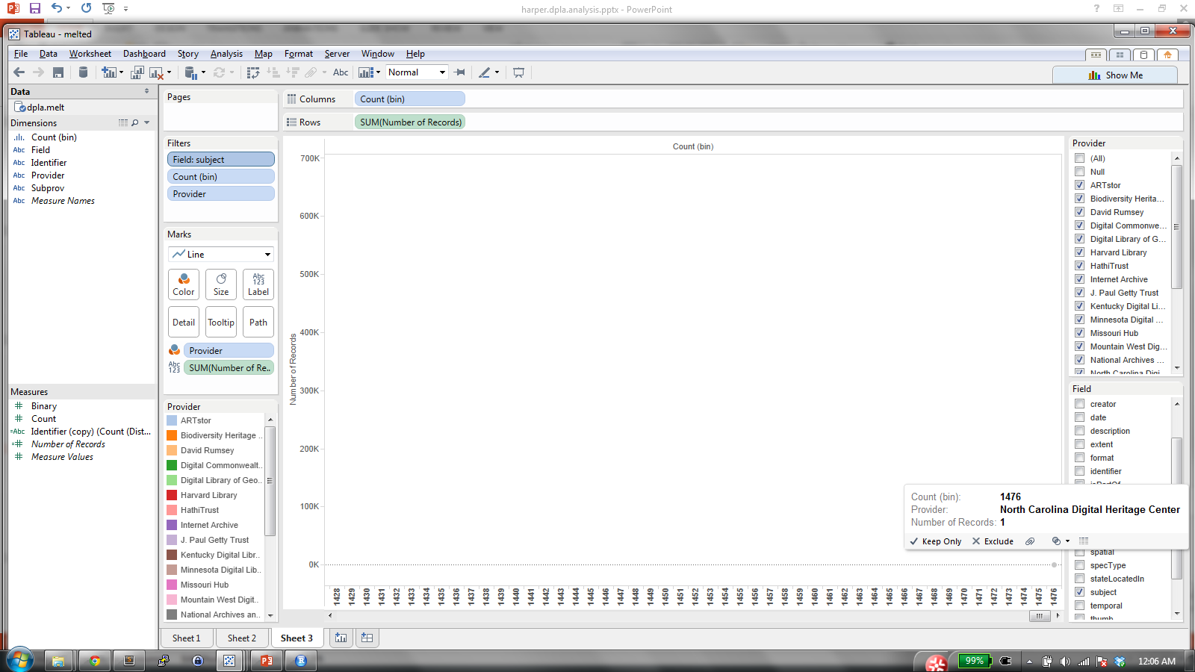
Outliers
Also: 3,800 IDs; 480 Spatials; 24 Languages
2015-10-28
Harper - Statistical DPLA - DLF 2015 Forum

Slide 22
Implicit Metadata
Usage Data
Query Terms
Top Facets (Empty Search)
Referral Patterns
Metadata Topic Maps
2015-10-28
Harper - Statistical DPLA - DLF 2015 Forum

Slide 23
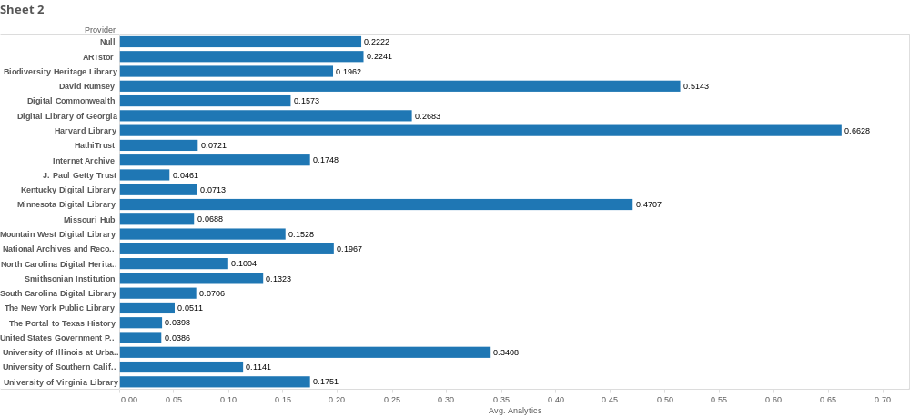
Average Pageviews Per Record by Provider
2015-10-28
Harper - Statistical DPLA - DLF 2015 Forum

Slide 24
Huge head / long tail: 597,553 total rows
/item/b6532388a7eee02db4ccb3d31a76a3df|3158
/item/c5cf1632a8a2c137c9b0e7b093024e0a|2580
/item/1619731699db08a2c2f8584e12729e72|1727
/item/16de95ea0eb35060576385966aed3f3f|1589
/item/123c3ea1d7f099da675ce7c3a6c0ca4b|1251
/item/ecdafcf9b06be6efed042e40b3923e57|1077
/item/295501959544528b1ef79330dcb598ed|919
/item/100b1a8594ff7d162e13ff9dfca27c3d|839
/item/b3d8c3ad9a97610d77eb9c53c7def845|811
/item/9824dc12222f81e6040f85db570a2a32|802
2015-10-28
Harper - Statistical DPLA - DLF 2015 Forum

Slide 25
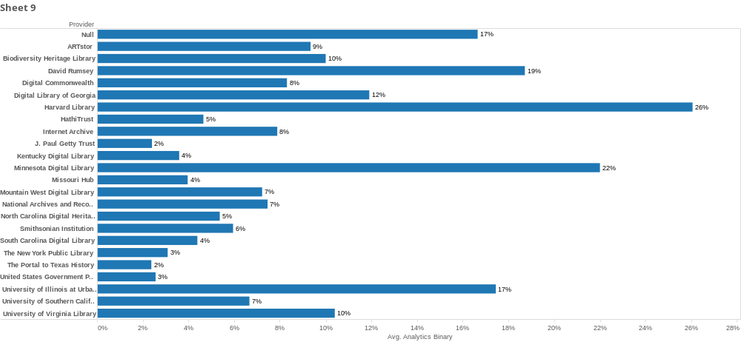
Percent of items with at least 1 hit
2015-10-28
Harper - Statistical DPLA - DLF 2015 Forum

Slide 26
Regression Analysis
> setwd("C:/dpla/new")
> dpla2 <- read.csv("dpla.merged2.csv", sep="|")
> Lin_m1b<- lm(analytics~ subject, data=dpla2)
> screenreg(Lin_m1b, single.row=TRUE)
==================================
Model 1
----------------------------------
(Intercept) 0.10 (0.00) ***
subject 0.01 (0.00) ***
----------------------------------
R^2 0.00
Adj. R^2 0.00
Num. obs. 8012390
==================================
*** p < 0.001, ** p < 0.01, * p < 0.05
2015-10-28
Harper - Statistical DPLA - DLF 2015 Forum

Slide 27
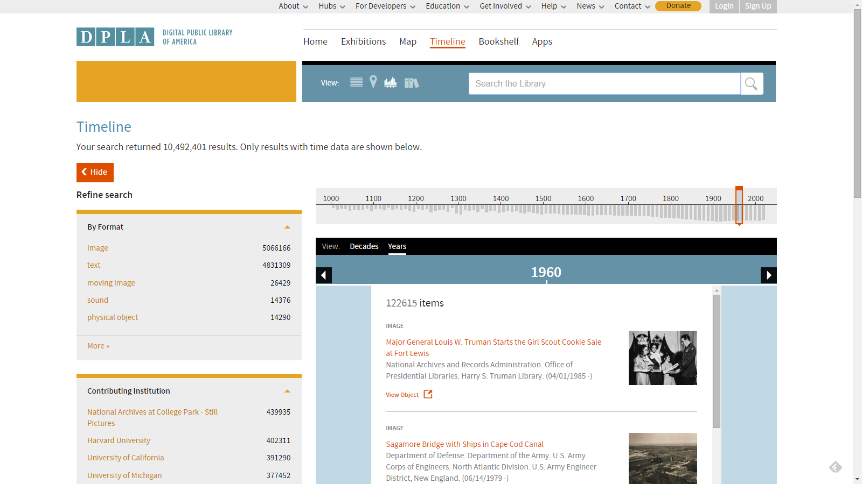
2015-10-28
Harper - Statistical DPLA - DLF 2015 Forum

Slide 28
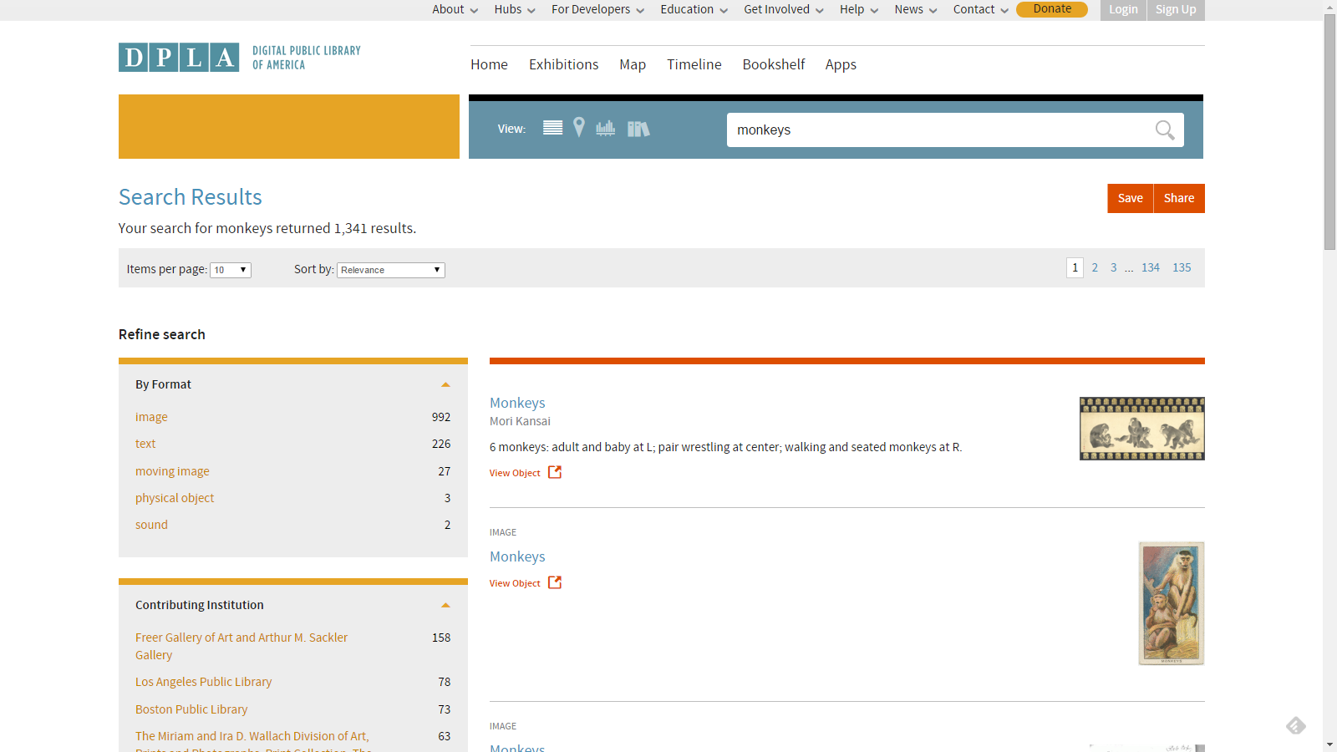
2015-10-28
Harper - Statistical DPLA - DLF 2015 Forum

Slide 29
Provider Analytics (Any interest?)
Python scripts to harvest
Referrals from DPLA
Counts, query strings, referring pages
2015-10-28
Harper - Statistical DPLA - DLF 2015 Forum

Slide 30

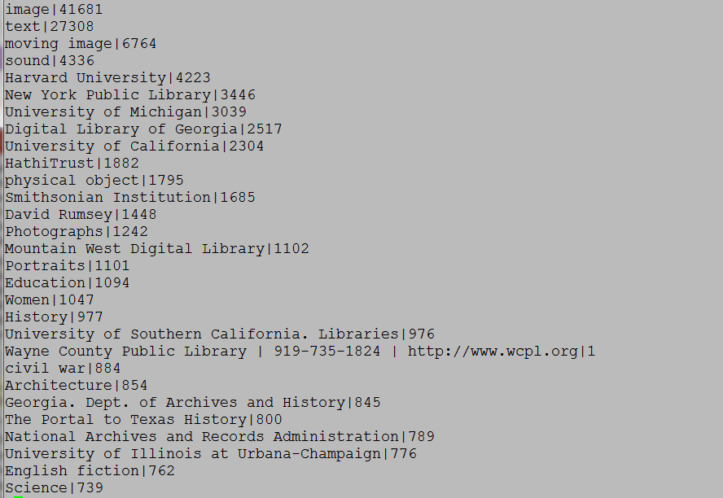
Over 450k unique queries or facet clicks
Almost 700,000 total
2015-10-28
Harper - Statistical DPLA - DLF 2015 Forum

Slide 31
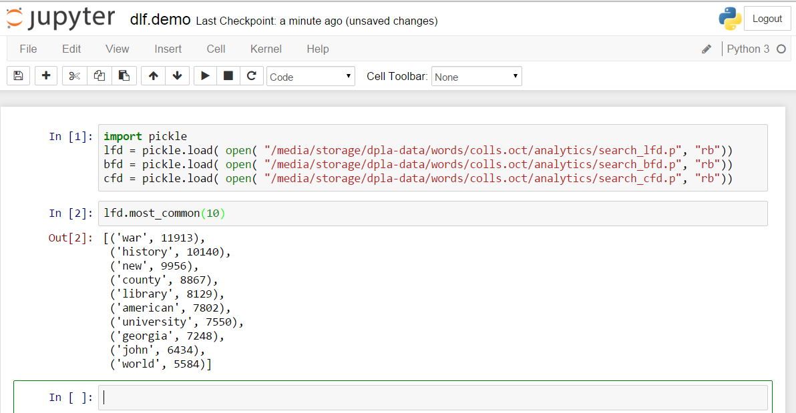
iPython Notebooks NLTK
https://github.com/chrpr/dpla-analytics/blob/master/nltk/dlf.demo.ipynb
2015-10-28
Harper - Statistical DPLA - DLF 2015 Forum

Slide 32
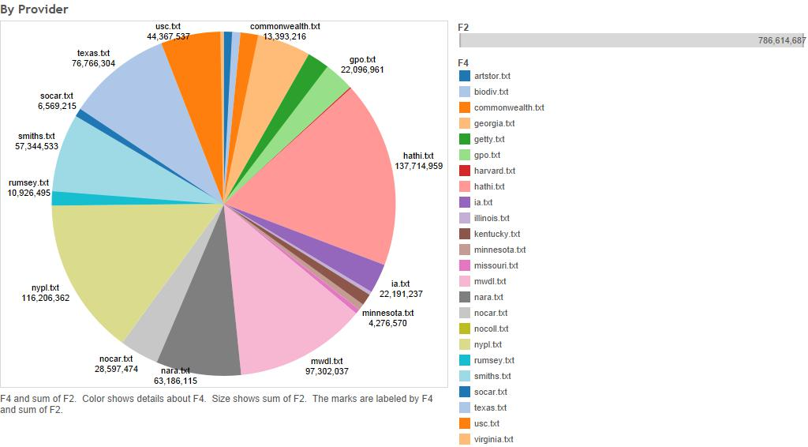
Text Analytics
2015-10-28
Harper - Statistical DPLA - DLF 2015 Forum

Slide 33
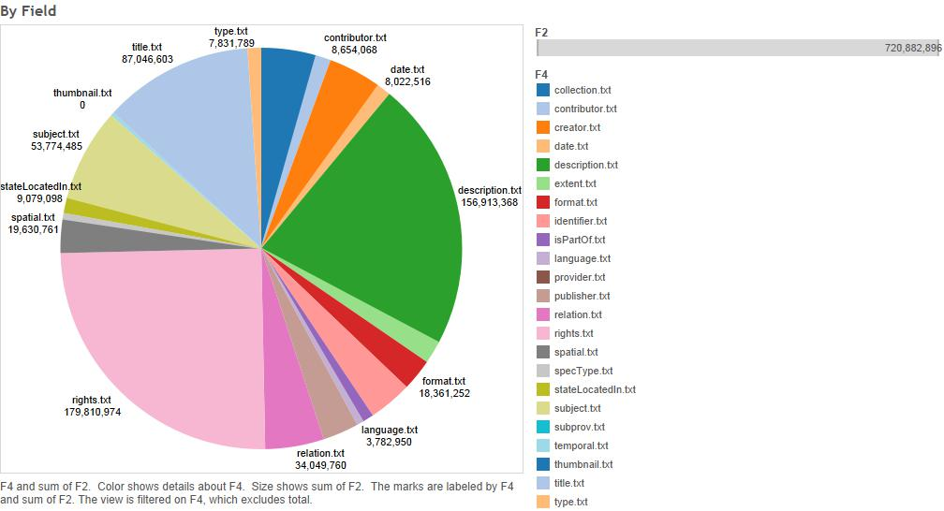
25% of Words are in Rights Statements!
2015-10-28
Harper - Statistical DPLA - DLF 2015 Forum

Slide 34
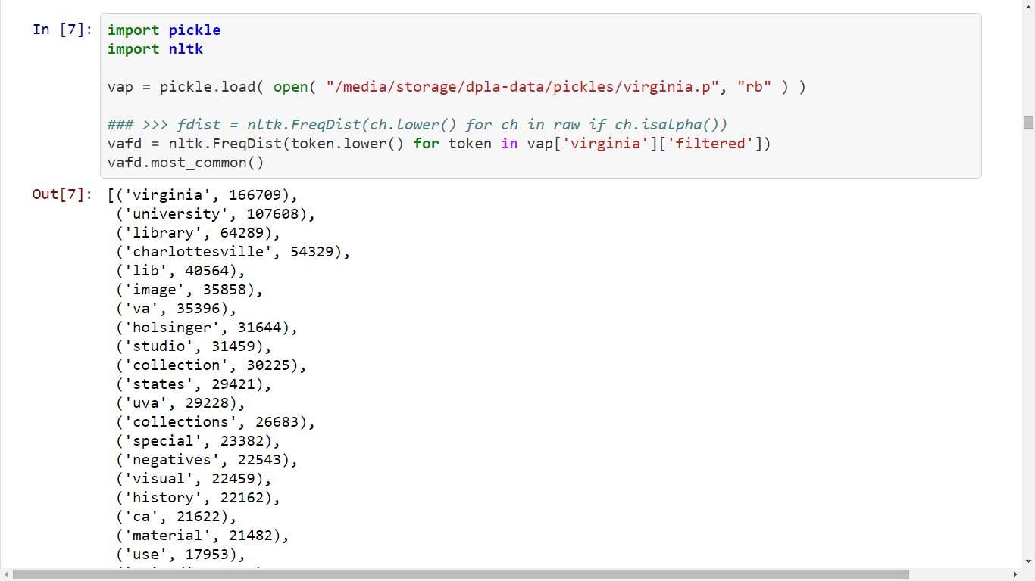
Skewed frequency distributions
2015-10-28
Harper - Statistical DPLA - DLF 2015 Forum

Slide 35
Remove noise – Just “conceptual metadata”
date
description
spatial
subject
temporal
title
2015-10-28
Harper - Statistical DPLA - DLF 2015 Forum

Slide 36
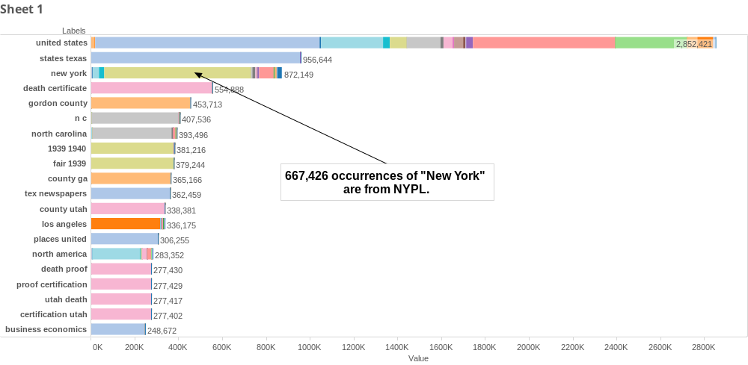
2015-10-28
Harper - Statistical DPLA - DLF 2015 Forum

Slide 37
Possibilities & Next Steps
Mapping!
Frequency distributions for used items
Map reduce / HPC & Reproducibility
Machine learning
New data
Language visualization
2015-10-28
Harper - Statistical DPLA - DLF 2015 Forum

Slide 38
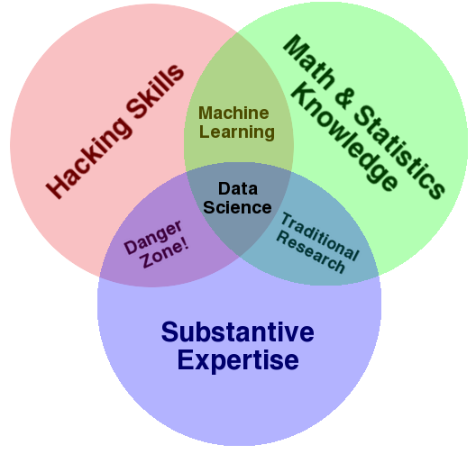
Data Science Venn Diagram
http://drewconway.com/zia/2013/3/26/the-data-science-venn-diagram
2015-10-28
Harper - Statistical DPLA - DLF 2015 Forum

Slide 39
Discussion Topics
What questions do we want to ask?
  How do these inform decision making?
  How does that inform your practice
Predicting usage through topic models?
Automated/machine assisted metadata?
How will libraries resource this?
  Data scientists in house?
  Community? DLF / CLIR
  Consultancies? Ithaka?
2015-10-28
Harper - Statistical DPLA - DLF 2015 Forum

Slide 40
Thanks!
corey.harper@nyu.edu
212.998.2479
@chrpr
2015-10-28
Harper - Statistical DPLA - DLF 2015 Forum

