Slide 1
Entwicklung eines VHDL Compilers
Christian Reisinger
0655859
https://github.com/chrreisinger/OpenVC

Slide 2
VHDL
IEEE 1076 Standard
Ada + Erweiterungen für Hardwarebeschreibung
packages, functions, variables, ...
assignments, if-statements, loops, ...

Slide 3
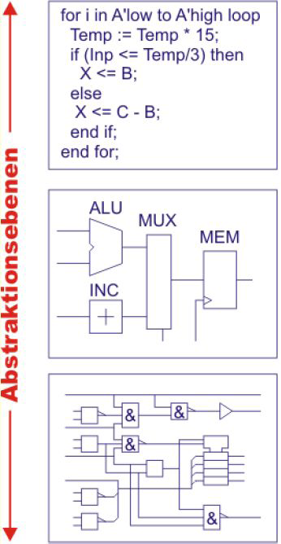
Abstraktionsebenen

Slide 4
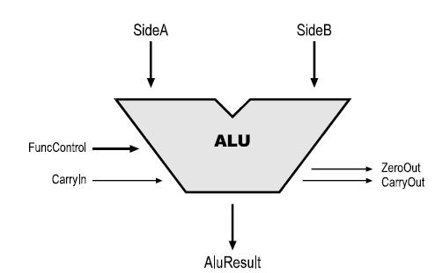
Entity Beispiel
entity alu is
port (SideA : in DataVec;
SideB : in DataVec;
AluResult : out DataVec;
CarryIn : in std_ulogic;
CarryOut : out std_ulogic;
ZeroOut : out std_ulogic;
FuncControl : in alu_op_code);
end alu;

Slide 5
Architecture Beispiel 1/2
architecture rtl of alu is
begin -- rtl
do_calc : process (SideA, SideB, CarryIn, FuncControl)
procedure addDataVec (
a, b : dataVec;
ci : std_ulogic;
add_result : out DataVec;
carryOut : out std_ulogic) is
variable tmp : unsigned (DataVec'high + 1 downto 0);
begin
tmp := (unsigned('0' & a) + unsigned('0' & b)) + unsigned(to_unsigned(0, a'length) & ci);
add_result := std_ulogic_vector(tmp(DataVec'range));
carryOut := tmp(DataVec'high+1);
end;
variable result : DataVec;
variable co : std_ulogic;
begin -- process do_calc
case FuncControl is
when ALU_OP_SIDEA => result := SideA; carryOut <= '0';
when ALU_OP_SIDEB => result := SideB; carryOut <= '0';
when ALU_OP_AND => result := (SideA and SideB); carryOut <= '0';
when ALU_OP_OR => result := (SideA or SideB); carryOut <= '0';
when ALU_OP_XOR => result := (SideA xor SideB); carryOut <= '0';
when ALU_OP_NOT => result := (not SideA); carryOut <= '0';

Slide 6
Architecture Beispiel 2/2
when ALU_OP_ADDC => addDataVec(SideA, SideB, CarryIn, result, co); CarryOut <= co;
when ALU_OP_SUBC => addDataVec(SideA, not(SideB), not(CarryIn), result, co); CarryOut <= not(co);
when ALU_OP_INC => addDataVec(SideA, (others => '0'), '1', result, co); CarryOut <= co;
when ALU_OP_DEC => addDataVec(SideA, (others => '1'), '0', result, co); CarryOut <= not(co);
when ALU_OP_SHL => result := sideA(DataVec'high-1 downto 0) & '0'; CarryOut <= SideA(DataVec'high);
when ALU_OP_SHR => result := '0' & sideA(DataVec'high downto 1); CarryOut <= SideA(0);
when ALU_OP_SHLC => result := sideA(DataVec'high-1 downto 0) & CarryIn; CarryOut <= SideA(DataVec'high);
when ALU_OP_SHRC => result := CarryIn & sideA(DataVec'high downto 1); CarryOut <= SideA(0);
when ALU_OP_ADD => addDataVec(SideA, SideB, '0', result, co); CarryOut <= co;
when ALU_OP_SUB => addDataVec(SideA, not(SideB), '1', result, co); CarryOut <= not(co);
-- pragma synthesis_off
when others => report "wrong alu_op_code";
-- pragma synthesis_on
end case;
if result = zero_value then
zeroOut <= '1';
else
zeroOut <= '0';
end if;
aluResult <= result;
end process do_calc;
end rtl;

Slide 7
Compiler-Design
ILOAD 0
ILOAD 1
IADD
STORE 0
x:=x+y
Parser
Semantic Analyzer
Backend
:=
x +
x y
:=
x +
x y
Name | Type | Slot
x | integer | 0
y | integer | 1

Slide 8
Literaturübersicht
[Ash02] Ashenden Peter J.: The Designer's Guide to VHDL. Morgan Kaufmann Publishers, San Francisco 2002
[IEEE02] IEEE: Standard VHDL Language Reference Manual, IEEE Std 1076™-2002
[Od08] Odersky Martin, Spoon Lex, Venners Bill: Programming in Scala
[Par07] Parr Terence: The Definitive ANTLR Reference: Building Domain-Specific Languages. The Pragmatic Programmers, LLC, Raleigh, NC, and Dallas, TX 2007.
[JLS05] Gosling, James, Bill Joy, and Guy Steele, and Gilad Bracha. The Java™ Language Specification, Third Edition. Addison-Wesley, Boston, 2005. ISBN: 0321246780.
Inspiration: Scala, Groovy, JRuby und JavaFX Compiler

Slide 9
Zeitplan
Code | Zeitpunkt
parser + AST subprograms + overloading foreign-subprograms type checks if-,while-,for-,loop-,next-,case-,exit-statements | jetzt
Standard Packages arrays aggregates | Semesterende
Simulation von einfachen Designs signals simulation cycle blocks processes | Anfang Winter Semester

Slide 10
Ende
Christian Reisinger
0655859
https://github.com/chrreisinger/OpenVC

Slide 11
Compiler-Design
x:=x+y
Parser
:=
x +
x y
Semantic Analyzer
:=
x +
x y
Name | Type | Slot
x | integer | 0
y | integer | 1
Backend
ILOAD 0
ILOAD 1
IADD
STORE 0

Slide 12
Karfreitag 11:30
22 April 2011

