Slide 1
Entwicklung eines VHDL Compilers
Christian Reisinger
0655859
https://github.com/chrreisinger/OpenVC

Slide 2
Compiler-Design
ILOAD 0
ILOAD 1
IADD
STORE 0
x:=x+y
Parser
Semantic Analyzer
Backend
:=
x +
x y
:=
x +
x y
Name | Type | Slot
x | integer | 0
y | integer | 1

Slide 3
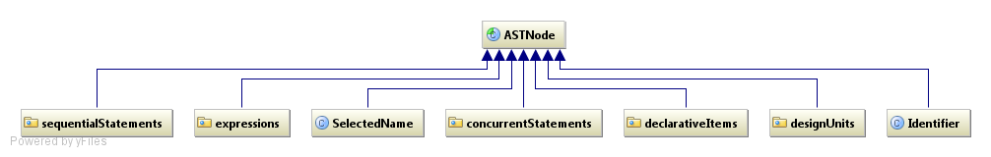
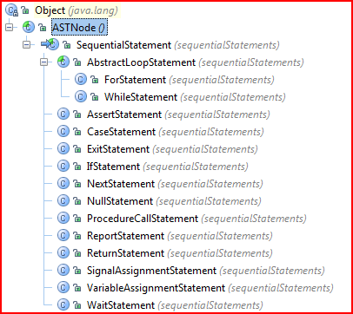
AST Hierarchie

Slide 4
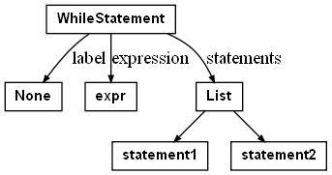
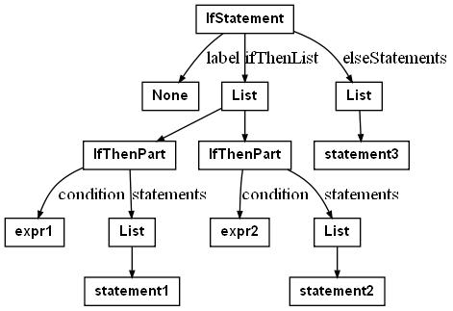
AST-Beispiele 1/2
while expr loop
statement1;
statement2;
end loop;
if expr1 then
statement1;
elsif expr2 then
statement2;
else
statment3;
end if;

Slide 5
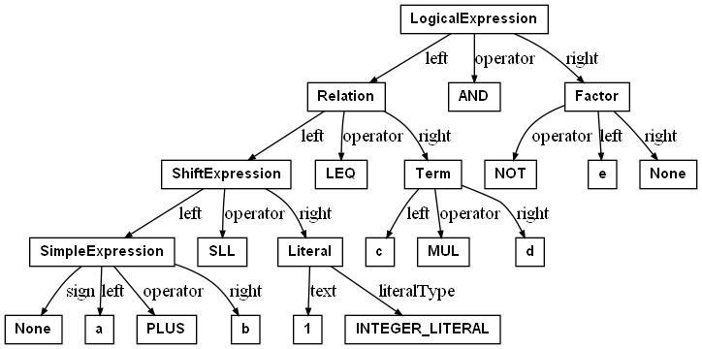
AST-Beispiele 2/2
a + b sll 1 <= c*d and not e

Slide 6
AST-Transformationen 1/2
target :=
expression1 when condition1 else
expression2 when condition2 else
...
expressionN when conditionN;
with expression select
target :=
expression1 when choice_list1,
expression2 when choice_list2,
...
expressionN when choice_listN;
if condition1 then
target := expression1;
elsif condition2 then
target := expression2;
...
elsif conditionN
target := expressionN;
end if;
case expression is
when choice_list1 => target := expression1;
when choice_list2 => target := expression2;
...
when choice_listN => target := expressionN;
end case;

Slide 7
AST-Transformationen 2/2
case expr is
when "000" => …
when "111" | "101" => …
when others => …
end case;
$tmp := expr;
if $tmp = "000" then
...
elsif $tmp = "101" || $tmp = "111" then
...
else
...
end if;

Slide 8
Packages
package package_test is
type intA is range 0 to 10;
type intB is range 0 to 10;
procedure test(x : IntA := 1);
procedure test(x : IntB := 2);
end package_test;
package body package_test is
procedure test(x : IntA) is
begin
end;
procedure test(x : IntB) is
begin
end;
end package_test;
public final class package_test_header {
public static int $default$test$1636619288_x()
{ return 1; }
public static void test$1636619288(int x)
{ package_test_body.test$1636619288(x); }
public static int $default$test$435516002_x()
{ return 2; }
public static void test$435516002(int x)
{ package_test_body.test$435516002(x); }
}
public final class package_test_body {
public static void test$1636619288(int x){ }
public static void test$435516002(int x) { }
}

Slide 9
Statements
for i in 0 to 10 loop
  null;
end loop
for i in 10 downto 0 loop
  null;
end loop
loop
  exit when expr1;
  next when expr2;
end loop;
Range $range = new Range (0, 10, 1);
int i = $range.start();
for (; i != $range.end(); i += $range.step())
Range $range = new Range(10, 0, -1);
int j = $range.start();
for (; j != $range.end(); j += $range.step())
while (true) {
  if (expr1) break;
  if (expr2) continue;
}

Slide 10
Datentypen 1/3
variable x : integer range 5 to 10;
x := expr;
type myRec is record
  a : integer;
  b : real;
end record;
int i=5;
x = VHDLRuntime.checkIsInRange(expr, 5, 10) ;
public static final class myrec {
public int a;
public double b;
public myrec
  (int paramInt, double paramDouble) /*...*/
public myrec() /* ... */
public String toString() /* ... */
public boolean equals(Object other) /* ... */
....
}

Slide 11
Datentypen 2/3
public final class myenum {
private static final String[] valuesArray;
static
{
valuesArray =
new String[] { "first", "second", "third" };
}
public static int value(String paramString) …
public static String image(int paramInt) …
}
byte a = 0;
a = myenum.value("first"); VHDLRuntime.report(myenum.image(a));
type myEnum is (first, second, third);
variable a : myEnum;
a := myEnum'value("first");
report myEnum'image(a);

Slide 12
Datentypen 3/3
type real_array is array
(integer range<>, integer range<>) of real;
variable a : real_array(5 to 10, -10 to 0);
b:=a(5,-3);
for i in a'range(1) loop
null;
end loop;
Array2D a = VHDLRuntime.createRuntimeArray(
new Range(5, 10, 1),
new Range(-10, 0, 1),
Double.MIN_VALUE);
b = a.getValue(5, -3);
Range $range = a.range(1);
int j = $range.start();
for (; j != $range.end(); j += $range.step())

Slide 13
Foreign Subprograms
function sin (s : real) return real;
attribute foreign of sin [real return real] : function
is "java.lang.Math";
type dummyAccess is access integer;
procedure showMessage(unused : dummyAccess; msg: string);
attribute foreign of showMessage [dummyAccess, string] :
procedure is "javax/swing/JOptionPane showMessageDialog (Ljava/awt/Component;Ljava/lang/Object;)V";
showMessage(null, "hello jvm");
sin(4.0);

Slide 14
Out Parameter
procedure swap (
x : out integer;
y : out integer) is
variable t : integer := x;
begin
x:=y;
y:=t;
end;
swap(a,b);
swap(arr(func()),arr(func());
public static Tuple2<Integer, Integer>
swap$-168257077(int x, int y) {
int t = x;
int x = y;
int y = t;
return new Tuple2(
new Integer(x), new Integer (y));
}
$tmp = swap$-168257077(a,b);
a=$tmp._1; b=$tmp._2;
$tmp = swap$-168257077(arr[func()],arr[func()]);
arr[func()]=$tmp._1;

Slide 15
Ende
Fragen ?
https://github.com/chrreisinger/OpenVC

