Slide 1

Bluemix and the Internet of Things
Christian Rellmann - 26.11.2014
Building a cloud-based alarm system

Slide 2
Step 1
Send an alarm when my door is opened.
2
Notes:
2

Slide 3

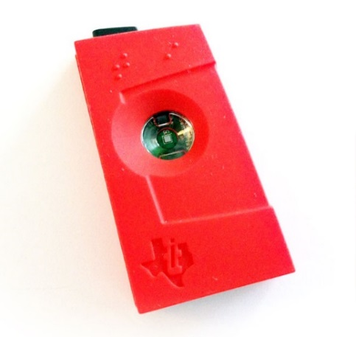

Step 1: Send an alarm when my door is opened.
+ =
3
Notes:
3

Slide 4







Step 1: Send an alarm when my door is opened.
mqtt
4
Notes:
DEMO Part 1
4

Slide 5
Step 2
Only send an alarm when someone else opens the door.
5
Notes:
5

Slide 6



Step 2: Only send an alarm when someone else opens the door.
+ + =
6
Notes:
6

Slide 7
Step 2: Only send an alarm when someone else opens the door.
mqtt
7
Notes:
DEMO Part 2
7

Slide 8
Step 3
Send me a text message when an alarm occurs.
8
Notes:
8

Slide 9


Step 3: Send me a text message when an alarm occurs.
9
Notes:
DEMO Part 3
9

Slide 10
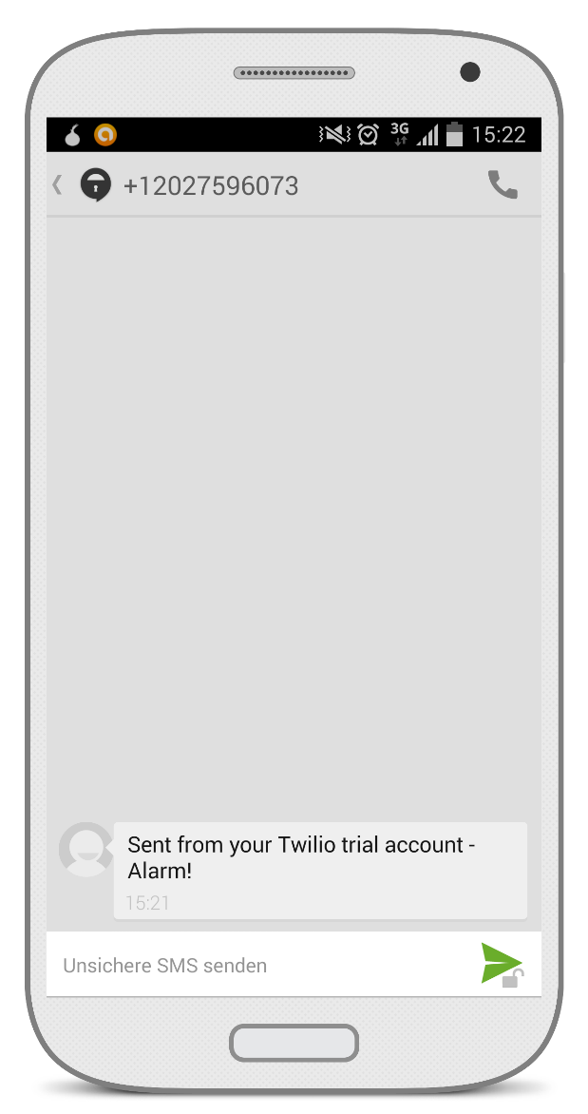
Step 3: Send me a text message when an alarm occurs.
10
Notes:
10

Slide 11
Step 3: Send me a text message when an alarm occurs.
mqtt
11
Notes:
11

Slide 12


Thank you for your attention!
Find the code on GitHub:
https://github.com/chrrel/bluemix-alarm-system
Christian Rellmann // christian.rellmann@de.ibm.com // github.com/chrrel
12
Notes:
12

Slide 13
Sources
http://www.mavromatic.com/wp-content/uploads/2014/04/ti-sensortag.jpg
http://upload.wikimedia.org/wikipedia/commons/thumb/d/da/Bluetooth.svg/500px-Bluetooth.svg.png
https://ace.ng.bluemix.net/lib/cloudOE/resources/dt/imgs/landing/bluemix_logo_multi_181.png?@revision@
http://www.hardill.me.uk/node-red.png
http://www.smartercomputingblog.com/wp-content/uploads/2014/10/Internet-of-Things.png
http://image.mathcaptain.com/cms/images/113/3-d-plane1.png
https://s3.amazonaws.com/awsmp-logos/company_logos/818fd455-b47c-4a62-9e3d-1a346e0f5e0e.png
http://www.flaticon.com/free-icon/open-exit-door_59801 http://www.flaticon.com/free-icon/location_3913
http://www.flaticon.com/free-icon/smartphone-with-blank-screen_62027
Icons made by Daniel Bruce from www.flaticon.com is licensed byCC BY 3.0:
Icons made by Freepik from www.flaticon.com is licensed byCC BY 3.0: http://www.flaticon.com/free-icon/phone-sms-message_89
http://www.elegantthemes.com/blog/freebie-of-the-week/free-galaxy-s4-psd-templates
https://github.com/logos
13
Notes:
13

