Slide 1
Data + Analytics Capstone: Chronic Obstructive Pulmonary Disease (COPD)
Christi Sutton
May 9, 2022

Slide 2
MOTIVATION
The topic of COPD (Chronic Obstructive Pulmonary Disorder) resonated with me. I watched a loved one cope with various lung conditions for nearly half of his lifetime. As a witness to COPD’s effects, I wanted to understand it better.

Slide 3
WHAT IS COPD?
Chronic Obstructive Pulmonary Disorder is a progressive lung disease that makes it difficult to breathe. It cannot be cured.
Emphysema – destruction and enlargement of air spaces
Chronic Bronchitis – inflammation and mucus production
COPD can have a genetic component: AATD (alpha-1 antitrypsin deficiency) – 3% of COPD cases (90% of AAT is undiagnosed)
Spirometry is one of the most common pulmonary function tests used to diagnose COPD; It measures lung function and assesses breathing patterns.
COPD has four distinct stages: Stage I (mild), Stage II (moderate), Stage III (severs), and Stage IV (very severe)

Slide 4
WHAT IS COPD?
Risk factors
Smoking (by far the greatest risk factor)
Long term exposure to environmental pollutants and chemicals, as well as second-hand smoke
Genetic factor(s)
Respiratory infections as a child
Potential Effects
Physical impairment
Bloating, due to pressure on the stomach, diaphragm, and intestines. It can not only make breathing difficult, but eating as well.
Cognitive impairment due to lack of oxygen
Social isolation/depression

Slide 5

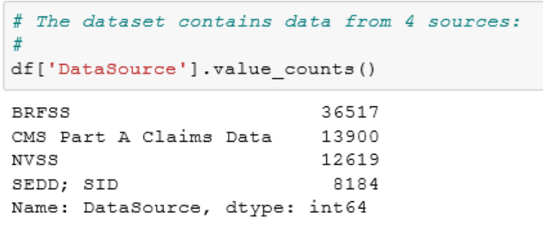
Dataset Notes
I utilized the following dataset in my analysis:
https://chronicdata.cdc.gov/Chronic-Disease-Indicators/U-S-Chronic-Disease-Indicators-Chronic-Obstructive/aqr6-8kj8
Notes:
https://www.cdc.gov/copd/data.html

Slide 6
Dataset Notes
4 data source components in the data:
BRFSS – Behavioral Risk Factor Surveillance System
NVSS – National Vital Statistics System; it provides the nation's official vital statistics based on the collection and registration of birth and death events at the state and local level
CMS Part A Claims Data
SEDD (State Emergency Department Databases) and SID (State Inpatient Databases) from AHRQ (Agency for Healthcare Research and Quality)
Method: Loaded the data into a Jupyter notebook and performed analysis using Python. Visualizations were generated in the notebook using matplotlib and seaborn..

Slide 7
Data Notes
I chose to focus on BRFSS (Behavioral Risk Factor Surveillance data. The dataset has data from three other sources, but time considerations led me to select the data source that contained the most data (36,517 records, 33 columns).
BRFSS is the United States’ premier system of health-related surveys that collects state data about U.S. residents regarding their health-related risk behaviors, chronic health conditions, and use of preventative services. The survey was established in 1984 and now includes all 50 states, the District of Columbia, and three U.S. territories (Puerto Rico, Guam, and the U.S. Virgin Islands). It conducts over 400,000 adult interviews each year. It is the largest continuously conducted health survey system in the world.
The Center for Disease Control uses the Behavioral Risk Factor Surveillance System (BRFSS) uses this data to make decisions about public health research, practice, and policies.

Slide 8
BRFSS – Behavioral Risk Factor Surveillance System
Data is presented based on the following questions: (Age-adjusted)
Prevalence of COPD in adults >=18 years old (2011 - 2020)
Prevalence of COPD in adults >=45 years old (2011 - 2020)
Current smoking among adults >=18 years old with diagnosed COPD
Current smoking among adults >=45 years old with diagnosed COPD
Prevalence of activity limitation among adults >= 18 years old with diagnosed COPD
Prevalence of activity limitation among adults >= 45 years old with diagnosed COPD
Not included in the analysis:
Influenza vaccination among noninstitutionalized adults >=18 with COPD
Pneumococcal vaccination among noninstitutionalized adults >=45 with COPD

Slide 9
COPD Prevalence

Slide 10
Who has COPD?
Individuals 45 years and older, but it can occur at an earlier age
Smokers
Women more frequently than men
Substantial racial/ethnic disparities

Slide 11
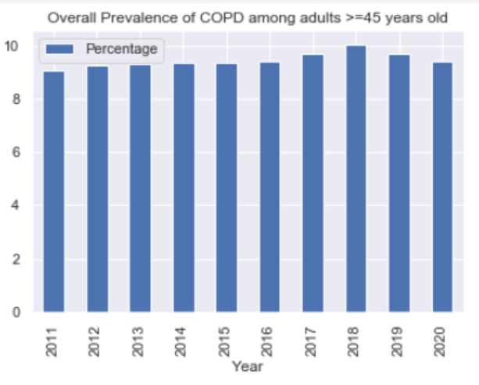
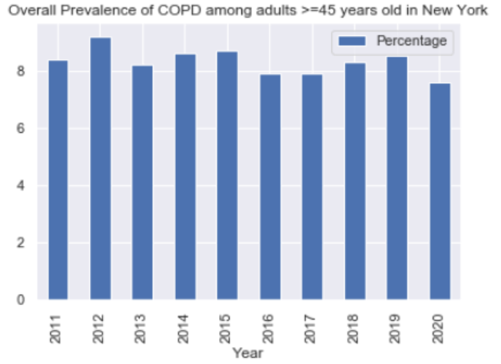
COPD Prevalence, 2011 - 2020
Overall prevalence of COPD is somewhat lower in New York than the national average

Slide 12
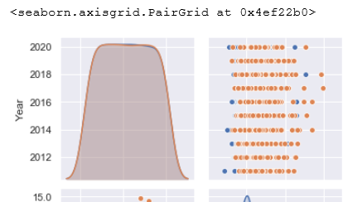
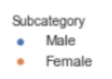
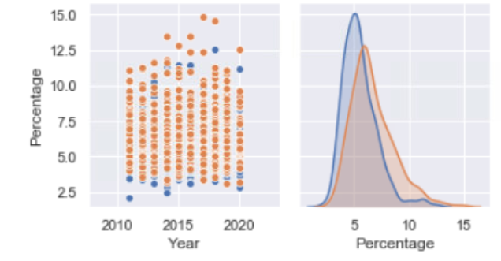
COPD Prevalence by Gender (>=45 years old), 2011 - 2020
There’ is a higher prevalence of COPD in women for all years indicated (2011 – 2020)
This result is consistent in both age categories (>=18 and >=45 years old)

Slide 13
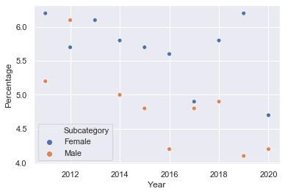
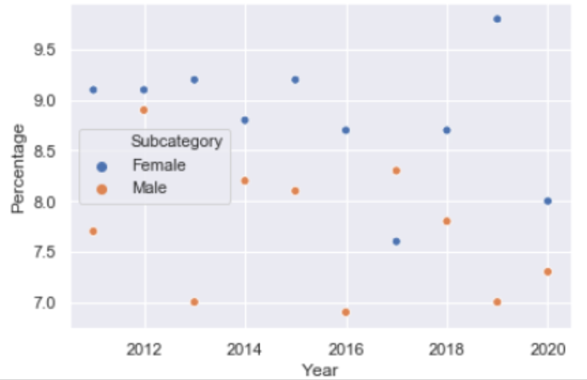
COPD Prevalence by Age and Gender in New York
COPD prevalence increases substantially with age
Women have a higher incidence than men in all years surveyed
NY >=18 NY >=45

Slide 14
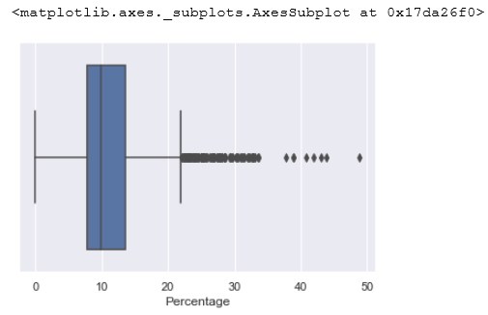
COPD Prevalence by Race/Ethnicity, 2011 - 2020
Race/Ethnicity:
Prevalence varies considerably among different racial/ethnic groups

Slide 15
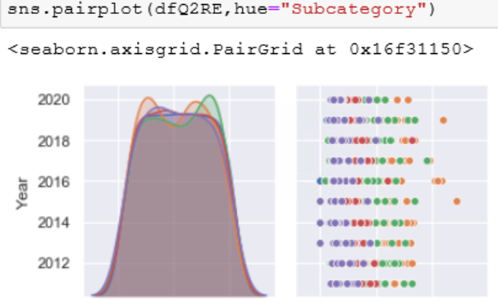
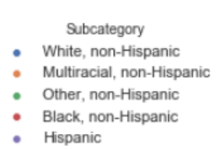
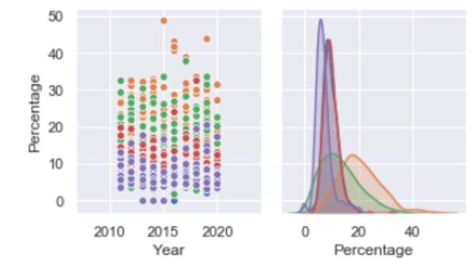
COPD Prevalence by Race/Ethnicity in the >=45 years age group
Race/Ethnicity:
Multiracial, non-Hispanics have a much higher incidence of COPD than other racial/ethnic groups
Hispanics as a group have the lowest incidence of COPD

Slide 16
Smoking

Slide 17
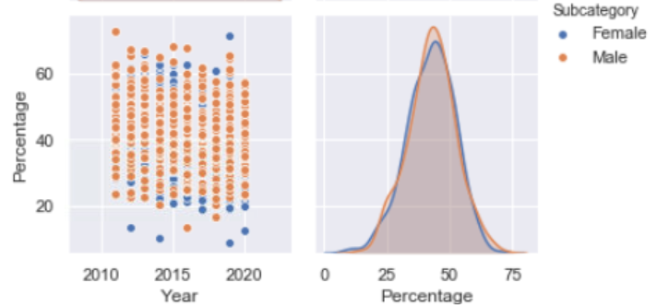
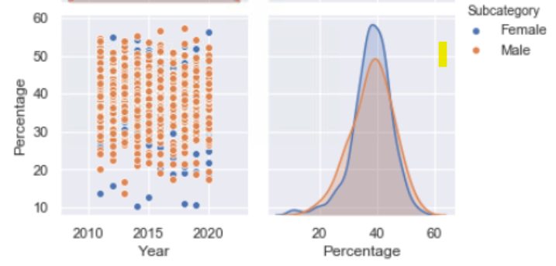
Prevalence of current smoking among individuals with diagnosed COPD by gender 2011 - 2020
>=18
The incidence of individuals smoking who have a COPD diagnosis decreases with age, and the mean percentage for women is noticeably higher than it is for men.
>=45

Slide 18
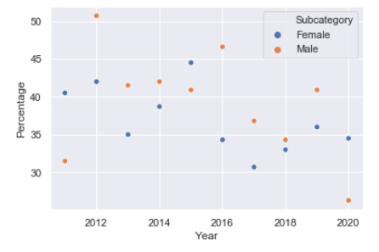
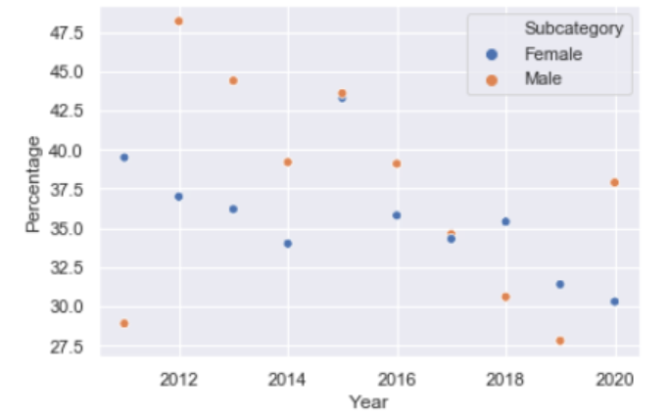
Prevalence of current smoking among individuals with diagnosed COPD by gender in New York
The incidence of individuals smoking who have a COPD diagnosis decreased with age for the years surveyed.
Incidence by gender varied over the years in both age groups, but in the >=45 age group, more men smoked than women most years.
>=18
>=45

Slide 19
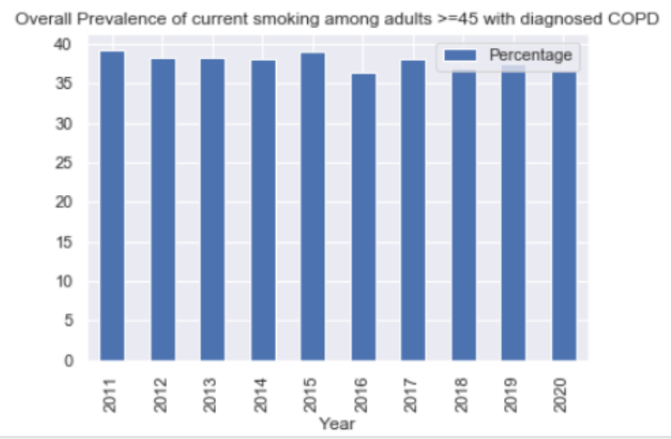
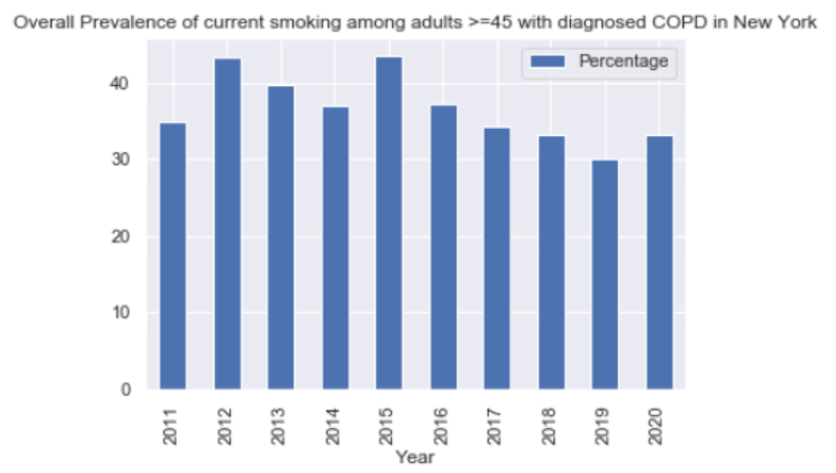
Prevalence of current smoking among individuals >=45 with diagnosed COPD National vs. New York comparison
Overall mean value for all years nationally is between 35 and 40% nationally.
NY: Lower than the national average in most years; it trended downward between 201 and 2020

Slide 20
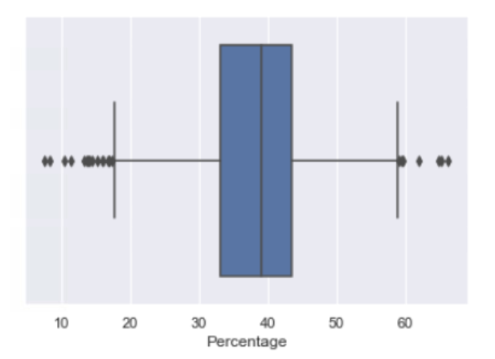
Prevalence of overall current smoking among individuals with diagnosed COPD by Race/Ethnicity, 2011 - 2020
Race/Ethnicity: Smoking rates vary significantly among the different race/ethnicity groups

Slide 21
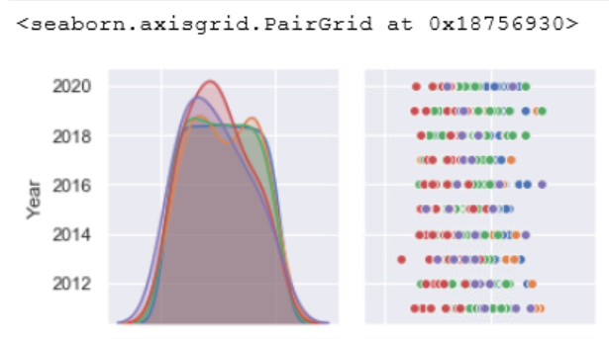
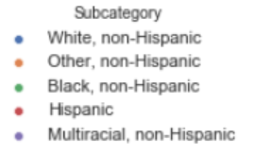
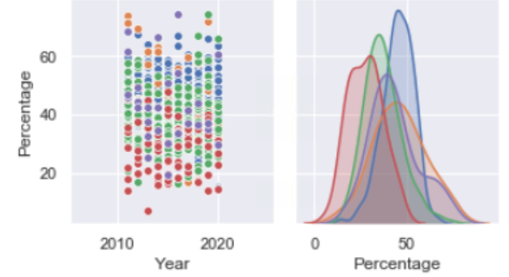
Prevalence of overall current smoking among individuals >=45 with diagnosed COPD by Race/Ethnicity, 2011 - 2020
Other, non-Hispanic and Multiracial, non-Hispanic groups have the highest rates of smoking with a COPD diagnosis. Hispanics have the lowest.

Slide 22
Activity Limitation

Slide 23
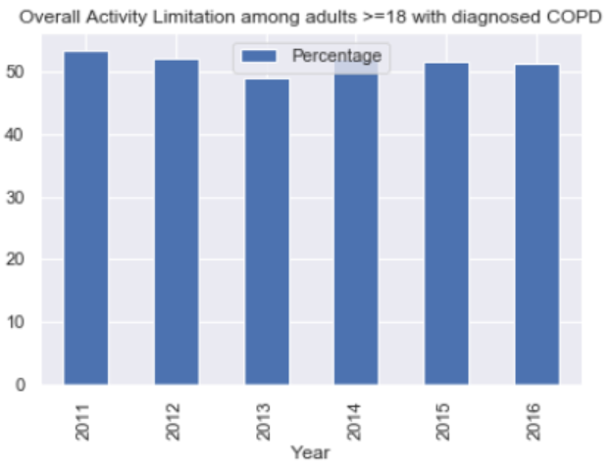
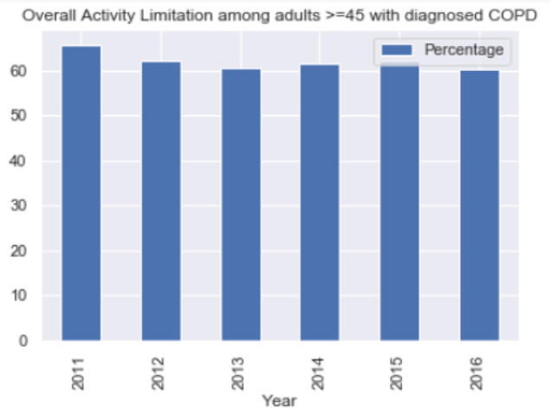
Activity Limitation, with Diagnosed COPD 2011 - 2016
The incidence of activity limitation Increases with age. No surprises because COPD is progressive.

Slide 24
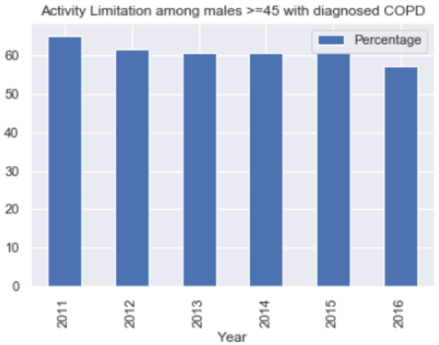
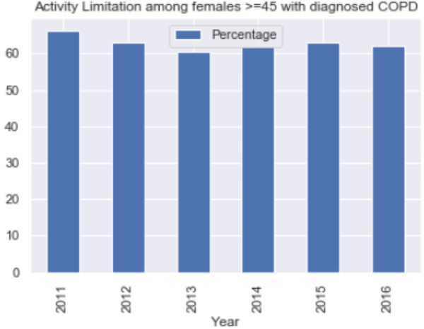
Activity Limitation, Gender, 2011 – 2016 Higher incidence in women than in men

Slide 25
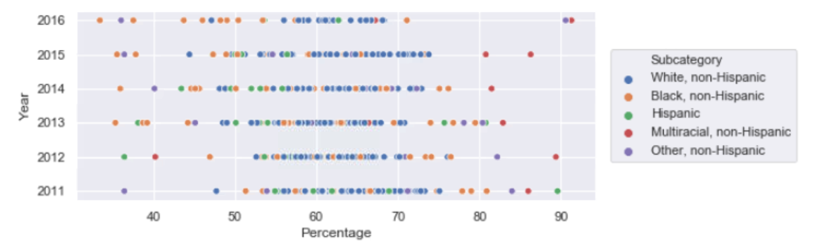
Activity Limitation, Race/Ethnicity, 2011 – 2016 Limited data. Data is most comprehensive for the White non-Hispanic and Black non-Hispanic groups

Slide 26
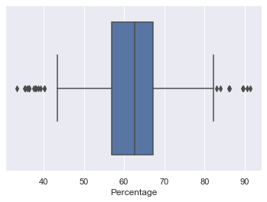
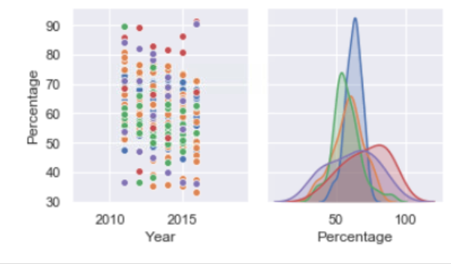
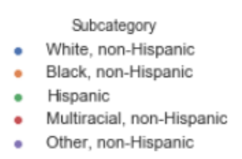
Activity Limitation, Race/Ethnicity, 2011 – 2016

Slide 27
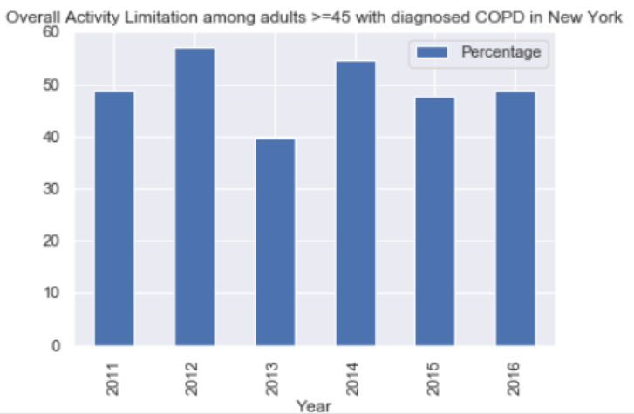
Activity Limitation, New York, 2011 – 2016 Overall mean rates of activity limitation are lower in New York than nationally

Slide 28
Thank you!

