Slide 1
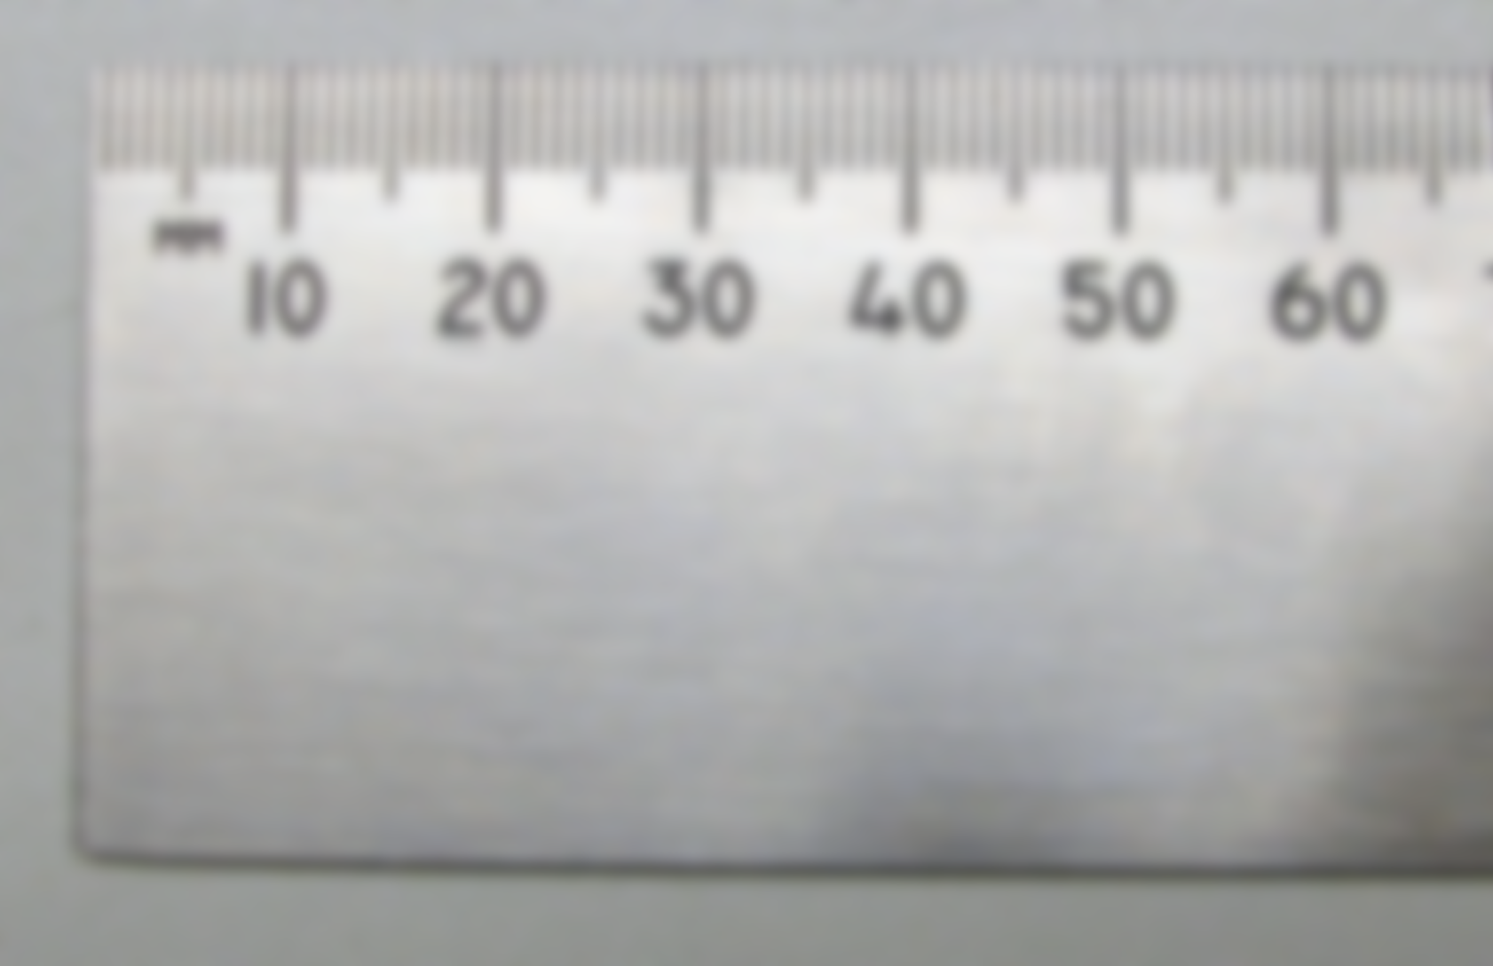



MoniScope
Login: Guest
Pass: Guest Pass
Forgot Password?
Log In
Log In with LinkedIn

Slide 2
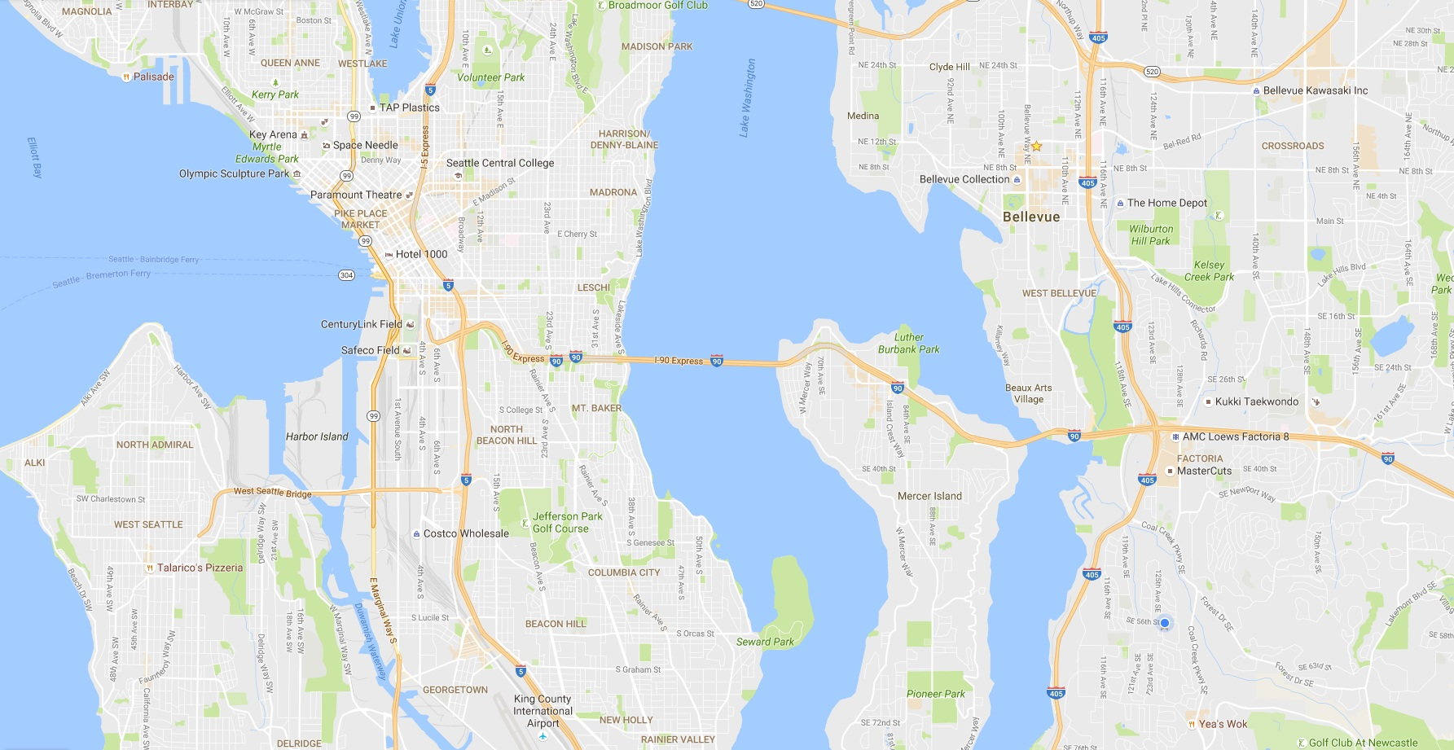
≡
Search For Measurement

Slide 3
≡
Search For Measurement
4mm
6mm
8mm
5mm
15mm
0.5⁰
11mm
72degF
6mm
12mm
6mm
13mm

