Slide 1
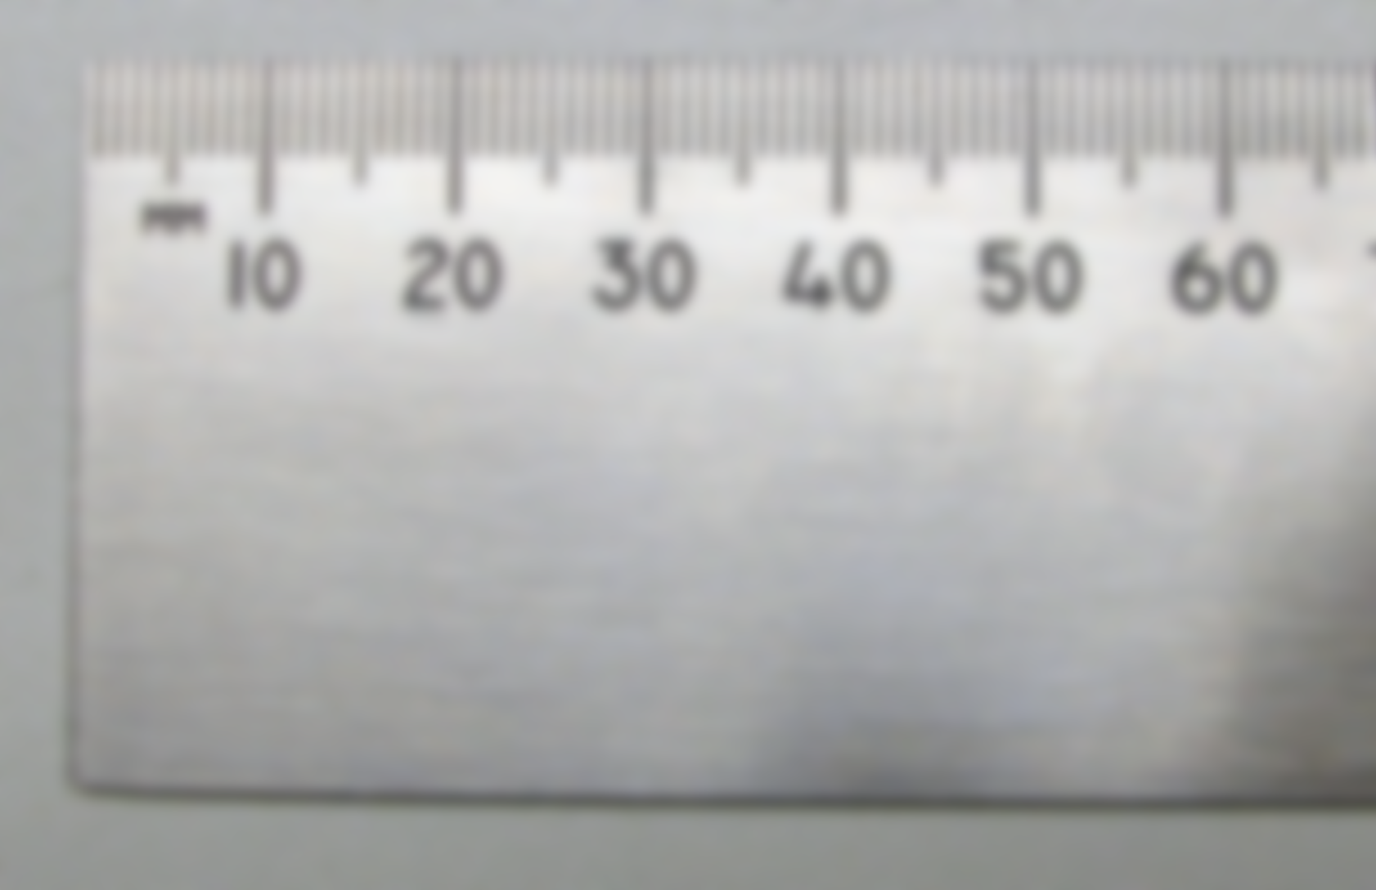



MoniScope
Login: Guest
Pass: Guest Pass
Forgot Password?
Log In
Log In with LinkedIn

Slide 2
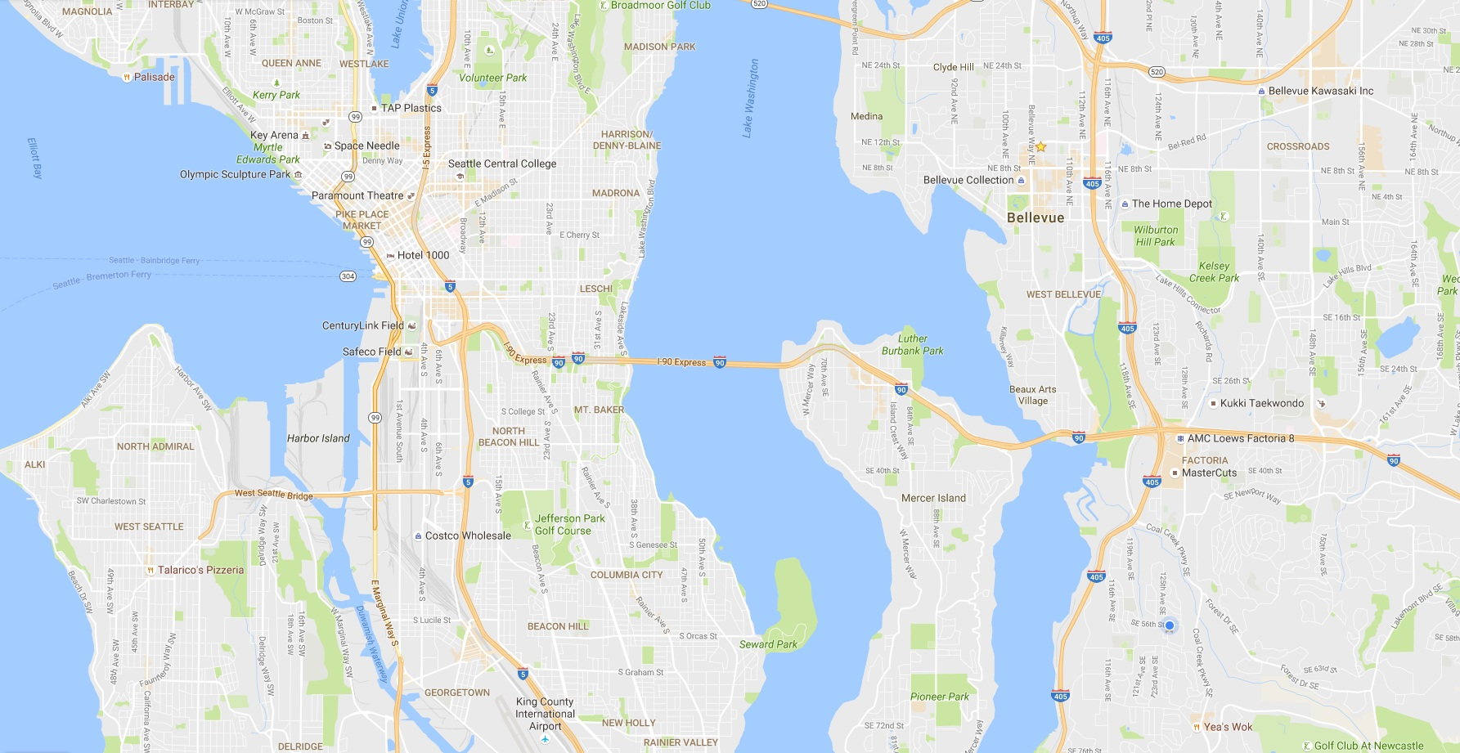
≡
Search For Measurement
Selected All

Slide 3
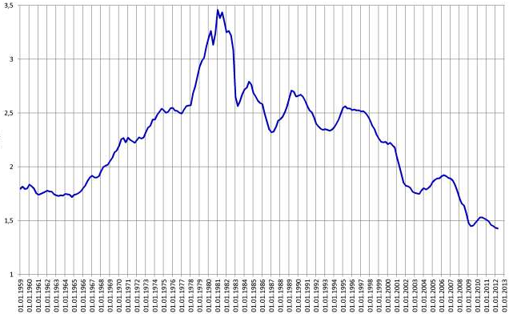
≡
Search For Measurement
Selected multiple
4mm
6mm
8mm
5mm
15mm
0.5⁰
11mm
72degF
6mm
12mm
6mm
13mm
2016-11-05 16:15
Battery: 12.1V
Temp: 72degF
X: 6.0mm
Y: 10.0mm
Z: 3.2mm

