Slide 1
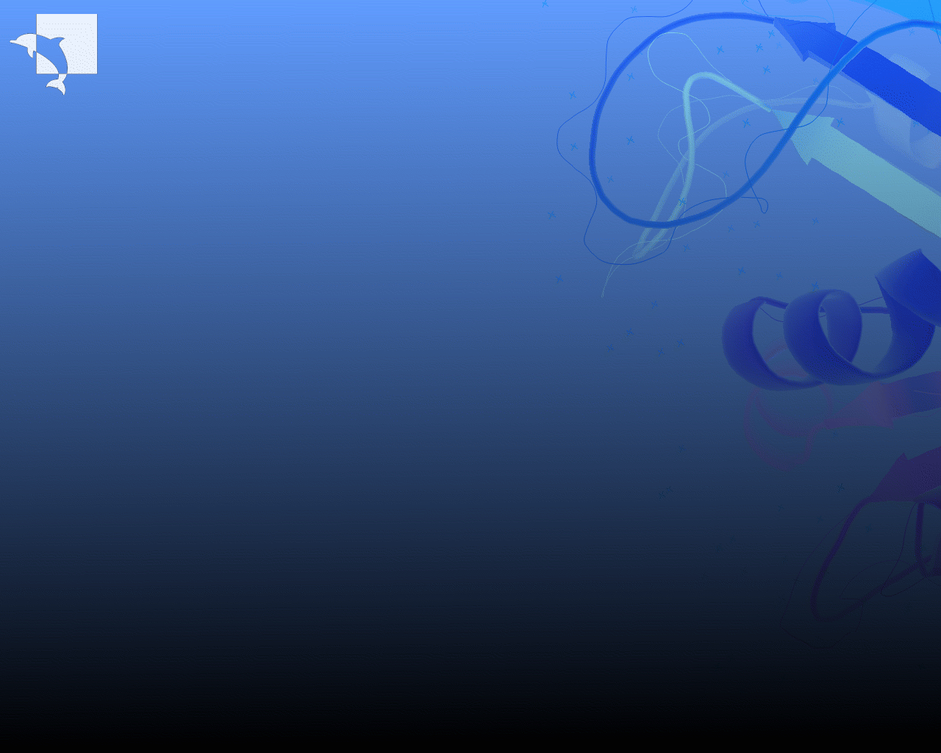
Sire
The Development of a Fast and Extensible Molecular Simulation Program
Christopher Woods

Slide 2
Some History…
This is not my first simulation program…
I developed ProtoMC at the university of Southampton in collaboration with Celltech (now UCB).

Slide 3
Some History…
ProtoMC was a 20K line Fortran 77 program developed to help me complete my PhD.
Design goals;
  Calculate protein/ligand relative binding free energies.
  Allow easy implementation of new, related science.
  Be fast.

Slide 4
ProtoMC 1.0
ProtoMC 1.0 achieved these goals.
Allowed me to complete my PhD.
Allowed me to develop and implement new science.
Allowed me to run protein/ligand simulations 10-12 times faster than with MCPRO.
My protein/ligand simulations each took a day using ProtoMC, rather than a week and a half with MCPRO.

Slide 5
Post PhD Development
Celltech/UCB provided an extra three months last year to develop ProtoMC.
More ambitious design goals;
  Be usable by other researchers.
  Be robust and reliable.
  Be feature-complete.
  Act as a base for the development of new science.

Slide 6
ProtoMS 2.0
ProtoMS 2.0 achieved most of these goals.
User manual and improved interface allowed the code to be taken by other users.
Testing and wider use demonstrated code to be robust and reliable (though not totally bug free!).
Code was taken as the base for several other researchers work.

Slide 7
ProtoMS 2.1
With the cooperation of Julien Michel at Southampton, ProtoMS 2.1 fully achieves the post PhD goals.
Code is pretty feature complete, bugs have been squashed, it is now a pretty solid little program that knows its job and does it well!

Slide 8
ProtoMS 2.1
Provides the foundations on which other researchers can build.
ProtoMS 2.1 is currently in use by six members of the Southampton group, and by Celltech/UCB.

Slide 9
The Future of ProtoMS
Julien Michel has taken over the development tree of ProtoMS. He is managing the varied development of the code.
This will hopefully soon lead to the release of ProtoMS 2.2.

Slide 10
The Future of ProtoMS
ProtoMS 2.X provides a solid, stable base on which to build. Open license means anyone is free to take it wherever they wish.
I foresee a bright future for the code used within the Southampton group (and beyond!).

Slide 11
My Future…
My plans have taken me away from the core abilities of ProtoMS.
I have been working on hybrid MC methods (mixed MC/MD), and will be working on mixed QM/MM forcefields and multiple time step MC.

Slide 12
My Future…
None of these methods can be implemented in ProtoMS 2.X.
I hope that over my career I will develop very radical and different ideas. ProtoMS 2.X cannot grow to accommodate these ideas.

Slide 13
My Future…
I need a new code, that can grow with my research, and that remains open so that I can take it between institutions and use it to collaborate with fellow researchers.
Design goals;
  Capable of relative free energy calculations.
  Complicated mixed forcefields (QM/MM).
  MC (incl. MTSMC) and MD capable.
  Extensible.
  Fast, robust and reliable.

Slide 14
Impossible Task?
These design goals look familiar…
At Southampton we unsuccessfully attempted this project a few years ago.

Slide 15
Impossible Task?
Despite many years of thought, and many attempts, we never come up with a design that could meet these goals.
The problem is that flexibility and speed are mutually exclusive.
If the code is easily extendable so that it can handle new science, then it will run very slowly!

Slide 16
Impossible Task?
In object-orientated designs, the base object is an ‘atom.’
This ‘atom’ is made to be very flexible and extendable, so it can be used in all forcefields.

Slide 17
Impossible Task?
Easy implementation, but the cost is that resolution of atom-atom interactions occurs within the pair-loop. This is very inefficient.
Added complication of managing interactions – need to code energy of each ‘atom’ with each other type of ‘atom’.
How does this design model non-atom based energies, e.g. restraints, electrostatic fields, umbrella terms, QM?

Slide 18
Christmas Present…
Solution came to me last Christmas.
Make the ‘atom’ a concrete, defined geometric class.

Slide 19
Christmas Present…
Make the base object a ‘ForceField.’
Atoms are added to ‘ForceFields’. The total energy is the sum of the energies of each ‘ForceField.’
A single ‘atom’ can be added to as many ‘ForceFields’ as desired, e.g. MM, restraint, QM/MM, umbrella etc.

Slide 20
Sire
From this idea, Sire was born.
Design is built on three concepts;
  A solid, geometrical ‘Atom’ class.
  ‘CutGroups’, which group ‘Atoms’ into cutoff-based groups.
  ‘ForceFields’, which calculate the energy and forces of added ‘CutGroups.’

Slide 21
MM
QM
MM
System consists of several CutGroups…
  CutGroups to represent the protein residues
  CutGroup to represent the ligand
  CutGroups to represent the solvent

Slide 22
MM
QM
MM
System consists of three forcefields
  An MM forcefield, for the purely MM interactions
  A QM forcefield, for the purely QM interactions
  A QM/MM forcefield for the mixed interactions

Slide 23
MM
QM
MM
Design the simulation as follows;
  Protein and solvent CutGroups added to MM
  Ligand is added to the QM forcefield
  Protein, solvent and ligand are added to QM/MM

Slide 24
Python Interface
Too difficult to write a ‘command’ file for such a complicated application.
Took the early decision to use a python front end.
All user-visible objects are exposed via python wrappers.
Python provides a powerful interface, both for use and for code testing.
Python is just used for wrapping. Real code is still C++, so we do not sacrifice any speed.

Slide 25
More Ideas!
Initial implementation led to many more ideas!
CutGroup data structure optimised for speed, not for loading/editing.
Separate all loading/editing into an ‘EditMol’ class.
Create fast functions to convert an EditMol into any CutGroup molecule, and then back again.

Slide 26
EditMol
All IO classes work with EditMols.
This separates all energy/simulation code from IO code.
EditMol has functionality to allow easy addition and deletion of atoms or residues from the molecule.
This functionality is not present in any molecule, so does not confuse the molecule interface.

Slide 27
EditMol
EditMol allows easy building of molecules, and geometrical manipulation.
Can use EditMol to apply templates, add hydrogens, rotate torsions etc.
Can even use an EditMol to build a molecule from scratch!
Can use an EditMol to make or convert solvent boxes.

Slide 28
SimSystem
A SimSystem contains a complete system to be simulated.
Each SimSystem can run in its own thread (via local threads or via MPI).

Slide 29
SimSystem
Each ForceField in each SimSystem can also be split over multiple processors (as ForceFields are independent).
Each ForceField can also be parallisable
You assign processors to a SimSystem, it can then assign processors to its ForceFields.

Slide 30
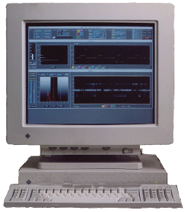
Multiprocessor
λ=0.0
λ=0.5
MM
QM
MM
QM

Slide 31
Non-Zmatrix Based Moves
Other new idea is to allow non-zmatrix based MC moves.
Only need to know the connectivity of a molecule.
Given connectivity, it is possible to split molecules into two parts (assuming no rings…).

Slide 32
Move a Bond…

Slide 33
Move an Angle…

Slide 34
Move a Dihedral…

Slide 35
Progress
Sire has been in development since January 2005.
Around 18 K lines of code (compared to 22 K for ProtoMS 2.1).
Nearly 300 subversion commits.

Slide 36
Progress
By this summer I had coded a prototype version of sire that I could use to test if the design was working.
The test version implemented enough of the design so that I could load and manipulate molecules and calculate energies.

Slide 37
Progress
Prototype was necessary to test that the flexible and extensible design was sufficiently fast.
I tested the prototype against ProtoMS 2.1.
  Prototype was between 30% and 100% faster than ProtoMS 2.1!
  This is despite C++ code compared to F77.
  Speed-up is because C++ data-structures are optimised for the processor cache.
  Real test, as all the code used was ‘gold’ quality.

Slide 38
Beyond the Prototype
Successful prototype test confirms that this design has potential.
Building the prototype taught me a lot about the strengths and weaknesses of the design.

Slide 39
Beyond the Prototype
I thus pulled the prototype to pieces and have been reconstructing sire from scratch.
Sire is now well-organised, modular and consistent.
In particular, I am adding multiprocessor support right in the core of the code.

Slide 40
This Months Work…
Currently working on NetObjects.
This is the system used to distribute objects over multiple processors and keep everything in sync.
Peer-to-peer communication is used, avoiding the bottleneck of an object server.

Slide 41
This Months Work…
Objects are copied to the processes that need them.
Only one process has the power to change the object. When it changes the object, the changes are pushed out to the other copies.
This matches the predominantly read-only nature of data access.
The ‘master’ process for the object is free to delegate its authority to any other process in the cluster.

Slide 42
Future Plans…
I want to use sire when I start at Bristol at the beginning of January.
Need to get bulk of coding completed by then…
Plan to spend until Christmas coding.
Code will not however be ready for external use for at least 1-2 years.

Slide 43
SireTest
“Live” whole
code testing
SirePy
Python interface to the program
SireSystem
Class to hold complete simulation systems. Simulations are performed using SimSystems.
SireMove
Classes to move molecules
e.g. minimisation moves, MC, MD, Hybrid MC, MTSMC etc.
SireFF
Methods to calculate the energy and forces for molecules and restraints
Multiple forcefields
Modular design
SireUnitTest
Offline single-class unit testing
Squire
Interface to QM forcefields and programs
SireVol
Methods to calculate distances, based on different volume topologies
SireMol
Molecular representations
Atom, EditMol, CutGroup,
Molecule etc.
Classes to manipulate
molecules
SireIO
Classes to convert file formats (e.g. PDB, MOL2 etc)
Uses SireStream for output
SireBase
Maths classes
Vector, Element,
Container templates
NetObjects
Distribution and control
objects across processors
Each higher layer depends on all of the libraries in the lower layer.
SireStream
Outputting information
(e.g. streaming DEBUG
messages to a file)
SireError
Sire exceptions

