Slide 1




Information & Communication
Technology Services
Automation of SysAdmin using Chef
Stefan Coetzee
Senior Technical Specialist
Technical Support Services – Computing Platforms
University of Cape Town

Slide 2

Components

Slide 3
Automation of SysAdmin using Chef
Components
Chef-Server
Chef-Client (node)
Knife
Cookbooks
Recipes
LWRP (Lightweight Resource Provider)
Attributes
Templates
Data Bags

Slide 4
Recipes & Cookbooks?

Slide 5
Automation of SysAdmin using Chef
Recipes & Cookbooks?
What are they?
Where do I get them?
How can I customize them?
Structure

Slide 6
Automation of SysAdmin using Chef
What are they?
A recipe is a list of instructions on how to install and configure a specific package/system/component.
They accomplish was recipes accomplish in real life, tell us how to bake a cake.
A cookbook is a collection of recipes, so the CAKE cookbook will have a number of recipes, eg Chocolate, Orange, etc etc

Slide 7
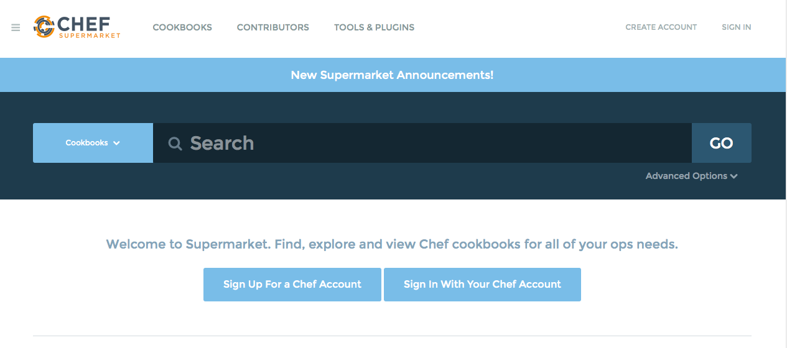
Automation of SysAdmin using Chef
Where do I get them?
Where do you usually get your ingredients from, the supermarket of course.
They most commonly used cookbooks are available @ https://supermarket.chef.io/.
These cookbooks are preconfigure and useable without any modification.
These include Apache, Mysql, Tomcat, Postgres, Java, Microsoft SQL

Slide 8
Automation of SysAdmin using Chef
How can I customize them?
Fork them on Github
Include them into you own recipe (List as dependency)

Slide 9
Automation of SysAdmin using Chef
Structure
-rw-r--r-- 1 501 20 142 Apr 22 15:01 Berksfile
-rw------- 1 501 20 311 May 21 14:23 Berksfile.lock
-rw-r--r-- 1 501 20 36 Feb 13 10:13 CHANGELOG.md
-rw-r--r-- 1 501 20 449 Feb 13 10:13 Gemfile
-rw-r--r-- 1 501 20 72 Feb 13 10:13 LICENSE
-rw-r--r-- 1 501 20 1693 Feb 13 10:13 README.md
-rw-r--r-- 1 501 20 241 Feb 13 10:13 Thorfile
-rw-r--r-- 1 501 20 4792 May 20 09:22 Vagrantfile
drwxr-xr-x 3 501 20 102 May 20 09:30 attributes
-rw-r--r-- 1 501 20 960 Feb 13 10:13 chefignore
drwxr-xr-x 3 501 20 102 Feb 13 10:13 files
-rw-r--r-- 1 501 20 319 May 18 09:15 metadata.rb
drwxr-xr-x 6 501 20 204 May 20 09:28 recipes
drwxr-xr-x 3 501 20 102 Feb 13 10:13 templates

Slide 10
Abstraction is Key

Slide 11
Automation of SysAdmin using Chef
Abstraction
package “nginx” do
action :install
end
service “mysql” do
action [:enable, :start]
end

Slide 12
Example Application

Slide 13
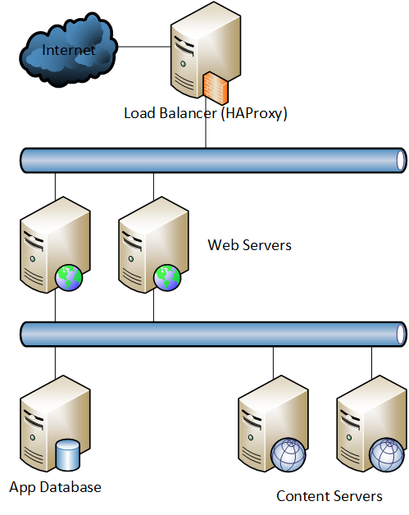
Automation of SysAdmin using Chef
Example Application

Slide 14
Section header
Subhead

Slide 15
Document Title

Slide 16
Thank You

