Slide 1

Information Barriers for Latino Immigrants
…and How They are Overcome

Slide 2

What we will examine:
Information barriers
Overcoming barriers
Literature research results
Our research results
Insights

Slide 3
Information barriers
Linguistic
Cultural
Economic/Legal

Slide 4

Existing research literature
Information Behavior of Migrant Hispanic Farm Workers and Their Families in the Pacific Northwest by Karen Fisher et al in 2004
Information Grounds and the Use of Need-Based Services by Immigrants in Queens, NY:A Context-Based, Outcome Evaluation Approach by Karen Fisher, Joan Durrance, and Marian Hinton in 2004
Health Information-Seeking Among Latino Newcomers: an Exploratory Study by Christina Courtright in 2005
Meeting the Information Needs of a Community: A Case Study of Services to Spanish Speaking Patrons at the Pasco Branch of the Mid-Columbia Library District by Sharon Herring in 2005
Information Behavior in Everyday Contexts

Slide 5

Our research results:
Interviews
  Latino immigrants
  Employees in relevant resource agencies
Observations
  Computer Labs
  Libraries
  Other information grounds

Slide 6
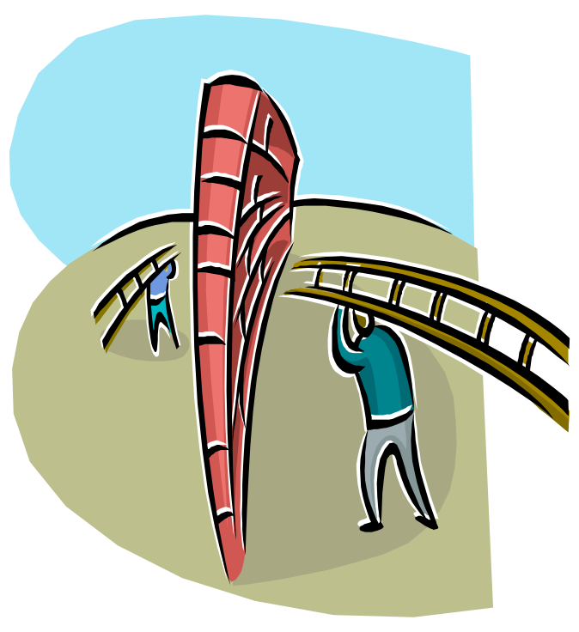
Barriers
Language and Education
Cultural Barriers
Economic/Legal Barriers

Slide 7
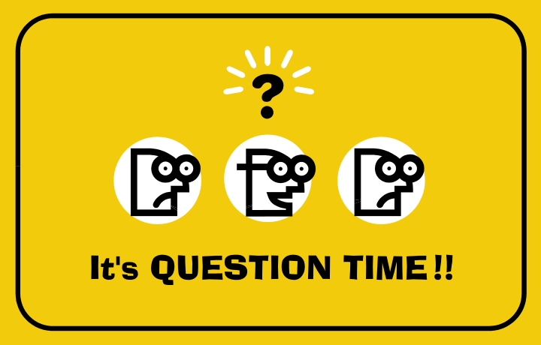
Ponderable
In what contexts, if any, is it useful to emphasize differences rather than similarities – and vice versa - between different cultures? Discuss in your team forums.

Slide 8

Overcoming Information Barriers
Library services
Building social relationships

Slide 9

Overcoming Information Barriers: Library Services
Outreach programs
Providing resources for other relevant agencies
Spanish collections
“Intercambio”
Bilingual staff and signage
Computer labs

Slide 10
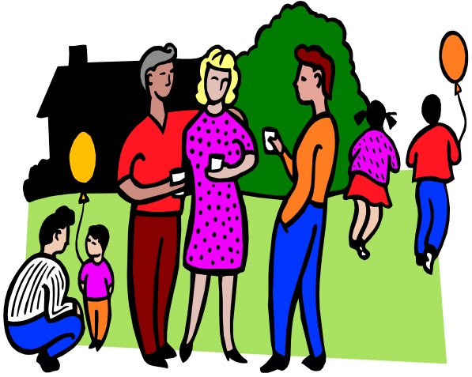
Overcoming Information Barriers: Building social relationships
Family
Community resources
Information grounds

Slide 11

Facilitating Information Flow: the Best of Both Worlds
Insiders: community members
  Trust
  Credibility
  Understanding
Outsiders: agency representatives
  Access to missing resources
  Cultural bridges

Slide 12
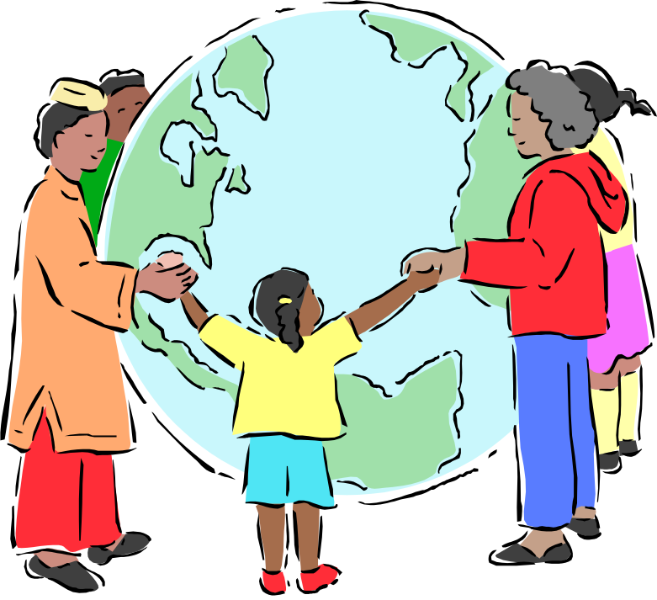
FIN

