Slide 1

Quartz - Job Scheduling Library
- Chris

Slide 2
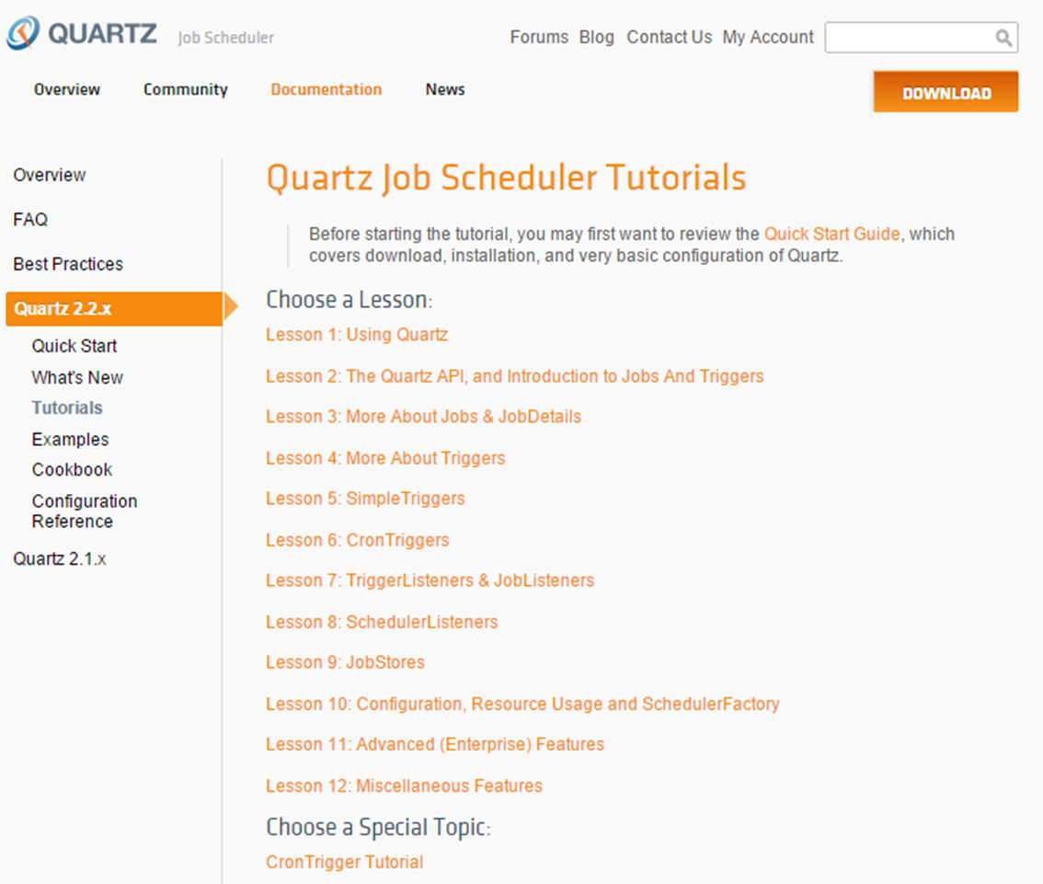

Slide 3
Quartz What - Overview Why - Features & Advantages How - Quick Start & Example
Quartz in Liferay*
Quartz in CMS*

Slide 4
Overview

Slide 5
Features & Advantages

Slide 6
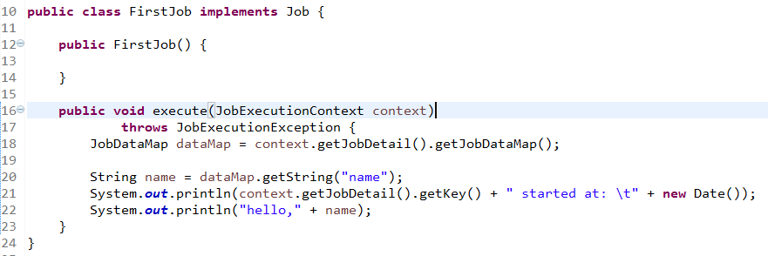
Quick Start
Implement Job interface

Slide 7
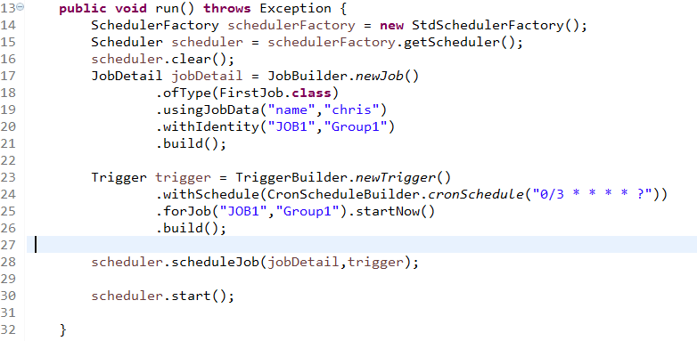

Slide 8
The key interfaces
Scheduler - the main API for interacting with the scheduler.
Job - implemented by components that you wish to have executed by the scheduler.
JobDetail - define instances of Jobs.
Trigger - a component that defines the schedule upon which a given Job will be executed.
JobBuilder - define/build JobDetail instances.
TriggerBuilder - define/build Trigger instances.

Slide 9
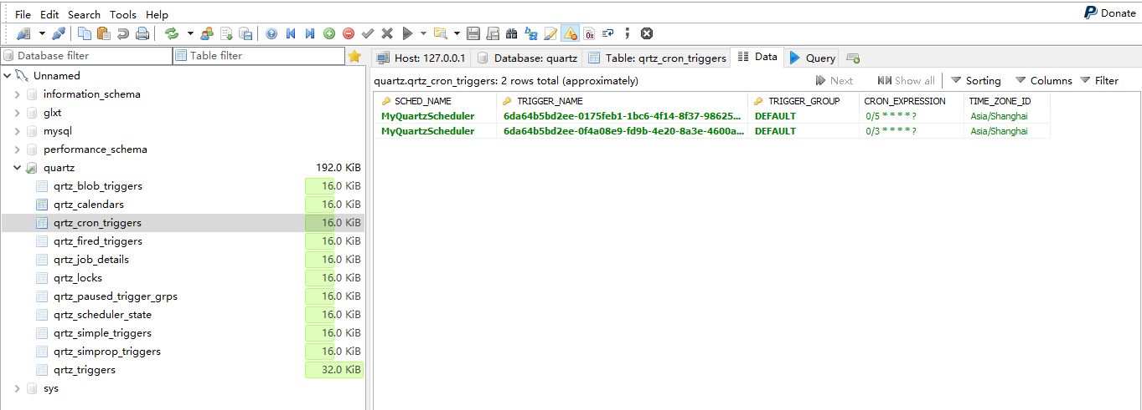
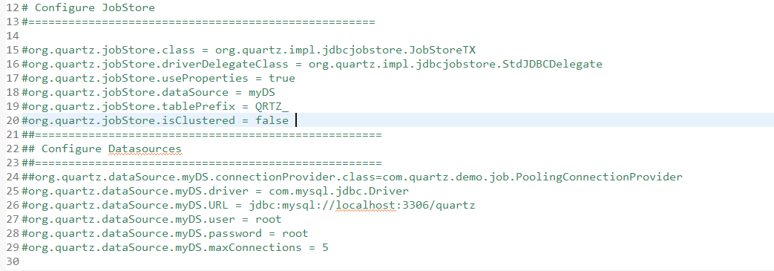
Configuration properties
Priority: custom properties path->current working dir: quartz.properties->org/quartz/quartz.properties
System.setProperty("org.quartz.properties", "src/quartz.properties");

Slide 10
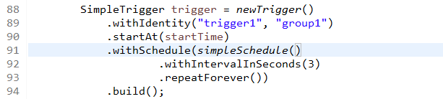
Simple Trigger

Slide 11
Cron Trigger
1
2
3
4
5
6
7
1-Seconds
2-Minutes
3-Hours
4-Day-of-Month
5-Month
6-Day-of-Week
7-Year (optional field)
/ * ? # , L , W

Slide 12
Example Cron Expressions
0 11 11 11 11 ?
10 0/5 * * * ?
0 30 10-13 ? * WED,FRI
0 15 10 L * ?
0 15 10 ? * 6#3

Slide 13
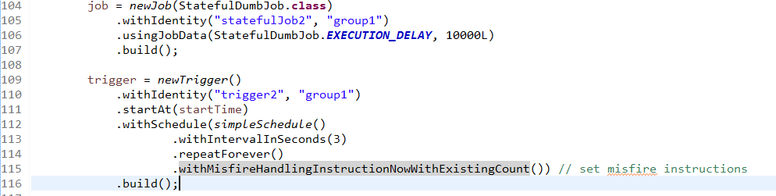
Misfire Instructions
Notes:
测试结果说明

Slide 14
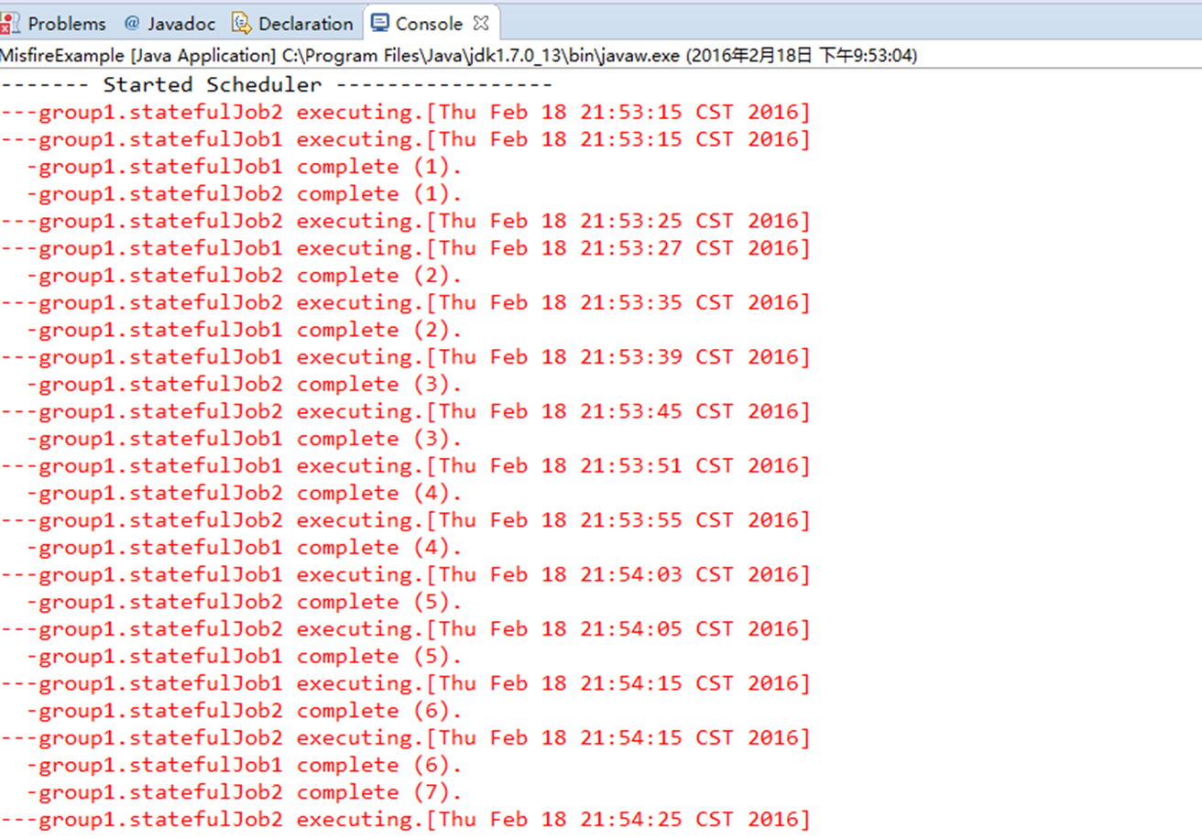
Misfire Instructions
Notes:
测试结果说明

Slide 15
Misfire Instructions
MISFIRE_INSTRUCTION_IGNORE_MISFIRE_POLICY
MISFIRE_INSTRUCTION_FIRE_NOW
MISFIRE_INSTRUCTION_RESCHEDULE_NOW_WITH_EXISTING_REPEAT_COUNT
MISFIRE_INSTRUCTION_RESCHEDULE_NOW_WITH_REMAINING_REPEAT_COUNT
MISFIRE_INSTRUCTION_RESCHEDULE_NEXT_WITH_REMAINING_COUNT
MISFIRE_INSTRUCTION_RESCHEDULE_NEXT_WITH_EXISTING_COUNT
MISFIRE_INSTRUCTION_IGNORE_MISFIRE_POLICY
MISFIRE_INSTRUCTION_DO_NOTHING
MISFIRE_INSTRUCTION_FIRE_NOW
Notes:
测试结果说明

Slide 16

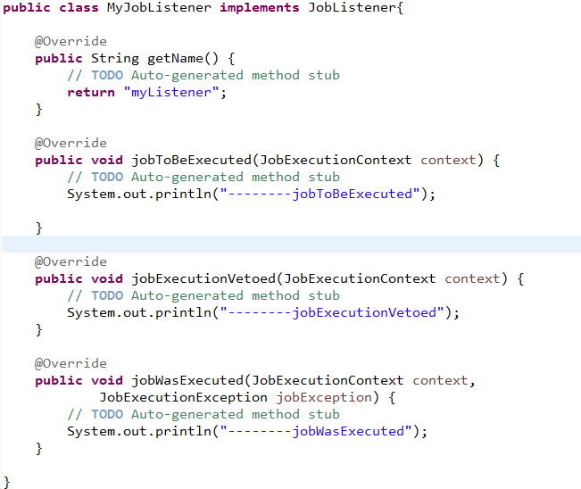
Job Listener

Slide 17
Trigger Listener
Notes:
测试结果说明

Slide 18
Schedule Listener
Notes:
测试结果说明

Slide 19
Download demo code from
https://github.com/chrzha/quartzdemo
or
>git clone https://github.com/chrzha/quartzdemo.git

