Slide 1

Quartz - Job Scheduling Library
- Chris

Slide 2
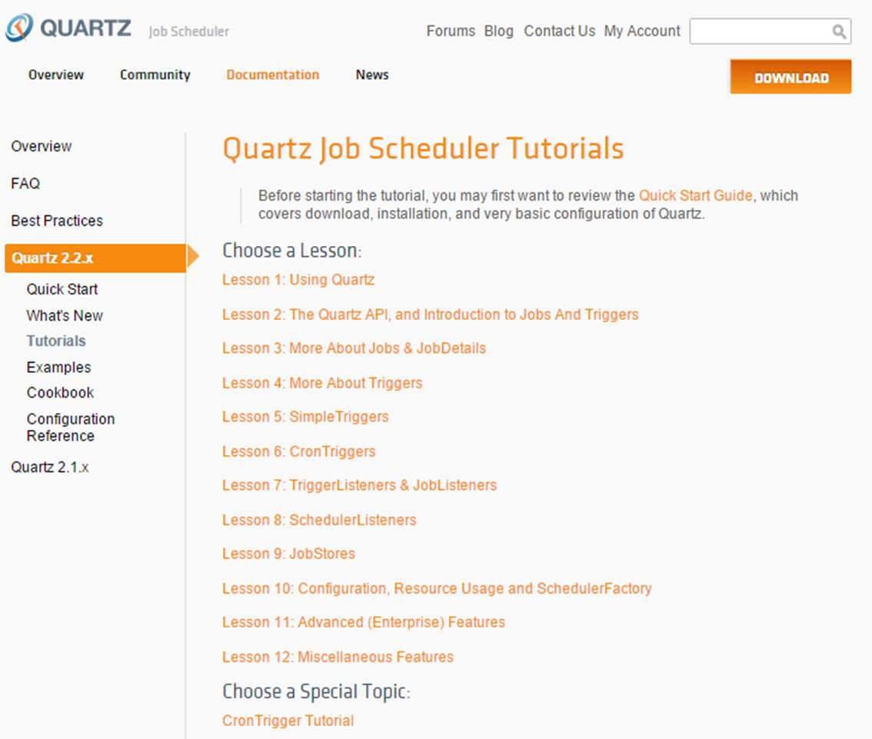

Slide 3
Quartz What - Overview Why - Features & Advantages How - Quick Start & Source code
Quartz in Liferay
Quartz in CMS

Slide 4
Overview

Slide 5
Features & Advantages

Slide 6
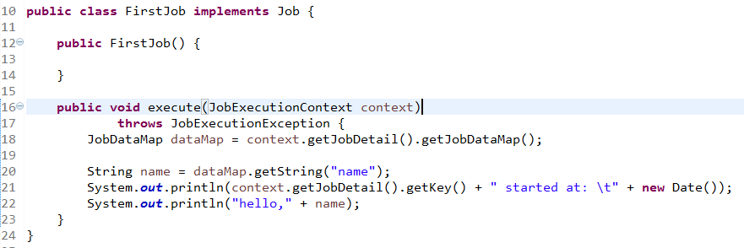
Quick Start

Slide 7
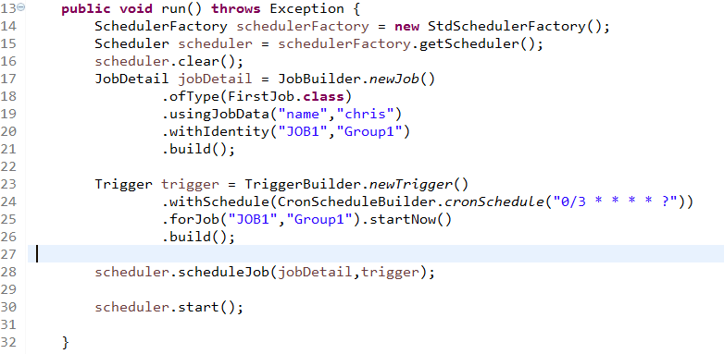

Slide 8
The key interfaces
Scheduler - the main API for interacting with the scheduler.
Job - implemented by components that you wish to have executed by the scheduler.
JobDetail - define instances of Jobs.
Trigger - a component that defines the schedule upon which a given Job will be executed.
JobBuilder - define/build JobDetail instances.
TriggerBuilder - define/build Trigger instances.

Slide 9
Configuration properties
Priority: custom properties path->classpth/quartz.properties->org/quartz/quartz.properties
System.setProperty("org.quartz.properties", "src/quartz.properties");

Slide 10
Simple Trigger

Slide 11
Cron Trigger
1-Seconds
2-Minutes
3-Hours
4-Day-of-Month
5-Month
6-Day-of-Week
7-Year (optional field)

Slide 12
Example Cron Expressions
0 0/5 * * * ?
10 0/5 * * * ?
0 30 10-13 ? * WED,FRI
0 0/30 8-9 5,20 * ?

Slide 13
Misfire Instructions
Notes:
测试结果说明

Slide 14
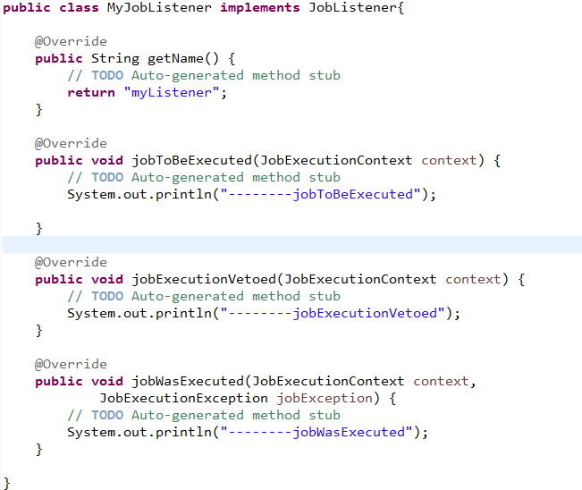
Job Listener
Notes:
测试结果说明

Slide 15
Trigger Listener
Notes:
测试结果说明

Slide 16
Schedule Listener
Notes:
测试结果说明

Slide 17
Download demo code from
https://github.com/chrzha/quartzdemo
or
>git clone https://github.com/chrzha/quartzdemo.git

