Slide 1
Medallion Architecture Basics
Synthetic fixture deck for parse-layer tests
ClassPilot fixture deck
Notes:
Welcome. Today we look at the bronze, silver, and gold layers.

Slide 2
Three Layers
Bronze keeps raw data exactly as it arrived
Silver holds cleaned and deduplicated records
Gold serves business-ready aggregates
ClassPilot fixture deck
Notes:
Stress that bronze is never edited, so every load can be replayed.

Slide 3
Data Flow
Bronze
Silver
Gold
ClassPilot fixture deck
Notes:
Data moves left to right; each step adds structure.

Slide 4
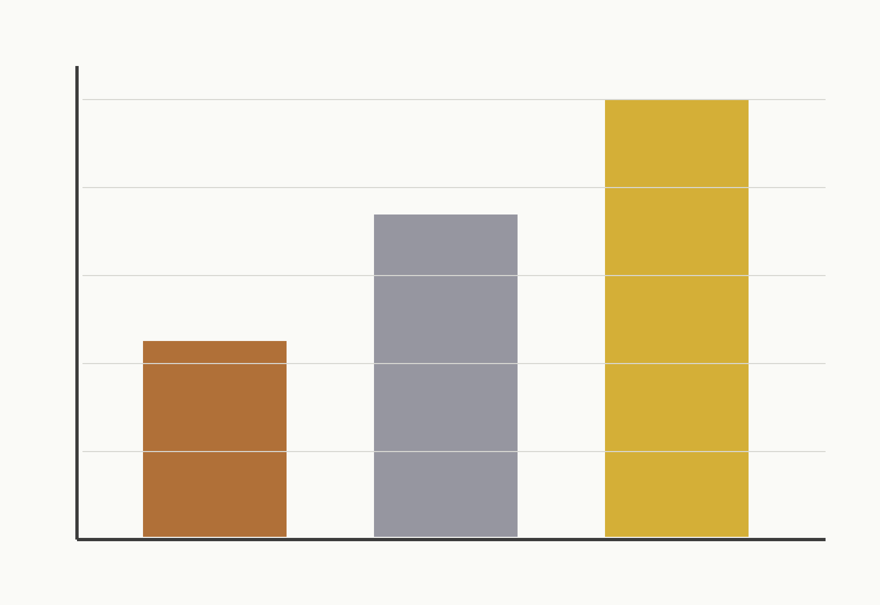
Notes:
The chart shows record counts growing from bronze to gold.

Slide 5
A Silver Model in dbt
SELECT order_id,
customer_id,
CAST(amount AS NUMBER(10, 2)) AS amount
FROM {{ source('shop', 'raw_orders') }}
WHERE status IS NOT NULL
ClassPilot fixture deck
Notes:
Read the model top to bottom: select, cast, then filter null statuses.

Slide 6
Summary
Keep bronze unchanged for replay
Clean once in silver
Aggregate for consumers in gold
ClassPilot fixture deck

