Slide 1

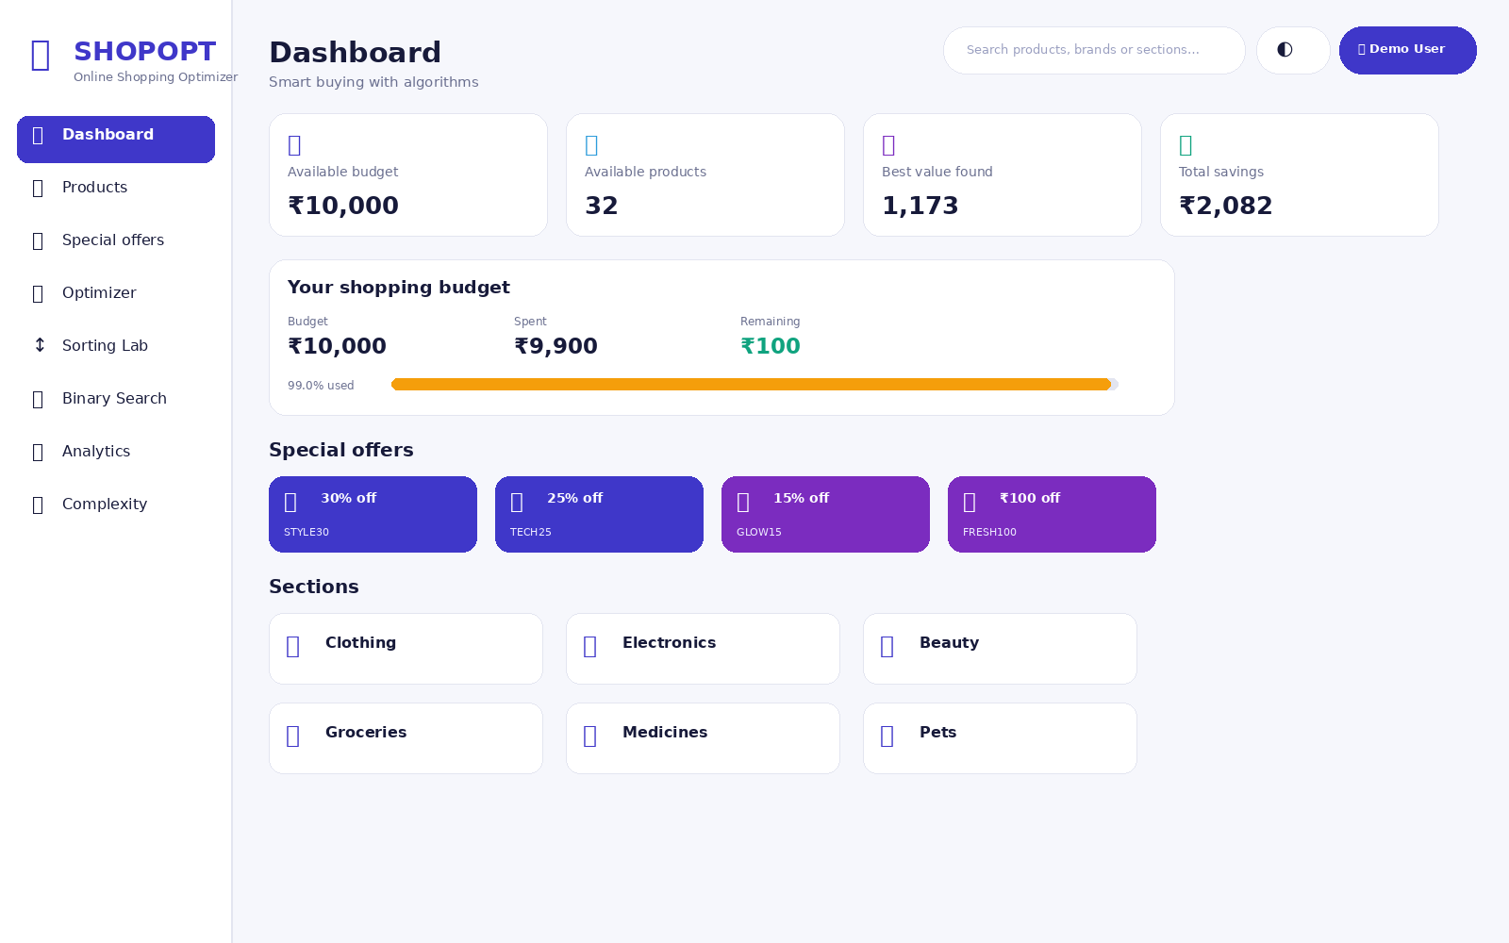

ShopOpt
Online Shopping Product Optimizer
Problem domain
E-commerce • Budget-aware product selection
Team Members:
1.ch. sai Chandana-(28)
2.v.vyshnavi-(90)
3.d.mokshitha-(30)
4.u.srija-(86)
2.
Team members: Add team names
LIVE PROTOTYPE

Slide 2
The Challenge
Why smarter shopping needs more than a product list
CHOICE OVERLOAD
The real-world problem
32 demo products across 6 sections
• Too many products make comparison difficult.
• A fixed budget can conflict with rating, utility and discounts.
• Users need a basket, not just a ranked list.
• Manual trial-and-error becomes slow as choices grow.
BUDGET CONSTRAINT
Every item consumes part of the basket
MULTI-CRITERIA
Utility • rating • discount • combined value
Core question
“What combination gives the best value without breaking the budget?”
ALGORITHM TRANSPARENCY
Show the steps instead of hiding the logic
ShopOpt • Hackathon Demo

Slide 3
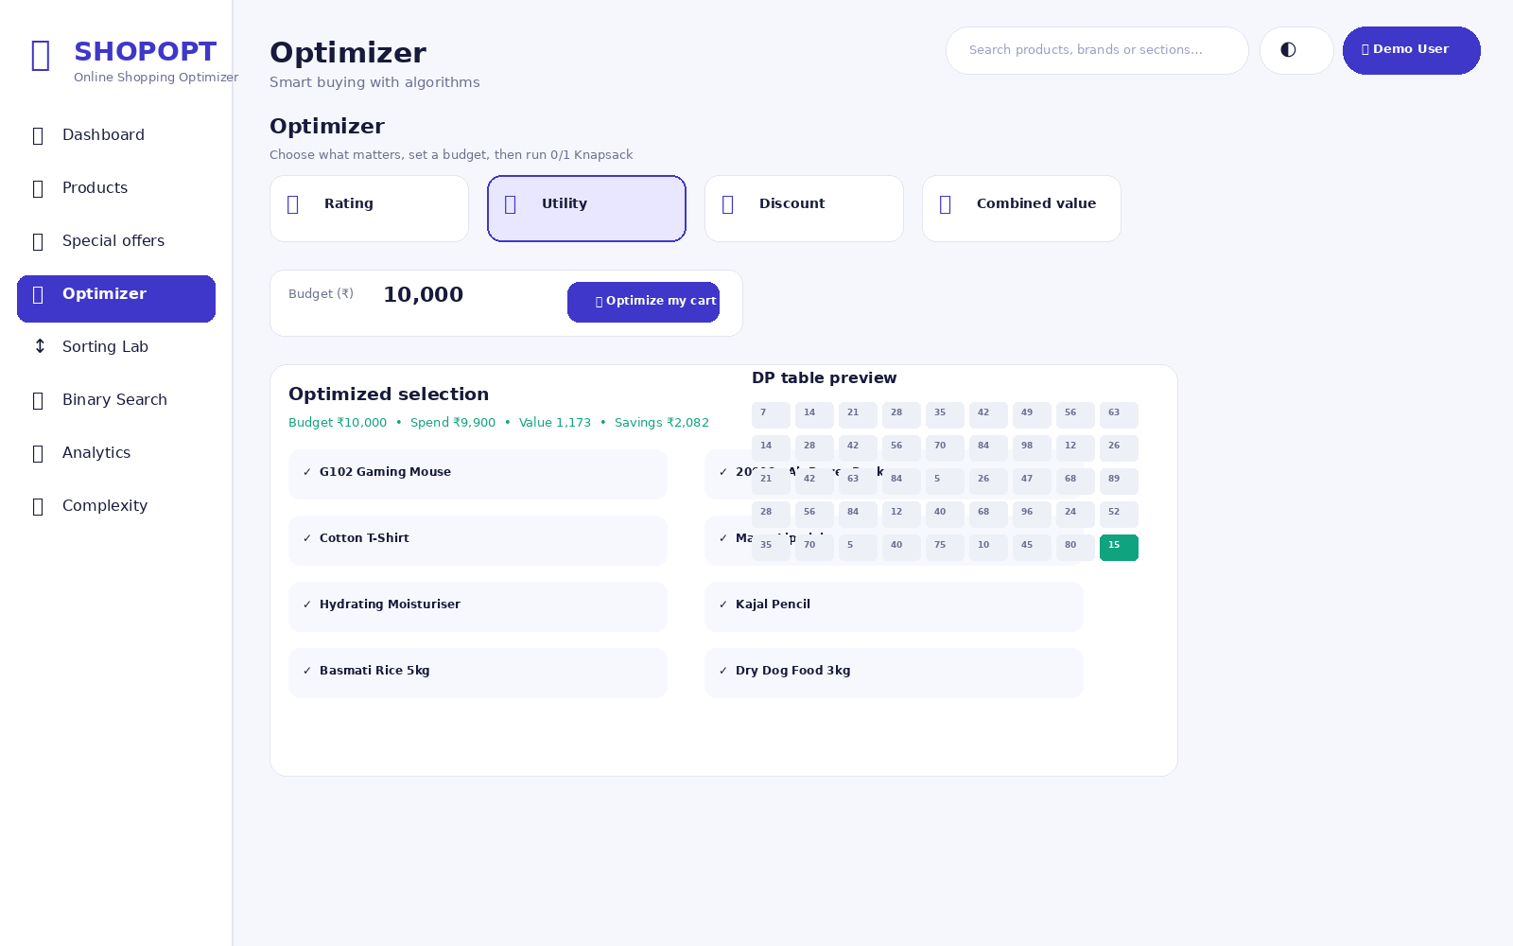
Our Innovation
Turn a shopping decision into an interactive algorithm experience
Core idea
Optimize the whole basket — not one product at a time.
The prototype explicitly implements the algorithms so users can watch the decision process.
0/1 Knapsack
Sorting Lab
Binary Search
Analytics
Unique approach
Same product catalogue → multiple algorithms → visible decisions
ShopOpt • Hackathon Demo

Slide 4
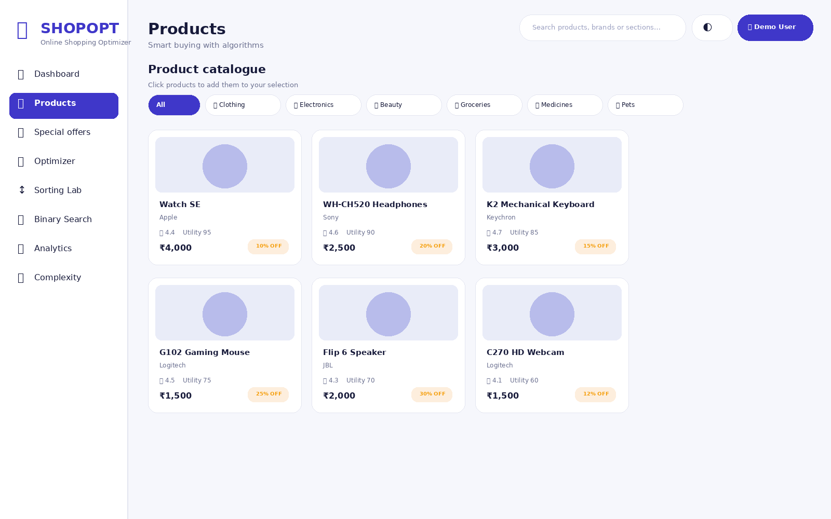
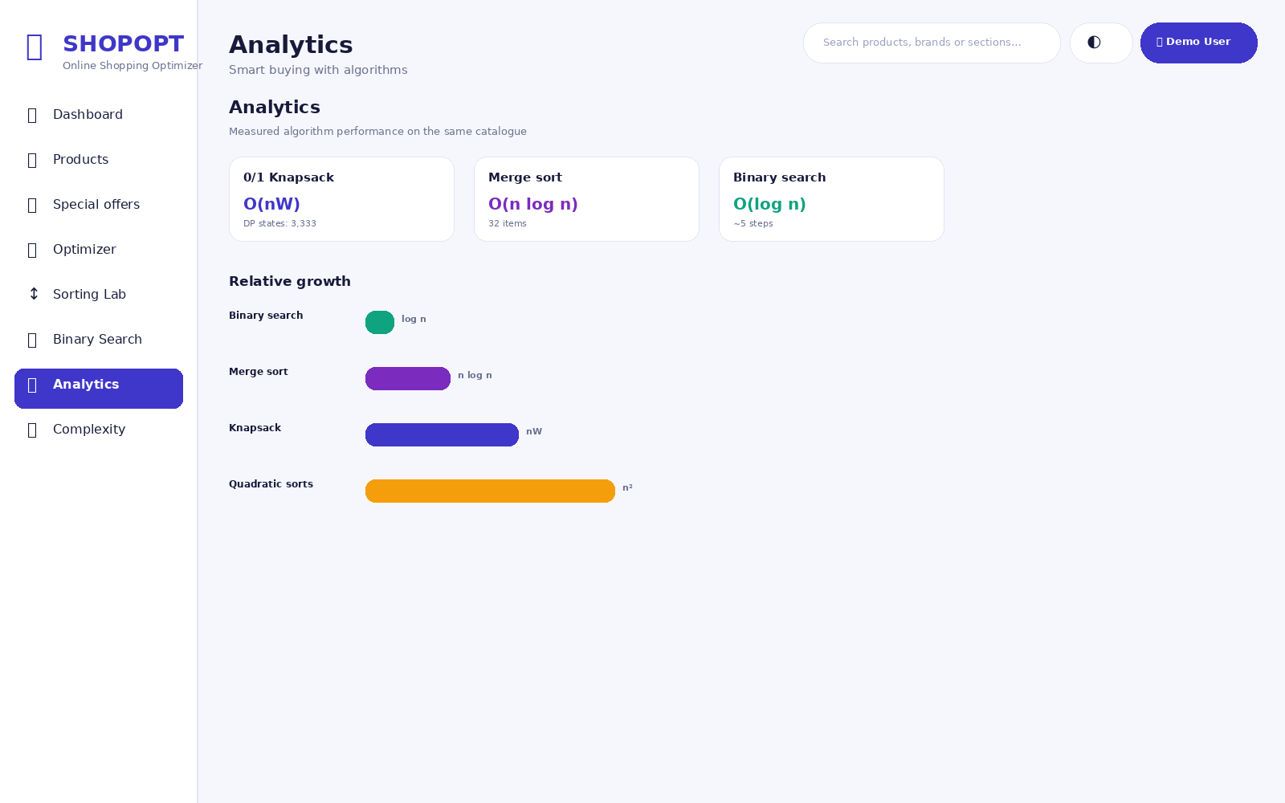
How It Works
Simple user journey from budget to an optimized basket
1
INPUT
2
PROCESS
3
ALGORITHM
4
OUTPUT
Budget + products + objective
→
Normalize utility / rating / discount
→
Run 0/1 Knapsack DP
→
Best basket + spend + savings
User journey
Choose
Optimize
Measure
ShopOpt • Hackathon Demo

Slide 5
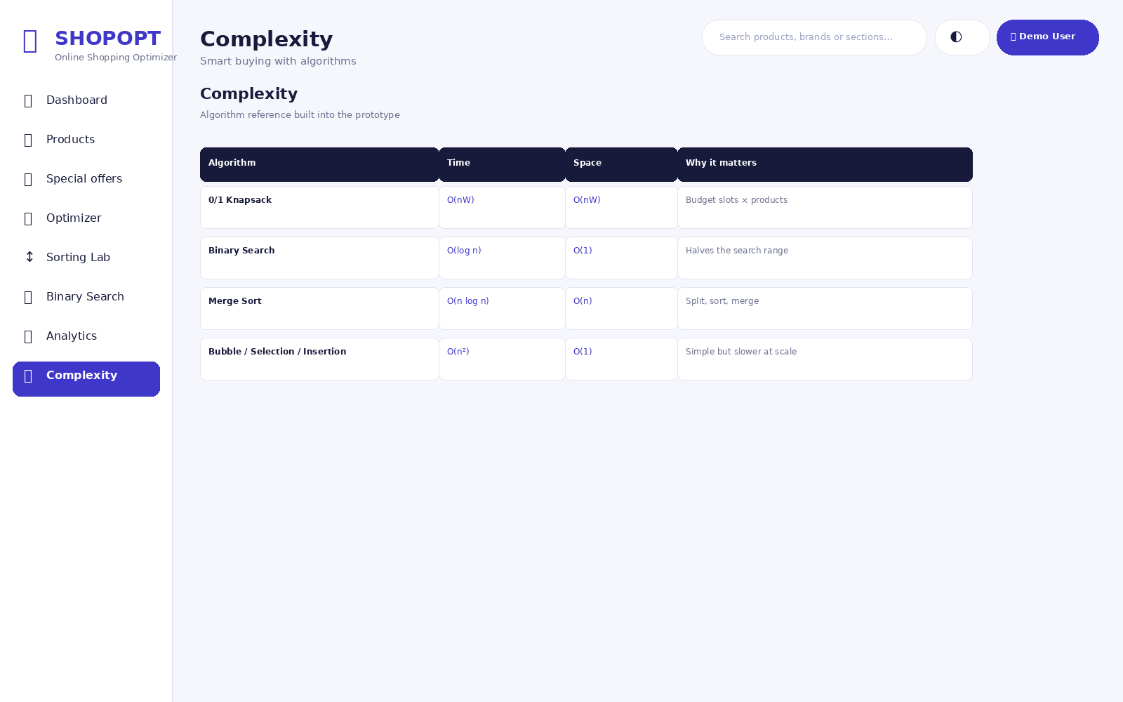
Technology & Algorithm
A lightweight web stack with explicit algorithm implementations
Tech stack
Main algorithms
HTML5
UI structure
Algorithm
Time
Space
Role
CSS3
Glass cards + responsive layout
0/1 Knapsack
O(nW)
O(nW)
Budget-constrained basket
JavaScript
UI + algorithm logic
Binary Search
O(log n)
O(1)
Fast lookup in sorted prices
SVG
Product illustrations
Merge Sort
O(n log n)
O(n)
Efficient ordering
Web Speech API
Voice search
Bubble / Selection / Insertion
O(n²)
O(1)
Educational comparison
REST API
Optional backend at localhost:5000
ShopOpt • Hackathon Demo

Slide 6
Demo & Impact
What the prototype produces with the built-in demo catalogue
Sample result • Utility objective
₹9,900
1,173
basket spend
utility value
₹2,082 estimated discount value
32
18
products in demo
items selected
3,333
6
DP states
catalogue sections
Practical benefits
Budget-aware decisions • Explainable algorithms • Interactive learning • Faster comparison
ShopOpt • Hackathon Demo

Slide 7
Future Vision
From a hackathon prototype to a scalable shopping decision engine
NOW
NEXT
SCALE
Working prototype
Smarter recommendations
Production-ready engine
Dashboard, catalogue, optimizer, sorting, binary search and analytics.
Live marketplace data, richer preference models, price history and personalized weights.
API-backed catalogue, larger datasets, caching, deployment and mobile-ready UI.
Final takeaway
ShopOpt makes algorithmic shopping decisions visible, explainable and practical.
THANK YOU • Q&A

