Slide 1
Particulate Matter 2.5 and COVID-19

Slide 2
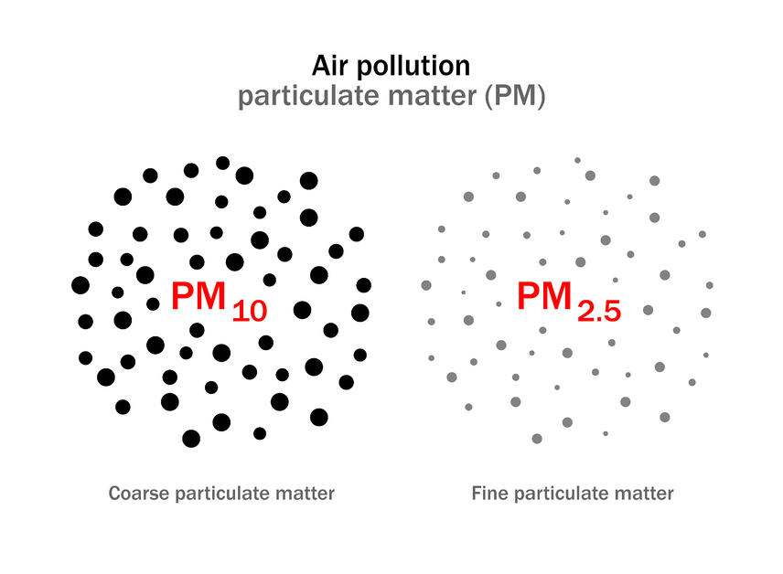
What Is Particulate Matter and what does it look like?
Particulate Matter is not 'One' Pollutant.
When people refer to ‘Particulate Matter’ (or 'PM') it often sounds like they’re referring to just one pollutant, however particulate matter is not a unified pollutant at all. We use this term to refer to a family of particles suspended in the air and characterized by their size.

Slide 3
What are the main sources of Particulate Matter?
Wildfires
Dust storms
Volcanic eruptions
Sea spray
Natural PM may include components of biological sources
Burning of gas in motorized vehicle engines
Industrial processes
Power generators
Burning wood, candles and incense
Stoves, heaters, fireplaces and chimneys
Tobacco smoke

Slide 4
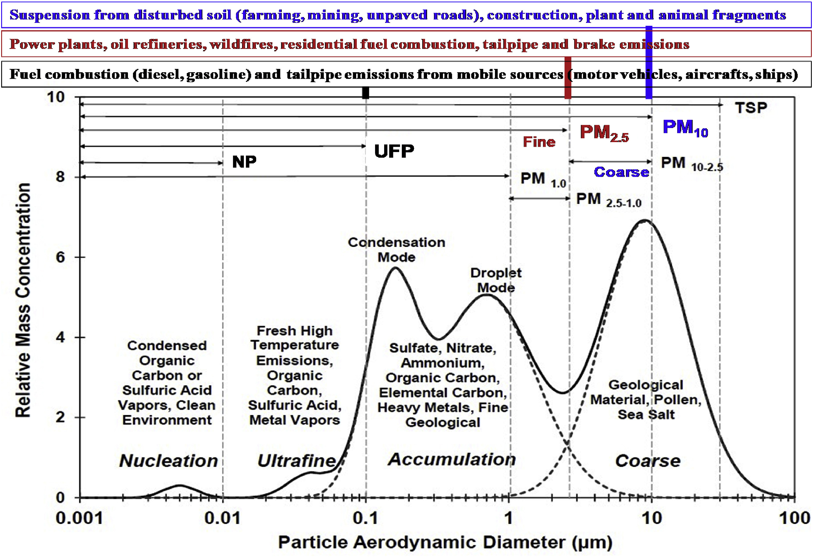

Slide 5
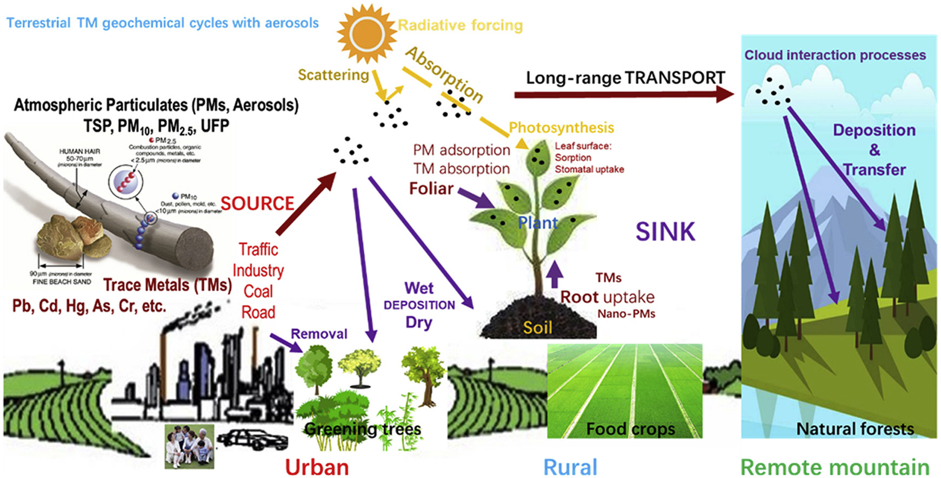

Slide 6
Why is it important to study Particulate Matter?
PM10 is inhalable and can get into our lungs, causing local and systemic inflammation in the respiratory system. In turn, this can cause respiratory diseases such as asthma and bronchitis.
PM2.5, similarly, is inhalable, and because of its even smaller size, it can get even farther into our bodies. PM2.5 particles can enter and deposit into the last corners of our lungs, the alveoli and some of them can also pass into the bloodstream. Once it enters the bloodstream, they may affect the heart, causing cardiovascular diseases or be carried to organs beyond the respiratory and cardiovascular systems, posing a range of long and short-term health threats.
Long-term exposure to PM2.5 has been linked to several forms of cancer. Studies have also found that long-term exposure to Fine Particulate Matter (PM2.5) can increase our likelihood of developing severe Coronavirus symptoms.

Slide 7
How do we reduce PM 2.5 Concentrations?
1. Use Alternatives to Open Burning
Open burning is a large source of PM. Open burning includes the burning of landscaping debris, household trash, demolition debris, and land-clearing debris.
2. Drive Less
We can reduce the levels of particulate matter pollution by reducing the amount of particulate matter produced through smoke and by reducing vehicle emissions. Driving a car is likely a person's single most polluting daily activity. Driving less reduces the number of vehicles on the road which helps to reduce air pollution from vehicle emissions.
3. Reduce anthropogenic activities.
Human activities, such as the burning of fossil fuels , stubble burning, power plants, road dust, wet cooling towers in cooling systems and various industrial processes, also generate significant amounts of particulates. Coal combustion in developing countries is the primary method for heating homes and supplying energy. Because salt spray over the oceans is the overwhelmingly most common form of particulate in the atmosphere, anthropogenic aerosols—those made by human activities—currently account for about 10 percent of the total mass of aerosols in our atmosphere.

Slide 8

If most non-essential activities were cancelled after the spread of COVID-19, were the concentration levels of PM 2.5 reduced after the Texas 2020 Stay at Home Mandate?

Slide 9
References:
Luo, X., Bing, H., Luo, Z., Wang, Y., & Jin, L. (2019). Impacts of atmospheric particulate matter pollution on environmental biogeochemistry of trace metals in soil-plant system: A review. Environmental Pollution, 255, 113138. https://doi.org/10.1016/j.envpol.2019.113138

